Slide 1
Color Sensor
Lesson 1 - What is Color?
Notes:
In this lesson, students explore different types of waves. In their comparisons, students come to identify two properties that determine their behavior: wavelength and frequency. Then, students will explore 4 types of waves: radio, micro-, infrared and x-ray. The Graphic Organizer can be used as a tool for recording their observations.

Slide 2
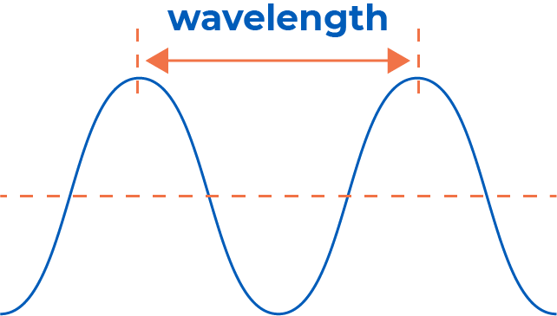
WAVELENGTH
Using your 3 waves, label each wavelength:
How did the movement affect the wavelength?
COLOR SENSOR
Compare wavelengths:
Which wave has the highest?
Which wave has the lowest?
‹#›
Notes:
Slides 2, 3 and 4 can be used to introduce wavelength and frequency. Students should use the drawings of the 3 waves they created.

Slide 3
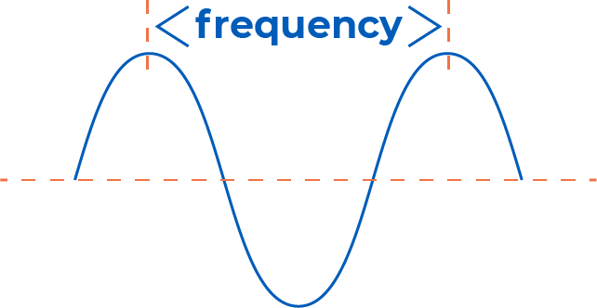
FREQUENCY
Label each frequency:
How did the movement affect the frequency?
COLOR SENSOR
Compare frequencies:
Which wave has the highest?
Which wave has the lowest?
‹#›
Notes:
After students have labeled the wavelengths for each wave, have them repeat with the frequency.

Slide 4
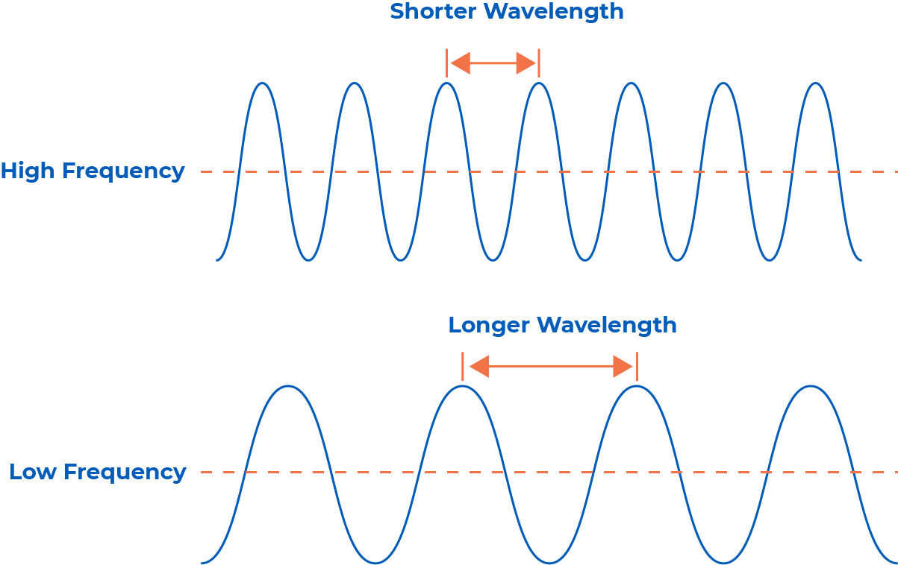
The wave with the most movement had the shortest wavelength and highest frequency.
WAVELENGTH
& FREQUENCY
The wave with the least movement had the longest wavelength and lowest frequency.
COLOR SENSOR
We will explore four types of waves with different wavelengths and frequencies.
‹#›
Notes:
Students can check their guesses with this slide. You can also use this slide to introduce the day’s exploration. (Overlapping text is animated and will not appear overlapping during the presentation .)

Slide 5
ELECTROMAGNETIC
SPECTRUM
COLOR SENSOR
The Electromagnetic Spectrum
‹#›
Notes:
After students have explored radio, micro-, infrared and x-rays, they will create a complete spectrum on their graphic organizers.

Slide 6
RADIO WAVES
COLOR SENSOR
What are some properties of Radio waves?
‹#›
Notes:
Have students share what they learned from their expert groups.

Slide 7
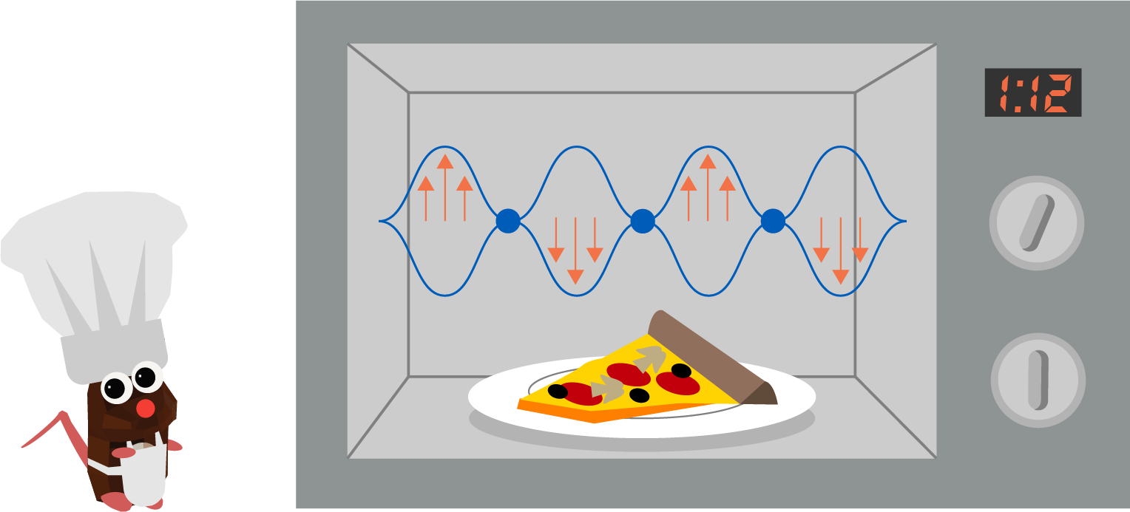
MICROWAVES
COLOR SENSOR
What are some properties of Microwaves?
‹#›
Notes:
Have students share what they learned from their expert groups.

Slide 8
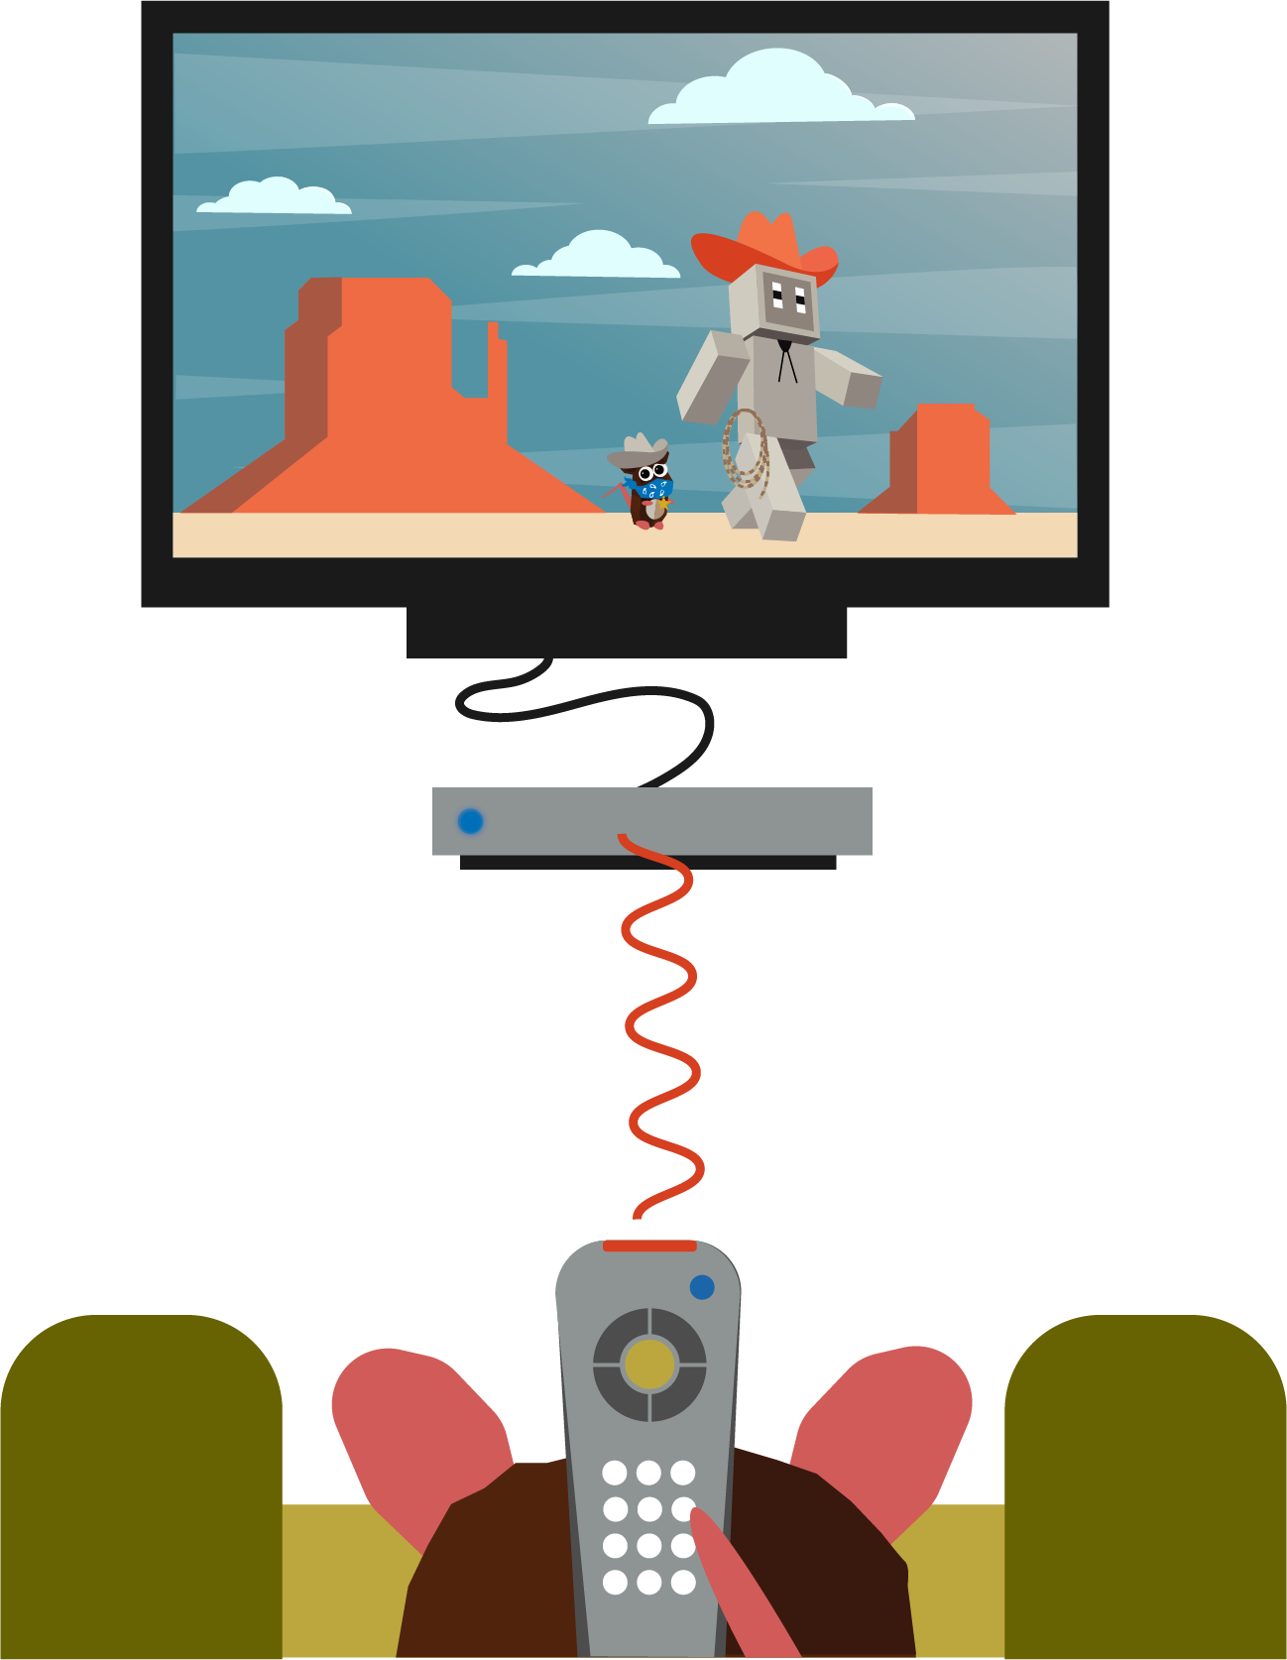
INFRARED
WAVES
COLOR SENSOR
What are some properties of Infrared waves?
‹#›
Notes:
Have students share what they learned from their expert groups.

Slide 9
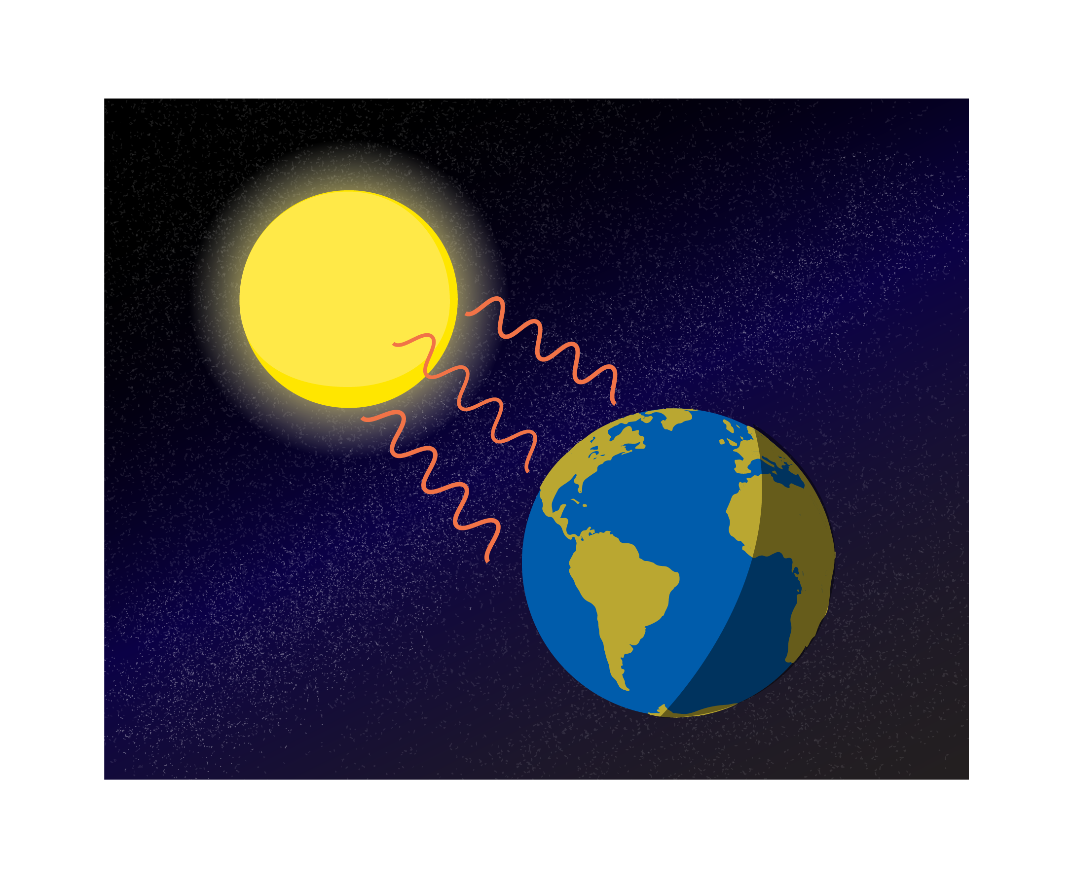
ULTRAVIOLET
WAVES
COLOR SENSOR
What are some properties of Ultraviolet waves?
‹#›
Notes:
Have students share what they learned from their expert groups.

Slide 10
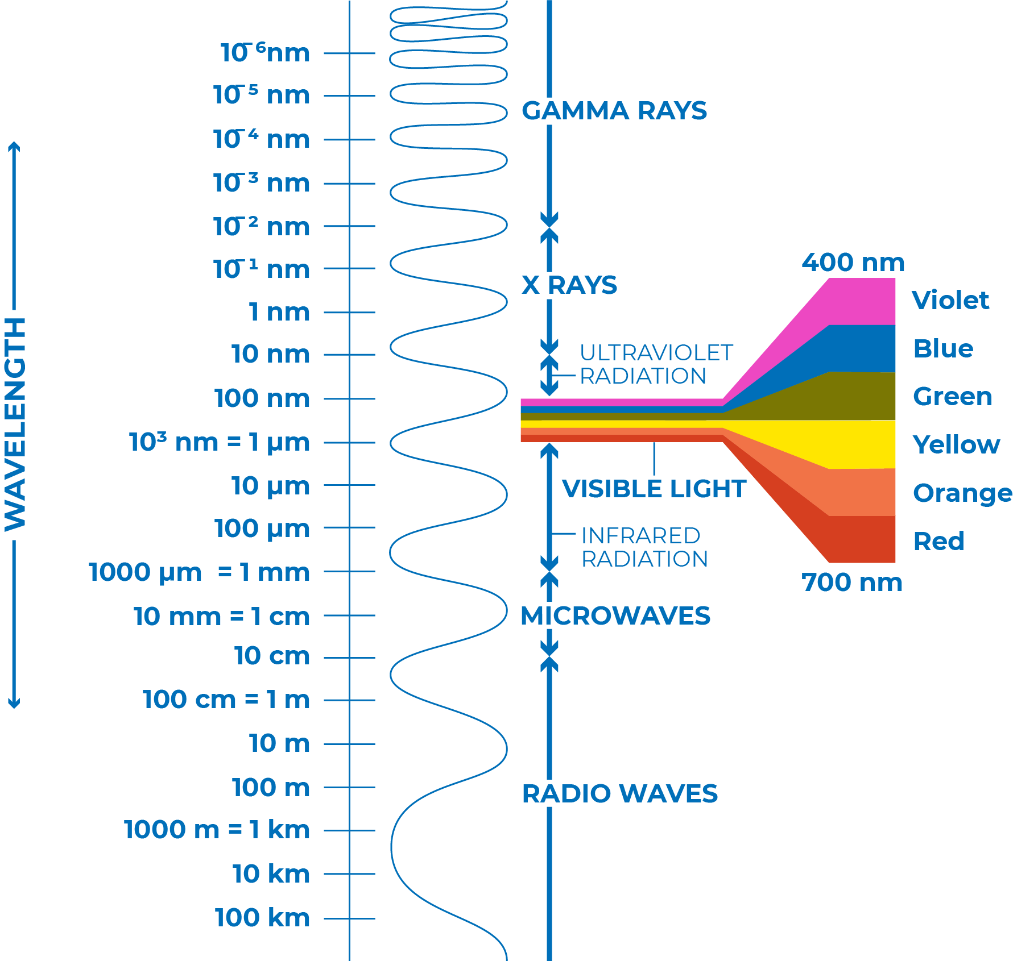
VISIBLE LIGHT
All of the waves we explored today are forms of light, but we only can see a small part of the spectrum.
The visible spectrum has a specific wavelength and frequency that allows humans to perceive it.
COLOR SENSOR
We will explore how humans perceive color during Lesson 2.
‹#›
Notes:
Students can identify the wavelength for each of the waves on the spectrum. During Lesson 2, students will explore how our eyes perceive color.

Slide 11
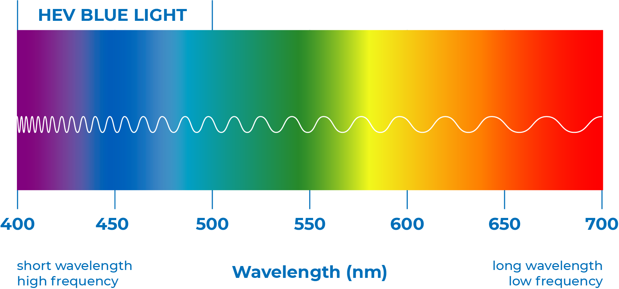
VISIBLE LIGHT
ROYGBIV is a way to remember the sequence of colors of light, from longest to shortest wavelength.
COLOR SENSOR
‹#›
Notes:
This chart shows the different wavelengths for each color.

Slide 12
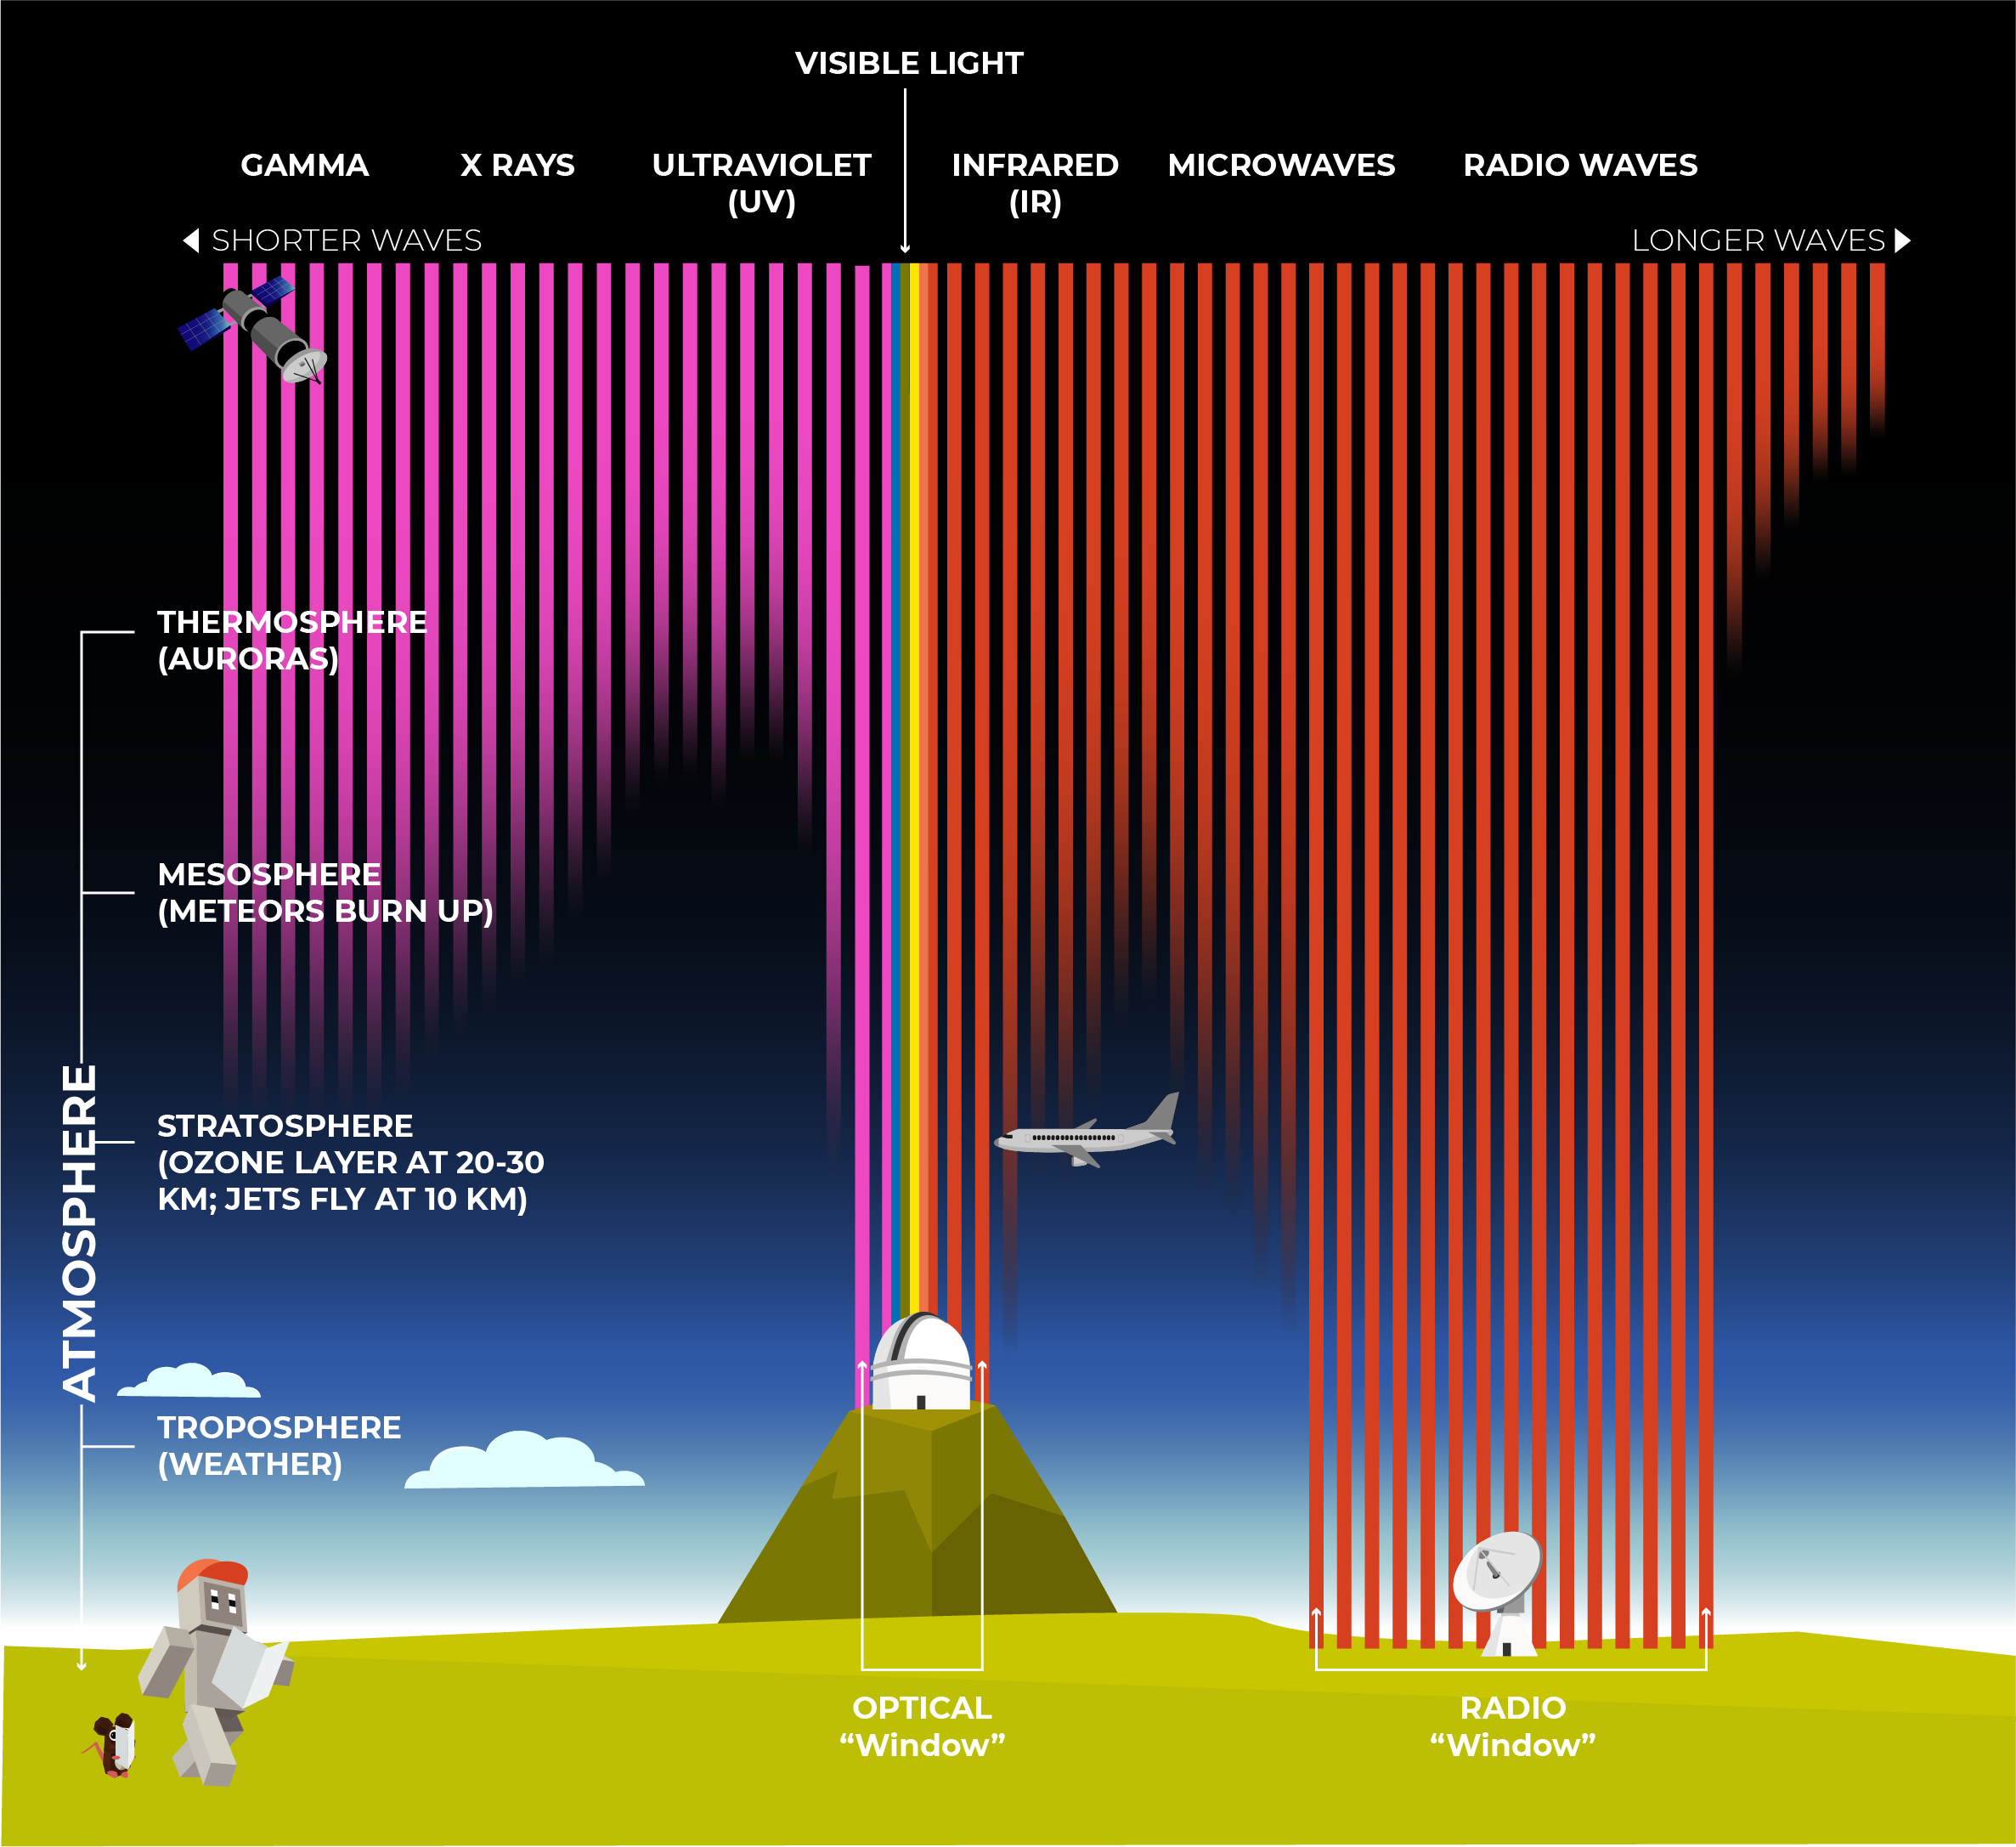
ATMOSPHERE
COLOR SENSOR
How do you think our atmosphere affects waves?
‹#›
Notes:
Most electromagnetic radiation from space is unable to reach the surface of the Earth. Radio frequencies, visible light and some ultraviolet light makes it to sea level. Astronomers can observe some infrared wavelengths by putting telescopes on mountain tops.

Slide 13
Reflect!
REFLECT
Respond to these writing prompts:
What waves do you deal with in your everyday life?
How do you interact with these waves?
COLOR SENSOR
‹#›
Notes:
Collect these exit slips as a reflective assessment.

