Slide 1
Color Sensor
Lesson 3 - How does the color sensor detect color?
Notes:
In this lesson, students explore how the color sensor detects color. Students will need to use their kits during the exploration of this lesson.

Slide 2
OBJECT #1
Object #1
Try using visual hints to identify the object in this image.
COLOR SENSOR
Write down your guess.
How do the colors help?
‹#›
Notes:
Our eyes typically have 3 types of cones, those that perceive red, green and blue. In this activity, students will test how well they can identify mysterious objects with just their color and/or outline.
Students can use their Graphic Organizer to record their notes for slides 2-11.

Slide 3
OBJECT #1
ANSWER:
COLOR SENSOR
Did you guess correctly?
‹#›
Notes:
Our eyes typically have 3 types of cones, those that perceive red, green and blue. In this activity, students will test how well they can identify mysterious objects with just their color and/or outline.
Students can use their Graphic Organizer to record their notes for slides 2-11.

Slide 4
OBJECT #2
Object: #2
Try using visual hints to identify the object in this image.
COLOR SENSOR
Write down your guess.
How do the colors help?
Can you identify any shapes?
‹#›
Notes:
Our eyes typically have 3 types of cones, those that perceive red, green and blue. In this activity, students will test how well they can identify mysterious objects with just their color and/or outline.
Students can use their Graphic Organizer to record their notes for slides 2-11.

Slide 5
OBJECT #2
ANSWER:
COLOR SENSOR
Did you guess correctly?
‹#›
Notes:
Our eyes typically have 3 types of cones, those that perceive red, green and blue. In this activity, students will test how well they can identify mysterious objects with just their color and/or outline.
Students can use their Graphic Organizer to record their notes for slides 2-11.

Slide 6
OBJECT #3
Object #3
Try using visual hints to identify the object in this image.
COLOR SENSOR
Write down your guess.
How do the colors help?
Can you identify any shapes?
‹#›
Notes:
Our eyes typically have 3 types of cones, those that perceive red, green and blue. In this activity, students will test how well they can identify mysterious objects with just their color and/or outline.
Students can use their Graphic Organizer to record their notes for slides 2-11.

Slide 7
OBJECT #3
ANSWER:
COLOR SENSOR
Did you guess correctly?
‹#›
Notes:
Our eyes typically have 3 types of cones, those that perceive red, green and blue. In this activity, students will test how well they can identify mysterious objects with just their color and/or outline.
Students can use their Graphic Organizer to record their notes for slides 2-11.

Slide 8
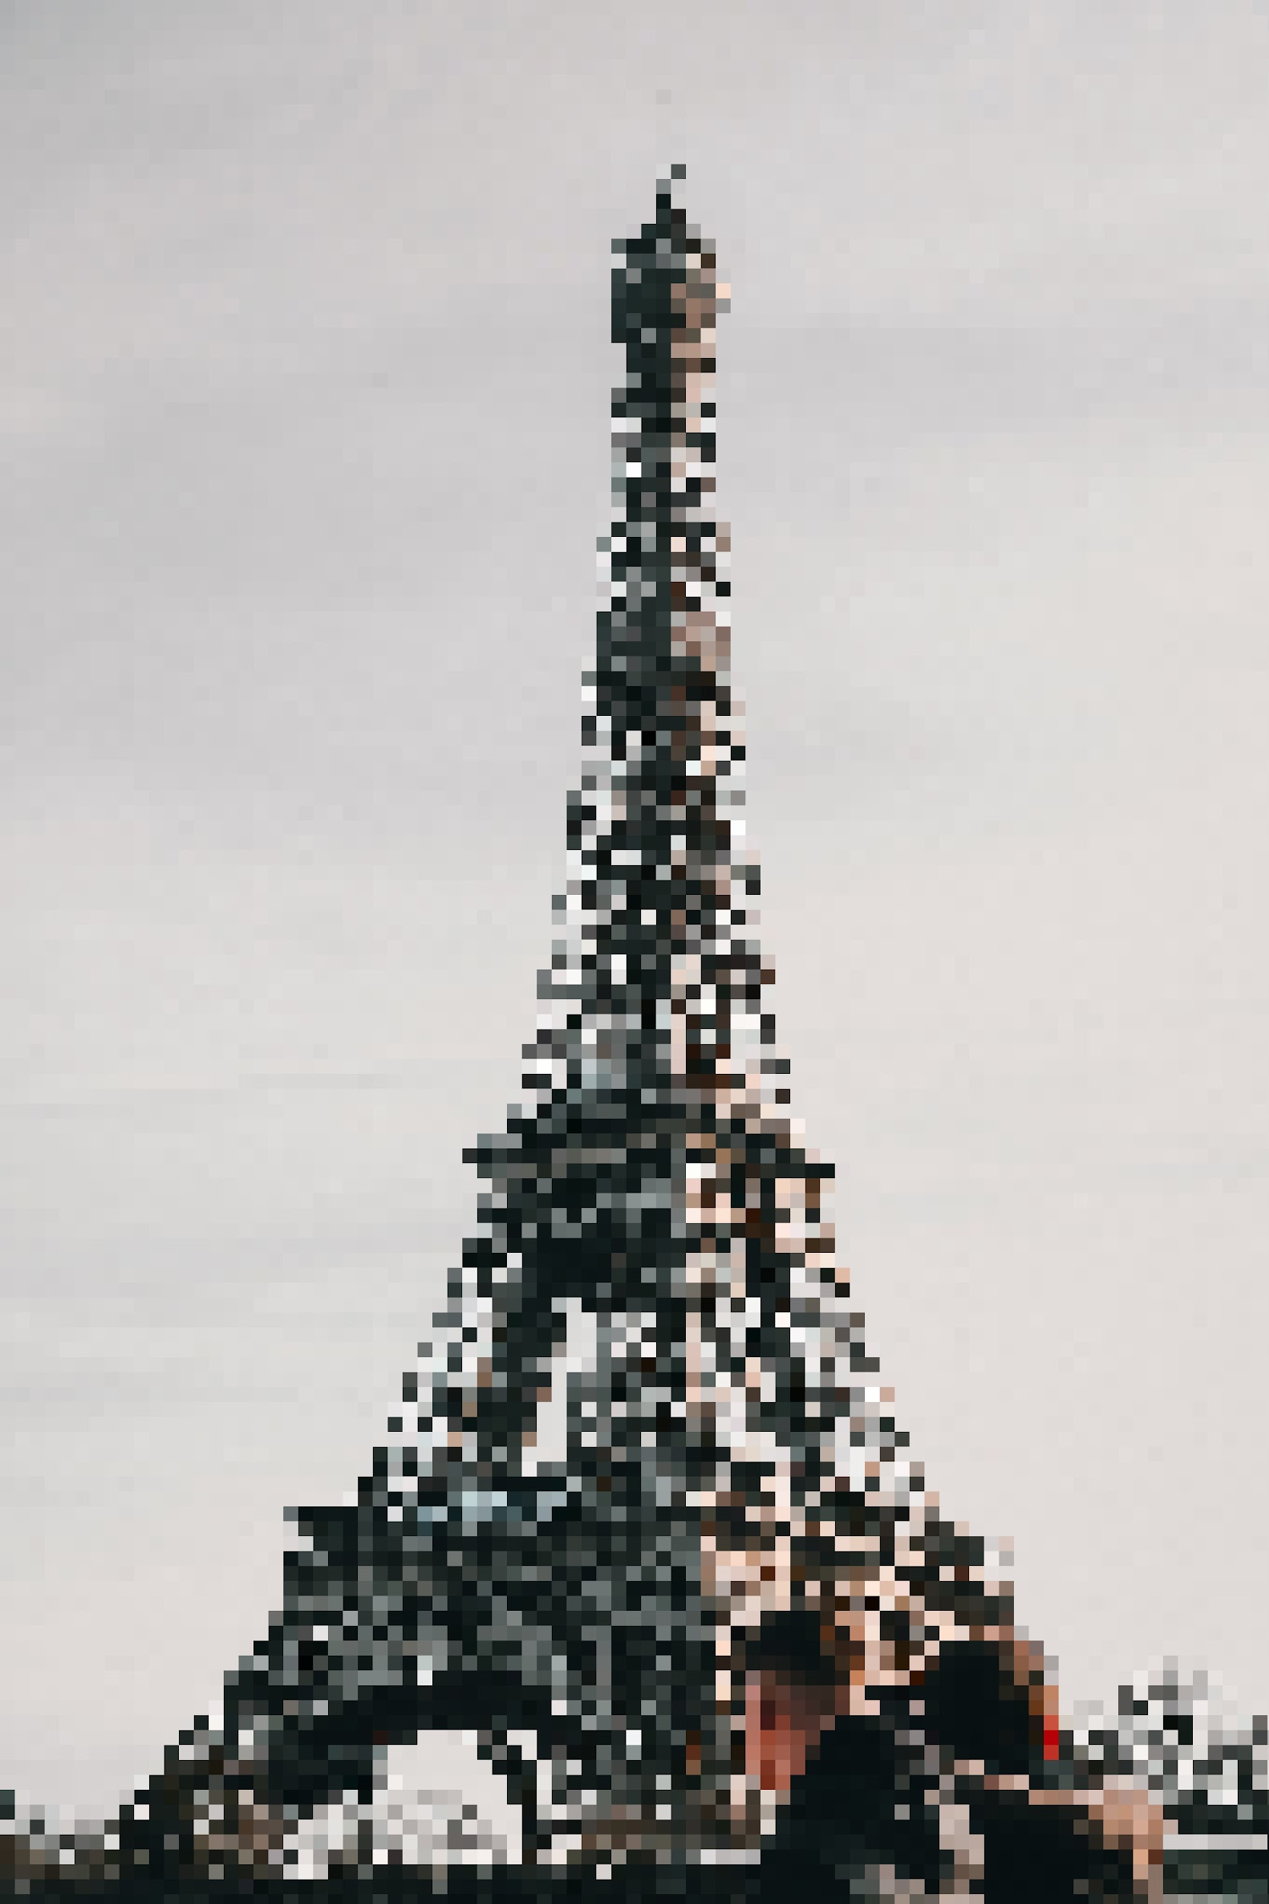
OBJECT #4
Object: #4
Try using visual hints to identify the object in this image.
COLOR SENSOR
Write down your guess.
How do the colors help?
Can you identify any shapes?
‹#›
Notes:
Our eyes typically have 3 types of cones, those that perceive red, green and blue. In this activity, students will test how well they can identify mysterious objects with just their color and/or outline.
Students can use their Graphic Organizer to record their notes for slides 2-11.

Slide 9
OBJECT #4
ANSWER:
COLOR SENSOR
Did you guess correctly?
‹#›
Notes:
Our eyes typically have 3 types of cones, those that perceive red, green and blue. In this activity, students will test how well they can identify mysterious objects with just their color and/or outline.
Students can use their Graphic Organizer to record their notes for slides 2-11.

Slide 10
OBJECT #5
Object #5
Try using visual hints to identify the object in this image.
COLOR SENSOR
Write down your guess.
How do the colors help?
Can you identify any shapes?
‹#›
Notes:
Our eyes typically have 3 types of cones, those that perceive red, green and blue. In this activity, students will test how well they can identify mysterious objects with just their color and/or outline.
Students can use their Graphic Organizer to record their notes for slides 2-11.

Slide 11
OBJECT #5
ANSWER:
COLOR SENSOR
Did you guess correctly?
‹#›
Notes:
Our eyes typically have 3 types of cones, those that perceive red, green and blue. In this activity, students will test how well they can identify mysterious objects with just their color and/or outline.
Students can use their Graphic Organizer to record their notes for slides 2-11.

Slide 12
Setting-Up PiperCode & the Color Sensor
Color Sensor
Select “My Projects”
Select “Component Library”, locate sensors, and select “Color Sensor”
COLOR SENSOR
Set up the color sensor using the steps provided.
Select “Data” on the bottom tabs.
‹#›
Notes:
This slide provides step-by-step instructions on how to set up the color sensor and PiperProject to complete the lesson’s exploration.

Slide 13
Color Sensor
Explore
Guess the RGB values for the Piper Battery.
Tell us why you chose those values.
COLOR SENSOR
Place the sensor on the battery. (Hold it flat against it for about 10 seconds.)
Copy the RGB values from your observation onto your notes.
‹#›
Notes:
This slide will help demonstrate how to complete the exploration. Students can record their observations on their Graphic Organizer.

Slide 14
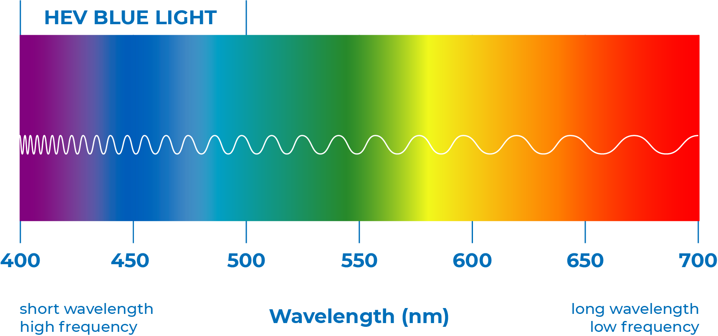
Detecting Color with the Color Sensor
Color Sensor
Why does the color sensor shine a white light?
Hint: Consider an important property of waves.
COLOR SENSOR
The white light has all wavelengths and frequencies, so when it shines on an object, the color sensor detects is a combination of waves that are reflected.
The colors we don’t see are waves that have been absorbed by the object.
‹#›

Slide 15
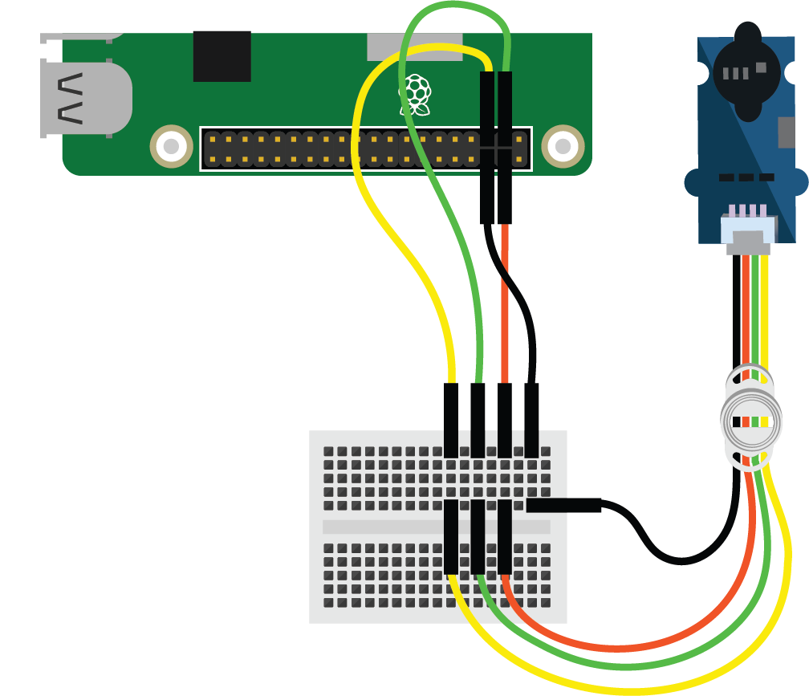
Detecting Color with the Color Sensor
Color Sensor
Like the human eye, the color sensor has separate sensors that detect different wavelengths.
COLOR SENSOR
The RGB value comes from the intensity of Red, Green and Blue detected.
That RGB value being sent to the Raspberry Pi through the cables is similar to neurons in your brain.
‹#›
Notes:
Students probably tried to guess the RGB values of their clothing. It is the chemical makeup of the clothing that determines the waves absorbed and those reflected. When wearing black, your clothing is absorbing all the wavelengths. This is why people avoid wearing black on sunny days; the clothing absorbs all wavelengths and, thus, causes the wearer to get hot.

Slide 16
EXTEND YOUR
UNDERSTANDING
COLOR SENSOR
How can a color unite our planet?
‹#›
Notes:
International Orange has served as a uniting color in aerospace and the building of structures. It has an RGB value of (255, 79, 0).
Students can explore the history of this color by reading this article or watching this video.

Slide 17
REFLECT
Reflect!
Respond to these writing prompts:
How do cultures identify with colors?
What are some memories you have that are tied to colors?
COLOR SENSOR
‹#›
Notes:
Collect these exit slips as a reflective assessment.
Sample responses:
Countries’ flags evoke different emotions for people.
The colorful houses from 2favellas and communities in Mexican cities can evoke pride of home/nostalgia.
The white washed homes in Greece.
The pink in the cherry blossoms found in Japan and Washington DC.
Foods and the emotions attributed to them.
Most of the world knows of Coca Cola, McDonalds, Mickey Mouse, and Disney. (There are other responses.)

