Slide 1
Color Sensor
Lesson 4 - RGB in Computing
Notes:
In this lesson, students explore how to create a program that decodes secret messages using RGB values. Students will need to use their kits, as well as markers and paper during the exploration of this lesson.

Slide 2
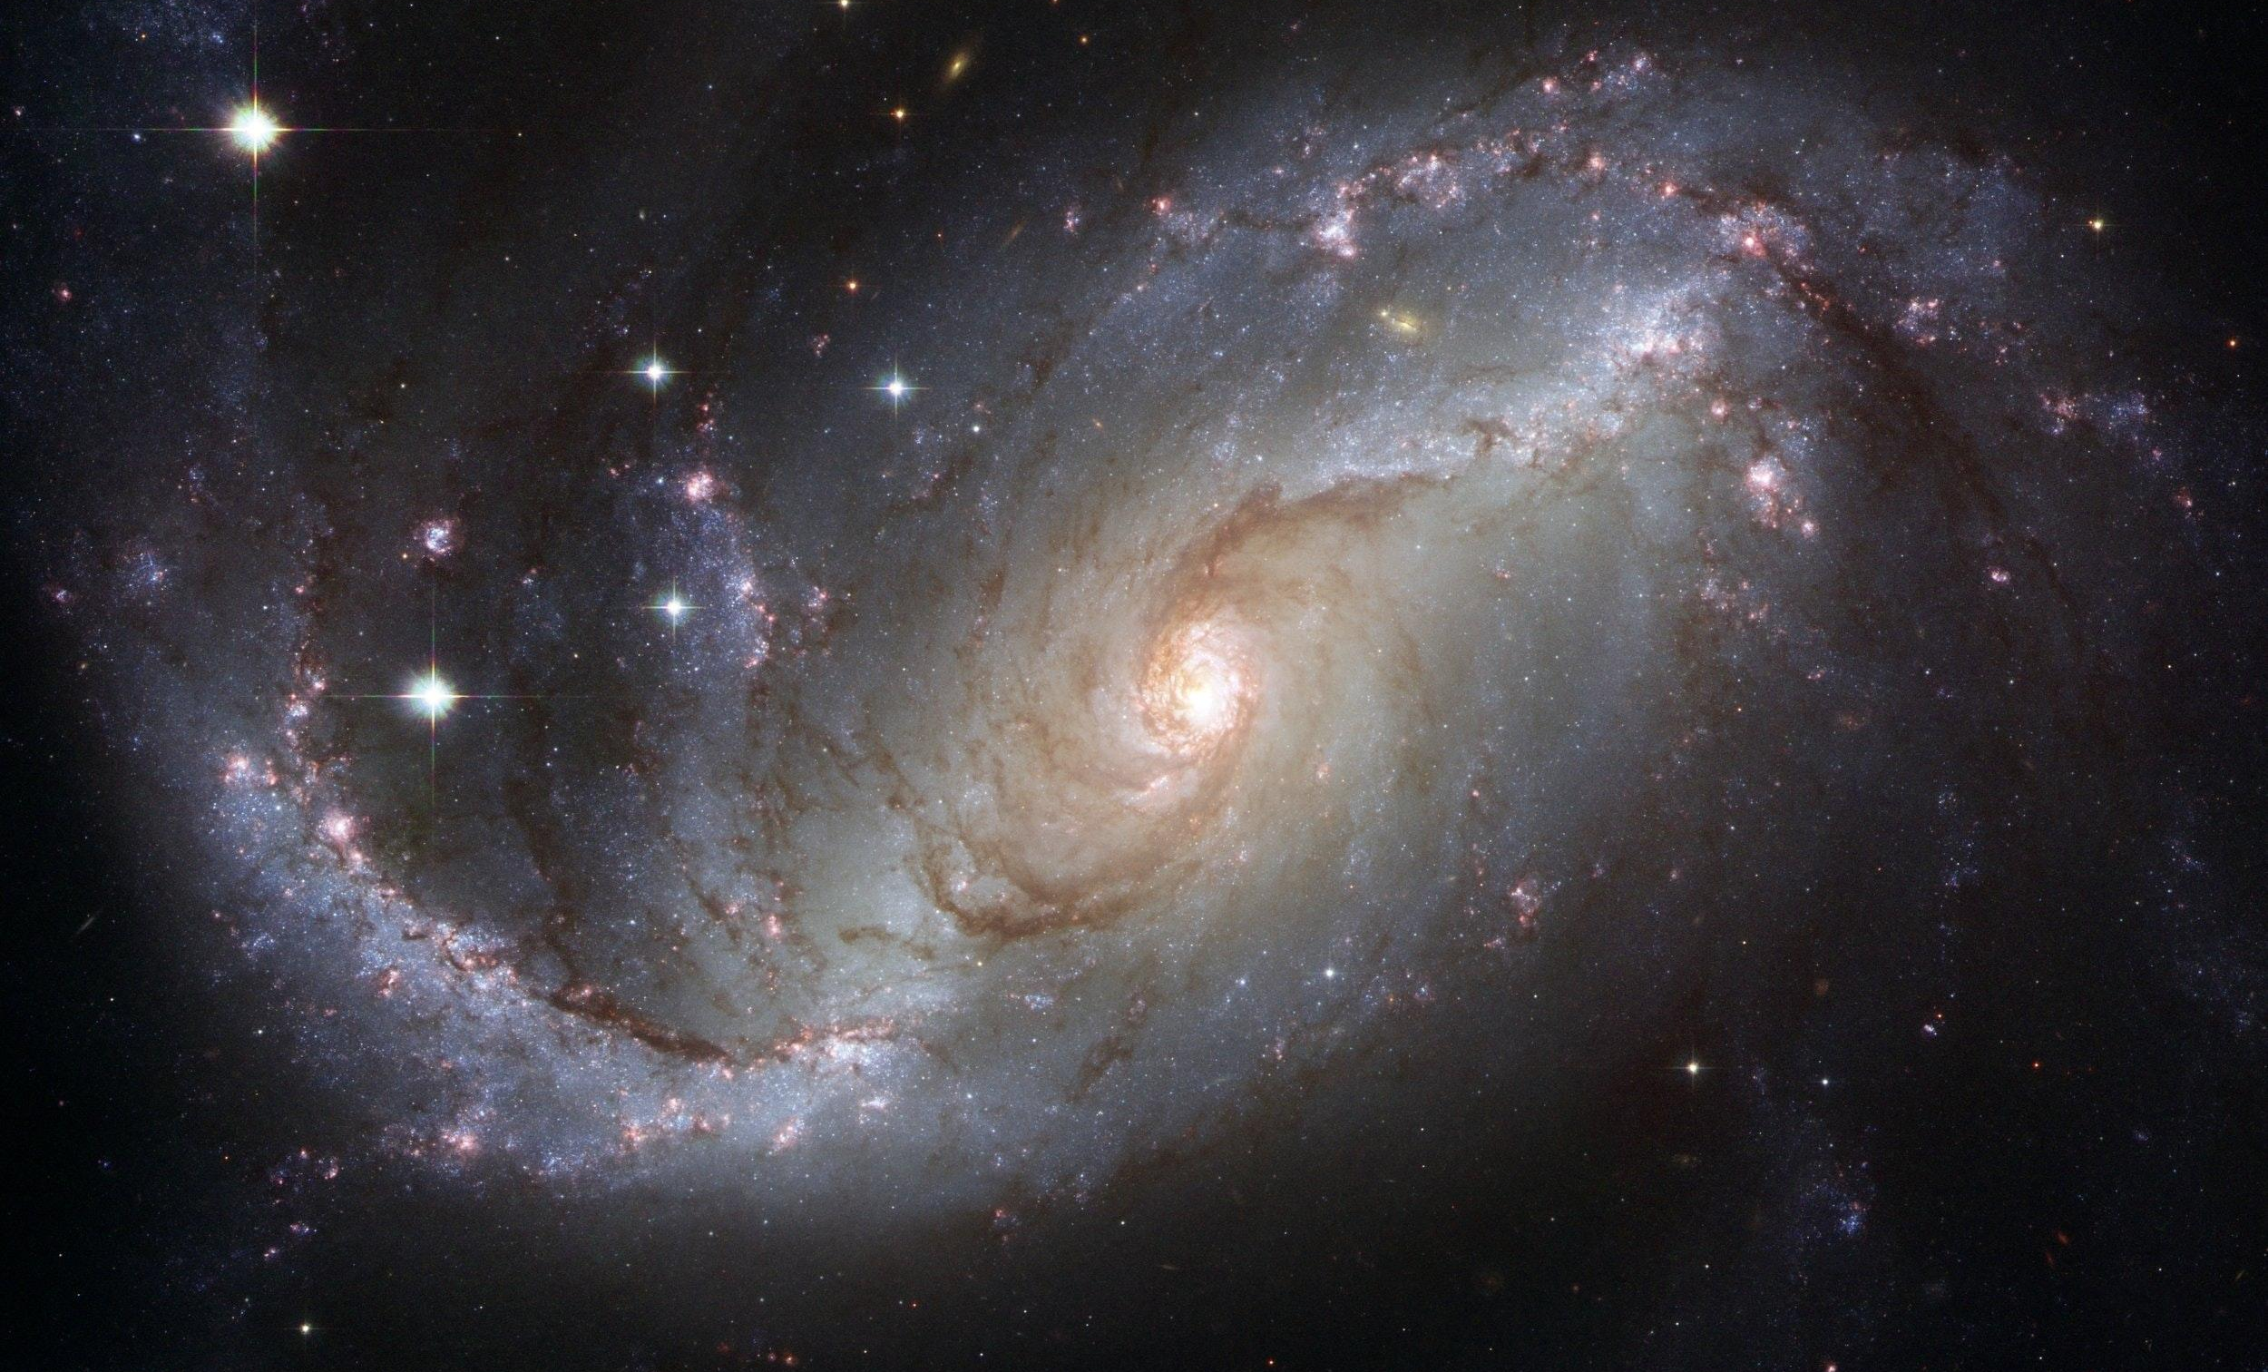
UNIVERSE
Decoding the Mysteries of our Universe
How can we use our knowledge of waves to decode the mysteries of our universe?
RANGE FINDER
What kinds of waves do you see in this image?
What properties have we discussed about these waves?
‹#›
Notes:
Astronomers use the same properties we have been learning about to make discoveries of our universe. Review the role wavelength and frequency play in the types of waves we explored in Lesson 1.

Slide 3
AMBULANCE
Have you heard the siren of an ambulance?
How does the sound change over time?
RANGE FINDER
What do you think is happening?
‹#›
Notes:
As the ambulance approaches you, the distance between the source of the waves and the observer decreases. Consequently, the siren sounds more shrill as the pitch of the wailing siren ‘sounds’ higher than its original value, as sound waves reach you ‘more frequently’. It should be noted that there is absolutely no difference between the frequency of the original sound waves and the sound waves approaching you; you simply perceive the sound to be higher pitched as the sound waves reach you at a more frequent rate, because the distance between you and the ambulance is closing.

Slide 4
UNIVERSE
Redshift: Focus on the red wave
Blueshift: Focus on the blue wave
RANGE FINDER
What do you notice about its wavelength and frequency?
What do you notice about its wavelength and frequency?
Think of the Earth as us, and think of an object in space as the ambulance.
‹#›
Notes:
Astronomers often use the term redshift when describing how far away a distant object is. To understand what a redshift is, think of how the sound of a siren changes as it moves toward and then away from you. As the sound waves from the siren move toward you, they are compressed into higher frequency sound waves. As the siren moves away from you, its sound waves are stretched into lower frequencies. This shifting of frequencies is called the Doppler effect.
A similar thing happens to light waves. When an object in space moves toward us it light waves are compressed into higher frequencies or shorter wavelengths, and we say that the light is blueshifted. When an object moves away from us, its light waves are stretched into lower frequencies or longer wavelengths, and we say that the light is redshifted.
In the visible portion of the electromagnetic spectrum, blue light has the highest frequency and red light has the lowest. The term blueshift is used when visible light is shifted toward higher frequencies or toward the blue end of the spectrum, and the term redshift is used when light is shifted toward lower frequencies or toward the red end of the spectrum. Today, we can observe light in many other parts of the electromagnetic spectrum such as radio, infrared, ultraviolet, X-rays and gamma rays. However, the terms redshift and blueshift are still used to describe a Doppler shift in any part of the spectrum. For example, if radio waves are shifted into the ultraviolet part of the spectrum, we still say that the light is redshifted - shifted toward lower frequencies.

Slide 5
CREATE
PiperCode Project:
Color Coded
Can you read the hidden message?
What do you know about each of the colors shown?
How will we use RGB VALUES to decode hidden messages?
RANGE FINDER
‹#›
Notes:
This slide introduces today’s PiperCode Project: Color Coded.

Slide 6
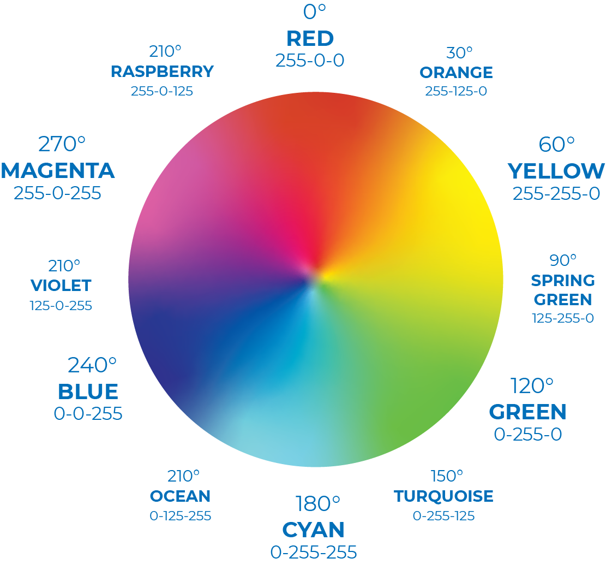
COLOR CODED
RANGE FINDER
STEP 5
How do RGB values represent the color you are scanning?
‹#›
Notes:
During the exploration, students were provided with discussion prompts. The graphic organizer will come in handy during this explanation.
Each color has a unique RGB value. After students used the markers to create their squares, they were able to use the color sensor to scan the square and identify its RGB value. Students recorded these values on their graphic organizer as a key.

Slide 7
COLOR CODED
STEP 8
What do these “if, return” functions do?
RANGE FINDER
‹#›
Notes:
After students created their “keys”, they inputted the RGB values into the “if, return” function. This allowed the computer to relate a specific color to a specific letter.

Slide 8
COLOR CODED
STEP 10
What do you think you will do to display each letter?
RANGE FINDER
‹#›
Notes:
By step 10, students have set up the RGB values for 4 colors. One color returns the letter E, another the letter I, another the letter P, and one for the letter R.
Students might have guessed that they were going to create a message using those scanned colors.

Slide 9
COLOR CODED
STEP 16
Describe the color and order you would need to scan with your color sensor in order to spell “PIPER”.
RANGE FINDER
‹#›
Notes:
Students should have seen letters pop up somewhere on their screen as they scanned the colors.
The order depends on the colors they chose for their code, but they should all follow the order “P-I-P-E-R”.

Slide 10
COLOR CODED
EXTEND YOUR
UNDERSTANDING
How are Pip & Piperbot seeing color now?
RANGE F
XTEND YOUR
UNDERSTANDING
RANGE FINDER
11
INDER
RANGE FINDER
‹#›
Notes:
This couple opted to hide their message. They included this set of glasses to decode the message. Have students guess how this system works with their knowledge of the reflection and absorption of waves.

Slide 11
EXTEND YOUR
UNDERSTANDING
RANGE FINDER
What are other ways to hide messages?
‹#›
Notes:
It is believed that approximately 12% of people are unable to properly see 3D images due to a variety of medical conditions.

Slide 12
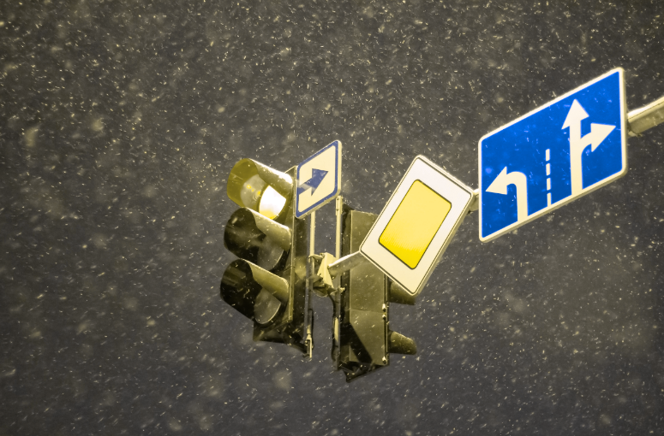
EXTEND YOUR
UNDERSTANDING
RANGE FINDER
What happens when you can’t perceive certain colors?
‹#›
Notes:
This is a color blindness test. Have students try to guess the numbers hidden in the colored dots.

Slide 13
Reflect!
REFLECT
Respond to these writing prompts:
How did working as a team make today’s coding project easier?
What obstacles did you have to overcome during today’s project?
RANGE FINDER
‹#›
Notes:
Students can record their responses in their journals and/or take this summative assessment.

