Slide 1
Ultrasonic Range Finder
Lesson 2 - How do waves help us describe patterns in our world?
Notes:
In this lesson, students will continue to work on the StoryMode: Post No. 34½
During the debrief of their exploration, students will learn about how the sensor detects the distance between it and students’ hands using ultrasonic waves.
The Graphic Organizer can be used as a tool for recording their observations.

Slide 2
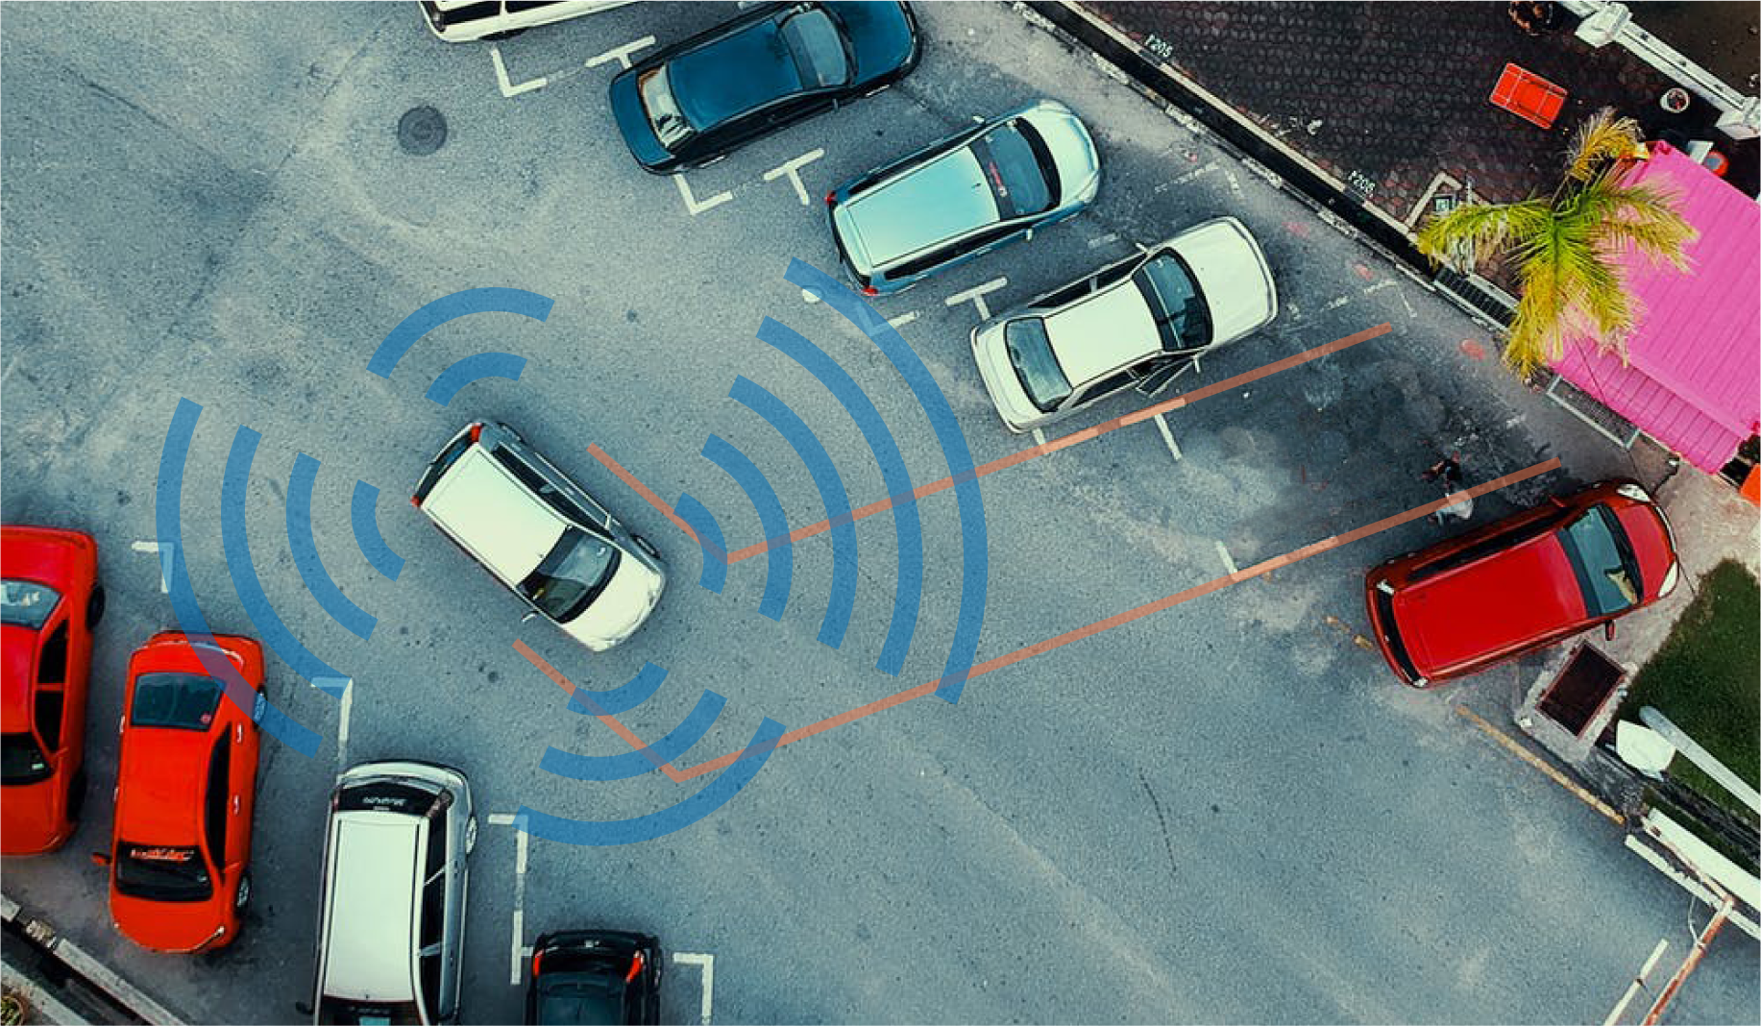
DISTANCE
RANGE FINDER
How do car sensors detect distance?
‹#›
Notes:
Students considered the different uses for a rangefinder during the reflection of Lesson 1.
One prominent use is currently ultrasonic sensors for cars. This technology allows cars to detect objects and warn the driver. In some cars, having the sensors allows the car to park itself. In a Tesla, the sensors allow the car to drive itself. Watch this video to see how a Tesla uses sensors for its Autopilot capability.

Slide 3
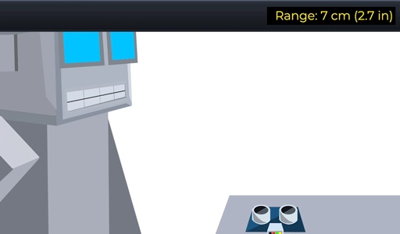
DISTANCE
What happens to the bouncing ball when you hover your hand over the Range Finder?
RANGE FINDER
What were you controlling in the game?
How do you think you did that?
‹#›
Notes:
In the game, the distance between the student’s hand and the sensor would control the height or space between the paddles where the ball would bounce.

Slide 4
DISTANCE
What do you observe in the top right hand corner of your screen as you move your hand?
RANGE FINDER
What was the sensor measuring?
How do you know that?
‹#›
Notes:
Distance measurement of your hand to the sensor

Slide 5
DISTANCE
DISTANCE is an amount of space between two things or people.
What are some units we use to measure DISTANCE?
RANGE FINDER
When do we need to measure DISTANCE?
‹#›
Notes:
Walk students through defining distance.

Slide 6
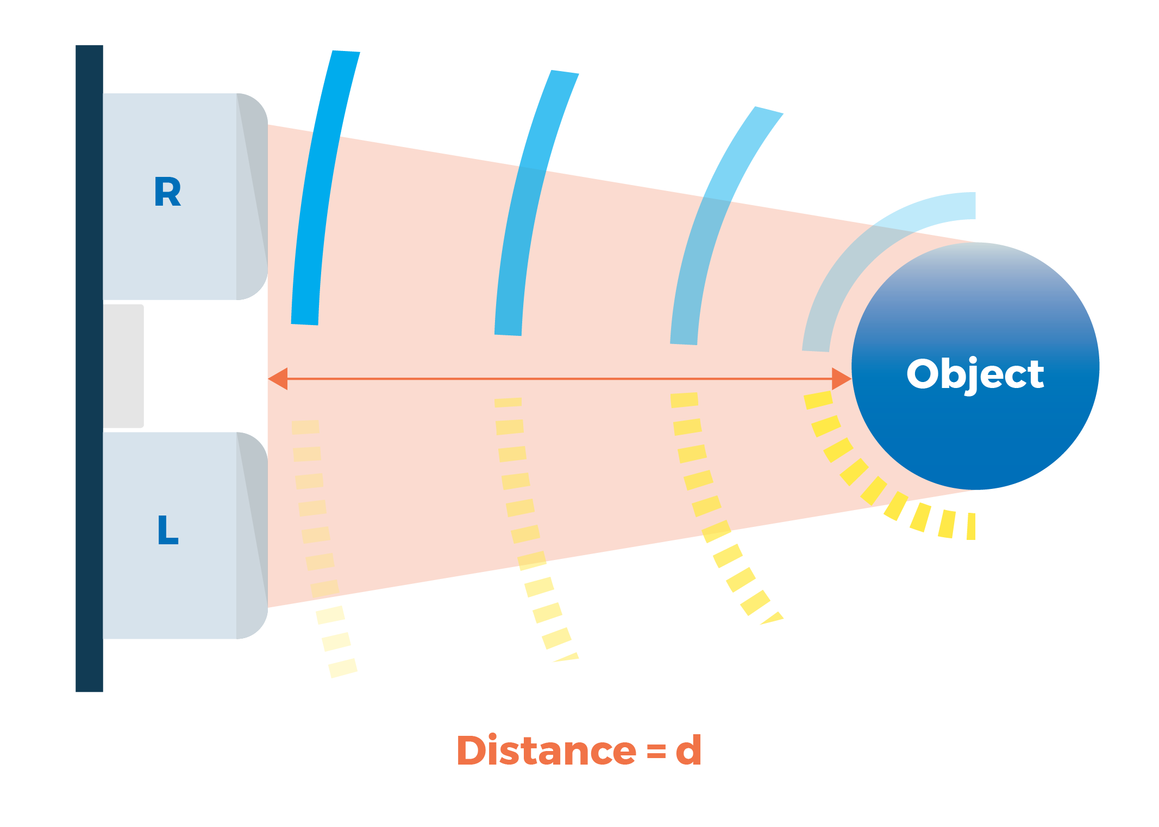
What was the sensor detecting?
DISTANCE
The Range Finder was detecting the distance your hand is from the sensor
RANGE FINDER
How do you think the sensor detects this?
What do you think the green and yellow lines represent in the image?
‹#›
Notes:
Have students consider the green and yellow arcs in the diagram.
Students can hypothesize what they think they represent. The next slide will describe with detail.

Slide 7
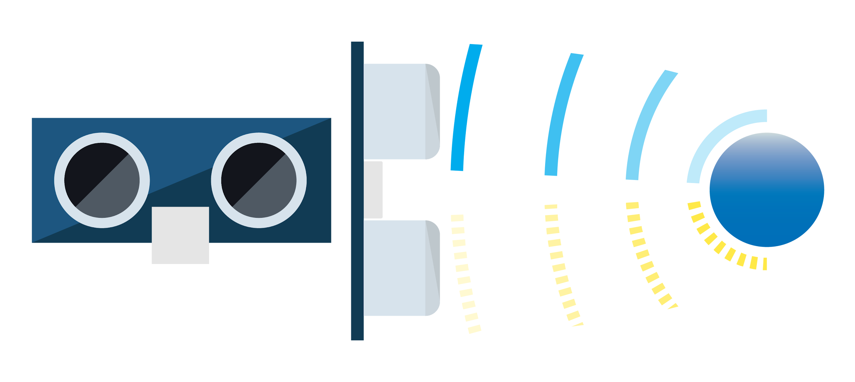
SENSOR
How does our sensor work?
The Range Finder emits an ultrasonic sound wave.
RANGE FINDER
What does ultrasonic mean?
‹#›
Notes:
Ultrasonic rangefinders measure distance by emitting a pulse of ultrasonic sound that travels through the air until it hits an object. When that pulse of sound hits an object, it’s reflected off the object and travels back to the ultrasonic range finder. The ultrasonic range finder measures how long it takes the sound pulse to travel in its round trip journey from the sensor and back. It then sends a signal to the Raspberry Pi with information about how long it took for the sonic pulse to travel.
Students might remember ultrasonic from their exploration of waves in the lessons for the Color Sensor.

Slide 8
SENSOR
Range Finder: An Ultrasonic Sensor
Identify the wave with the highest frequency and the wave with the lowest frequency.
RANGE FINDER
‹#›
Notes:
The purple wave has the highest frequency and the red wave has the lowest.
Ask students: What do we know about the different waves in the slide? (Students should remember wavelength and frequency from the lessons for the Color Sensor.)

Slide 9
SOUND WAVES
RANGE FINDER
The audible frequency range for humans
‹#›
Notes:
In this diagram, students will see the sound wave spectrum. The frequencies an ear can hear are limited to a specific range of frequencies. The audible frequency range for humans is typically given as being between about 20 Hz and 20,000 Hz (20 kHz), though the high frequency limit usually reduces with age. Other species have different hearing ranges. For example, some dog breeds can perceive vibrations up to 60,000 Hz.

Slide 10
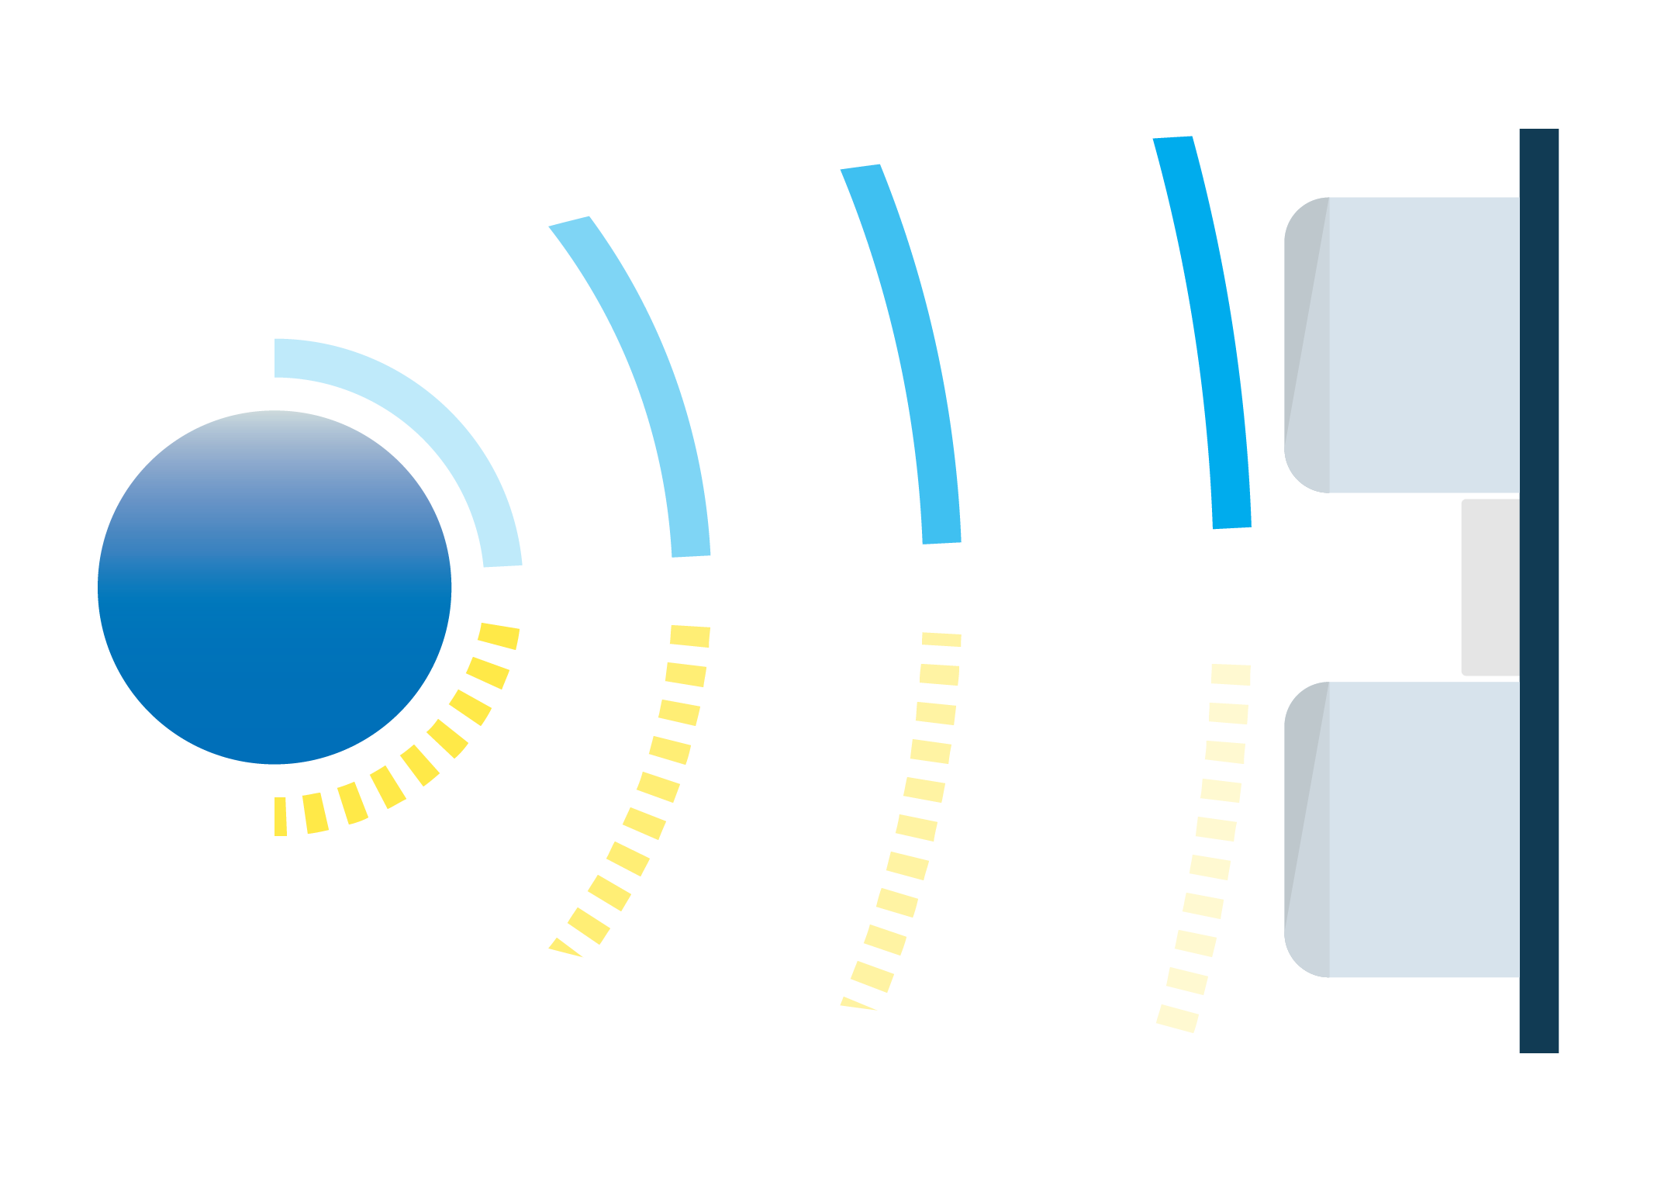
SENSOR
How does your sensor work?
The transmitter emits the ultrasonic pulse.
RANGE FINDER
The receiver catches the reflected pulse.
‹#›
Notes:
This slide explains how the transmitter and receiver work to solve for distance.
Students might have noticed a ticking sound coming from the sensor. If they make a note of it, have them consider what that might mean.
Students might have noticed that movements to the left and right of the sensor didn’t affect the observed distance. Ask them to consider why this happened.

Slide 11
SENSOR
How does your sensor work using the following formula?
RANGE FINDER
Distance = speed x time
The Speed of Sound is 343 m/s.
Time it takes for the pulse to be reflected.
‹#›
Notes:
Sound travels at approximately 340 meters per second. This corresponds to about 29.412µs (microseconds) per centimeter. To measure the distance the sound has travelled we use the formula: Distance = (Time x SpeedOfSound) / 2. The "2" is in the formula because the sound has to travel back and forth. First the sound travels away from the sensor, and then it bounces off of a surface and returns back. The easy way to read the distance as centimeters is to use the formula: Centimeters = ((Microseconds / 2) / 29). For example, if it takes 100µs (microseconds) for the ultrasonic sound to bounce back, then the distance is ((100 / 2) / 29) centimeters or about 1.7 centimeters.

Slide 12
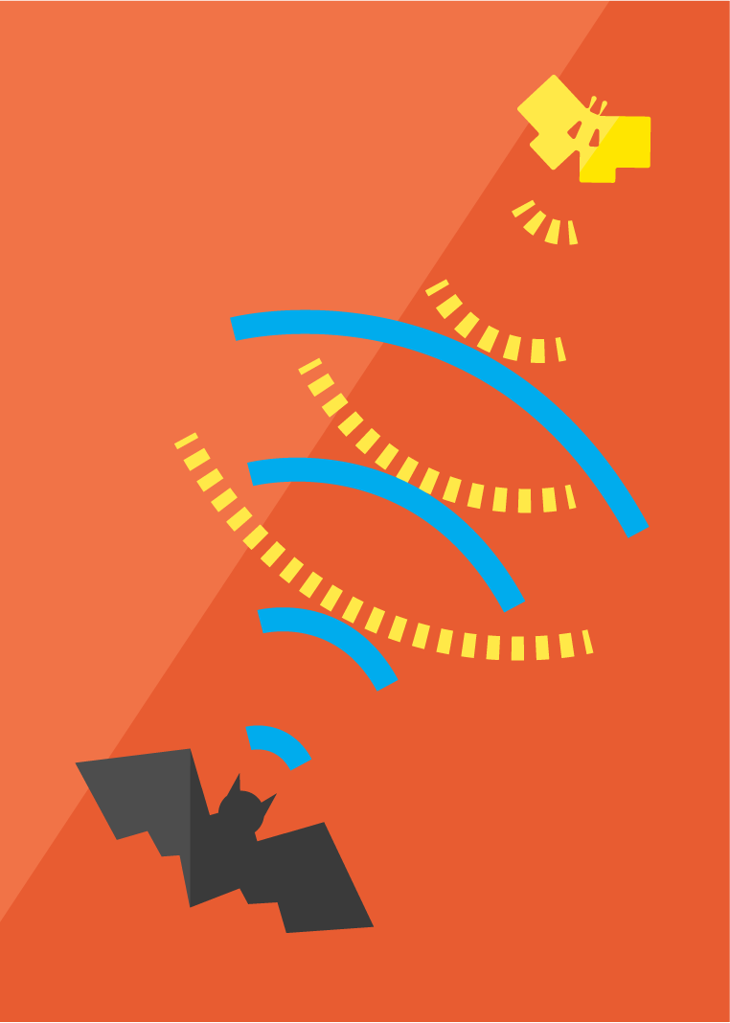
EXTENSION
What else can use frequencies to determine distances?
RANGE FINDER
= Echo
= returning sound waves
*Sound waves from the whale’s song are reflected in an echo and travel back to the whale.
‹#›
Notes:
Echolocation: the location of objects by reflected sound, in particular that used by animals such as dolphins and bats.
Students can also watch this video about echolocation and how bats use it to “see”.
Other helpful videos can be found at https://www.discoverwildlife.com/animal-facts/mammals/what-is-echolocation/

Slide 13
REFLECT!
Respond to these writing prompts:
What are some ways you would use a Ultrasonic Range Finder in your everyday life?
Who do you think would benefit most from having a Ultrasonic Range Finder?
RANGE FINDER
‹#›
Notes:
Collect these exit slips as a reflective assessment.

