Slide 1
Ultrasonic Range Finder
Lesson 3 - How can we create devices using Range Finder data?
Notes:
In this lesson, students will work on the PiperCode Project: Security Zone.
During the debrief of their exploration, students will describe how they used their sensor to create a sensor alarm.
The Graphic Organizer can be used as a tool for recording their observations.

Slide 2
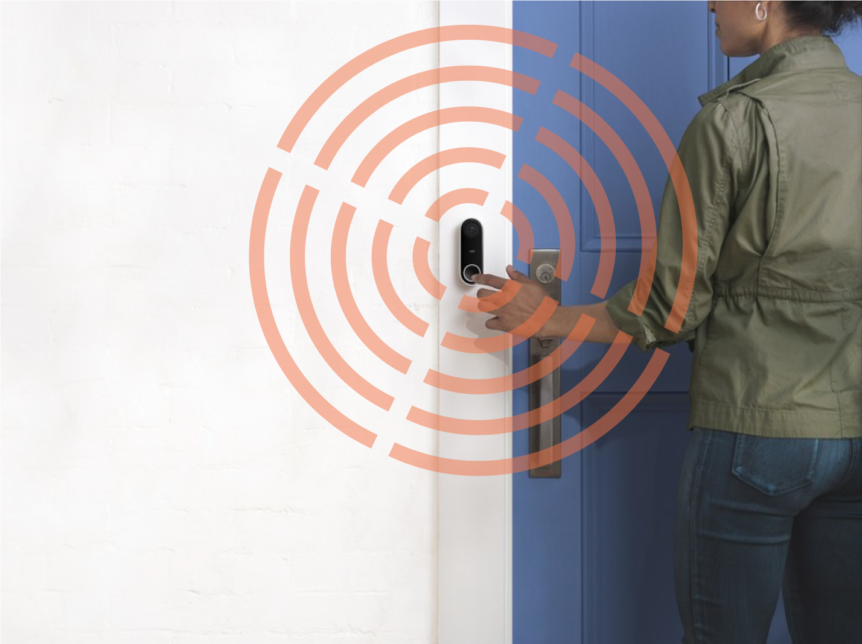
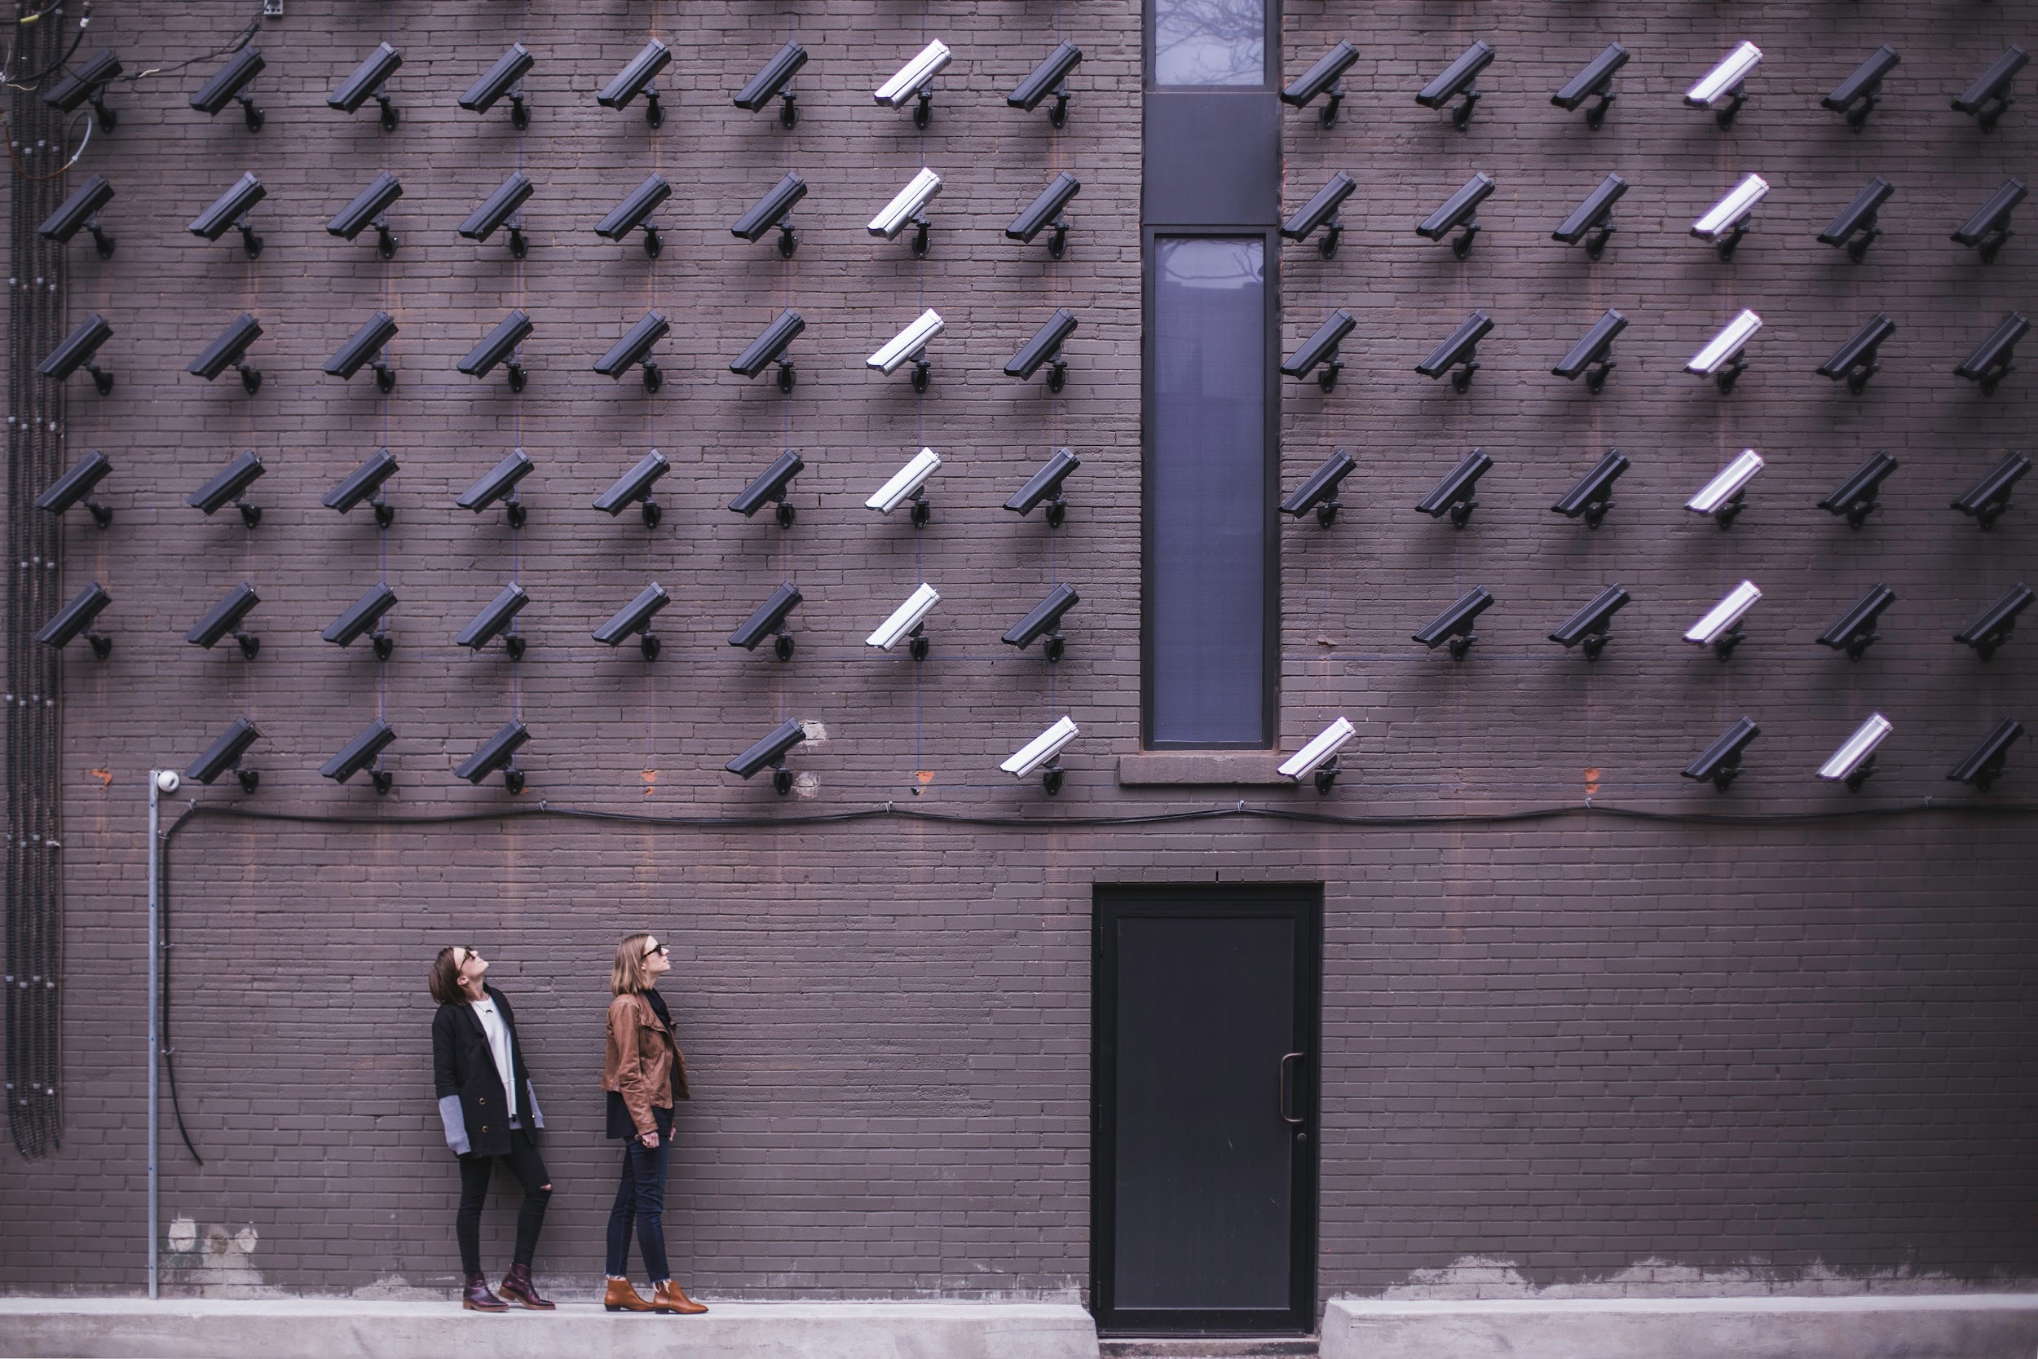
CREATE
RANGE FINDER
Door Motion Detector
Hallway Camera
What are other uses for the Ultrasonic Range Finder?
‹#›
Notes:
Students discovered how rangefinders allow cars to park and drive on their own during Lesson 2.
Have students consider one more use for the rangefinder: security.
Ask:
“How could the rangefinder be used at home?”
There are several examples of sensor alarms that are for sale on this website.
Have students explore the different products and debrief using the following discussion questions:
How do you think this alarm works?
What are some advantages for using this type of alarm?
What are some limitations when using this type of alarm?
When would this alarm be useful?

Slide 3
CREATE
PiperCode Project:
Security Zone
Follow the tutorial.
Pause to respond to discussion questions.
Record responses in your GRAPHIC ORGANIZER.
RANGE FINDER
‹#›
Notes:
During their exploration of the PiperCode Project, students were provided 3 discussion questions to help guide their group work. Students may record their group’s responses on the graphic organizer.
Discussion Questions:
Step 3: What would be different if we used inches? (Have rulers available to help students visualize the difference between the units and estimate distance.)
Step 6: How does setting the Range Finder value to 20 affect the output? What would be different if the value were 5?
Step 11: How would the alarm change if you used the units inches?

Slide 4
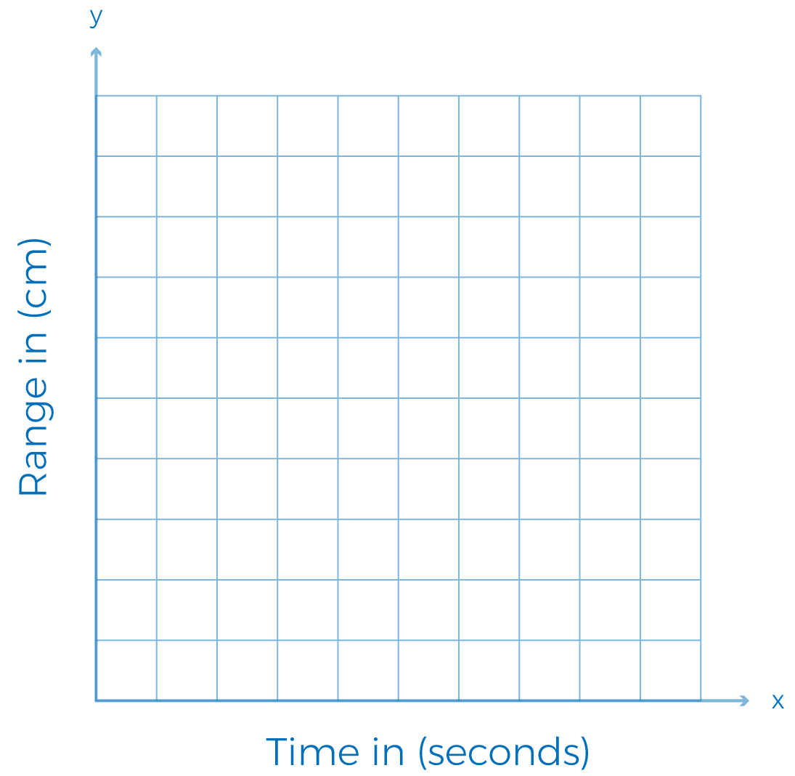
DISPLAY DATA
What is represented by the x-axis?
Time in seconds
RANGE FINDER
What is represented by the y-axis?
Range in centimeters
‹#›
Notes:
Students can debrief by displaying the tables of data created in the project.
Walk students through labeling their axes. Have students consider how the graph changes when the units are changed.
Which axis is affected when changing the units for measuring distance?
What part of the code determines the size of the “security zone”?
How does changing the size of the zone affect your graph?

Slide 5
MEASURE
Which unit is larger 1 cm or 1 in?
How can we be sure?
How can we convert from one unit to another?
RANGE FINDER
To convert from in to cm,
divide the length value by 2.54
To convert from cm to in, multiply the length value by 2.54
1 inch = 2.54 cm
‹#›
Notes:
Some students might have mentioned the relationship between centimeters and inches. In this slide, students can use the relationship between the units to create their own formula for converting between the two.
For 4th grade and up, pause before providing the steps to allow students to create the formula on their own.

Slide 6
CONVERT
20 cm = _____ in
5 in = ____ cm
50 cm = ____ in
12 in = ____ cm
RANGE FINDER
To convert from in to cm,
divide the length value by 2.54
To convert from cm to in, multiply the length value by 2.54
1 inch = 2.54 cm
‹#›
Notes:
Students have units to convert on their Graphic Organizer.
Provide them some time to practice using their group mates.

Slide 7
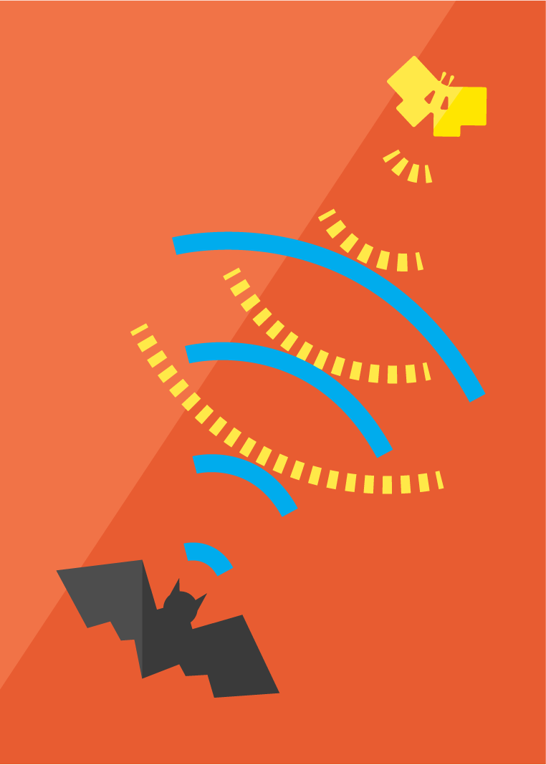
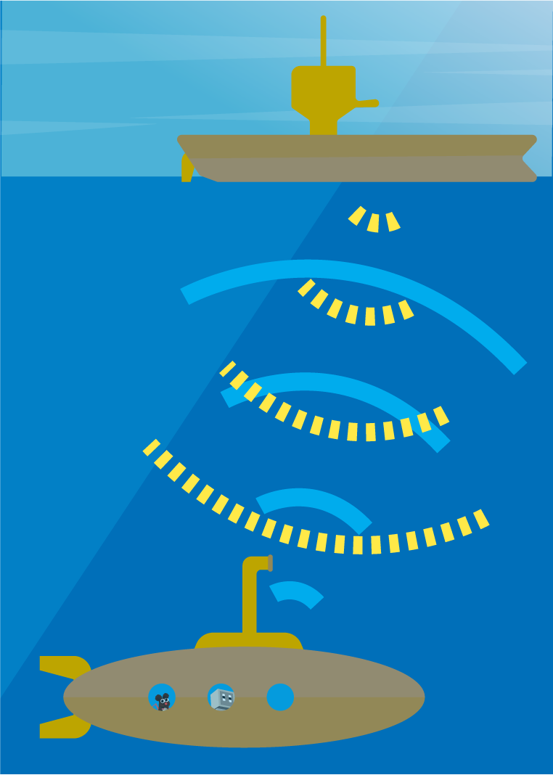
EXTENSION!
How can we use echolocation?
RANGE FINDER
= sonar
= returning sound waves
‹#›
Notes:
Echolocation: the location of objects by reflected sound, in particular that used by animals such as dolphins and bats.
Students learned of echolocation during Lesson 2. In this article, students will learn how echolocation can help navigate submarines.

Slide 8
REFLECT!
Respond to these writing prompts:
How would you use your sensor alarm at home?
What distance would you set your alarm to detect? Explain why you chose that distance.
RANGE FINDER
‹#›
Notes:
Collect these exit slips as a reflective assessment.

