Slide 1
Ultrasonic Range Finder
Lesson 4 - How can we use data to describe movement?
Notes:
In this lesson, students will work on the PiperCode Project: Security Zone.
During the debrief of their exploration, students will describe how they used their sensor to create a table.
The Graphic Organizer can be used as a tool for recording their observations.

Slide 2
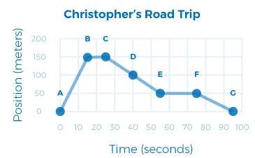
STORYTELLING
How far did Christopher’s car travel between points A and B?
How much time did it take for Christopher to travel from point A to point B?
Describe the motion of Christopher’s car between points B and C.
What is the speed of the car between points A and B?
RANGE FINDER
‹#›
Notes:
Students will practice reading graphs.
Guiding questions:
What do the labels tell us about the data on display?
What do you think is happening in this data?
Can you create a story for this graph?
Share your story with your partner/group.

Slide 3
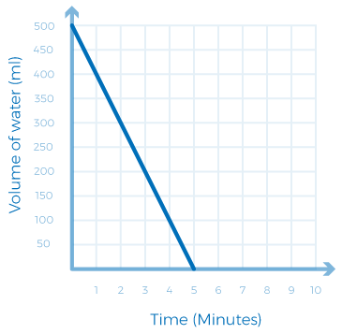
STORYTELLING
What do the labels tell us?
What do you think is happening in the graph?
How can you tell?
RANGE FINDER
‹#›
Notes:
Students will practice reading graphs.
Guiding questions:
What do the labels tell us about the data on display?
What do you think is happening in this data?
Can you create a story for this graph?
Share your story with your partner/group.

Slide 4
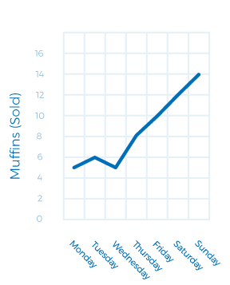
STORYTELLING
What do the labels tell us?
What do you think is happening in the graph?
How can you tell?
RANGE FINDER
‹#›
Notes:
Students will practice reading graphs.
Guiding questions:
What do the labels tell us about the data on display?
What do you think is happening in this data?
Can you create a story for this graph?
Share your story with your partner/group.

Slide 5
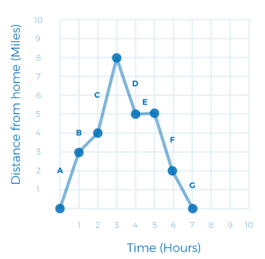
STORYTELLING
What do the labels tell us?
What do you think is happening in the graph?
How can you tell?
RANGE FINDER
‹#›
Notes:
Students will practice reading graphs.
Guiding questions:
What do the labels tell us about the data on display?
What do you think is happening in this data?
Can you create a story for this graph?
Share your story with your partner/group.

Slide 6
STORYTELLING
Open “New” Piper Project
View data.
Follow the directions in your Graphic Organizer.
RANGE FINDER
‹#›
Notes:
This slide can be used to walk students through the day’s activity. It is similar to the PiperCode Project from Lesson 3, but this activity is an open-ended exploration.

Slide 7
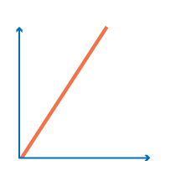
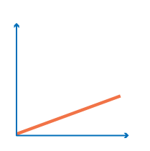
EXTENSION
DISTANCE
DISTANCE
RANGE FINDER
TIME
TIME
How can we calculate speed?
‹#›
Notes:
Graphs can help us identify when objects are moving at a fast speed. The rate can be described as the slope of the graph. In the following slides, we will discuss the different types of slopes found on these kinds of graphs.

Slide 8
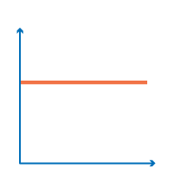
EXTENSION
How can we calculate speed?
y
y
y
RANGE FINDER
x
x
x
A steep line indicates a fast speed
A shallow graph indicates a slow speed
A flat line indicates zero speed, the object is stationary
‹#›
Notes:
The slope of a line tells us the speed at which the object is moving.
Ask students to identify the steep, shallow and flat lines on their graphs. Have groups describe their movement during that time.

Slide 9
SLOPE
Where does the line have a steep slope?
Distance travelled = 4 miles
What happened here?
Time travelled = 1 hour
RANGE FINDER
Where does the line have a shallow slope?
Distance travelled = 1 mile
SLOPE = distance covered
time
Time travelled = 1 hour
‹#›
Notes:
This slide walks students through solving for slope by identifying the distance traveled over a period of time.

Slide 10
REFLECT!
Respond to these writing prompts:
How do waves help you experience the world around you?
How do graphs help us describe situations in our lives?
RANGE FINDER
‹#›
Notes:
Collect these exit slips as a reflective assessment.

