Slide 1
Energy Efficiency Lesson 1
How much energy does something use?

Slide 2
Recall: What is Energy?
Energy allows you to make change
Energy can put things into motion, light something up, make sounds through vibration, etc.
There are many types of energy: light, sound, chemical, kinetic and electrical
Which types of energy do you think the Piper Computer Kit uses?
Notes:
Ways that we can be more energy efficient - use newer technologies, use smaller/fewer energy-consuming things, and simply use less energy.

Slide 3
When do you expend energy?
Examples:
Running, biking, swimming or playing sports
Living daily life
Turning on the lights
Playing music out of a speaker
When you use energy to do one of the above, you are doing work. This means you transfer energy from one type to another.
For example when you run you are converting chemical potential energy to kinetic energy in order to move.
Notes:
Ways that we can be more energy efficient - use newer technologies, use smaller/fewer energy-consuming things, and simply use less energy.

Slide 4
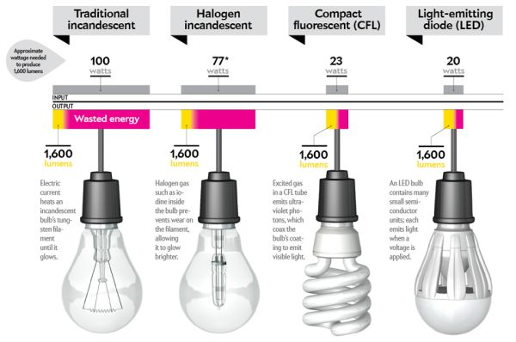
What is efficiency?
Compare how much energy goes into each light bulb to how much light comes out.
Notes:
Efficiency is what amount of the energy input comes out as desired work. In the case of the light bulbs, electricity, measured in watts goes in, and light, measured in lumens comes out. This chart, from homedit.com compares 4 different kinds of light bulbs that all output 1600 lumens of light.

Slide 5
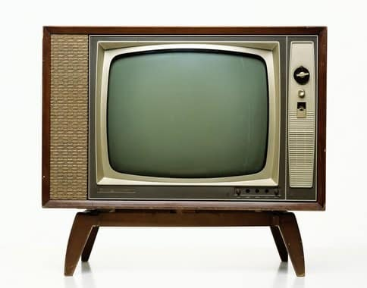
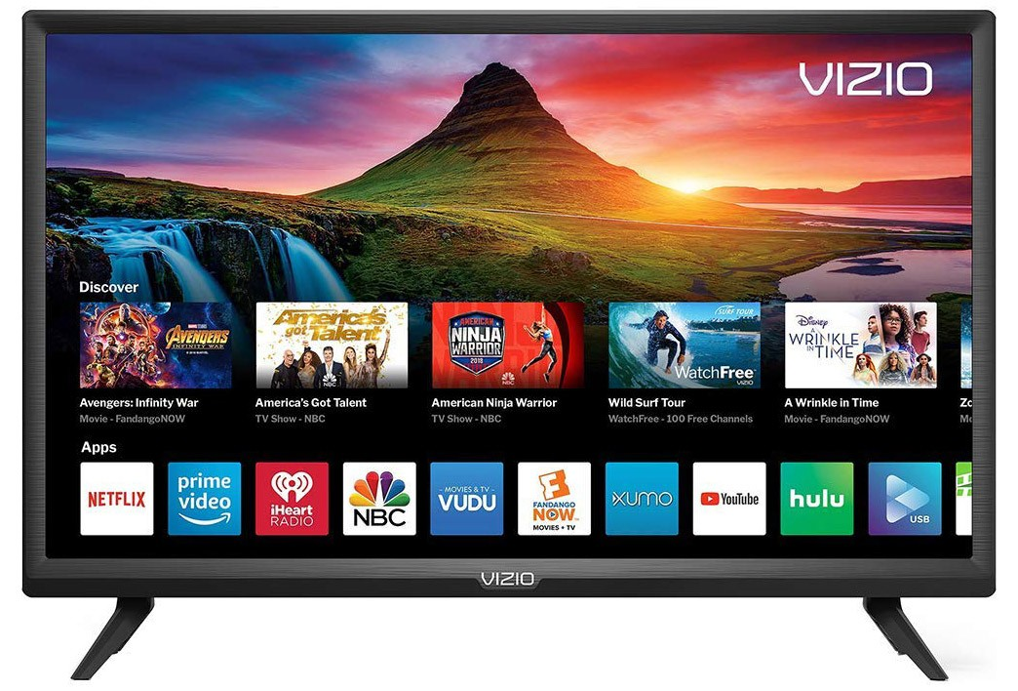
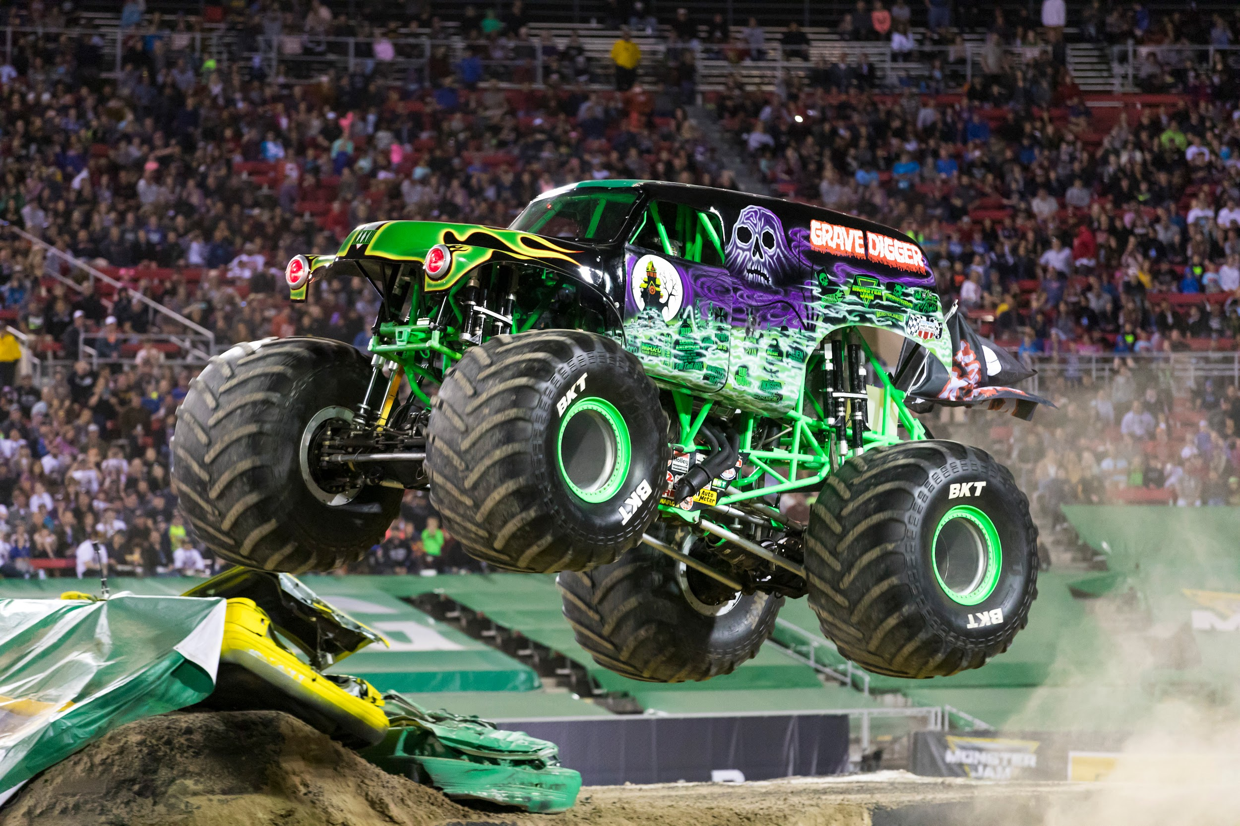
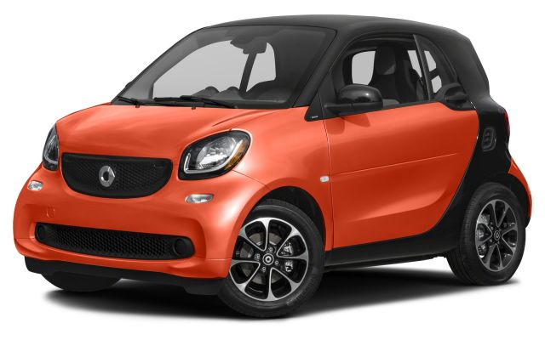
What makes something energy efficient?
Newer technologies use less energy
Smaller devices like TVs or air conditioners need less energy than the bigger versions. You can also save energy by using fewer devices - play a video game together instead of everyone on their own console.
And simply using less energy - mountain biking instead of dirt biking.
Notes:
Ways that we can be more energy efficient - use newer technologies, use smaller/fewer energy-consuming things, and simply use less energy. In classroom, use energy efficient devices like sensor for heat, cool, and motion.

Slide 6
Why Size Matters
In this activity we’ll model different size TV screens with paper to compare how much energy they use.

Slide 7
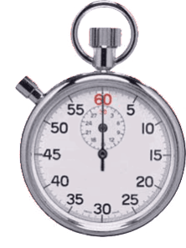
How much energy does the Piper Computer Kit use?
We can use battery and a timer to figure out how much energy the Piper Computer Kit uses.

Slide 8
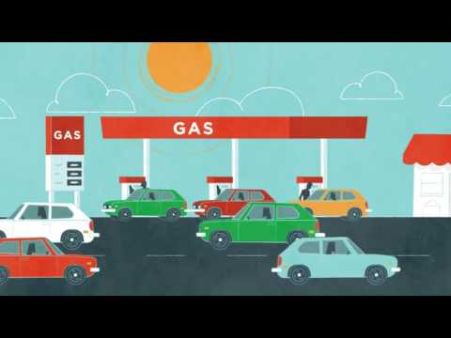
Why Efficiency Matters
Notes:
If you have time, students can watch this video on the LA traffic control center.

Slide 9
Reflect!
On your Exit Slip, write down:
2 things that you learned today
1 question you have about today’s lesson
1 challenge you faced and how you were able to work through it
Notes:
Collect these exit slips as a formative assessment to see what you need to review next class!

