Slide 1
Energy Efficiency
Lesson 2 - Reducing, Reusing, and Recycling

Slide 2
VAMPIRE POWER
In this exploration, students will identify sources of energy loss and ways to save energy and money to create efficiencies.
Vampire power is electricity leakage from devices that use power even when they're off. These devices are called "Energy Vampires" and they waste valuable energy.
Let’s work together to figure out how we can find ways to get rid of “Energy Vampires” and save energy.
ENERGY EFFICIENCY
‹#›

Slide 3
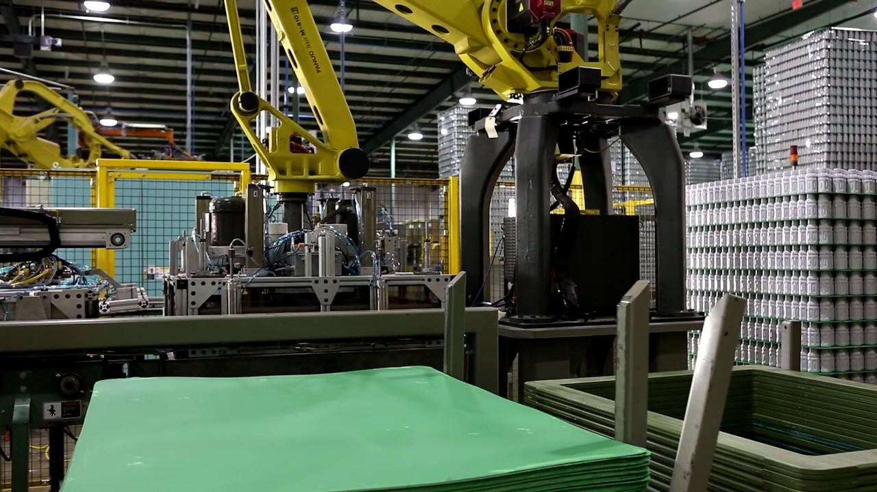
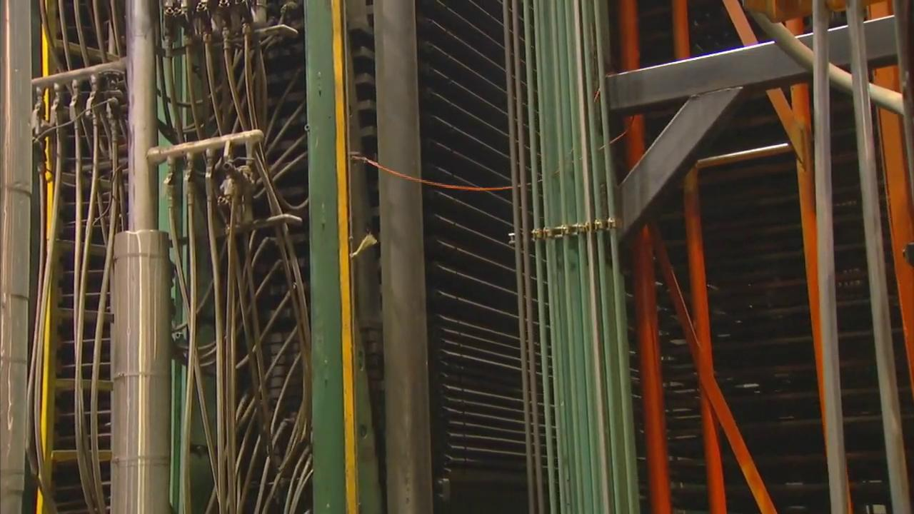
THE SET-UP
ENERGY EFFICIENCY
Plastic
Plywood
‹#›
Notes:
Intro clip to the Stoplight problem
(Only need to watch 1:10 to 1:50)

Slide 4
VIDEO REFLECTION
Plastic or Wood?
Why do you think the Piper Computer Kit is made with wood instead of plastic?
Do you think the wood design helps conserve energy? Why?
How does energy conservation help the environment?
ENERGY EFFICIENCY
‹#›
Notes:
Ways that we can be more energy efficient - use newer technologies, use smaller/fewer energy-consuming things, and simply use less energy.

Slide 5
Although there are a lot of different kinds of materials used in many of our devices, they can be grouped into a few general categories:
Glass
Metal
Plastic
Interestingly, we don’t see very many devices made from wood but the Piper Computer Kit does - let’s find out why!
RAW MATERIALS
ENERGY EFFICIENCY
‹#›

Slide 6
Material Jigsaw Reflection
METAL
To make metal parts, like those used in screws, bolts, hinges, frames, and circuit boards:
A raw material called ore (a kind of rock) first has to be mined (dug out) of the ground.
The ore must be processed into large pieces of metal using chemicals and heat.
The metal is then cut or bent into the shape needed for the final product.
ENERGY EFFICIENCY
‹#›
Notes:
Have expert group students add additional points they found about this material

Slide 7
Material Jigsaw Reflection
PLASTIC
To make plastic parts- although there are very few in the Piper Computer Kit:
Oil and natural gas has to be extracted from underground reservoirs.
The oil and natural gas are mixed with other chemicals to make raw plastic.
The raw plastic is then melted and formed into the shape needed for the final product.
Where can plastic be found in the Piper Computer Kit?
ENERGY EFFICIENCY
‹#›

Slide 8
Material Jigsaw Reflection
GLASS
To make glass parts:
Sand and other chemical additives have to be melted at very high temperatures.
The molten sand is then rolled out into thin sheets and cooled into glass.
The glass is cut into the shape needed for the final product.
Are there any glass parts in the Piper Computer Kit? What about in the Raspberry Pi?
ENERGY EFFICIENCY
‹#›
Notes:
Have expert group students add additional points they found about this material

Slide 9
Material Jigsaw Reflection
WOOD
Your Piper Computer Kit is made mostly of wood. To make the wooden parts:
Trees are cut down and taken to a mill, where they are shaved into thin sheets of wood.
Thin sheets of wood are glued together, pressed, and dried.
This creates plywood that is cut into the shape needed for the final product.
Unlike the other materials, wood is known as a sustainable material - Why do you think that is?
ENERGY EFFICIENCY
‹#›
Notes:
Answer: trees can be replanted
Have expert group students add additional points they found about this material

Slide 10
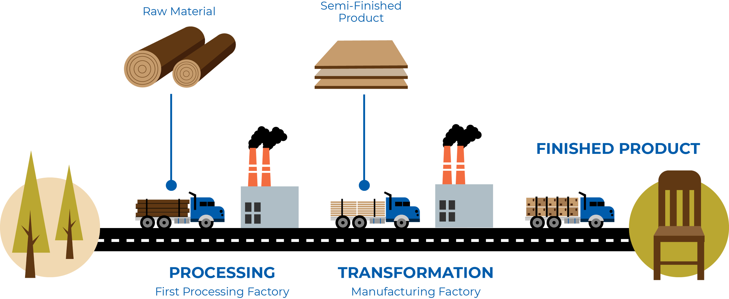
SUSTAINABLE
CHOICES
ENERGY EFFICIENCY
It takes energy to make the everyday items we purchase and use. Can you identify all of the ways energy is used to make a finished product?
‹#›
Notes:
Ways that we can be more energy efficient - use newer technologies, use smaller/fewer energy-consuming things, and simply use less energy.

Slide 11
The energy required to make 1 kg (2.2 lbs) of each material in each step 2 above is:
Metal (steel from ore): 22,000,000 Joules (6100 watt-hours)
Plastic (PVC): 25,000,000 Joules (6900 watt-hours)
Glass (containers): 4,600,000 Joules (1300 watt-hours)
Wood (mixed plywood): 980,000 Joules (270 watt-hours)
These figures don’t include the energy required to harvest or mine the raw materials needed. What do you think requires more energy? Mining for ore, drilling for oil/natural gas, or logging trees?
SUSTAINABLE
CHOICES
ENERGY EFFICIENCY
‹#›

Slide 12
The average household in the US uses 867,000 watt-hours per month. That’s 1190 watt-hours of energy every hour!
The energy required to make 1 kg (2.2 lbs) of each material in each step 2 above is:
Metal (steel from ore): 22,000,000 Joules (6100 watt-hours)
Plastic (PVC): 25,000,000 Joules (6900 watt-hours)
Glass (containers): 4,600,000 Joules (1300 watt-hours)
Wood (mixed plywood): 980,000 Joules (270 watt-hours)
How many hours could you power an average house with the energy it takes to make 1 kg (2.2 lbs) of metal? Plastic? Glass? Wood?
ENERGY IN
THE HOUSE!
ENERGY EFFICIENCY
‹#›
Notes:
Have students work on these calculations in small groups. Walk students through these calculations on the board.

Slide 13
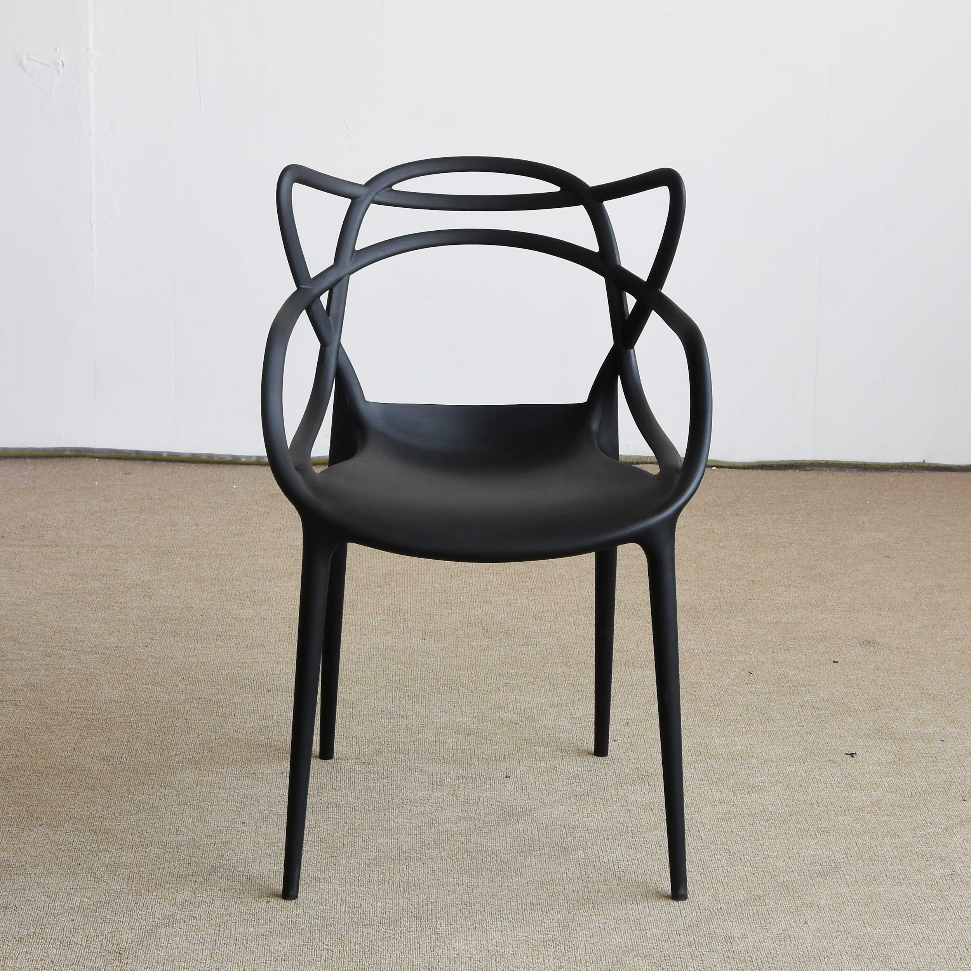
How long could that energy power my home?
TRY THIS
If it takes 1 kg (2.2 pounds) of material to make a chair - how long would the energy required to make the chair power your home?
ENERGY EFFICIENCY
Hint: Remember, the average household in the US uses 867,000 watt-hours per month. That’s 1190 watt-hours of energy every hour!
‹#›
Notes:
Have students return to small groups to complete these calculations then reflect as a group on the board.

Slide 14
3 R’s
Reducing, Reusing, and Recycling save energy
Which of these practices can save the most energy?
How would using recycled material save energy?
How would reusing finished products save energy?
How would reducing (buying less) save energy?
ENERGY EFFICIENCY
‹#›

Slide 15
RECYCLING
Recycling is one way to save energy when making new materials. For example, making steel from recycled steel instead of iron ore takes only half as much energy.
Recycling glass doesn’t save much energy, but sand and chemicals (which take energy to extract), can be saved.
Plastics are hard to recycle, because re-melted plastics lose some of their properties - so only about 10% of newly manufactured plastic can be made from recycled material.
ENERGY EFFICIENCY
‹#›

Slide 16
REUSING
By reusing materials - they don’t have to be made again, and they don’t end up in a landfill or in the ocean. Can you think of anything that you have thrown away in the last week that could have been reused?
By disassembling the Piper Computer Kit at the end of the school year, you are helping make sure it is reused. Because the kit will be reused, you’ve helped conserve a substantial amount of energy!
ENERGY EFFICIENCY
‹#›

Slide 17
Reflect!
REFLECT
On your Exit Slip write down:
Four things you can do to rid yourself of Energy Vampires in your home to lower your power bill.
Two things you learned today.
One question you have about today’s lesson.
One problem you faced and how you were able to solve it.
ENERGY EFFICIENCY
‹#›
Notes:
Collect these exit slips as a formative assessment to see what you need to review next class!

