Slide 1
PC04 Components Review
Piper Premium Curriculum Lesson 1.1
Notes:
Order: R-Pi, mouse, speaker, display, battery*, cables (power, USB, HDMI), SD card*, CPU, GPIO, breadboard*skip SD card and battery at your discretion.

Slide 2
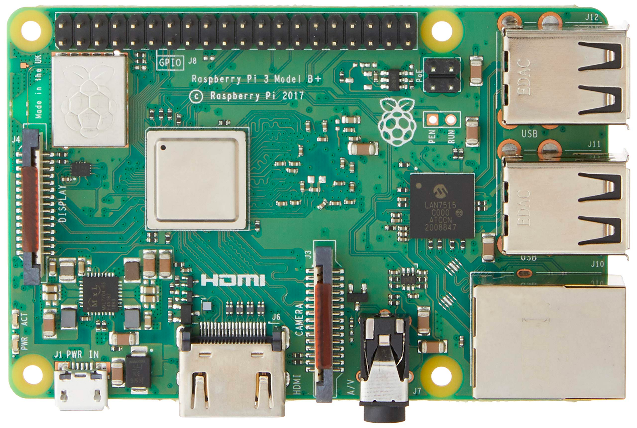
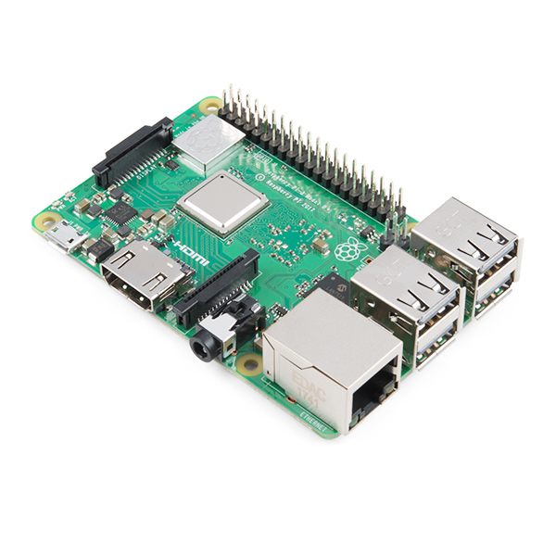
WHAT IS THIS?
Handle this part carefully!

Slide 3
It’s a Raspberry Pi (RPi) Single Board Computer (SBC), specifically a Raspberry Pi 3 Model B+

Slide 4
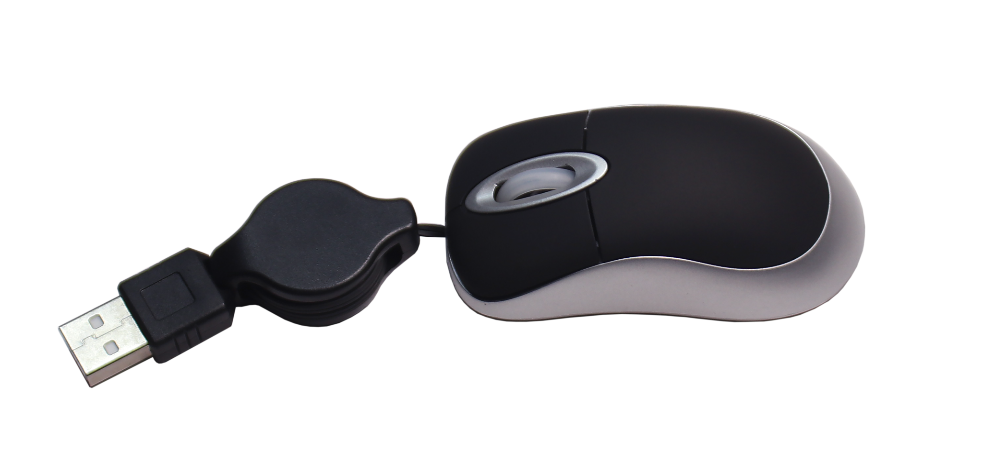
Basic inputs and outputs (IO):
Is the mouse an input or output?
Why?
—
It’s an input, meaning it inputs data from the user or environment to the computer.

Slide 5
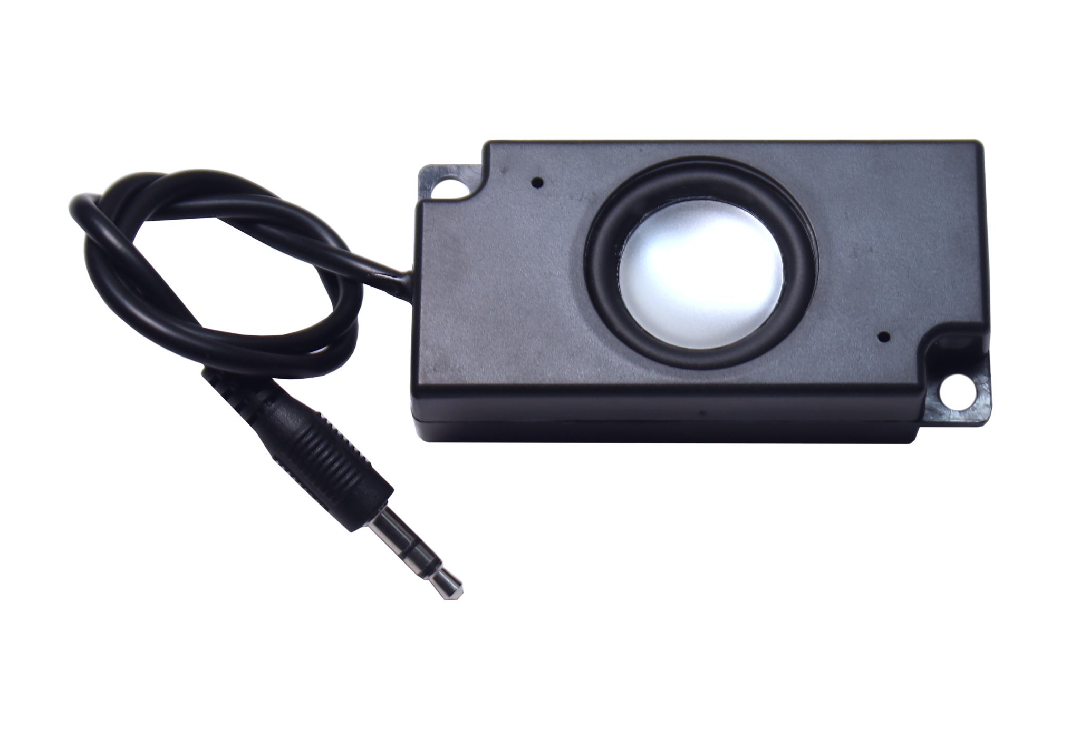
Basic inputs and outputs (IO):
Is the speaker an input or output?
Why?
—
It’s an output, and outputs an audio signal to the user or environment.

Slide 6
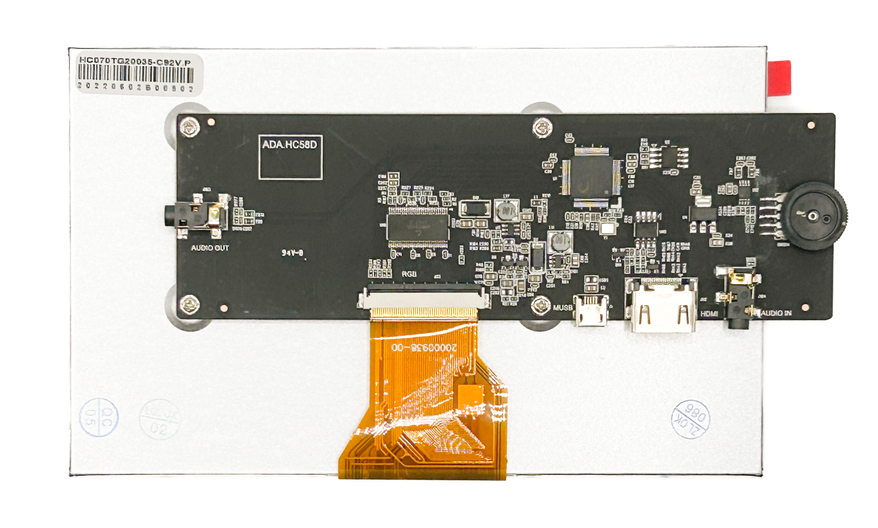
Basic inputs and outputs (IO):
Is the display an input or output?
Why?
—
It’s an output, as it converts electrical video signals from the RPi into color images that the user can see.
The Amplifier boosts the signal’s strength, so we can hear the signal.
?
?
If this was a touchscreen,
what would it be?
What do you think the
amplifier knob does?

Slide 7
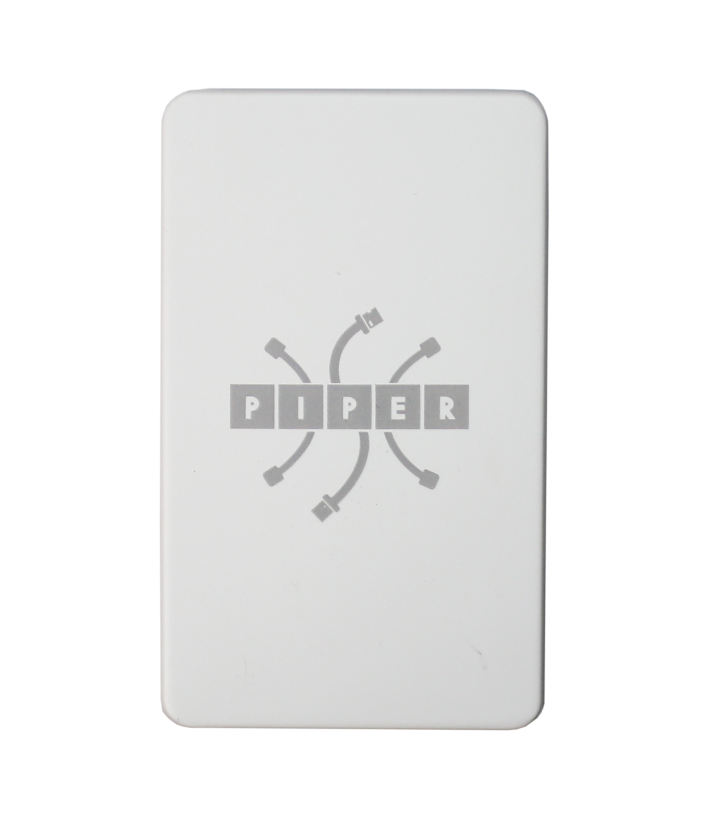
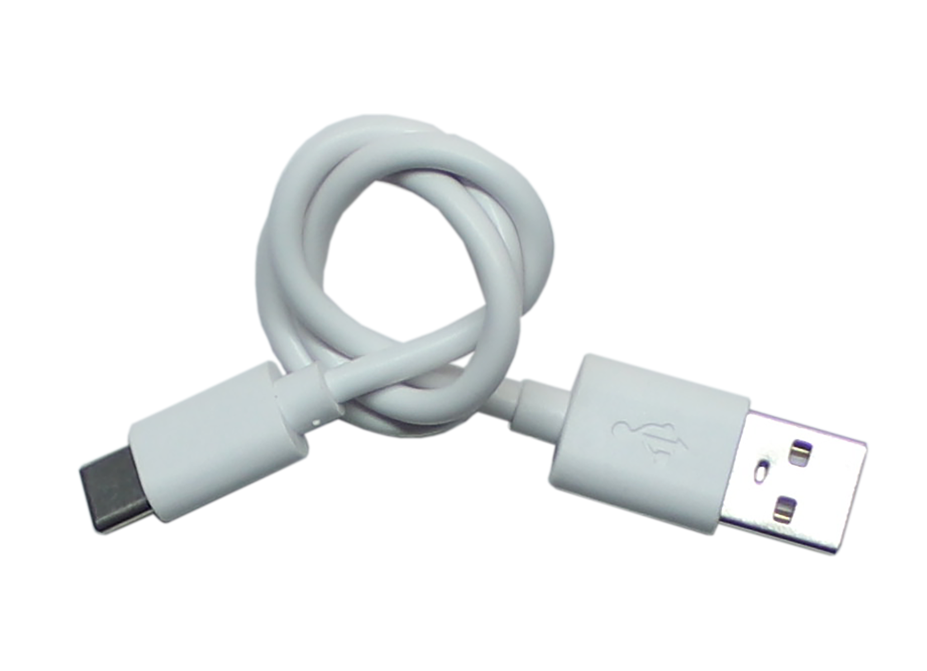
Power Supply
What is this? What does it do?
(older Kits have smaller ones)
—
It’s a Battery, with USB connectors, an on/off button and an LED energy gauge. It directly powers the Display and the RPi.
!
It uses Lithium Ion (Li-ion) cells…
Just like a Tesla.

Slide 8
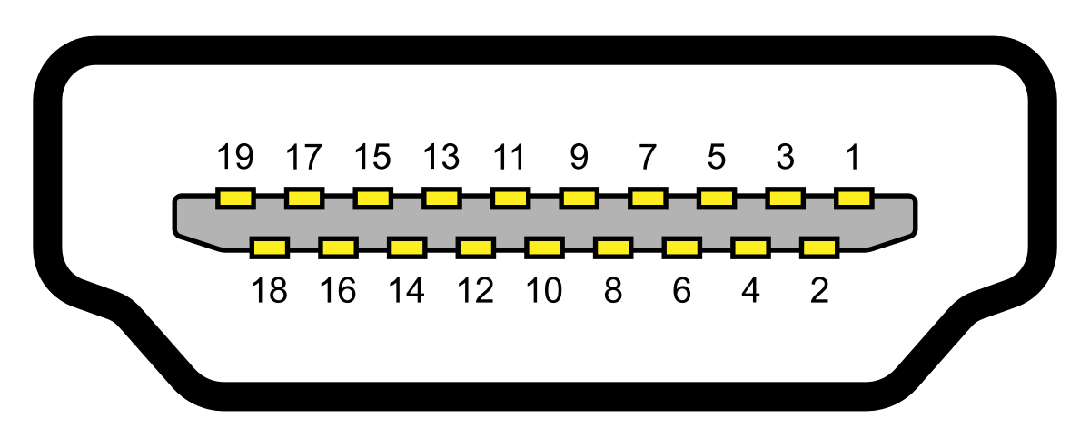
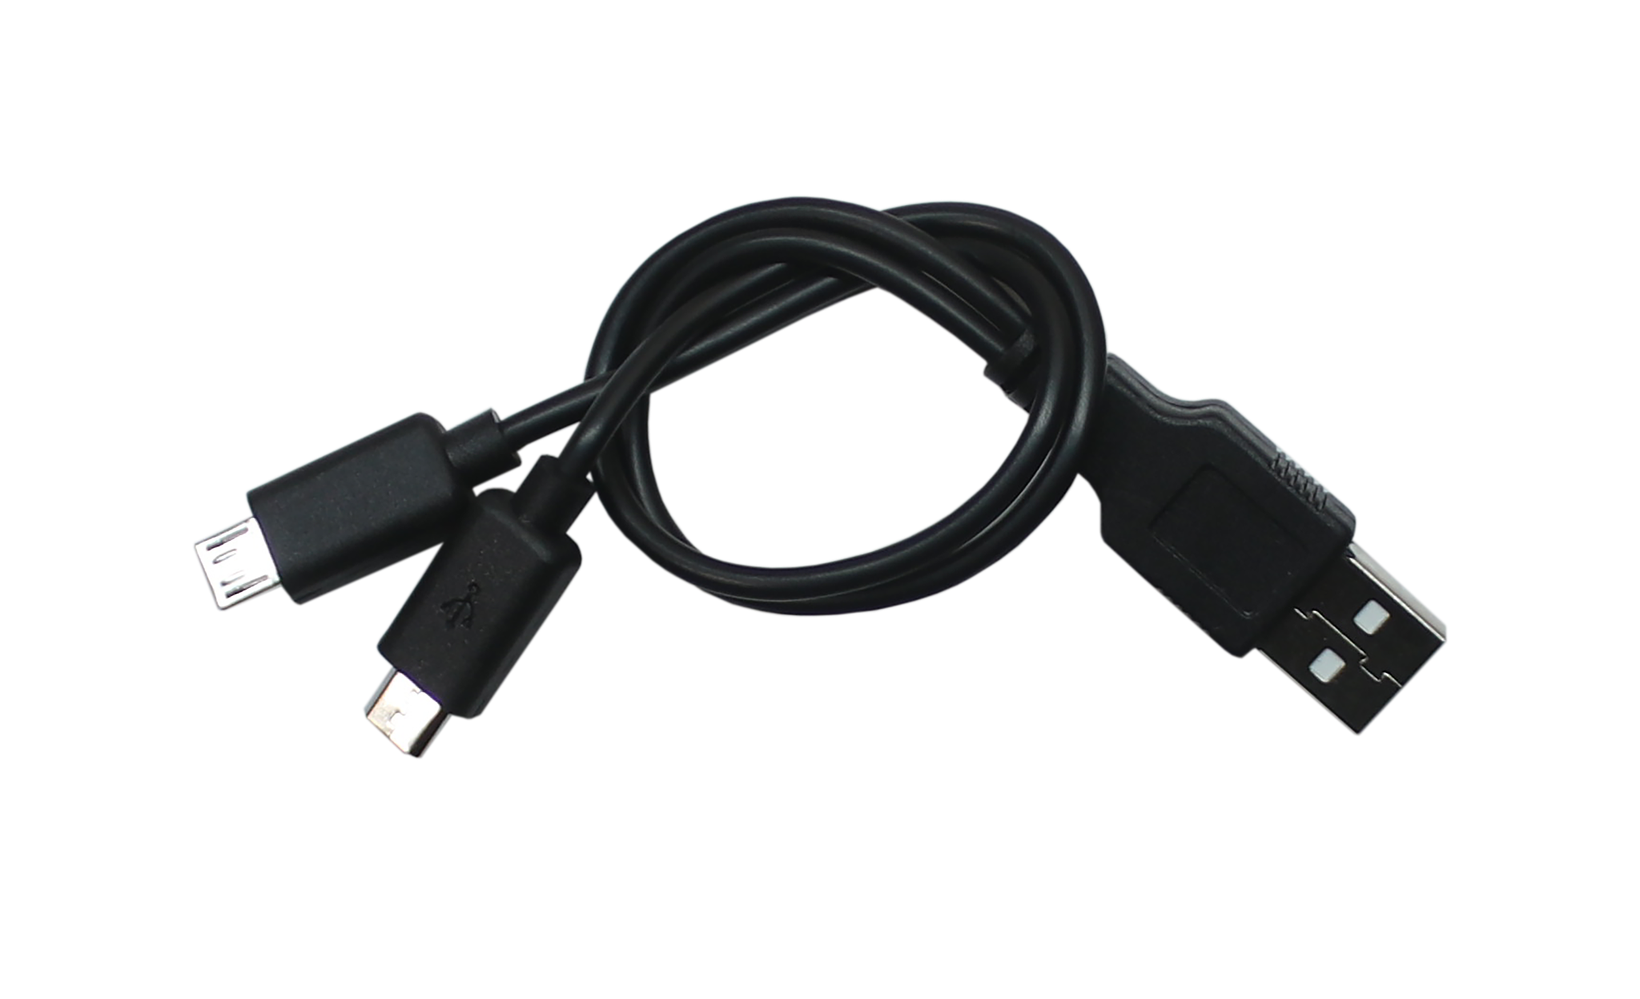
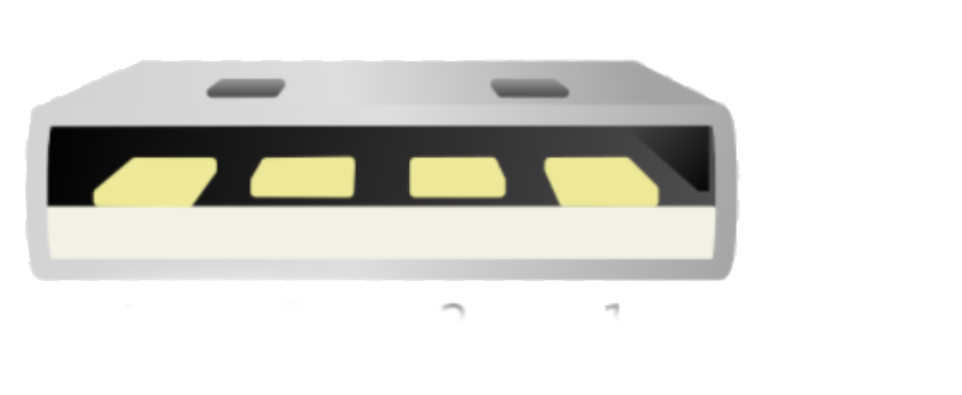
Cables
What are these. How are they different? What’s each one for?
The HDMI* Cable is for Display data. It has 19 connections.
*High Density Multimedia Interface
The Power Harness Cable is for Display & RPi power. It has USB* A and 2 micro USB connectors. USB can connect power AND data, as in the Mouse. It always has 4 connections.
*Universal Serial Bus

Slide 9
SD Card
What’s this? Where does it go? What’s it for?
—
It’s called an SD* Card. It’s not an input or an output, it’s a memory device to store digital files.
It contains the RPi software:
-Raspbian (a Linux OS*)
-Applications, like the R Pi
edition of Minecraft
-Your files
*
SD: secure digital,
OS: operating system

Slide 10
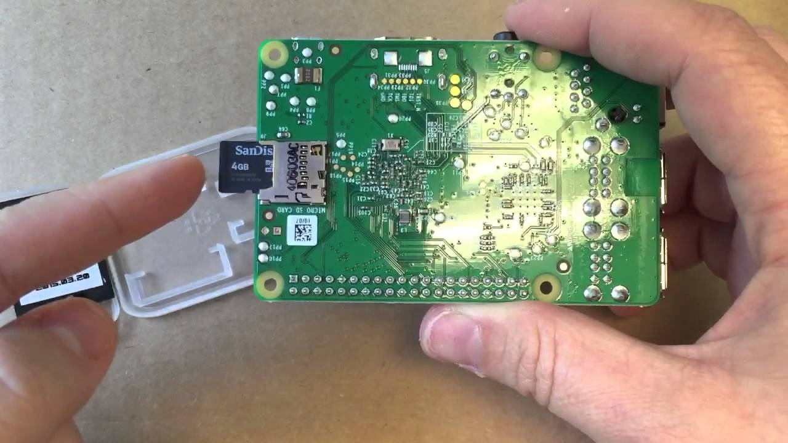
The SD card goes in the RPi SBC, on the bottom.

Slide 11
What’s in the yellow box? What does it do?

Slide 12
CPU
It’s known as a CPU, or Central Processing Unit
—
It actually has several processors, including a CPU and GPU*, and memory. It runs code, including the OS, RPi Edition of Minecraft, and any custom code that uses the GPIO pins.
It’s also called an SOC*, or “chip”.
*
GPU: Graphics Processing
Unit; SOC: System on Chip

Slide 13
What are these pins? What do they do?

Slide 14
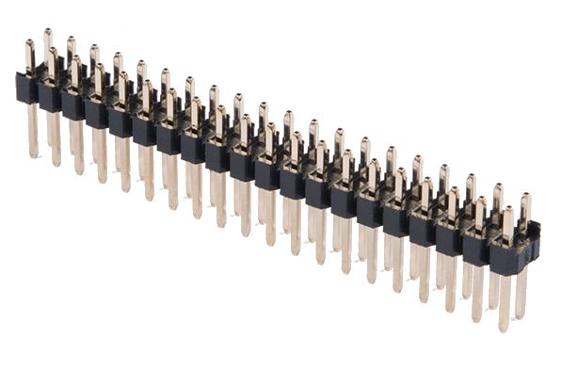
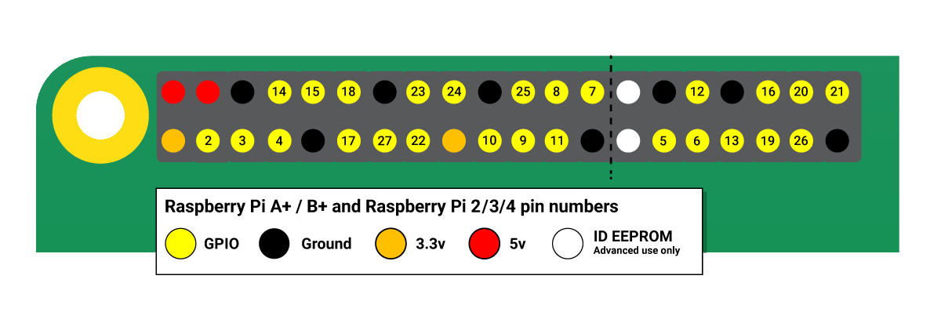
GPIO PINS
They’re generally called header pins, but on the RPi, they’re called GPIO pins.
—
With the coding language Python, each pin can be coded as input (buttons, switches) or output (LEDs, buzzers).
*
GPIO: General Purpose
Input Output

Slide 15
There’s lots more on RPis than the uP and GPIO pins - more than on any laptop, actually.
video and audio
CSI camera
HDMI
micro USB
power
Network
Port
SD Card (underside)
DSI Display
SOC
USB 2.0 (2)
Bluetooth 4.1, Wi-Fi
GPIO pins

Slide 16
What is this? What does it do?

Slide 17
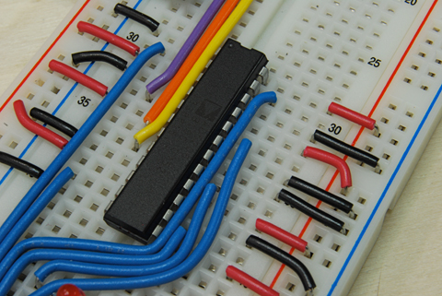
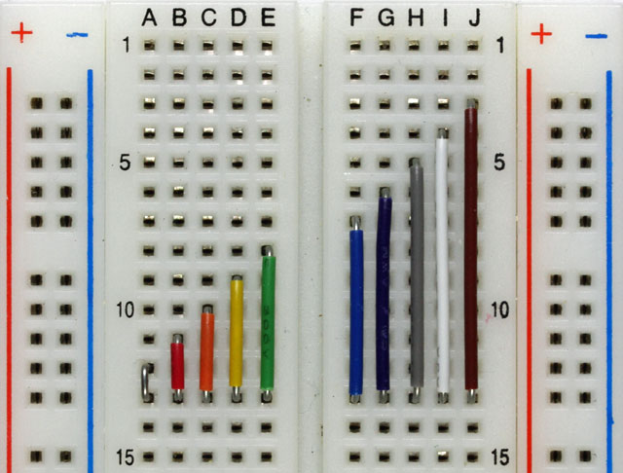
It’s a “breadboard”, also called a wiring or prototype board.

Slide 18
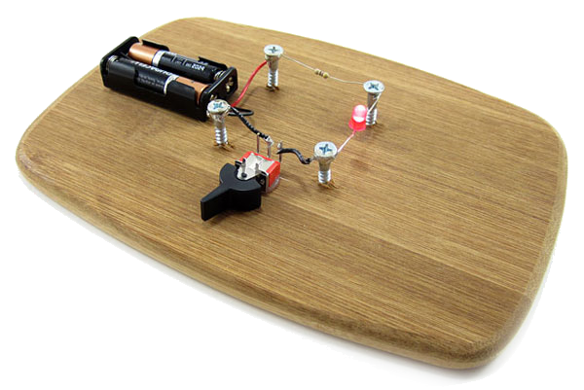
Breadboards
Hearsay is: long ago an inventor borrowed a kitchen* breadboard to build a circuit.
!
The best engineers ask the
kitchen crew before doing this.

Slide 19
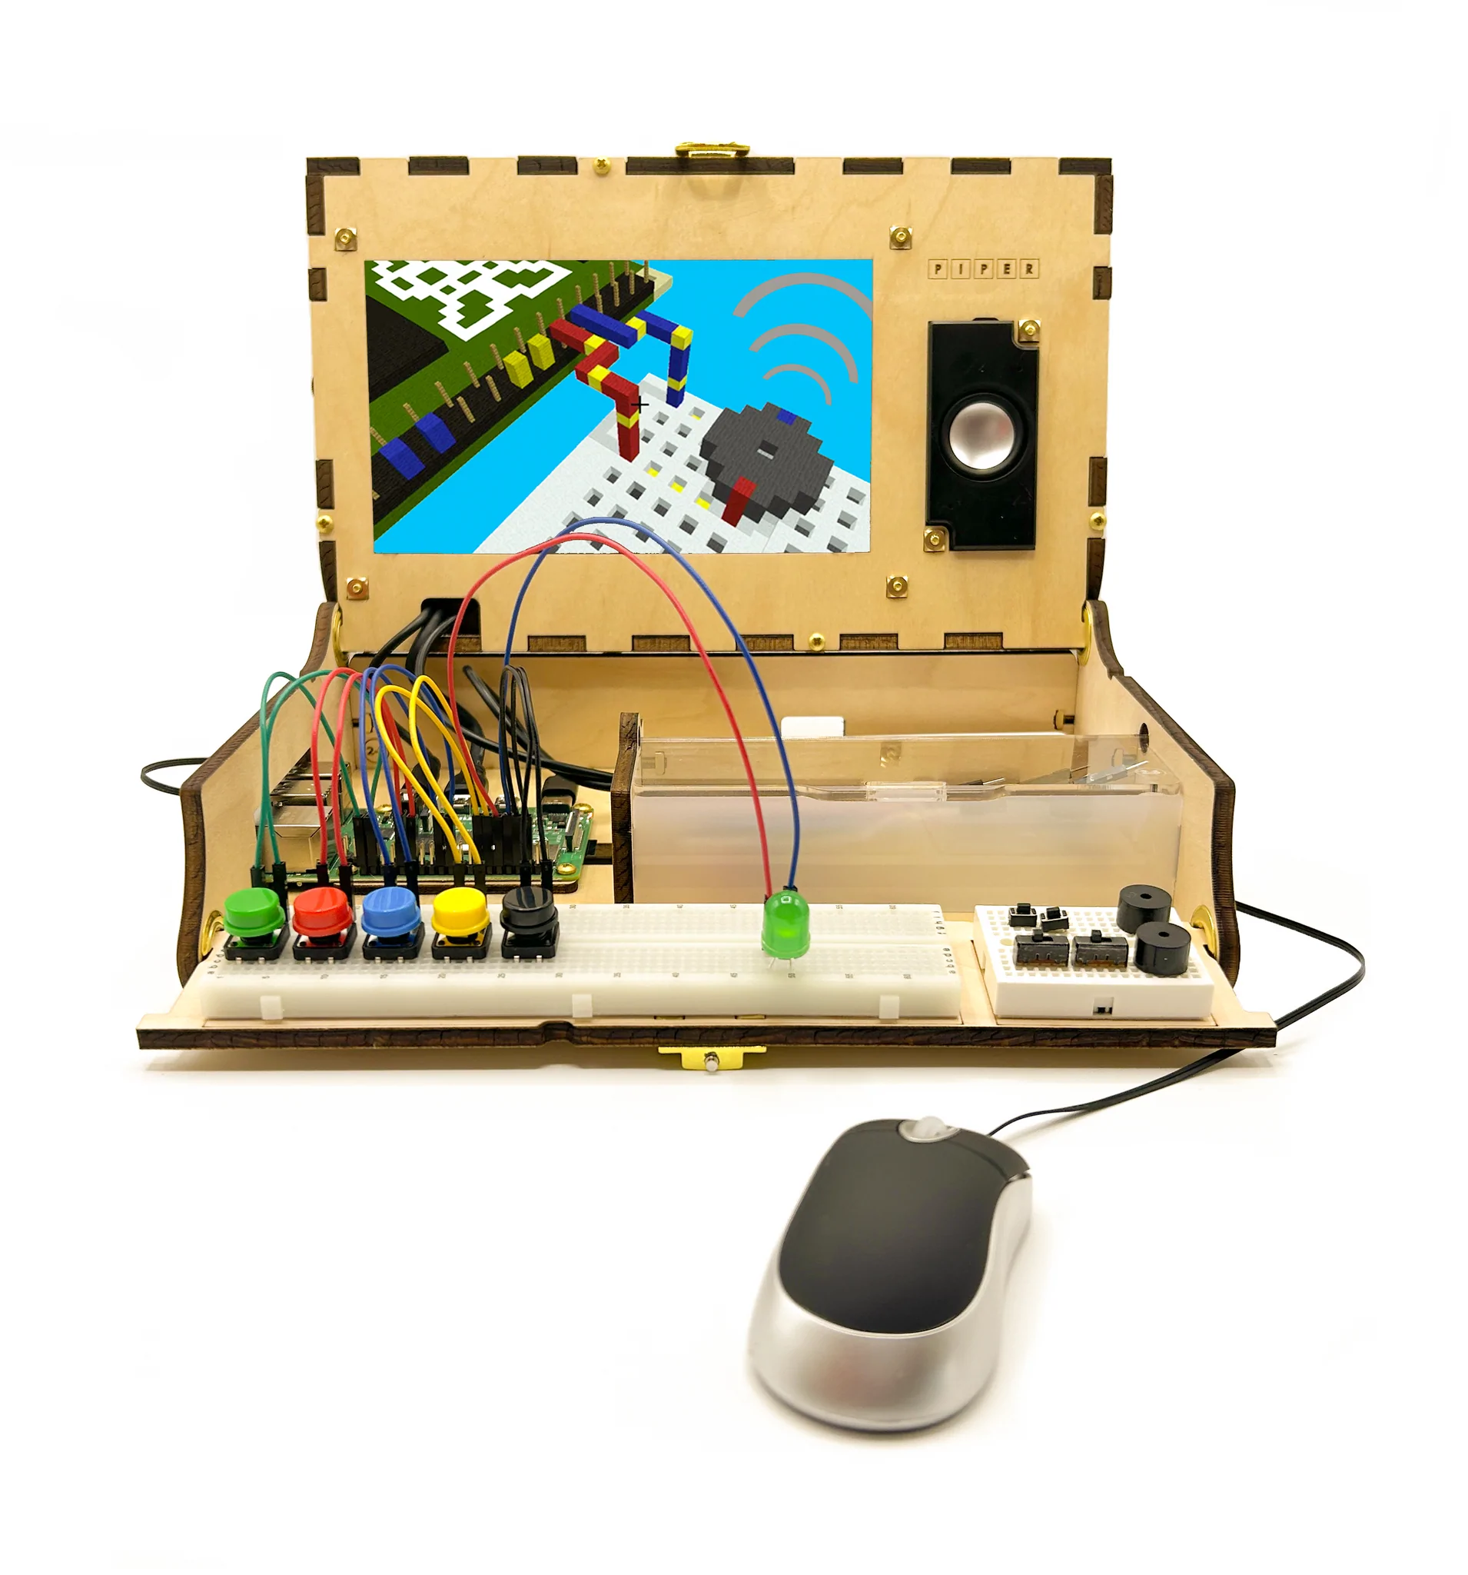
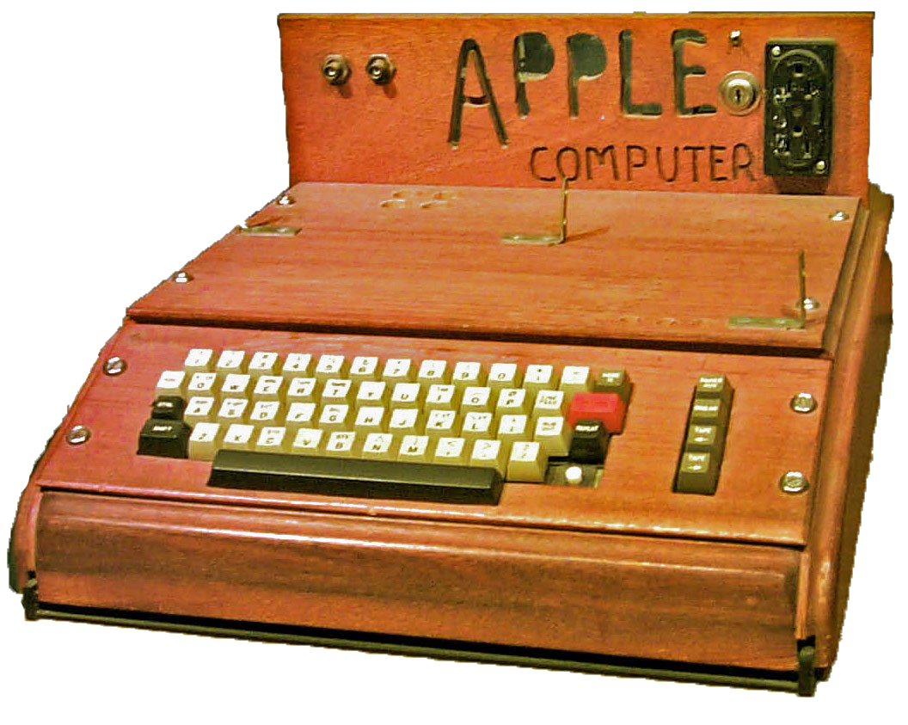
Your Turn!
Together, the battery, basic IO, RPi with its Processor, software, GPIO pins, breadboard, wood case, brass hardware and other components make Piper Computers possible.
!
...Apple’s first computer
used a wood case too.

