Slide 1
PC02 Blueprint Building
Piper Premium Curriculum Lesson 1.2 and 1.3

Slide 2
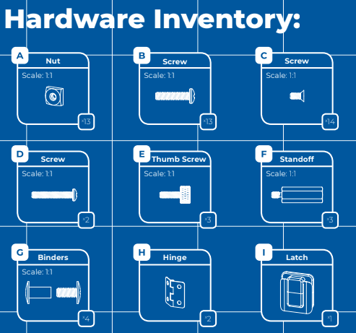
HARDWARE INVENTORY OVERVIEW
Which of these look familiar?
When or where have you seen these before?

Slide 3
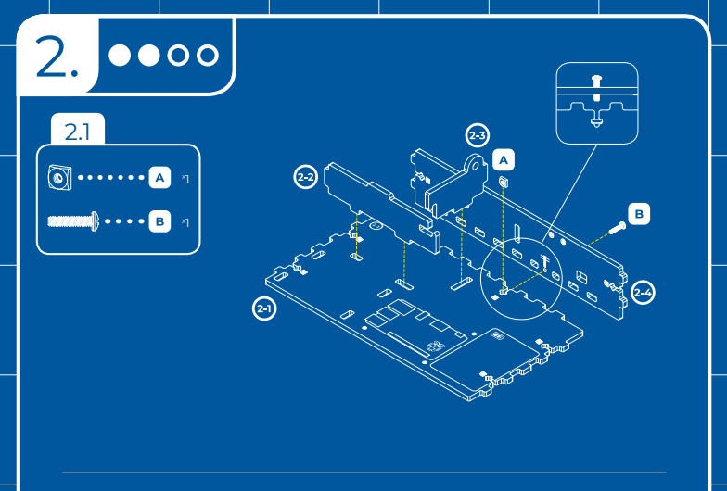
HARDWARE INVENTORY: BUILDING
Identify the hardware for this step.

Slide 4
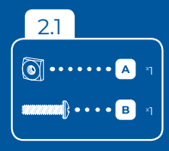
HARDWARE INVENTORY: BUILDING
What are these called?
Have you used these before?
What tool will we need here?
Why do we use these here?

Slide 5
HARDWARE INVENTORY: BUILDING
You screw the bolt into the nut that is held in place by the wooden insert.
Notes:
Potential question: Who knows how to use the screwdriver?

Slide 6
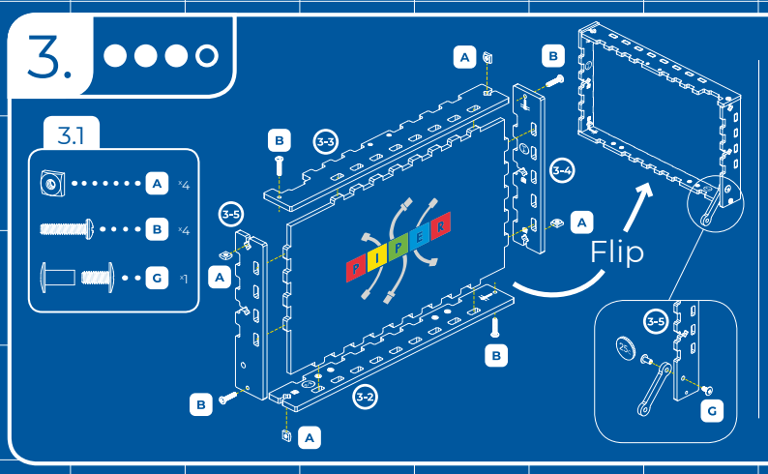
HARDWARE INVENTORY: BUILDING
Identify the hardware for this step.
Notes:
Again, we are guiding students through deciphering the blueprint. You could ask, how many will we need of each tool for this step? What tool should we have handy? Give students enough time to identify where this is located on the blueprint.

Slide 7
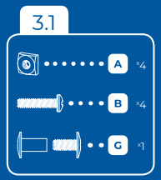
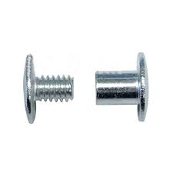
HARDWARE INVENTORY: BUILDING
In this step, we will also be using binders.
What do you think they do?
How are they different from a nut and bolt?
Notes:
Have students focus on the smooth edge of the binder. Why would a smooth edge be useful?
(The next slide will show where the binder is used in building the kit. That might give students a clearer answer to the first question.)

Slide 8
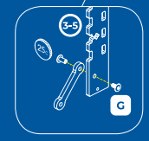
HARDWARE INVENTORY: BINDERS
What tool would you use for the binder?
Why would we use a binder here instead of a nut and bolt to connect the linkage?
Linkage
Notes:
Again, have students focus on the round edge of the binder.
The linkage will allow the kit to open and shut smoothly, so we need a smooth edge around our bolt.

Slide 9
HARDWARE INVENTORY: BUILDING
The blueprint tells us to use a coin.
Why would we use a coin here?
Have you used a coin as a tool before?
Notes:
The coin fits the top of the bolt, so we can use it in the same manner in which we use the screwdriver.

Slide 10
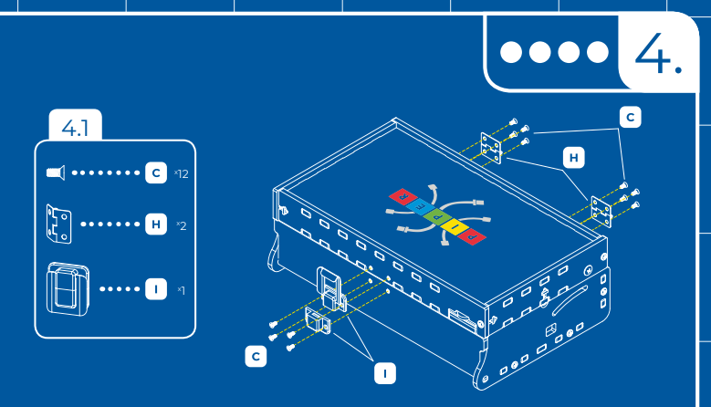
HARDWARE INVENTORY: BUILDING
What are these called?
Have you used these before?
What tool will we need here?
Why do we use these here?
Notes:
The names for all parts are found in the inventory. Give students enough time to identify where this is located on the blueprint.

Slide 11
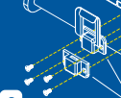
HARDWARE INVENTORY: BUILDING
We will need a screwdriver for this step.
We will screw the bolts into the latch.
What does a latch do?
We will also screw the bolts into the hinge.
What does a hinge do?
Notes:
A latch keeps the Piper Computer closed.
The hinge allows the Piper Computer to open.

Slide 12
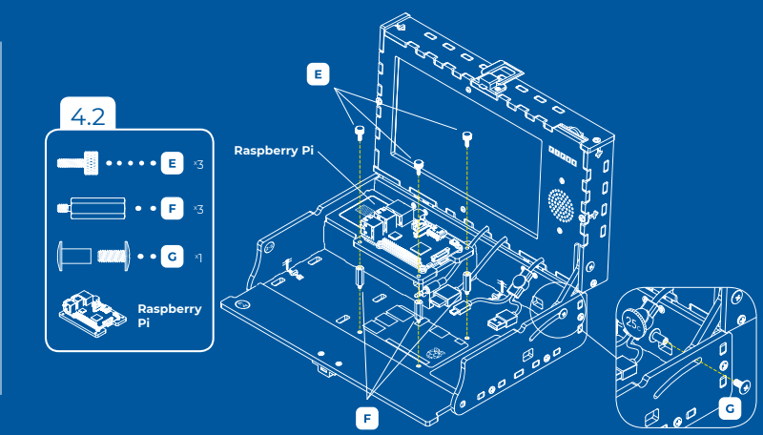
HARDWARE INVENTORY: BUILDING
What are these called?
Have you used these before?
What tool will we need here?
Why do we use these here?
Notes:
The names for all parts are found in the inventory. Give students enough time to identify where this is located on the blueprint.

Slide 13
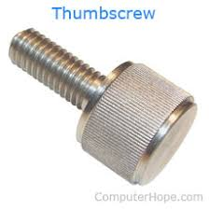
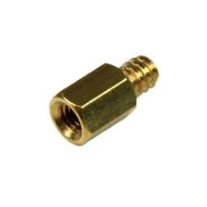
HARDWARE INVENTORY: BUILDING
This is a thumb screw and standoff.
The tool is in the name; we will use our thumbs!
Standoff
Notes:
The names for all parts are found in the inventory. Give students enough time to identify where this is located on the blueprint.

Slide 14
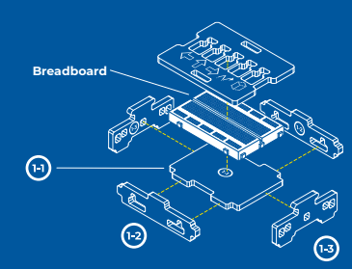
READING THE BLUEPRINT
Describe the steps you would take to complete this item on the blueprint.
How would you put the parts together?
What order would you follow?
How do you know?
Notes:
Guiding discussion: (think-pair-share)
Example: “First, connect 1-1 to 1-2. Then, add 1-3. Then, add the breadboard and the top.”
(This is an incorrect answer because the breadboard will need to go in before 1-3. Kids will experience this and learn from it when they build during Lesson 1.2.)

Slide 15
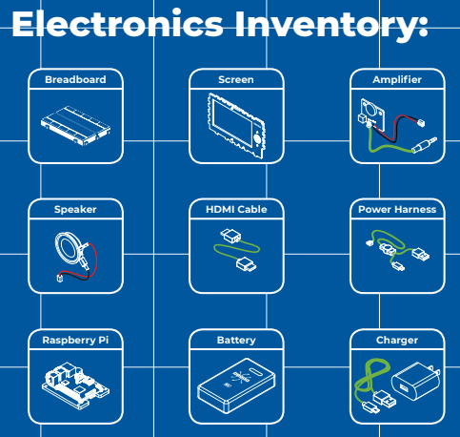
ELECTRONICS INVENTORY OVERVIEW
Which of these look familiar?
When or where have you seen these before?

Slide 16
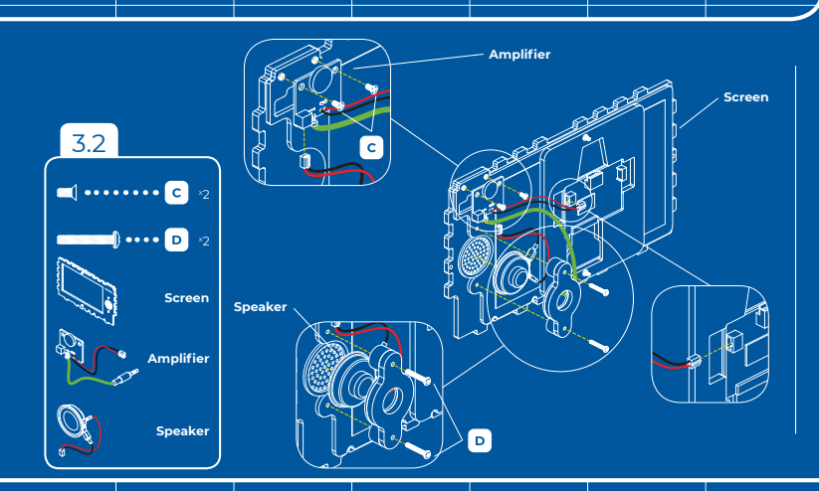
ELECTRONICS INVENTORY OVERVIEW
Which of these look familiar?
Identify the hardware and electronics for this step.
Notes:
The names for all parts are found in the inventory. Give students enough time to identify where this is located on the blueprint.
Have students share where they’ve seen or worked with the components.

Slide 17
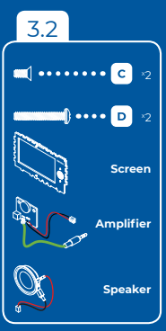
Inventory: Building with Electronics
Have you ever built a screen, amplifier or speaker?
What do you think are the red and black lines in the drawing?
Does the green line look familiar?
Notes:
The lines are cables.
Have students consider headphones or an auxiliary cable for the green cable. Does the end of the green cable look familiar?

Slide 18
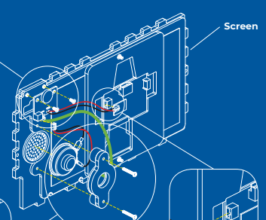
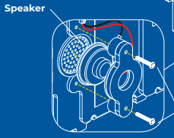
Inventory: Building with Electronics
Inventory:
Why does a computer need a speaker?
What does a speaker do?
How does it work?
Speaker
Notes:
The blueprint labels the speaker and where it is located on the screen.
Students will dive deeper into how a speaker works during Lesson 1.4.

Slide 19
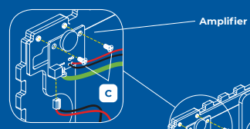
Inventory: Building with Electronics
Inventory:
What does an amplifier do?
Why would a computer need an amplifier?
Why is the amplifier wired up to the speaker?
Amplifier
Notes:
Guide students through this slide with the following questions:
What word do you recognize in amplifier? (Potential answer: “amplify” which generally means to make bigger. In this case, it would be adding energy to the sound wave produced so that more air particles are vibrating resulting in us hearing a louder sound)
How are amplifiers used? (Potential answer: when it comes to sound, amplifiers are used to control the audio signal emitted by the speaker)
What will the amplifier in the Piper computer allow us to do? (answer: control the volume)
What are other examples of amplifiers controlling speakers? (Hint: think about your phone.)

Slide 20
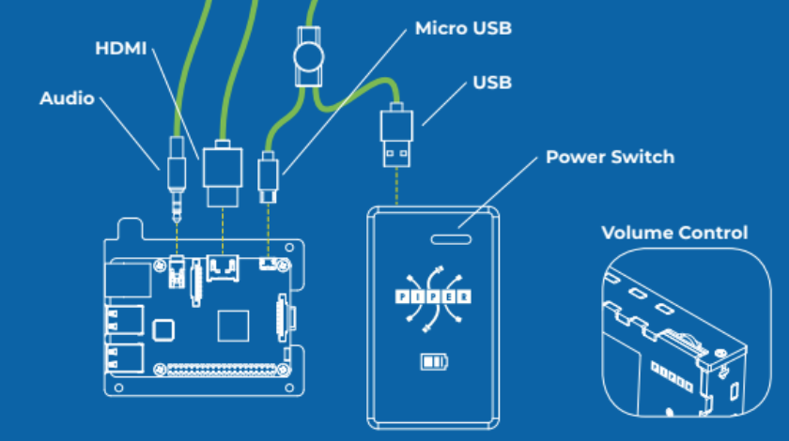
Inventory: Making Connections
Inventory:
Can you identify the green cables?
Where else have you seen these cables?
What do you think would happen if we didn’t connect the HDMI cable?
What do you think would happen if we didn’t connect the Audio?
Notes:
Students will be connecting these cables during Lesson 1.4. This slide is an introduction to connections within a system.

Slide 21
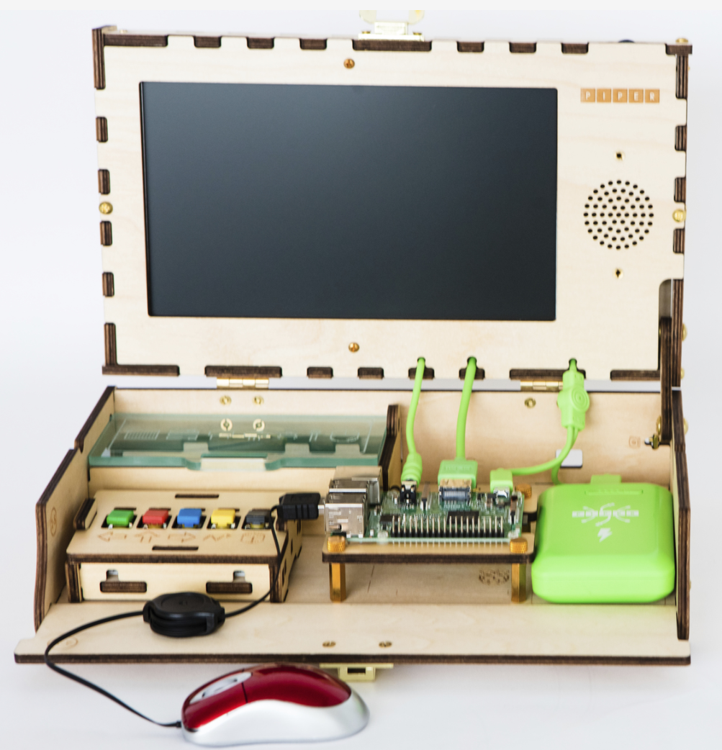
Your finished product will look something like this by the end of our building experience.
Are you ready?!
Notes:
The coin fits the top of the bolt, so we can use it in the same manner in which we use the screwdriver.

