Slide 1
PC03 Blueprint Building
Piper Premium Curriculum Lesson 1.2 and 1.3

Slide 2
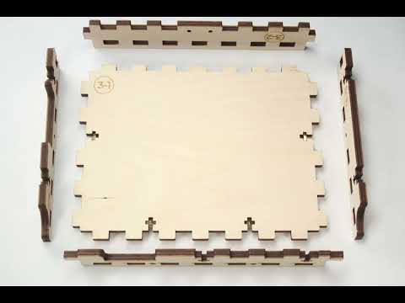
WATCH THE BUILD
IN PREP

Slide 3
OVERVIEW
MECHANICAL INVENTORY
Which of these look familiar? When or where have you seen these before?

Slide 4
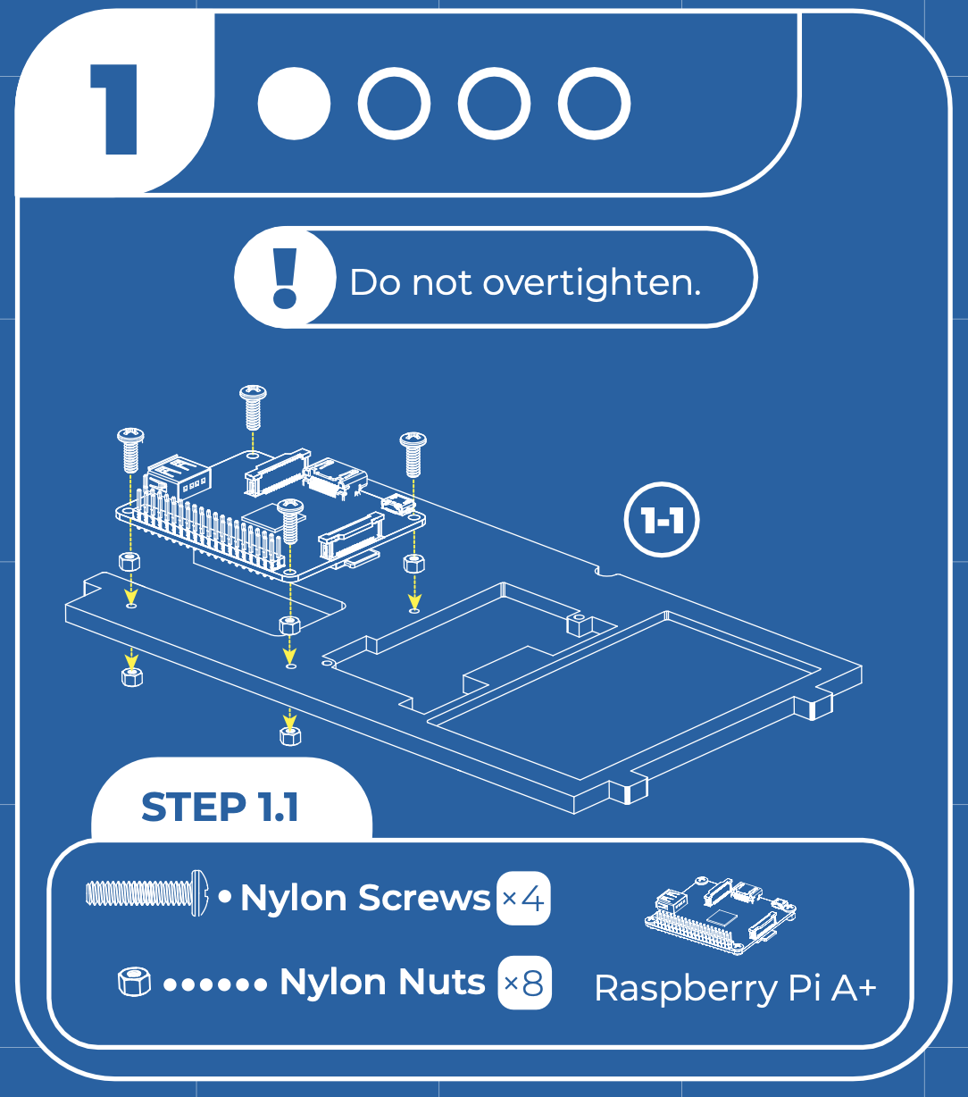
STEP 1 BUILD
MECHANICAL INVENTORY
Identify the hardware for this step.

Slide 5
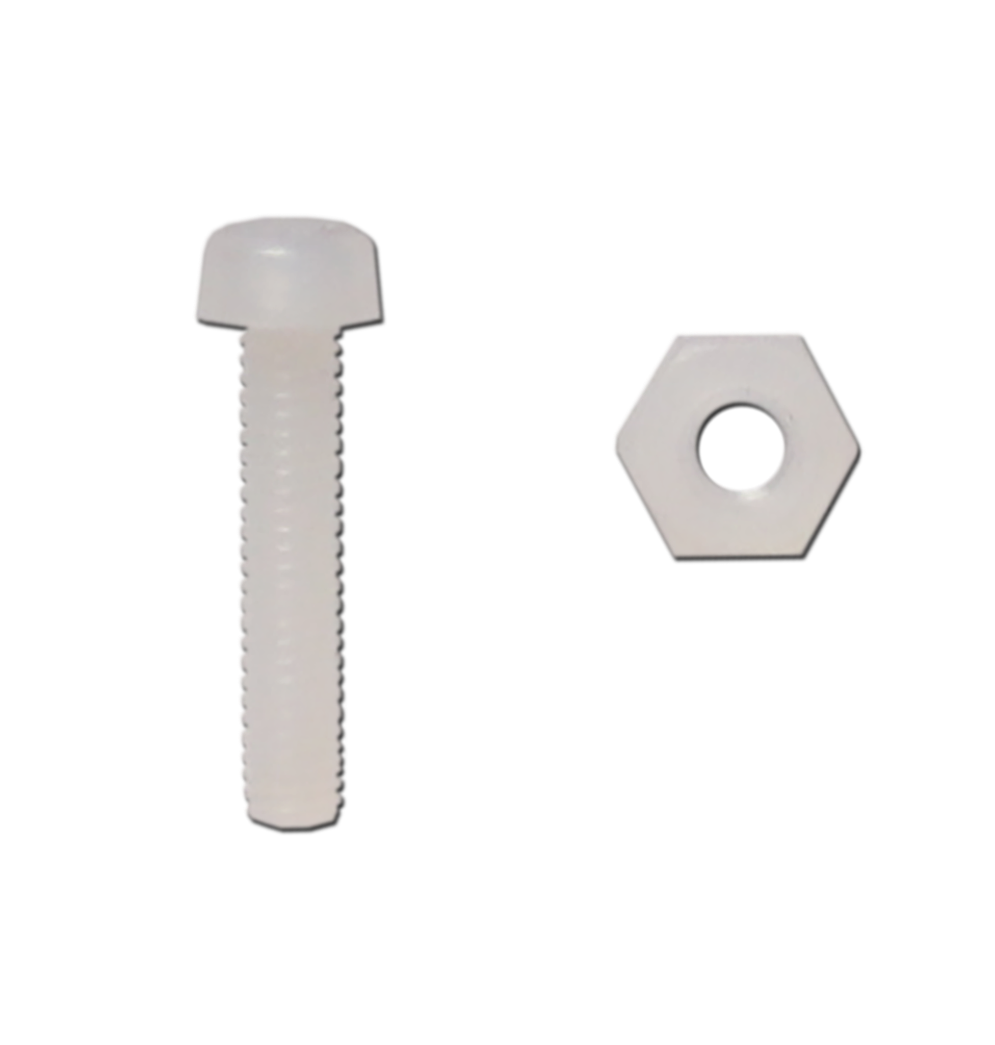
STEP 1.1
MECHANICAL INVENTORY
What are these called?
Have you used these before?
What tool will we need here?
Why do we use these here?
Notes:
The names for all parts are found in the inventory. Give students enough time to identify where this is located on the blueprint.
The nut and bolt can be seen in this box. Students should identify how many they will need of each in order to complete every step.

Slide 6
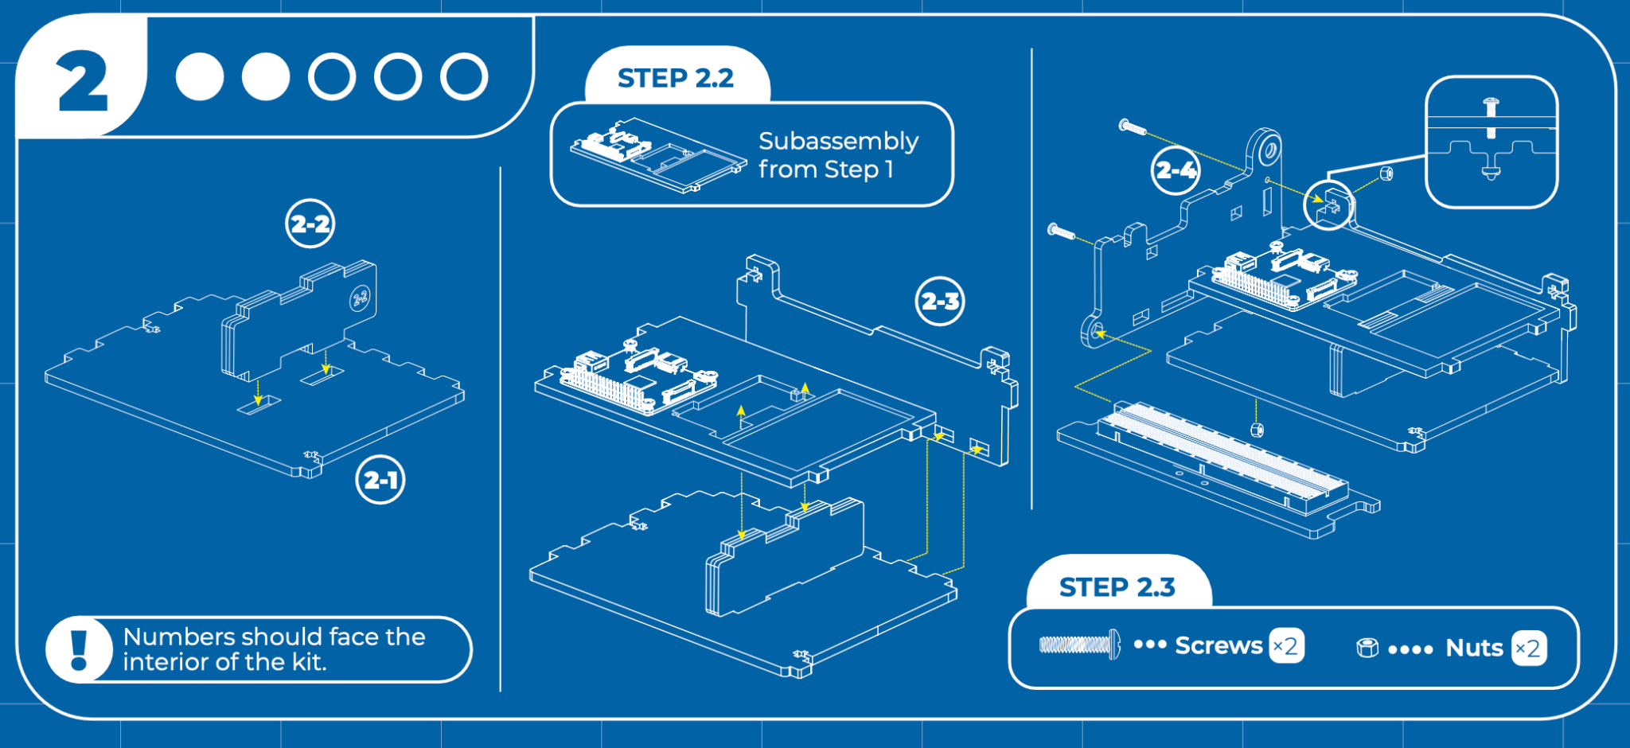
STEP 2
MECHANICAL INVENTORY
In this step, you will assemble the base, including the breadboard that flips out and the cubby where the drawer will fit in!
Notes:
Note that piece 2-2 actually has a magnet contained within the three pieces of wood glued together! This allows the drawer to be held in place at the end of the build. As a fun exercise, put the drawer next to this piece, and demonstrate how this works.

Slide 7
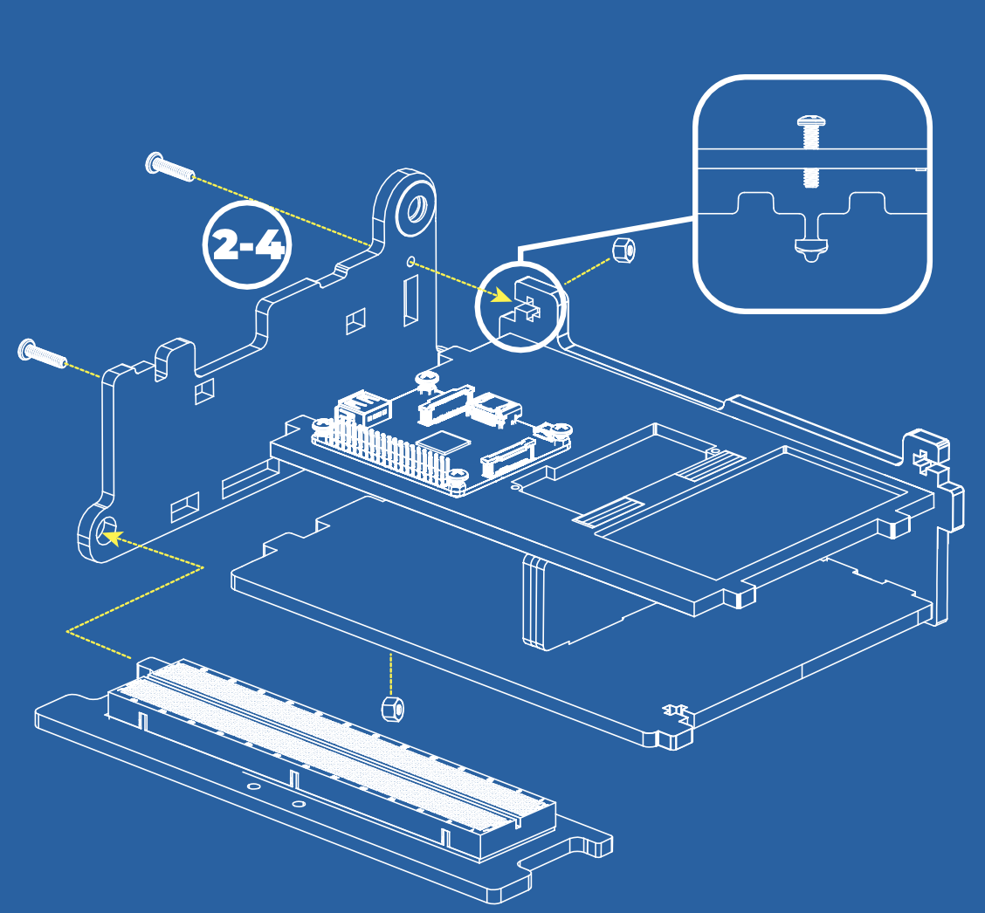
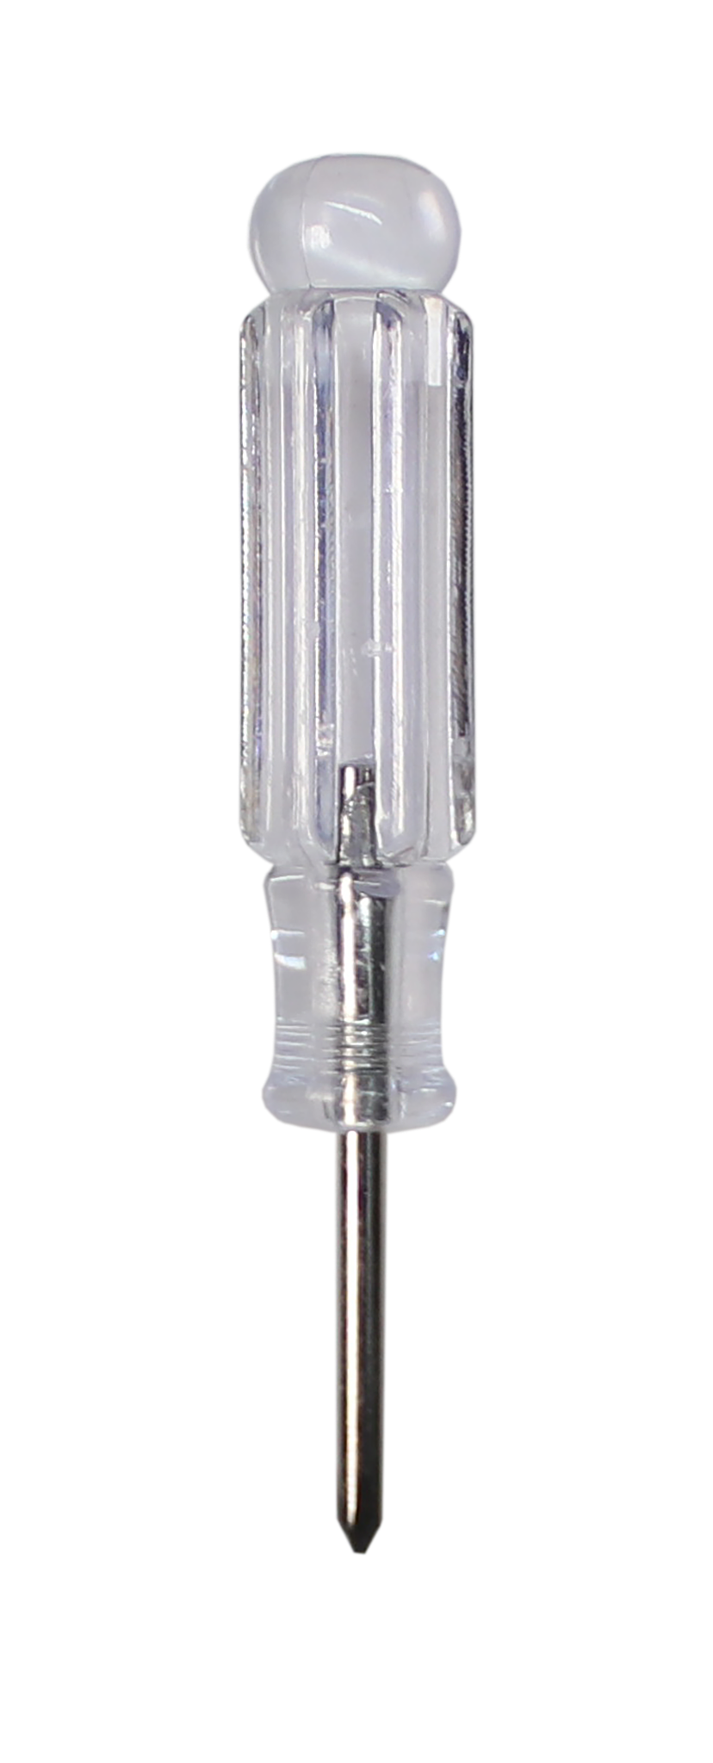
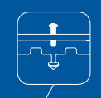
STEP 2.3
MECHANICAL INVENTORY
You screw the bolt into the nut that is held in place by the wooden insert.
Notes:
The names for all parts are found in the inventory. Give students enough time to identify where this is located on the blueprint.
The nut and bolt can be seen in this box. Students should identify how many they will need of each in order to complete every step.

Slide 8
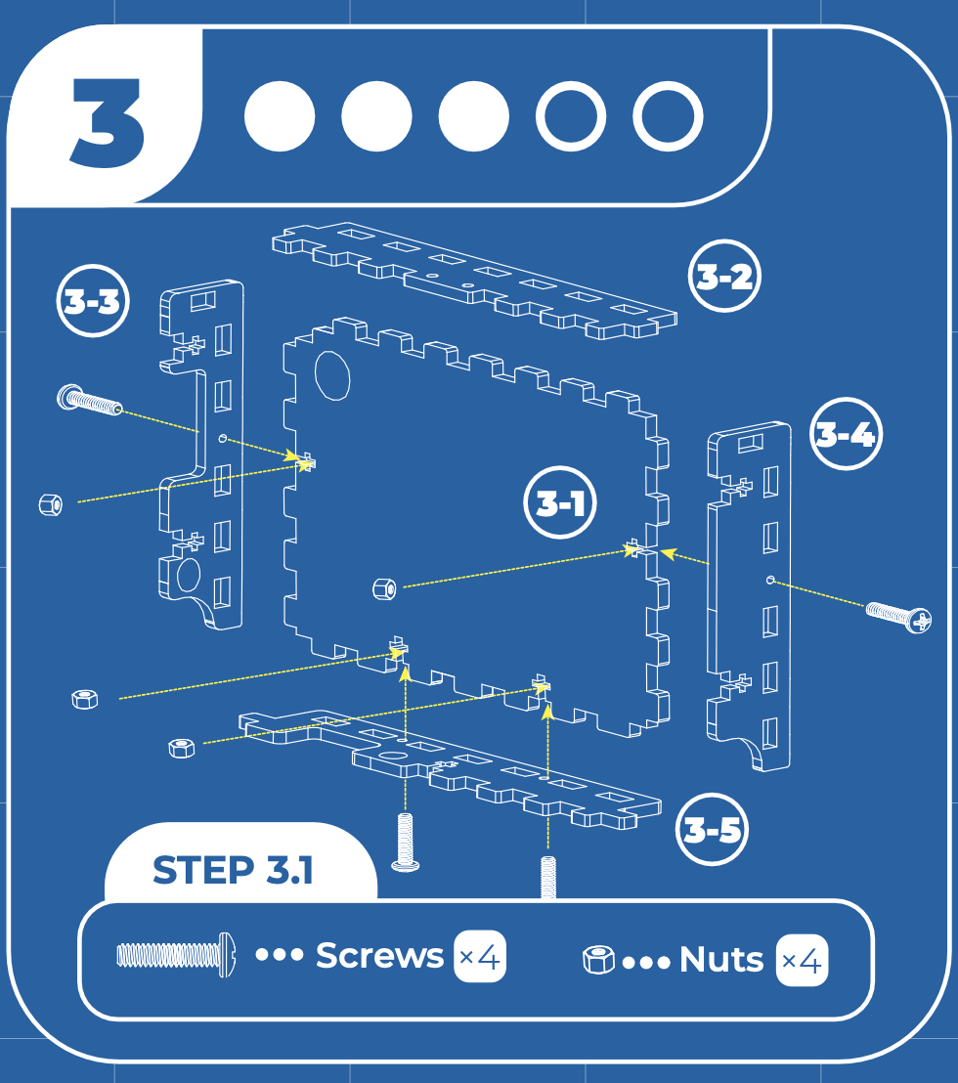
STEP 3
MECHANICAL INVENTORY
NOTE: The etched numbers should face inwards!
You screw the bolt into the nut that is held in place by the wooden insert.
Notes:
Again, we are guiding students through deciphering the blueprint. You could ask, how many will we need of each tool for this step? What tool should we have handy? Give students enough time to identify where this is located on the blueprint.

Slide 9
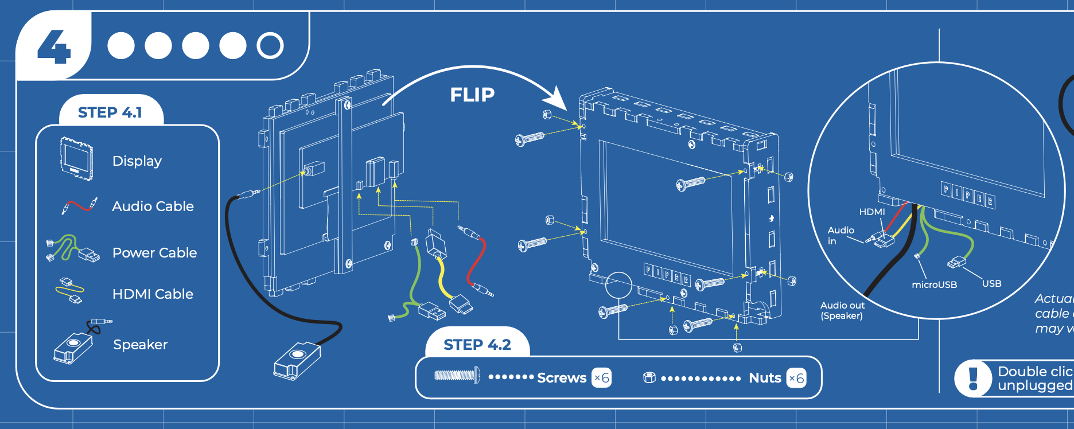
STEP 4
MECHANICAL INVENTORY
In this step, you will set up all the electronic components for your build. Which of these components do you recognize?
Notes:
Again, we are guiding students through deciphering the blueprint. You could ask, how many will we need of each tool for this step? What tool should we have handy? Give students enough time to identify where this is located on the blueprint.

Slide 10
OVERVIEW
ELECTRONICS INVENTORY
Which of these look familiar? When or where have you seen these before?

Slide 11
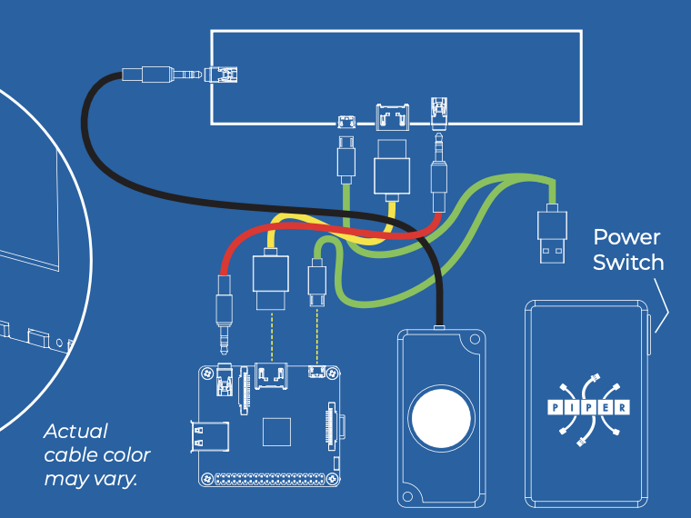
MAKING CONNECTIONS
ELECTRONICS INVENTORY
Can you identify the cables?
Where else have you seen these cables?
What do you think would happen if we didn’t connect the HDMI cable?
What do you think would happen if we didn’t connect the Audio?
Notes:
Double click the power button on the power bank to turn off – keep the battery UNPLUGGED when the kit is not in use.

Slide 12
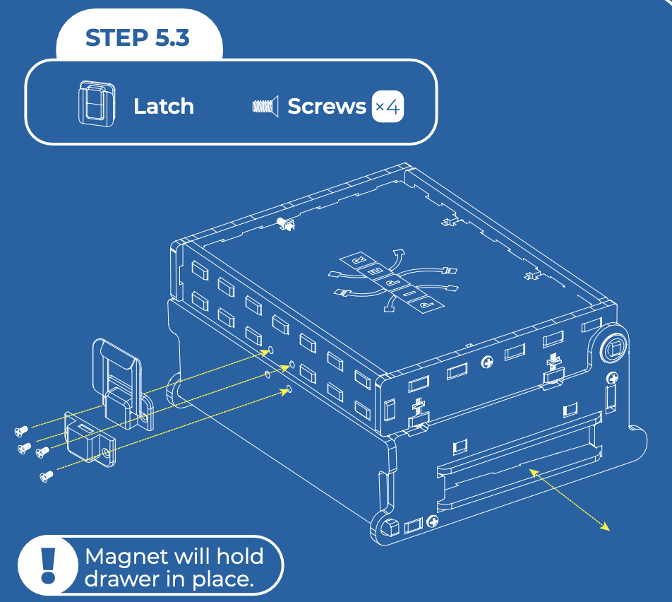
STEP 5.3
MECHANICAL INVENTORY
What are these called?
Have you used these before?
What tool will we need here?
Why do we use these here?
Notes:
The names for all parts are found in the inventory. Give students enough time to identify where this is located on the blueprint.

Slide 13
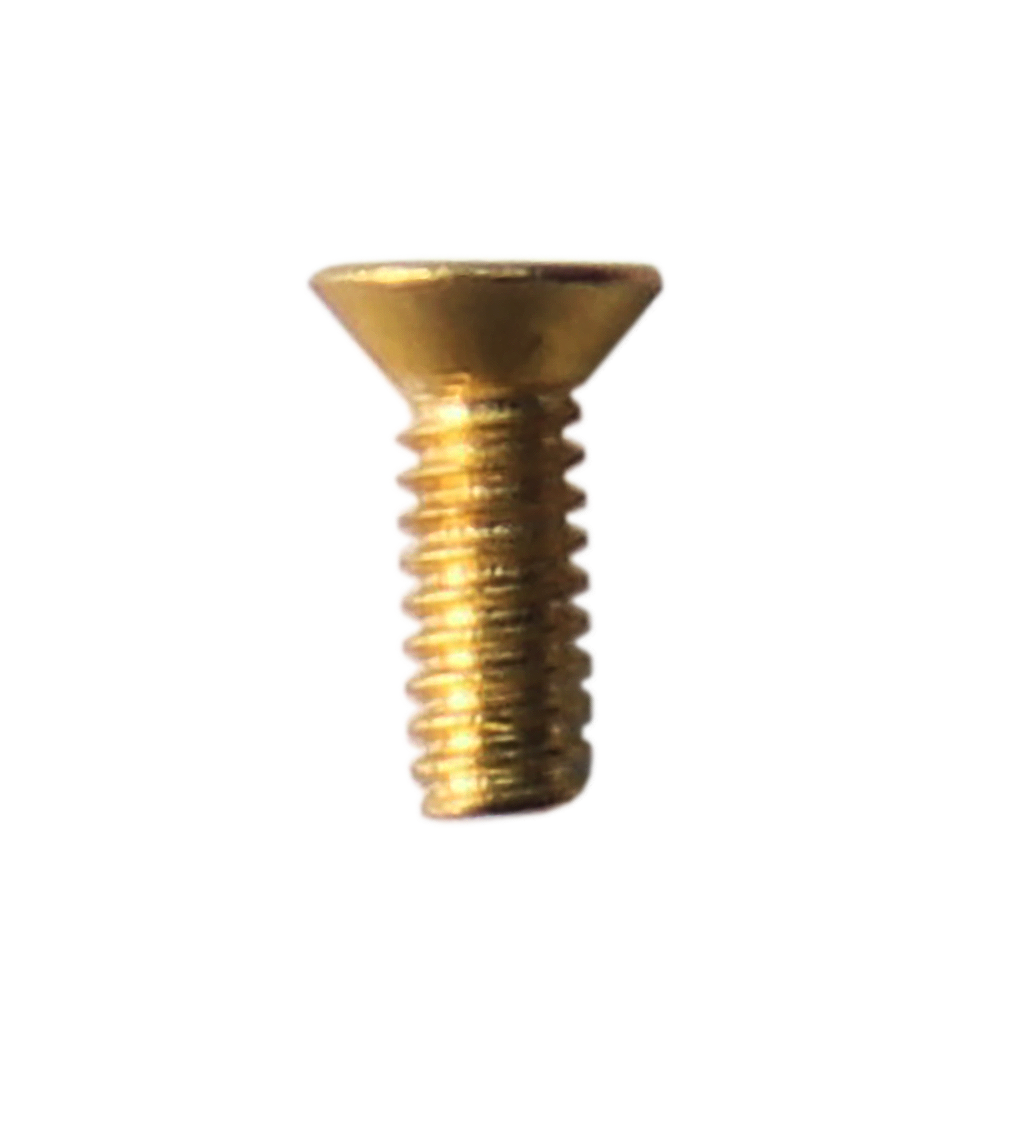
STEP 5.3
MECHANICAL INVENTORY
Note these screws are flat headed and slightly smaller:
We will screw the bolts into the latch. What does a latch do?
We will also screw the bolts into the hinge. What does a hinge do?
Notes:
A latch keeps the Piper Computer closed.
The hinge allows the Piper Computer to open.

Slide 14
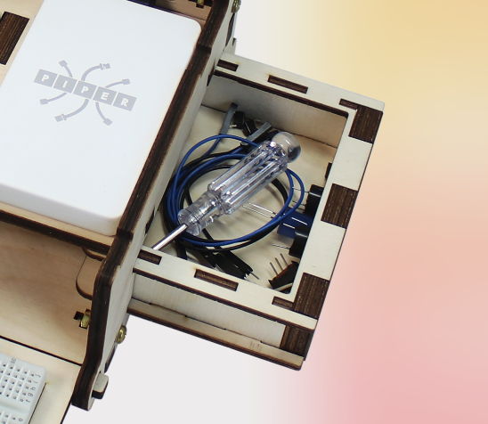
THE DRAWER
MECHANICAL INVENTORY
The magnetic drawer slides into place! The magnet from step 2 will hold the drawer in place so it doesn’t slide out.
Notes:
The drawer is a great storage solution to make sure that the hardware pieces stay with the kit.

Slide 15
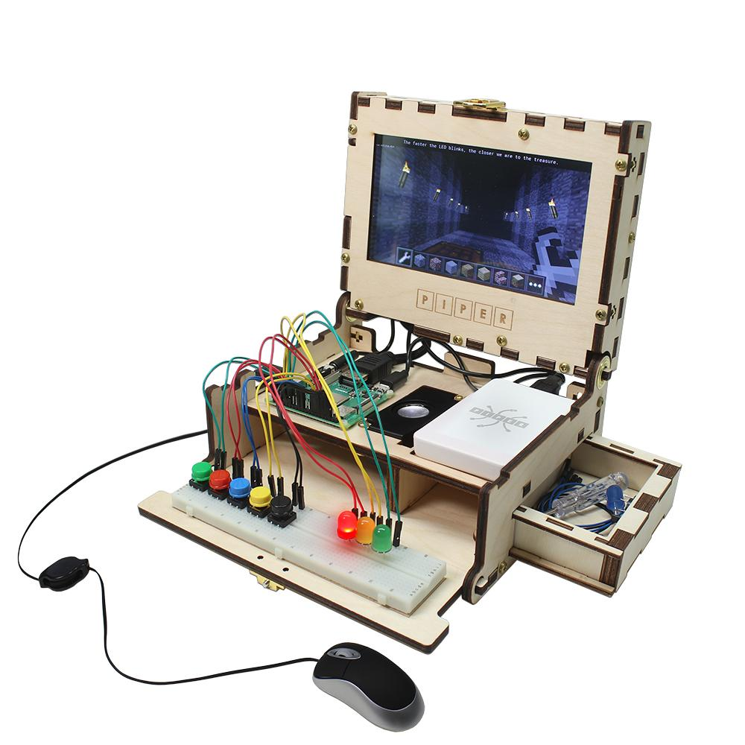
ARE YOU READY?
Your finished product will look something like this by the end of our building experience.
Notes:
Note: Students don’t need to add buttons on the breadboard. (Buttons are a part of Phase 2)
As you wrap up the slideshow, review what students completed for the first column of their visual organizer. They will be using their answers to guide the building of the kits during Lessons 1.2 and 1.3.

