Slide 1
PC04 Blueprint Building
Piper Premium Curriculum Lesson 1.2 and 1.3

Slide 2
WATCH THE BUILD
IN PREP

Slide 3
OVERVIEW
MECHANICAL INVENTORY
Which of these look familiar? When or where have you seen these before?

Slide 4
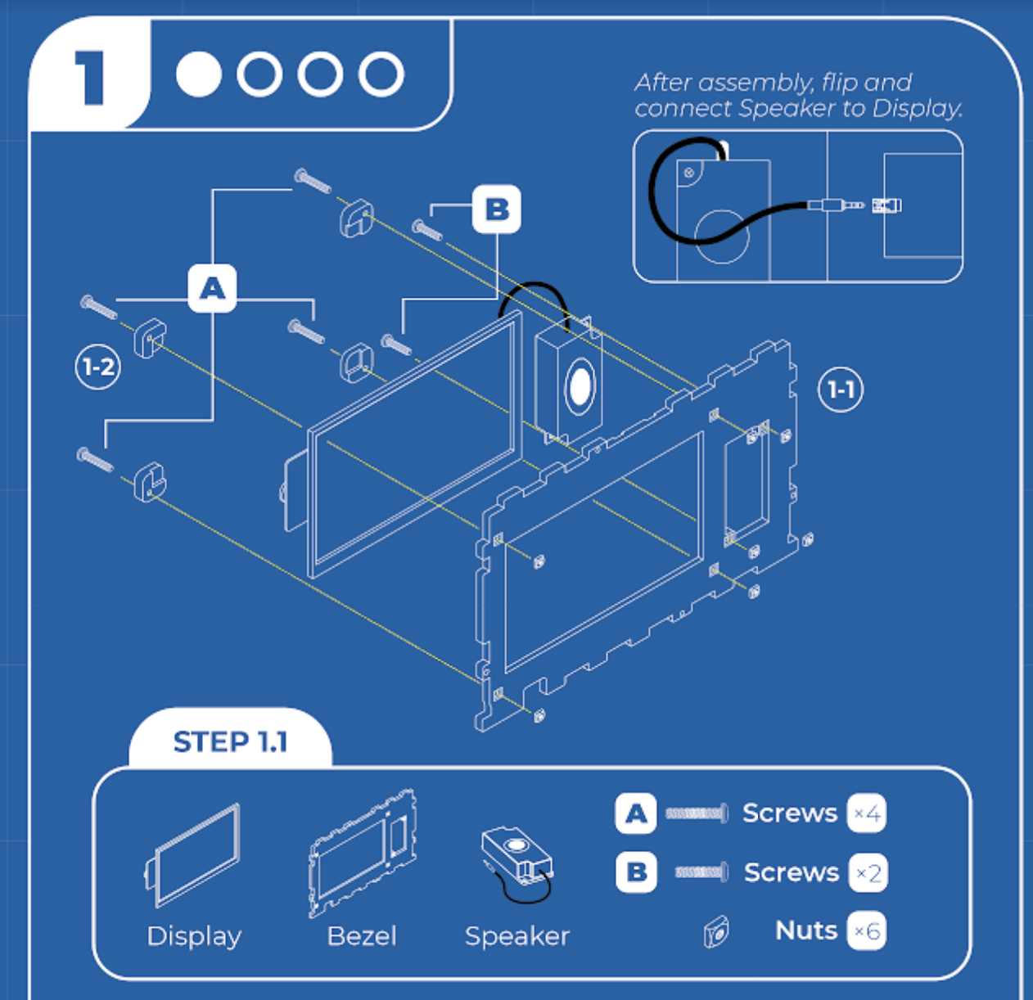
STEP 1 BUILD
MECHANICAL INVENTORY
Identify the hardware for this step.

Slide 5
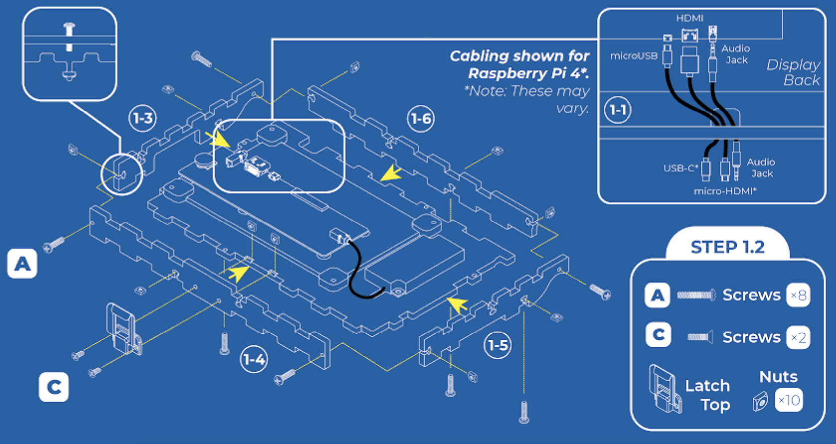
STEP 1.2
Hint: You might find it easier to add the wiring BEFORE you screw the sides on
LET’S START WITH THE CABLES.
ELECTRONICS INVENTORY
Notes:
The names for all parts are found in the inventory. Give students enough time to identify where this is located on the blueprint.
The nut and bolt can be seen in this box. Students should identify how many they will need of each in order to complete every step.

Slide 6
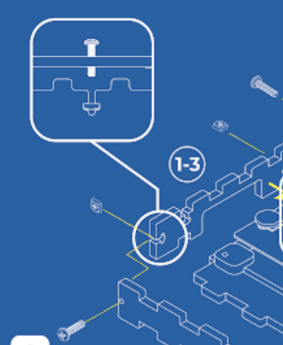
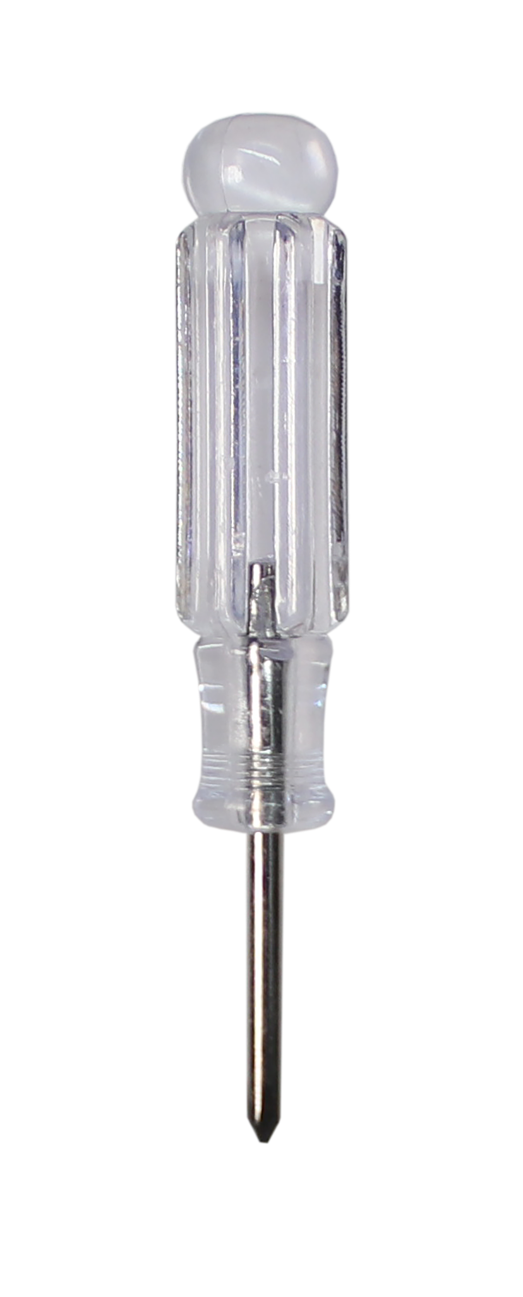
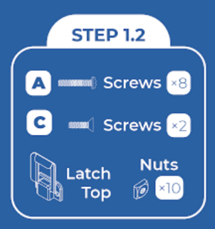
STEP 1.2
MECHANICAL INVENTORY
You screw the bolt into the nut that is held in place by the wooden insert.
Notes:
The names for all parts are found in the inventory. Give students enough time to identify where this is located on the blueprint.
The nut and bolt can be seen in this box. Students should identify how many they will need of each in order to complete every step.

Slide 7
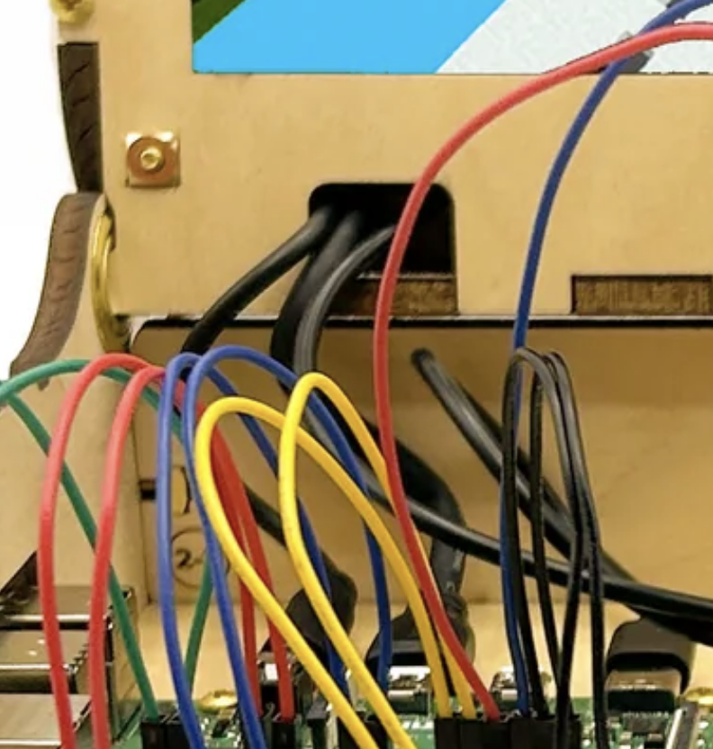
STEP 1.2
What is the order that you will have to put the pieces together?
Hint: Put the ends of the wires through little slot in red shown.
MECHANICAL INVENTORY
Notes:
The names for all parts are found in the inventory. Give students enough time to identify where this is located on the blueprint.
The nut and bolt can be seen in this box. Students should identify how many they will need of each in order to complete every step.

Slide 8
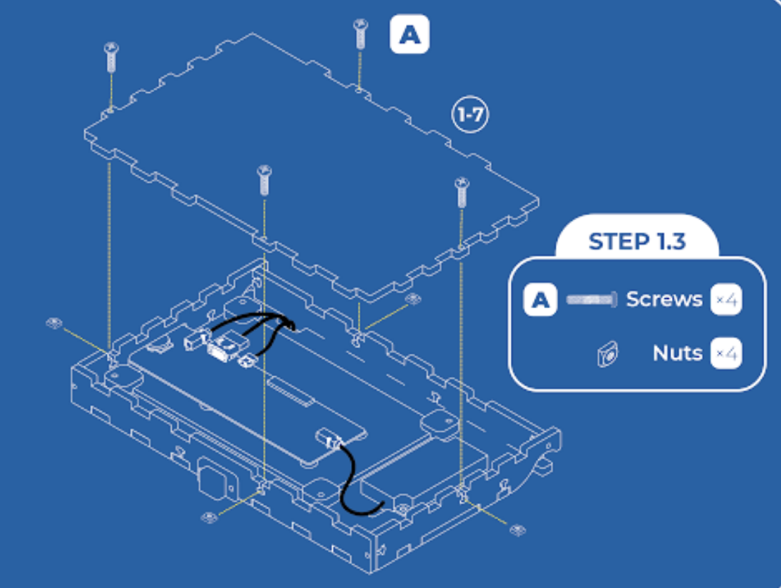
STEP 1.3
MECHANICAL INVENTORY
In this step, you will add the back of the screen, which can be easily removed to mess with wiring if needed!

Slide 9
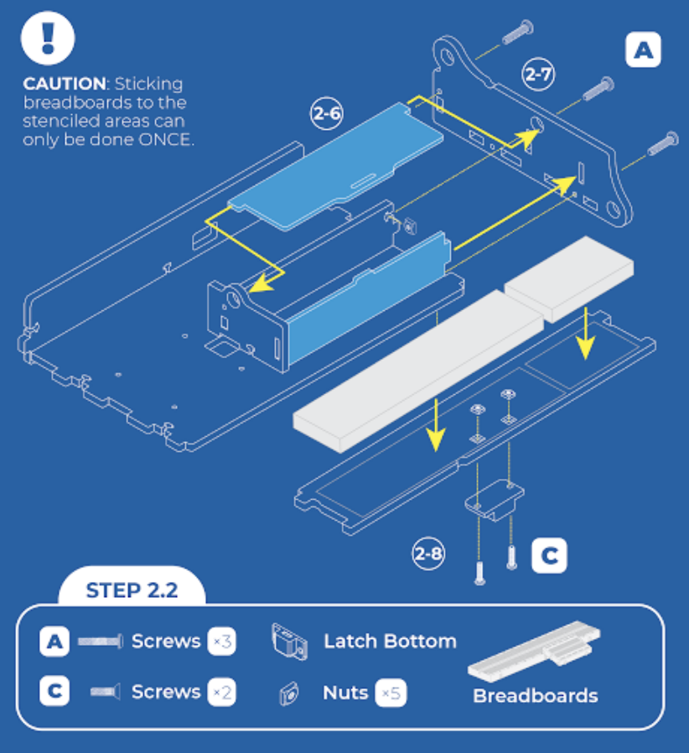
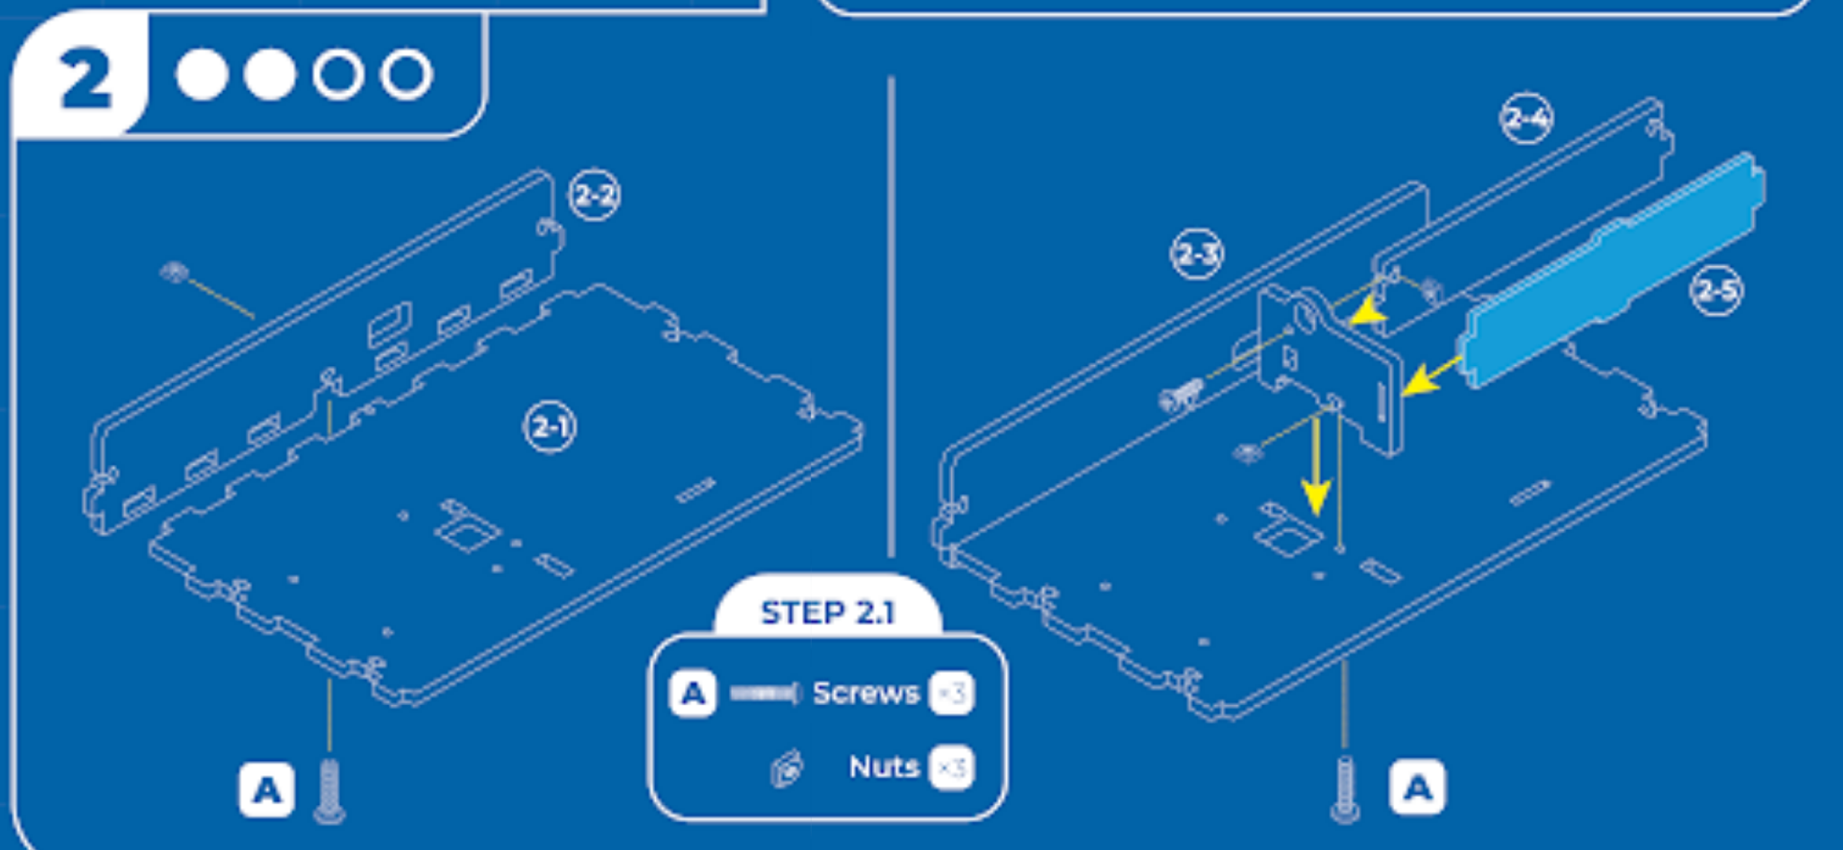
STEP 2
MECHANICAL INVENTORY
In this step you will set up the base of your kit. Check out the blue pieces. What are those made out? Stick the breadboards down carefully!
Notes:
Again, we are guiding students through deciphering the blueprint. You could ask, how many will we need of each tool for this step? What tool should we have handy? Give students enough time to identify where this is located on the blueprint.

Slide 10
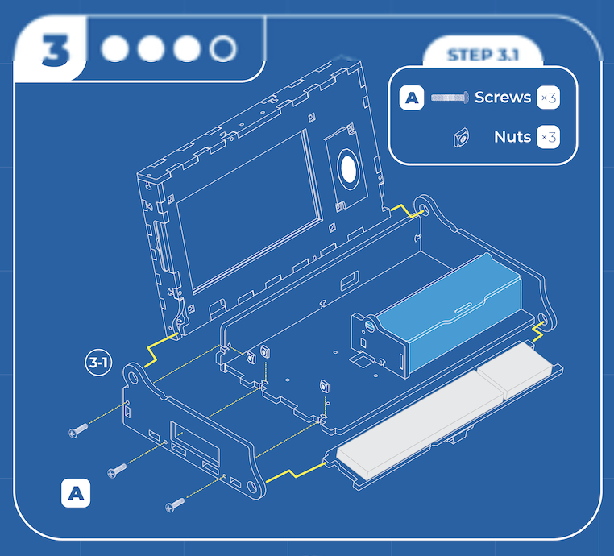
STEP 3
MECHANICAL INVENTORY
This can be a hard step – be sure to hold the pieces carefully – and if easier, turn the kit on its side!
Notes:
Check out our build video if you’re having trouble with this – a second pair of hands to hold the screen in place also makes this easier!

Slide 11
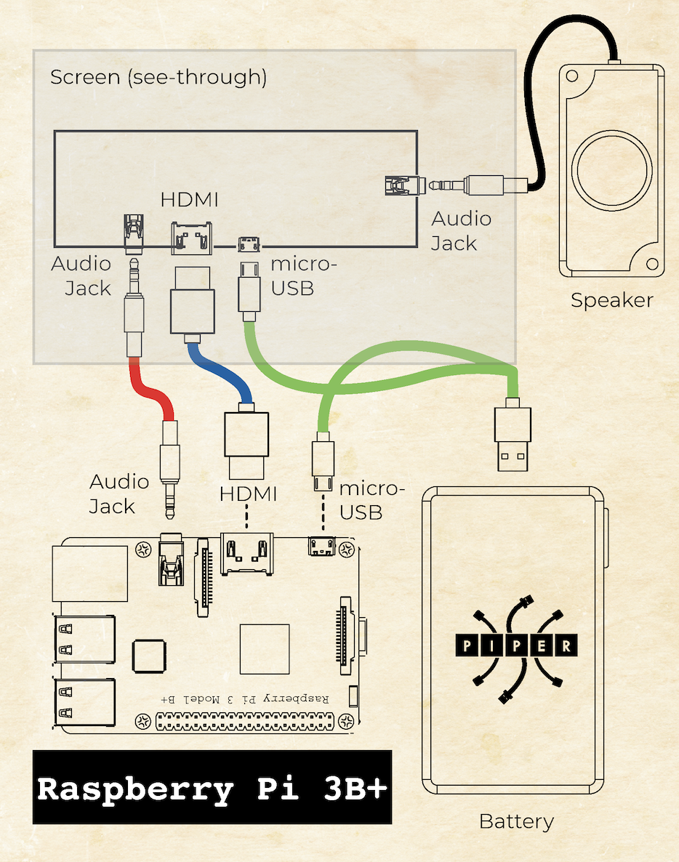
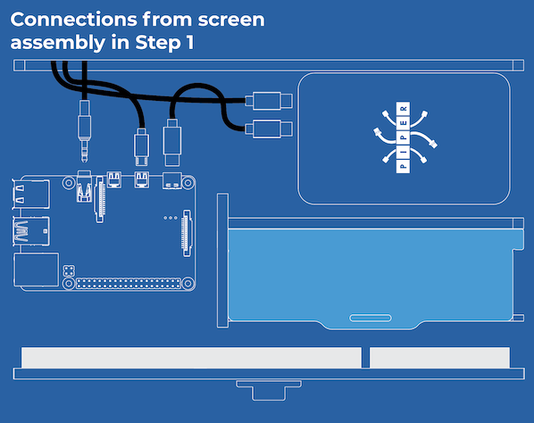
STEP 4
MECHANICAL INVENTORY
When looking at the blueprint at this point, use the wiring diagram shown on your insert instead of the blueprint!
Wiring for Raspberry Pi 4 Model B.
USE WIRING FOR
RASPBERRY PI 3 MODEL B+
AS SHOWN →
Notes:
Again, we are guiding students through deciphering the blueprint. You could ask, how many will we need of each tool for this step? What tool should we have handy? Give students enough time to identify where this is located on the blueprint.

Slide 12
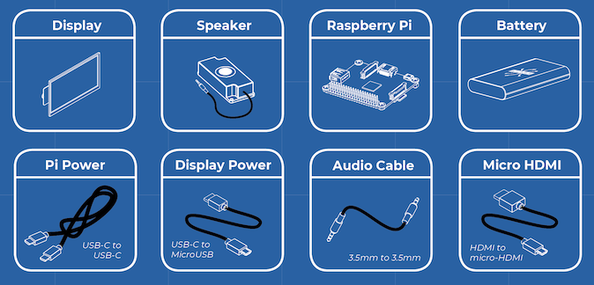
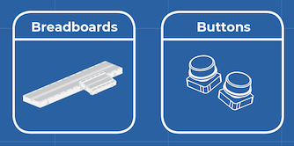
OVERVIEW
ELECTRONICS INVENTORY
Which of these look familiar? When or where have you seen these before?

Slide 13
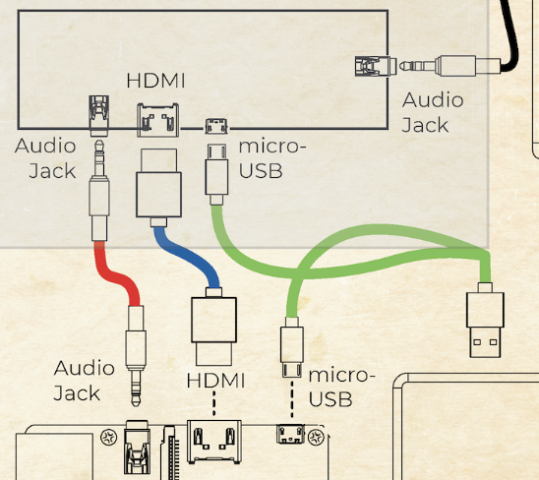
MAKING CONNECTIONS
ELECTRONICS INVENTORY
Can you identify the cables?
Where else have you seen these cables?
What do you think would happen if we didn’t connect the HDMI cable?
What do you think would happen if we didn’t connect the Audio?
Notes:
Double click the power button on the power bank to turn off – keep the battery UNPLUGGED when the kit is not in use.

Slide 14
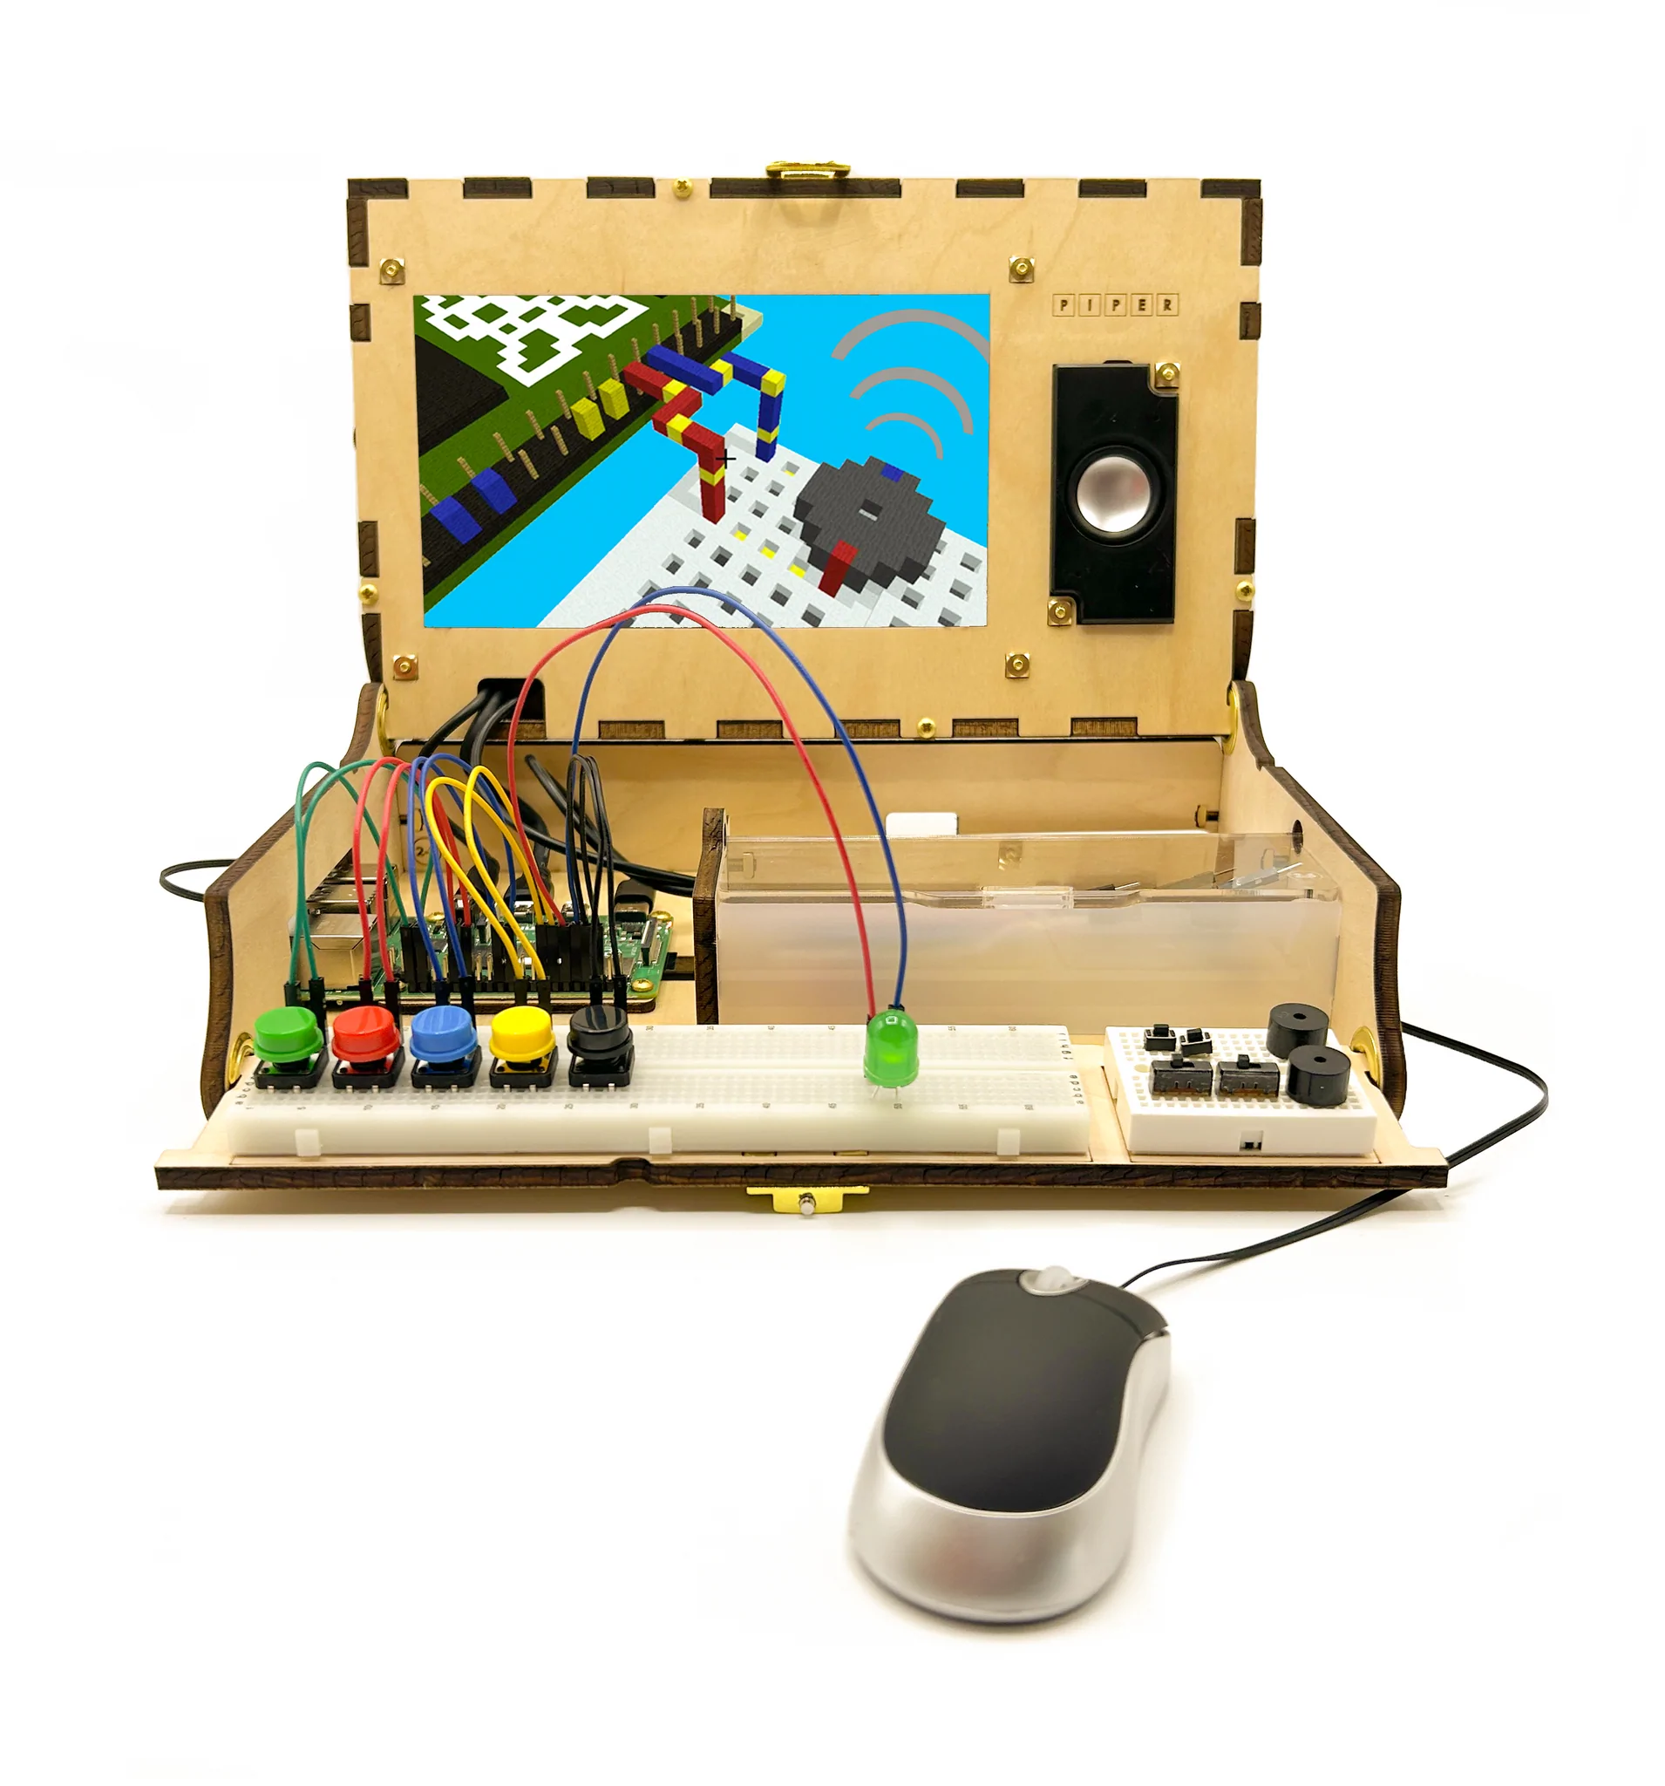
ARE YOU READY?
Your finished product will look something like this by the end of our building experience.
Notes:
Note: Students don’t need to add buttons on the breadboard. (Buttons are a part of Phase 2)
As you wrap up the slideshow, review what students completed for the first column of their visual organizer. They will be using their answers to guide the building of the kits during Lessons 1.2 and 1.3.

