Slide 1
Lesson 2.1 Slides
Story Mode: Buttons, Breadboards, & Current
Project: Stoplight

Slide 2
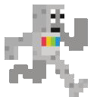
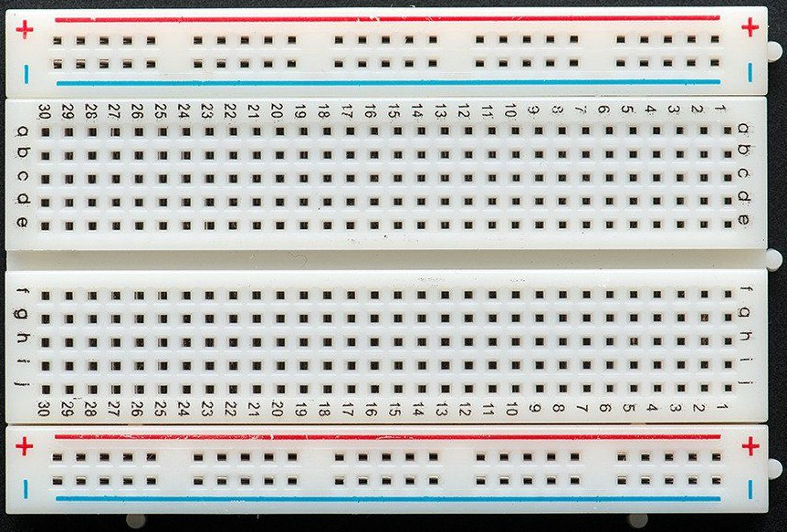
Engaging Prior Knowledge: Do you know what this is called? Do you know what it is used for?

Slide 3
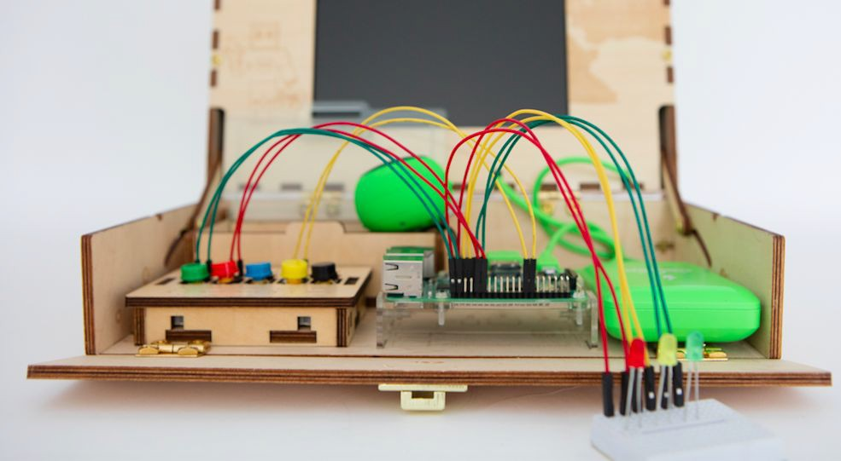
This is called a “breadboard” Breadboards are used for wiring & prototyping.
We will use it to build and create electronics!

Slide 4
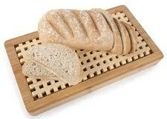
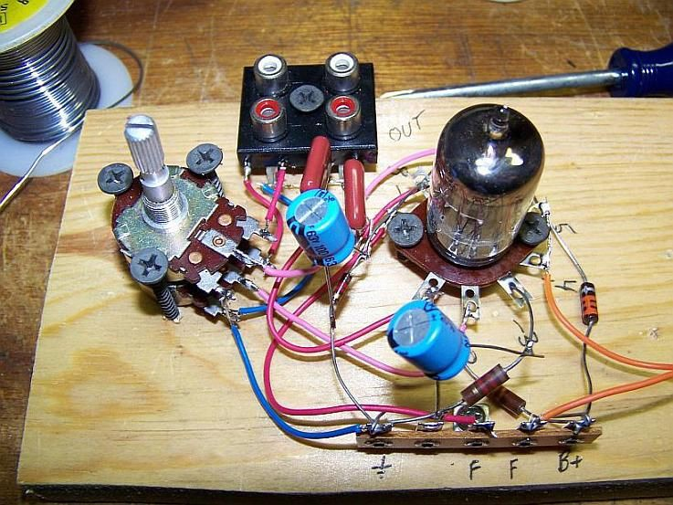
So why is it called a “breadboard”??
An inventor borrowed the breadboard to put together a circuit.

Slide 5
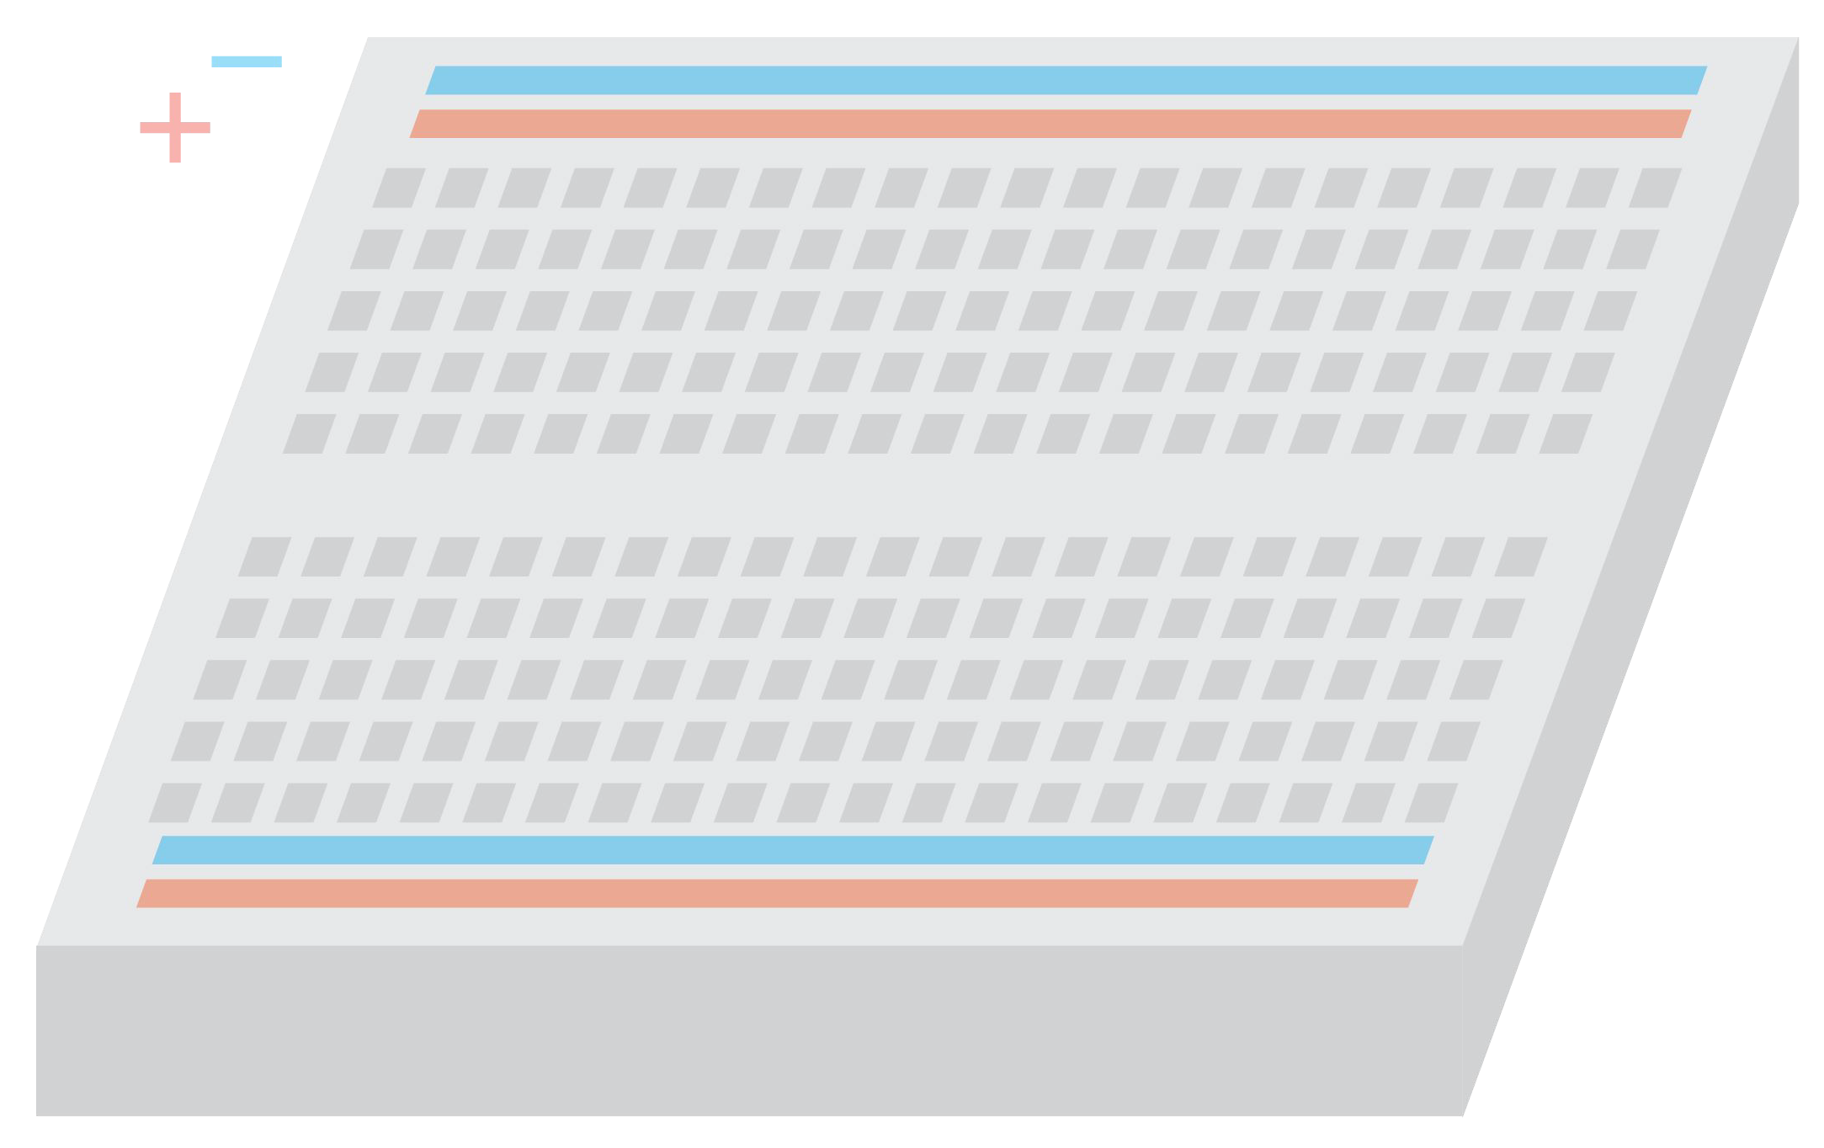
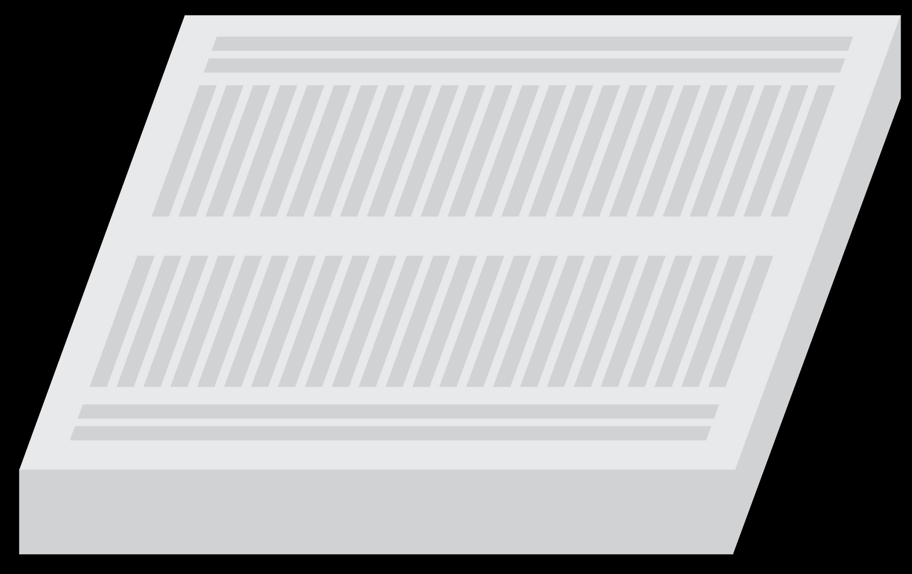
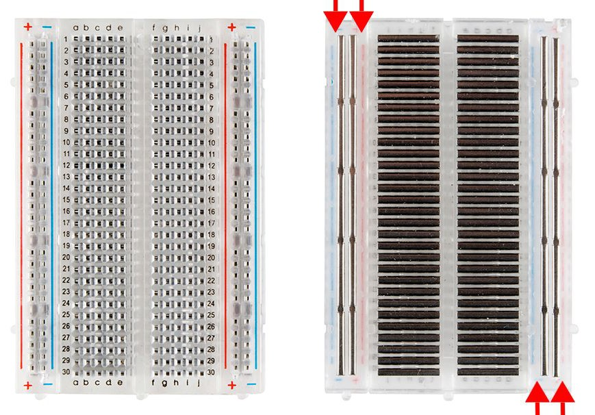
How does a breadboard work?: the answer is in the metal strips that conduct electricity.

Slide 6
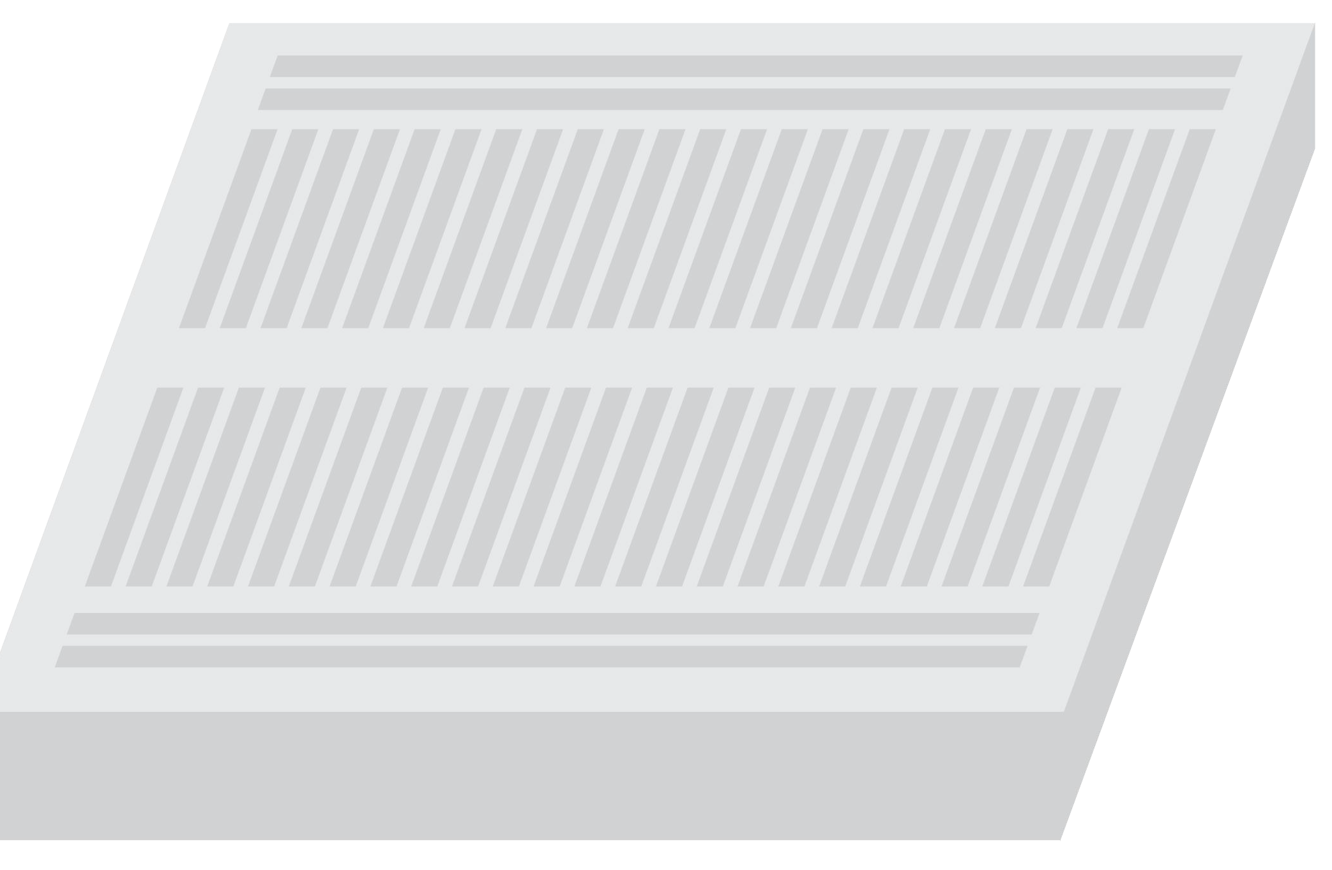
Numbered/Lettered “wells” are connected by a metal strip.
The + wells are connected via metal strip and the - wells are connected via metal strip.

Slide 7
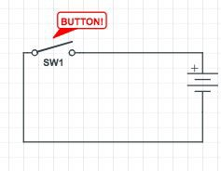
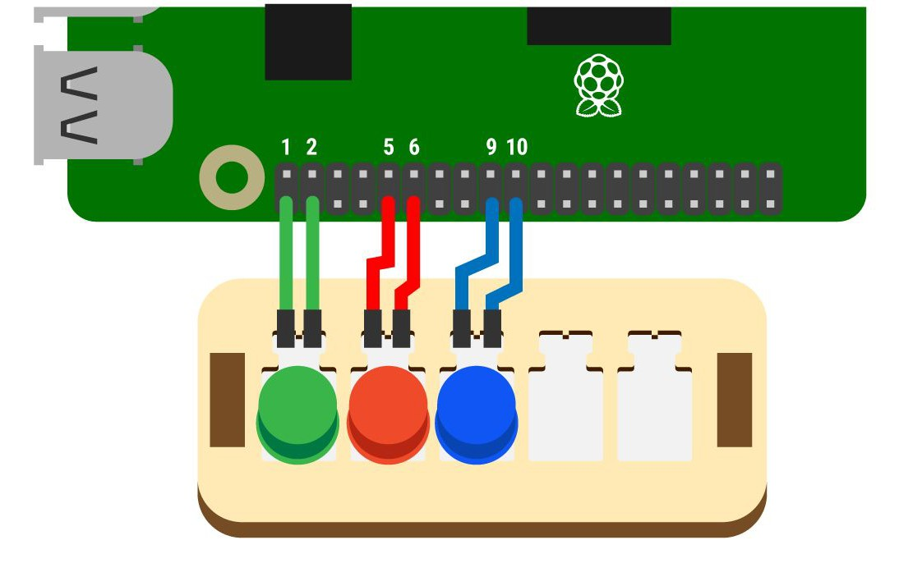
Buttons & breadboards
Why do we need two jumper wires to connect one button to the Raspberry Pi using the breadboard?

Slide 8
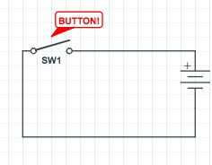
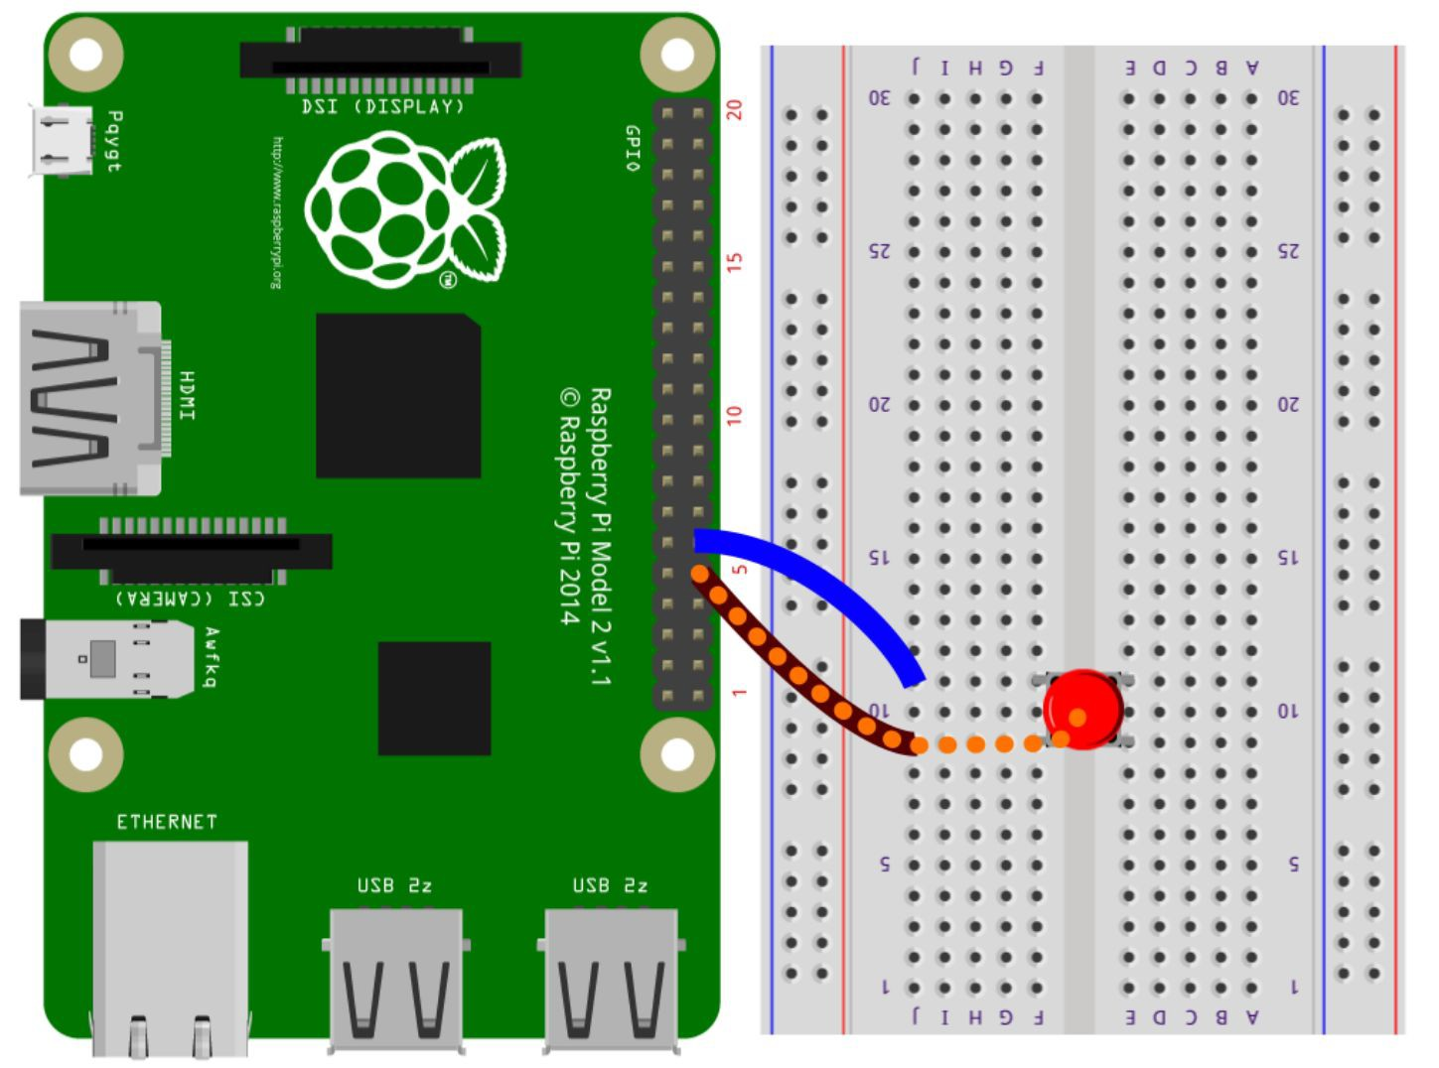
This is an
CIRCUIT.
The button here has not been pressed down so current cannot ﬂow from one GPIO pin to another.

Slide 9
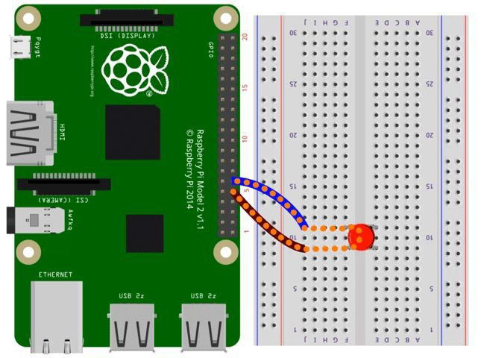
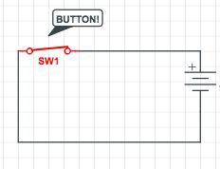
This is a
CIRCUIT.
The button here has been pressed down so current is ﬂowing from one GPIO pin to another.

Slide 10
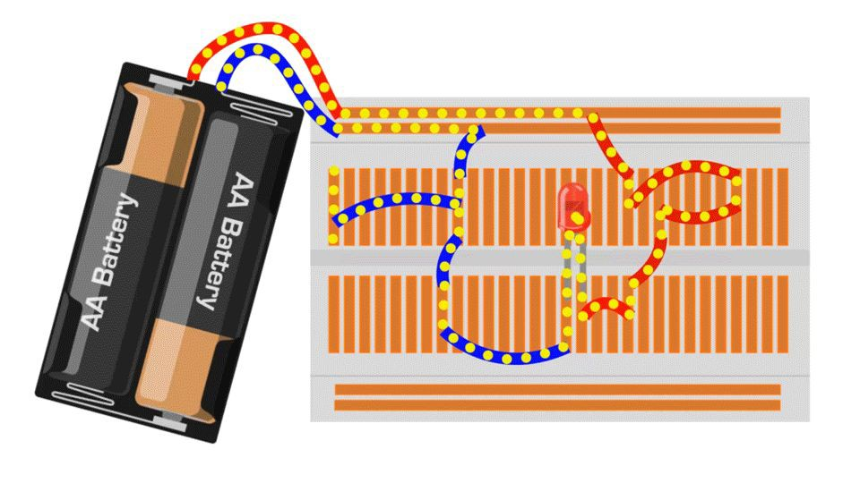
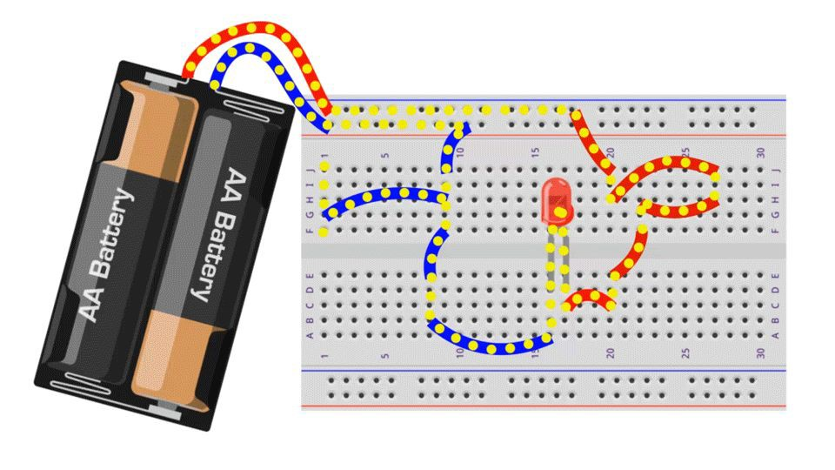
Try This!
Use the diagrams below to explain what is happening in the circuit.
Hint: Pay close attention to the yellow dots that
are not moving.

Slide 11
Try This!
Is the circuit OPEN or CLOSED?

Slide 12
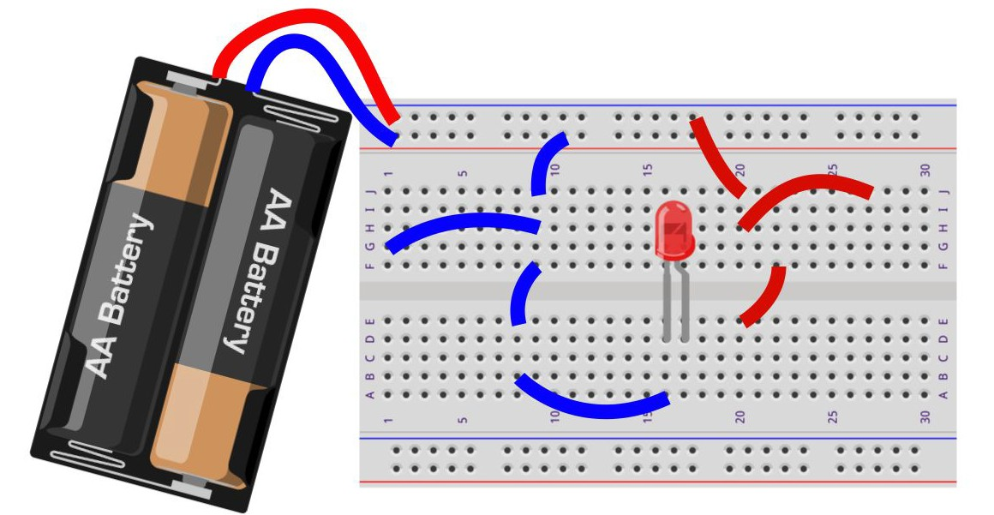
Extend Your Understanding
Will the LED in this circuit light up?
Hint: you can draw the connections within the breadboard

Slide 13
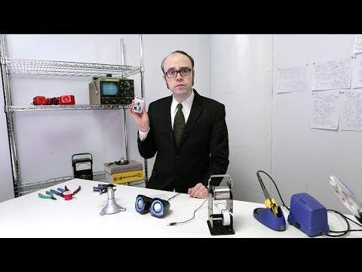
Watch this:

Slide 14
Reﬂect!
On your Exit Slip, write down:
2 things you learned today.
1 question you have about today’s lesson
1 problem you faced and how you were able to solve it.

