Slide 1
Lesson 2.2 Slides
Basic Inputs & Outputs

Slide 2
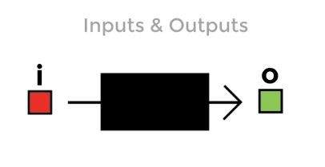
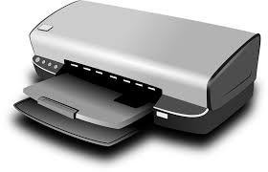
Basic inputs and outputs:
Inputs put in data from the user or environment into the computer. Example: Keyboard
Outputs take data from the computer and produce an outcome. Example: Printer

Slide 3
Your Turn!
Is the mouse an input or output? Why?

Slide 4
And the answer is:
It’s an input. The mouse’s click, location and scroll tell computer what to do on the screen.

Slide 5
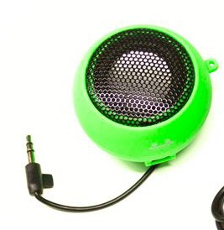
The Speaker
Is the speaker an input or output? Why?

Slide 6
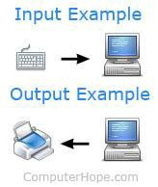
And the answer is:
It’s an output. The computer puts out an audio signal to the user or environment and the speaker plays it.

Slide 7
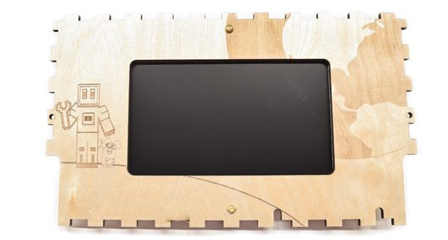
Screen display:
Is the display an input or output? Why?

Slide 8
If it had a touch screen, what would it be?

Slide 9
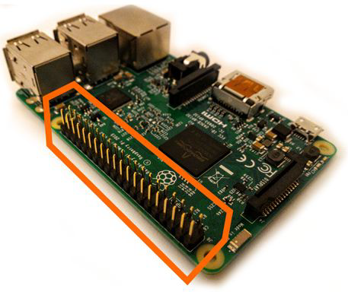
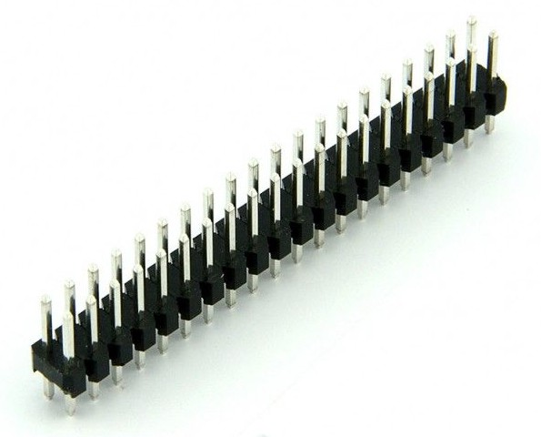
What are these called? What do you use them for?

Slide 10
Generally called “header pins”
On the Raspberry Pi they are called GPIO pins.
GPIO stands for: General Purpose Input and Output.

Slide 11
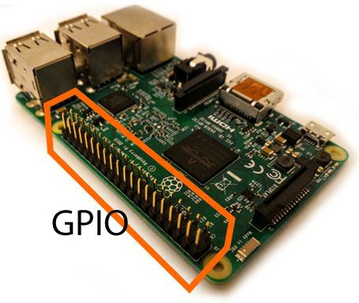
Each pin can be programmed to interact with an input (ex: buttons, switches) or
an output (ex: LED lights, buzzers).

Slide 12
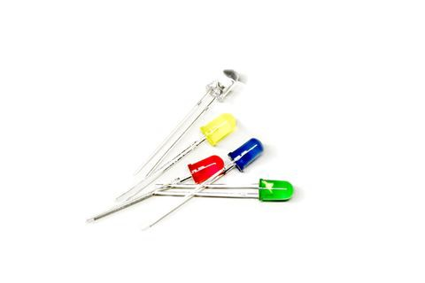
Let’s look at some inputs and outputs we encountered in Story Mode
First Stop: LED’s
LED’s are Outputs
The mouse has both buttons and an LED. What does the LED indicate?
The RPi has LEDs as well. What could they be for?

Slide 13
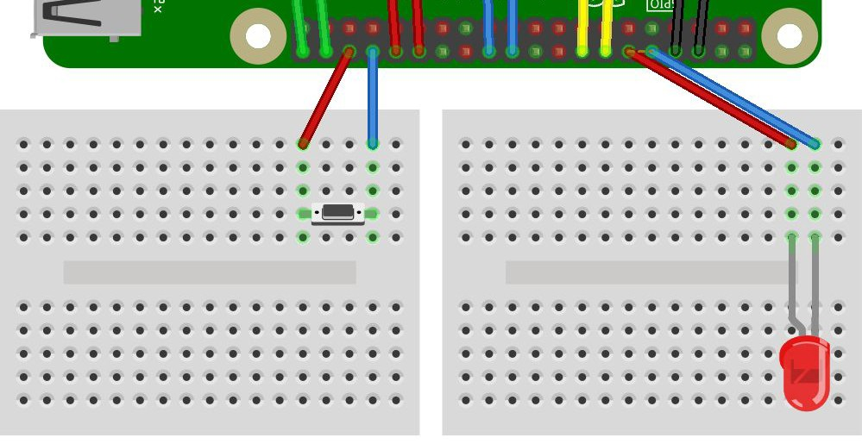
LED treasure detector and TNT Igniter.
Which direction will current ﬂow through the switch? Draw a diagram to support your answer

Slide 14
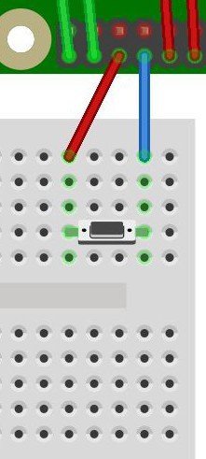
ANSWER
From the Raspberry Pi, through red jumper wire, down the column, through the switch if it is ﬂicked to “on”, through the column, through blue, back to RPi.

Slide 15
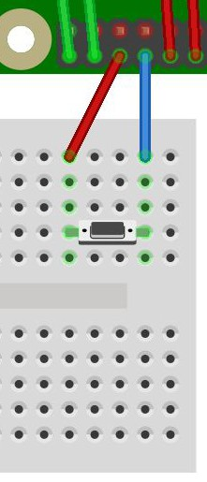
In Chain Reaction, the pin connected to
CHALLENGE:
Write the pseudocode or directions you would tell the computer to do if you wanted the switch to result in the TNT block when it is switched on!
the red wire is coded to detect voltage, HIGH or LOW.

Slide 16
In Chain Reaction, the pin connected to
SAMPLE ANSWER:
#If button connected to pin 3 is HIGH, #then do nothing
the red wire is coded to detect voltage, HIGH or LOW.
#else if button is LOW,
#make sand block into TNT
#Or alternatively
#If button connected to pin 3 is LOW, #then do nothing
#else if button is HIGH,
#make sand block into TNT

Slide 17
LED treasure detector and TNT Igniter.
Which direction will current ﬂow through the LED? Draw a diagram to support your answer

Slide 18
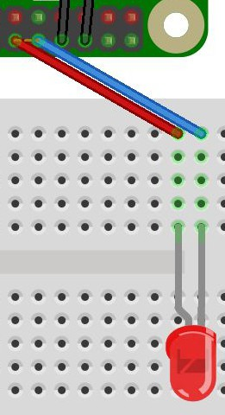
LED treasure detector and TNT Igniter.
It will ﬂow from the Raspberry Pi through the red jumper wire to the breadboard, down the column, through the + leg of th LED (long leg), then through the LED to the - leg (shorter leg), through the column in the breadboard and back to the PI through the blue jumper wire. wer

Slide 19
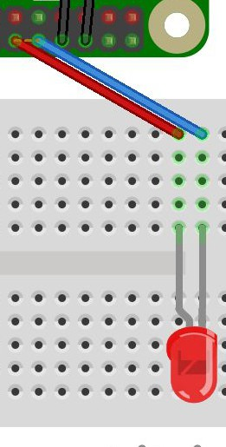
CHALLENGE:
In Treasure Hunt, the pin connected to the red wire and long leg of the LED is coded to blink at increasingly faster rates.
Write the pseudocode or directions you would give the computer to have the LED blink based on distance from the treasure.
Hint: Try to use the words: “if” “then” and “else” in your directions

Slide 20
In Treasure Hunt, the pin connected to the red wire and long leg of the LED is coded to blink at increasingly faster rates.
SAMPLE ANSWER
#If VERY far away from treasure #no blink
#else if far away from treasure #blink slowly
#else if close to treasure #blink fast
#else
#blink super fast
Blinking is sending a sequence of HIGH and LOW voltages.

