Slide 1
Buttons and Switches + Polarity and Audio
Buttons and Switches + Polarity and Audio

Slide 2
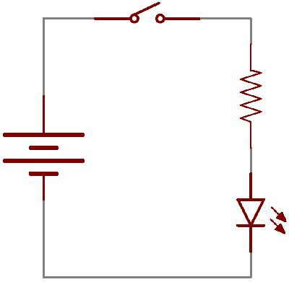
Buttons & Switches open & close a circuit
Resistor
Power Source
LED

Slide 3
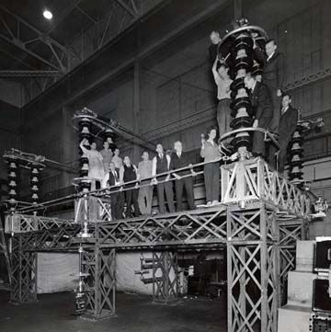
The world’s biggest switch!
Electric Transformers
September 1942
This towering 230,000-volt
disconnecting switch was
completed in an east coast General
Electric factory and shipped to the
west coast for service in a new giant
plant during WWII.
© General Electric Company

Slide 4
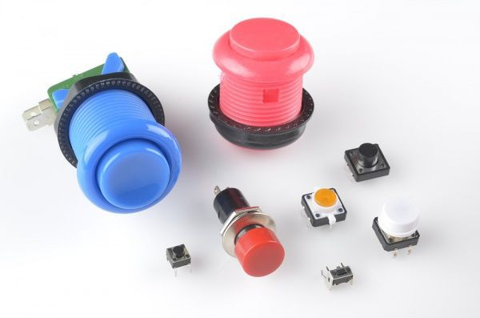
Different kinds of buttons.

Slide 5
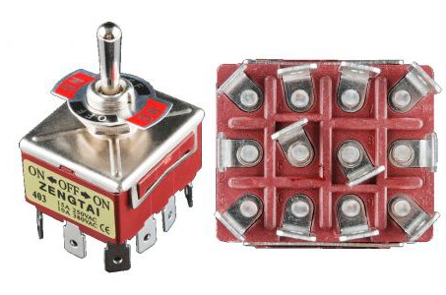
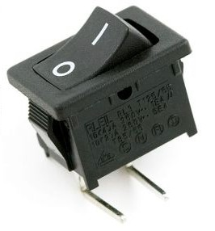
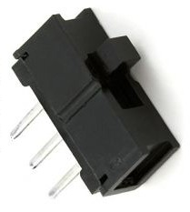
Different kinds of switches.

Slide 6
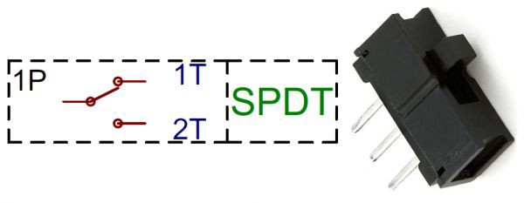
Our Piper switch is an SPDT or sliding switch
Single Pole Dual Throw: It means it can alternate between two components. While one is ON the other is OFF.

Slide 7
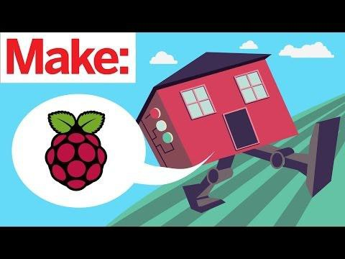
Buttons and Switches are everywhere!

Slide 8
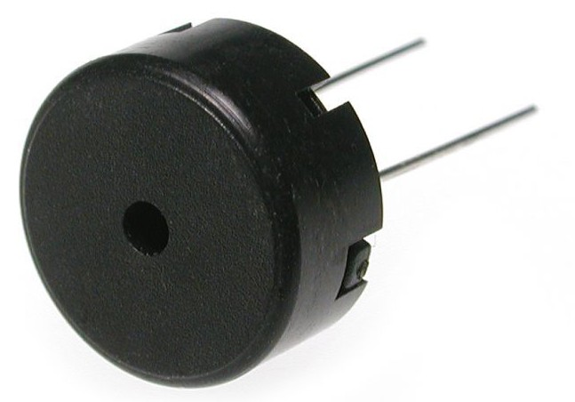
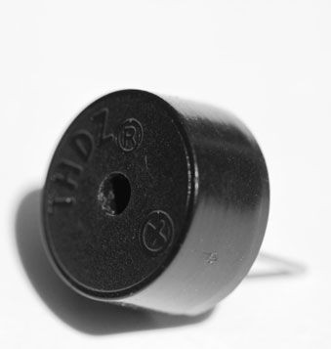
More outputs: The piezo buzzer
It is polarized! Look for the plus sign!

Slide 9
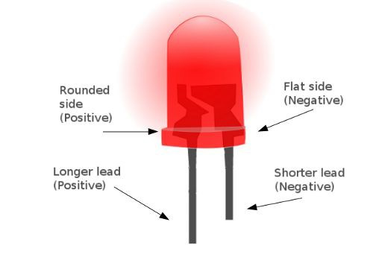
LEDs have polarity too!

Slide 10
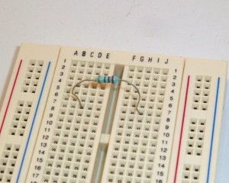
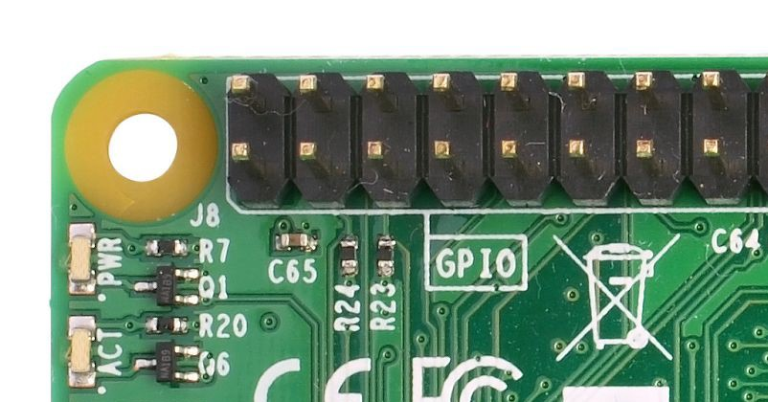
Like buttons and switches, resistors don’t have polarity.
Piper doesn’t have resistors except tiny ones on the RPi itself. They’re labeled R1 - R79 or so.

Slide 11
Polarity is important when building circuits
Key takeaways:
If connected incorrectly:
At best, the component won’t work as expected.
At worst, the component could get fried (this will never happen with Piper)

