Slide 1
Parallel Buttons and Switches

Slide 2
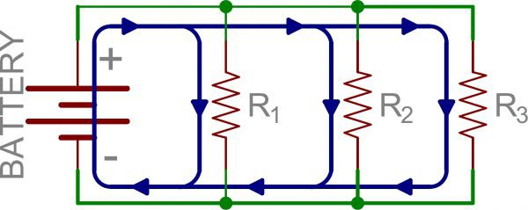
A parallel circuit is a parallel setup of components. For example:
They’re most commonly used with resistors to control current inside a circuit. However...

Slide 3
… buttons and switches in parallel can be used to create complex input devices (such as keyboards).

Slide 4
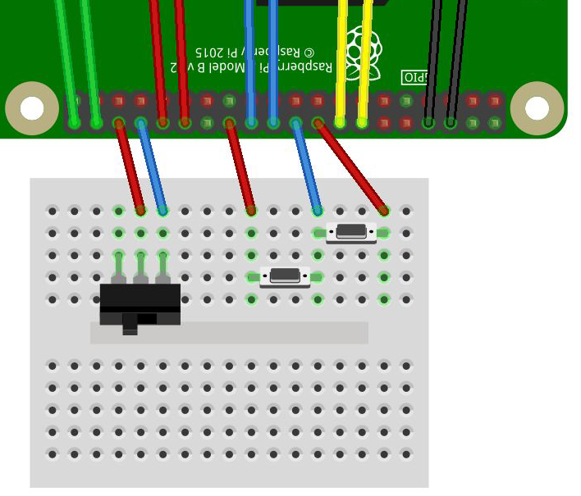
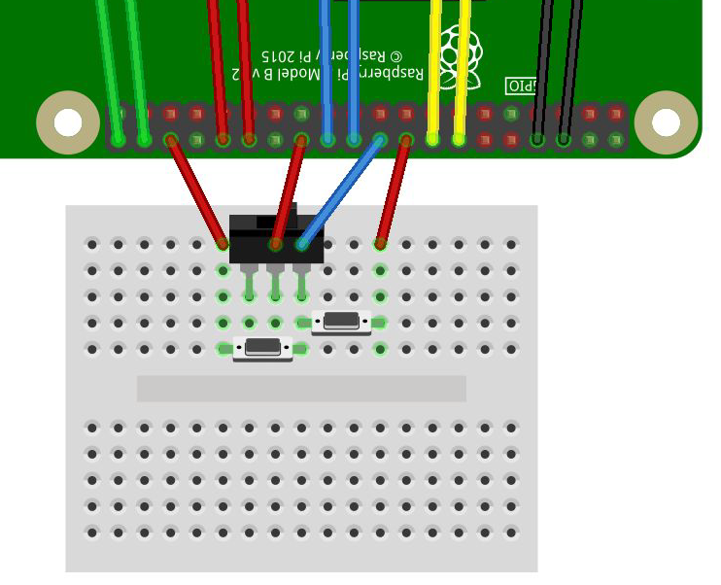
In Funky Fungi and in Return to Cheeseteroid

Slide 5
More about parallel and series circuits.

