Slide 1
Piper Code
Intro to computational thinking & programming

Slide 2
Tour of the Interface
Start here!

Slide 3
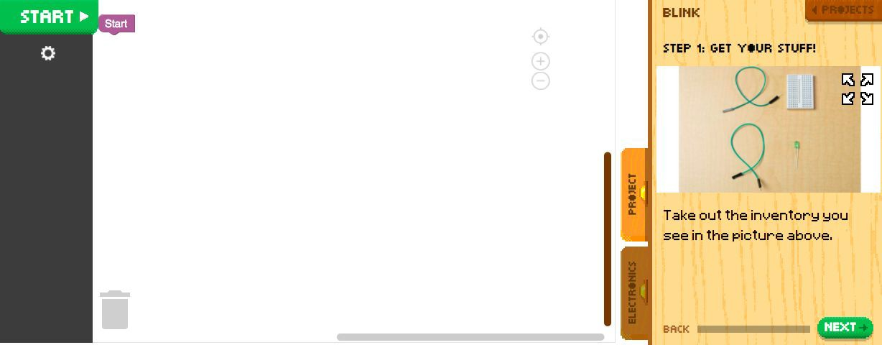
Blocks Library
Code Canvas
Project Panel

Slide 4
Electronics Panel

Slide 5
Sneak Preview!
Blocks Library Tabs
Setup
Chip Logic Loops Variable Sounds Lists Function
Trash

Slide 6
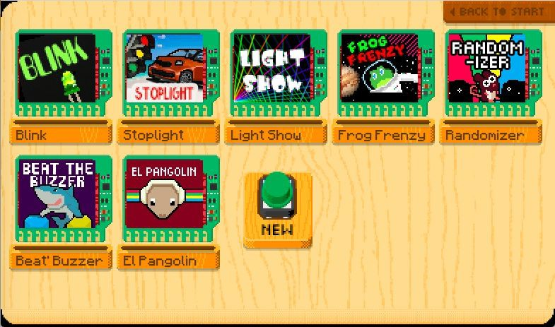
What’s Next?

Slide 7
What is Computational Thinking?
Problem Solving
Logic
Design a solution
Analyze data
No instructions!
Order
Responding to challenges
Open-ended Problems
Putting action into a series
Ordered Steps
Getting from start to ﬁnish

Slide 8
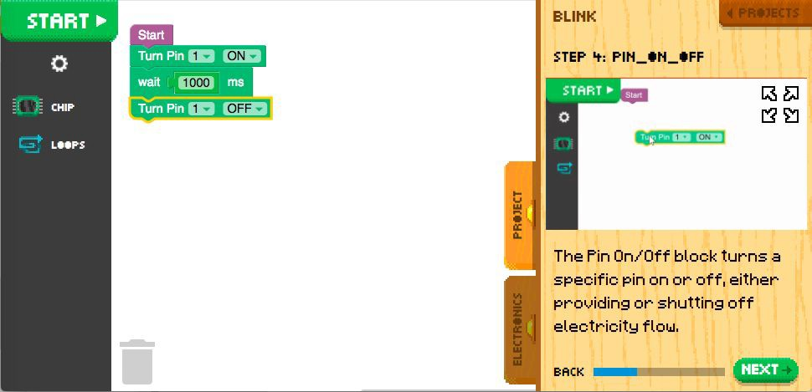
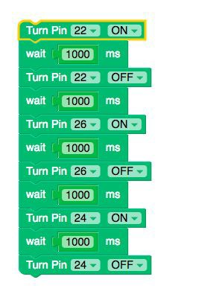
Sequences
Identifying a series of steps for a task

Slide 9
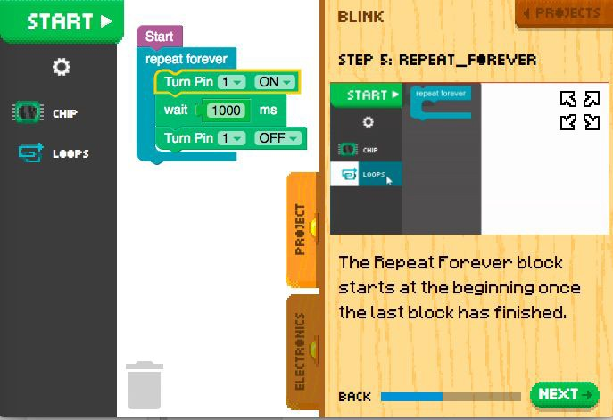
Loops
Running the same sequence multiple times

Slide 10
How did you use Computational Thinking TODAY?
Problem Solving
Logic
Order
Design a solution
Analyze data
Responding to challenges
No instructions!
Open-ended Problems
Putting action into a series
Ordered Steps
Getting from start to ﬁnish

Slide 11
Reﬂect!
Write down two things you learned today.
Write down one question you have about today’s lesson.
Write down one problem you've encountered, if and how you were able to resolve it.

