Slide 1
Piper Code
Loops & Sequences

Slide 2
Share Your Software Hints to the Idea Wall!
Locked out? Finish each project!
Right Click Menu
Duplicate
Expand Project images
Electronics tab
Click Start to test
No instructions!
Click Stop then Start to re-send code Expand Project images
Zoom & Re-Center on Canvas!
Others?

Slide 3
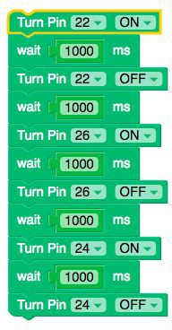
Sequences
Identifying a series of steps for a task

Slide 4
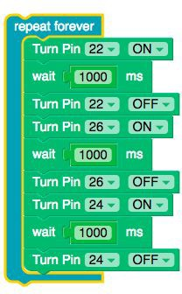
Loops
Running the same sequence multiple times

Slide 5
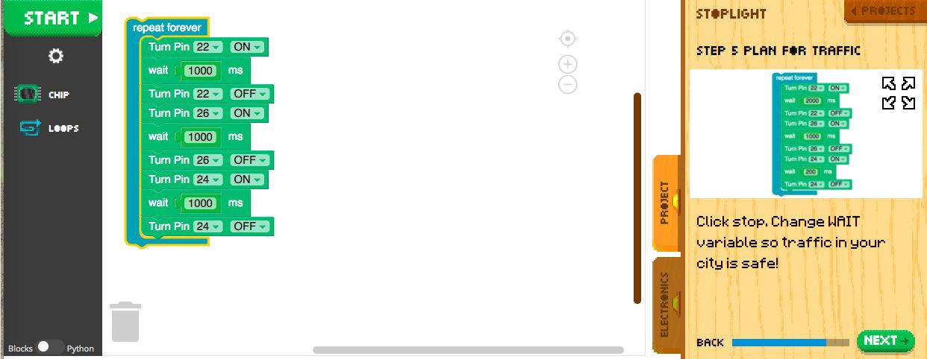
Sequences in a Loop With Wait variations

Slide 6
How might we???? Program a two-way stop?

Slide 7
Reﬂect!
Write down two things you learned today.
Write down one question you have about today’s lesson.
Write down one problem you've encountered, if and how you were able to resolve it.

