Slide 1
Piper Code
Events

Slide 2
Share Your Software Hints to the Idea Wall!
Locked out? Finish each project!
Right Click Menu
Duplicate
Expand Project images
Electronics tab
Click Start to test
No instructions!
Click Stop then Start to re-send code
Expand Project images
Zoom & Re-Center on Canvas!
Others?

Slide 3
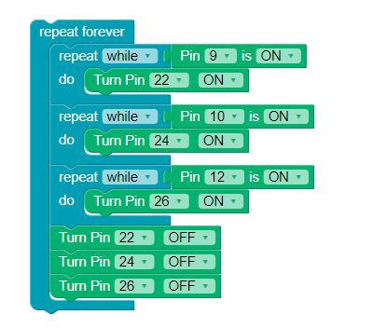
What is an event in coding?
One thing causing another thing to happen

Slide 4
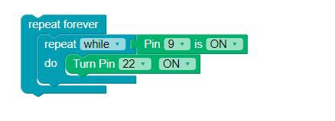
Which part of the code is an Event?
The “while”- “do” statement.

Slide 5
Reﬂect!
Write down two things you learned today.
Write down one question you have about today’s lesson.
Write down one problem you've encountered, if and how you were able to resolve it.

