Slide 1
Lesson 3.4 Slides PiperCode: Loops & Events with Light & Sound
Project: Frog Frenzy

Slide 2
Share Your Software Hints to the Idea Wall!
Locked out? Finish each project!
Right Click Menu
Duplicate
Expand Project images
Electronics tab
Click Start to test
No instructions!
Click Stop then Start to re-send code
Expand Project images
Zoom & Re-Center on Canvas!
Others?
Notes:
ASK: As you were working in your teams, did you pick up any software hints you want to share with your classmates!
If not revealed by students, point some of these out:
All but the first Blink project are locked until the student clicks Next and successfully follows the prompts to build the code of each project.
The right click menu on the blank Canvas has some handy actions:
Undo/Redo actions
When the Code Canvas gets crowded, tuck away blocks (Clean up, Collapse/Expand)
Add comment to leave yourself a note
The right click menu on a code block also has shortcuts like:
Duplicate - make an exact copy of the selected block or group of blocks to save time
Click the four arrowed icon on the top right of diagrams and videos to expand to full screen - this is helpful when trying to exactly line up lights and wires to the right pins on the breadboard.
Under Electronics tab in the Project Panel, you can always reference the GPIO pin map, but you might also want to coach the students to create their own physical “cheat sheet” diagram in their design journal or on sticky labels under the Pi board
You need to click the green Start block on the top left of the Block Library to run your code. You should also see the lights on the Raspberry Pi board react
To save time, you can right-click on a block in the Code Canvas and duplicate a single or group of blocks as a sort of copy and paste of your code.
Stop running the code when your adjusting blocks or variables!
If you adjust the variables of the code blocks while its running, you have to start/stop to make sure you communicate the new code to the board.
If your code blocks string gets long:
click on the white of the Code Canvas and drag up to move the whole canvas.
Use the mouse scroll to zoom in and out.

Slide 3
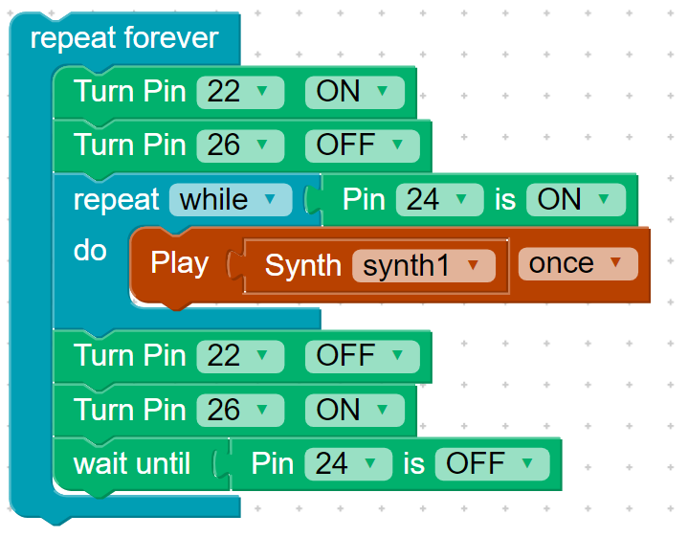
Variables
A program storage location for information that is given a name
Notes:
ASK: What is a Variable?
A program storage location for information that is given a name
ASK: When did you create a variable in your Piper Code today?

Slide 4
Conditions
A programming method for making decisions based on code that equates true or false
Notes:
ASK: What is a Condition?
A programming method for making decisions based on code that equates true or false
ASK: When did you create a condition in your Piper Code today?

Slide 5
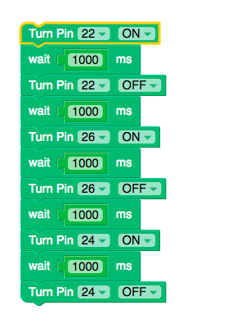
Sequences
Identifying a series of steps for a task
1.
2.
3.
4.
5.
6.
Notes:
ASK: What is a Sequence?
identifying a series of steps for a task
ASK: When did you create a sequence in your Piper Code today?

Slide 6
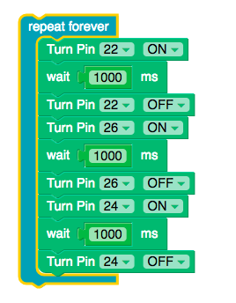
Loops
Running the same sequence multiple times
Notes:
ASK: What is a Loop?
running the same sequence multiple times
ASK: When did you create a loop in your Piper Code today?
SAY: Repeat Forever in all three!
ASK: Why code a loop to make the light blink?
SAY: That’s why we use the Repeat Forever code versus just a one-time sequence

Slide 7
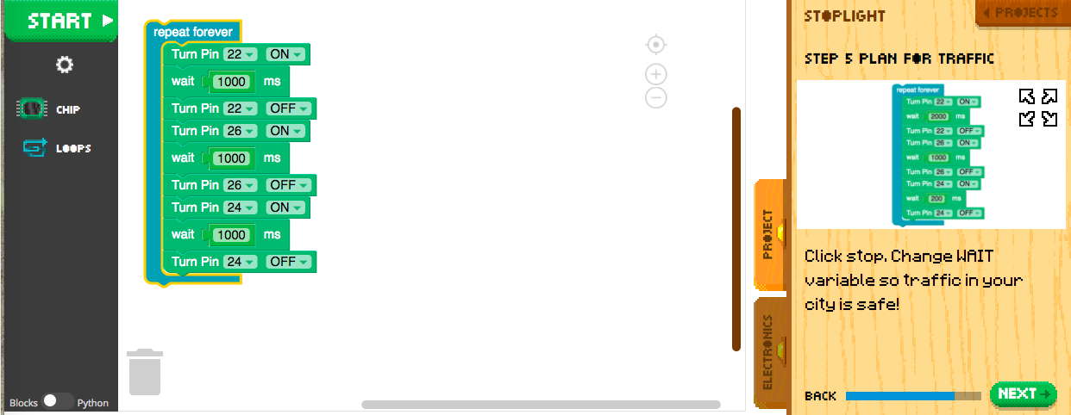
Sequences in a Loop with Wait variations

Slide 8
How might we program a two-way stop?

Slide 9
Reflect!
On your Exit Slip, write down:
2 things you learned today.
1 question you have about today’s lesson
1 problem you faced and how you were able to solve it.
Notes:
Collect these exit slips as a formative assessment to see what you need to review next class!
Also can have them do the survey online at https://goo.gl/forms/bd8RCvGrdaIY8Ekp2

