Slide 1
Lesson 4.1 Slides Story Mode: MiniGames & Creative Mode

Slide 2
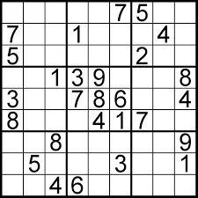
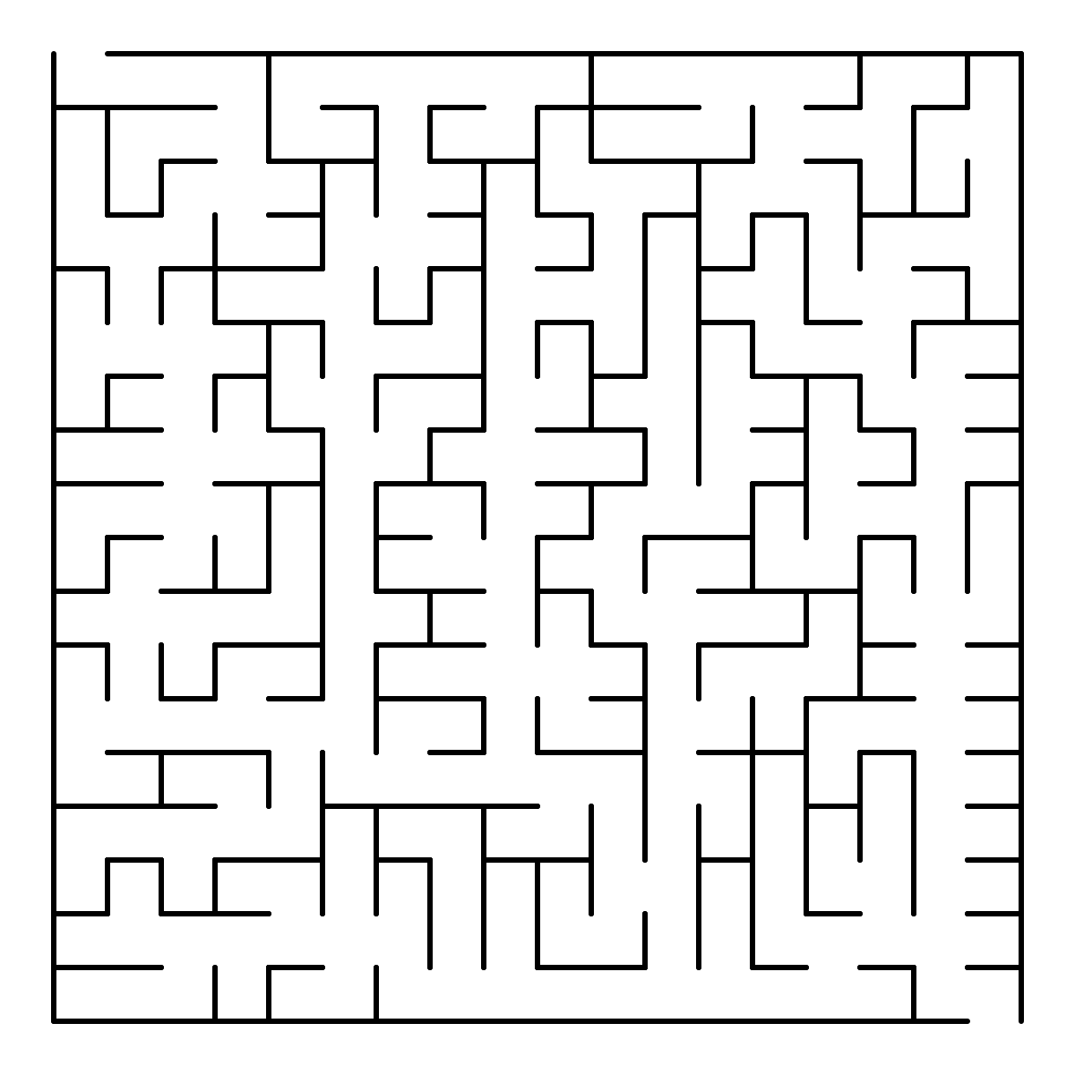
Which kinds of puzzles do you prefer?
There are mechanical puzzles.
(The kind you can solve with your hands.)
There are all kinds of
puzzles!
There are logic puzzles.
(The kind you can solve with your mind.)
Notes:
Teacher Notes: discuss

Slide 3
Planets Unlocked: MiniGames
After completing a StoryMode Planet, MiniGames are unlocked
Each MiniGame consists of a “Power-Up” or new circuit build to play
Let’s review what you learned in the MiniGames!

Slide 4
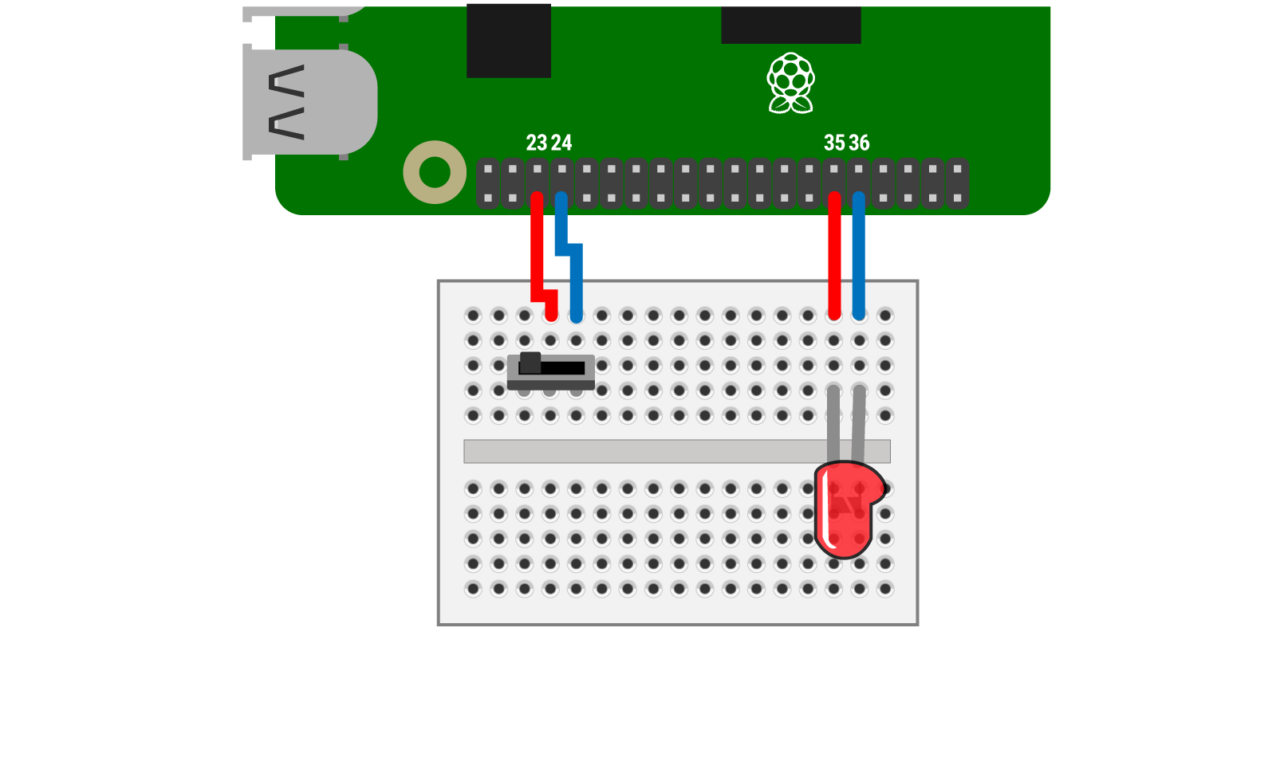
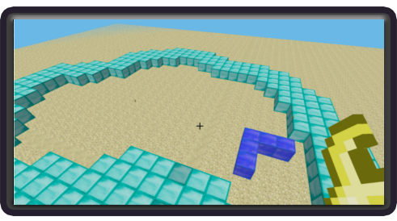
MiniGame:
Snake Trap
What power-up do you get in the game from connecting the circuit above?
Notes:
What was the problem you solved?
How did you solve it? (What process did you use?)

Slide 5
MiniGame:
Snake Trap
How does this circuit work? What is the purpose of the switch?
What happens to the LED when you flip the switch? Why do you think this happens?
GPIO Setup
Notes:
What was the problem you solved?
How did you solve it? (What process did you use?)

Slide 6
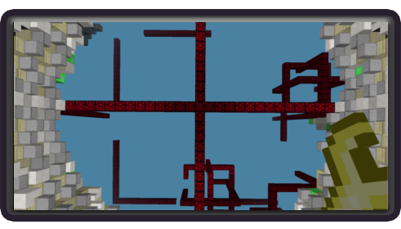
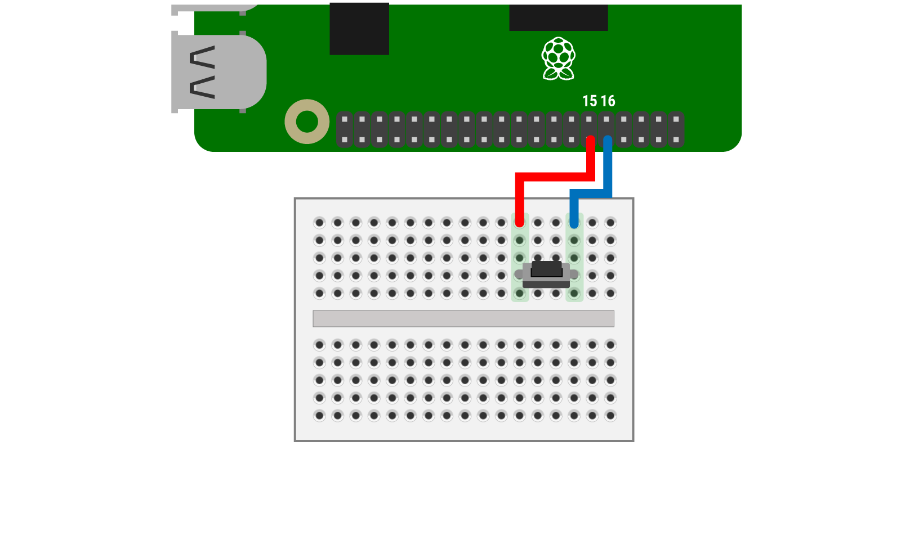
MiniGame:
Ring Race
What power-up do you get in the game from connecting the circuit above?
Notes:
What was the problem you solved?
How did you solve it? (What process did you use?)

Slide 7
MiniGame:
Ring Race
How does this circuit work? What is the purpose of the small tactile button?
GPIO Setup
Background This button is a type of SPST (Single Pole Single Throw) switch. They have two terminals which means they can only connect to a single input and a single output. These work well as simple on/off circuits for one conducting loop.
Notes:
What was the problem you solved?
How did you solve it? (What process did you use?)

Slide 8
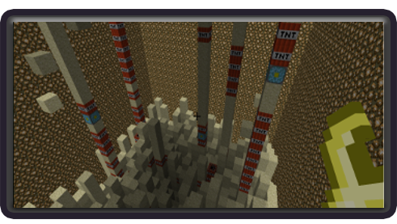
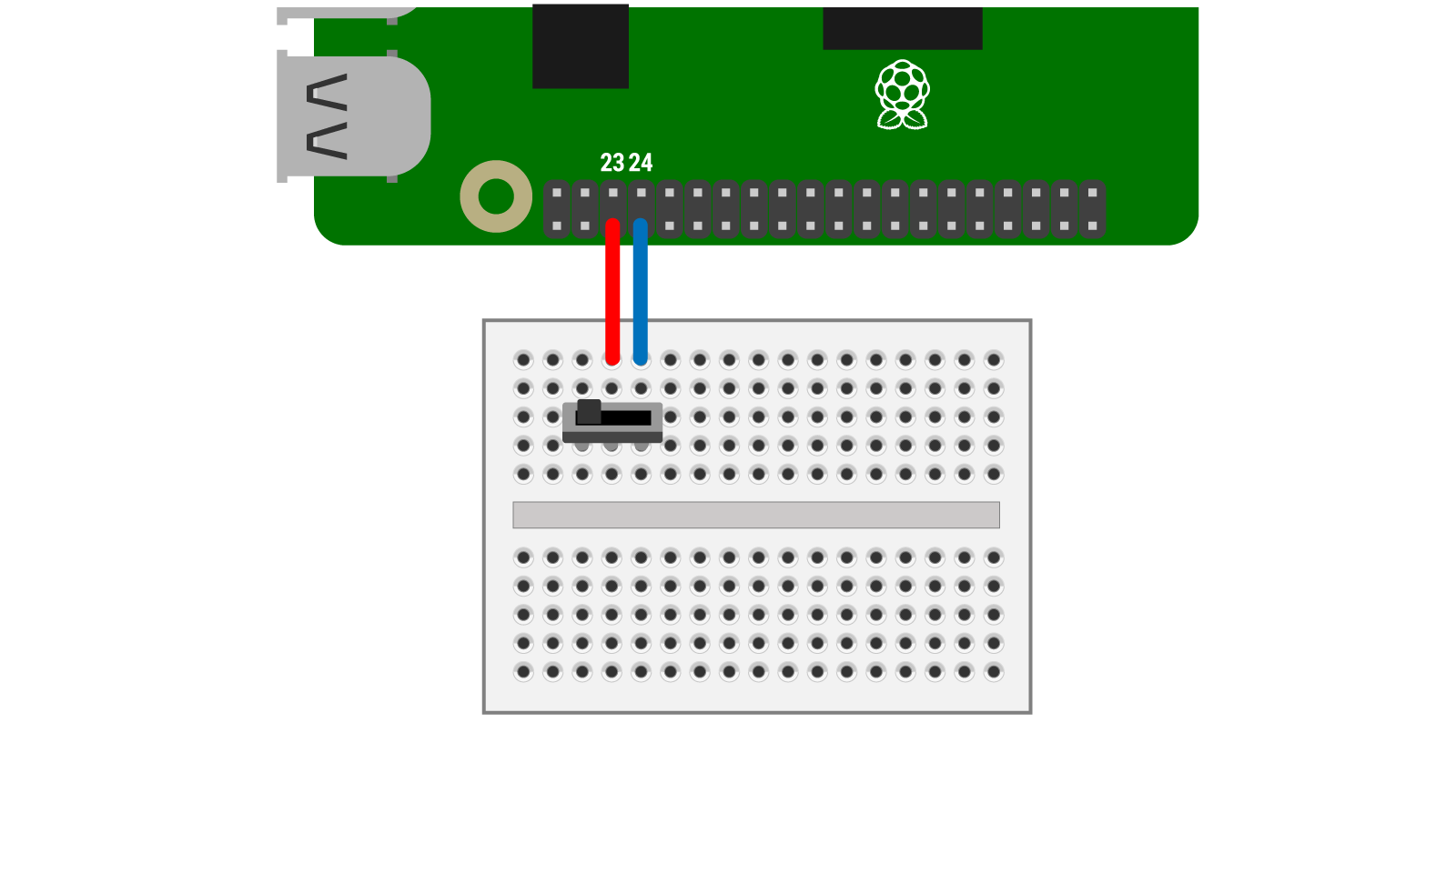
MiniGame:
Explosive Escape
What power-up do you get in the game from connecting the circuit above?
Notes:
What was the problem you solved?
How did you solve it? (What process did you use?)

Slide 9
MiniGame:
Explosive Escape
How does this circuit work? What is the purpose of the small tactile button?
GPIO Setup
Background This switch is a type of SPDT (Single Pole Double Throw) switch. They have three terminals: one common pin and two pins which vie for connection to the common pin. SPDTs allow you to select between two power sources, swap inputs, or have two circuits attached to the same switch.
Notes:
What was the problem you solved?
How did you solve it? (What process did you use?)

Slide 10
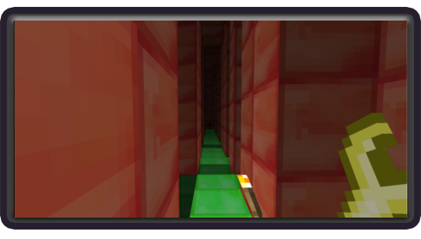
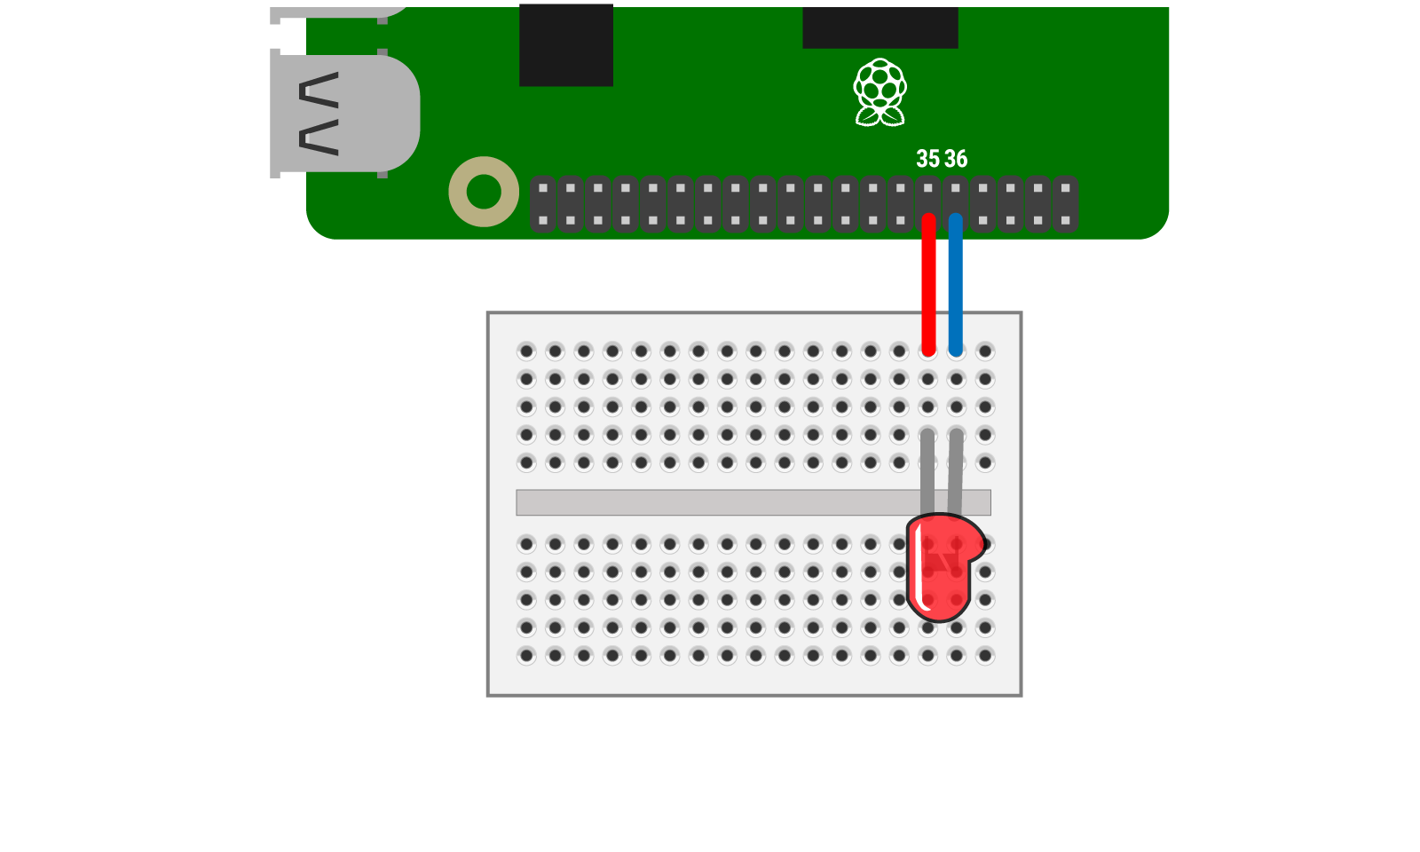
MiniGame:
Dark Maze
What power-up do you get in the game from connecting the circuit above?
Notes:
What was the problem you solved?
How did you solve it? (What process did you use?)

Slide 11
MiniGame:
Dark Maze
How does this circuit work? How does the LED know to light up?
GPIO Setup
Background LED stands for "Light Emitting Diode". A diode is device that allows current to flow in only one direction, aka unidirectionally. LEDs use current traveling through the circuit to release energy in the form of photons or light. The LEDs in your kit emit light in the visible spectrum.
Notes:
What was the problem you solved?
How did you solve it? (What process did you use?)

Slide 12
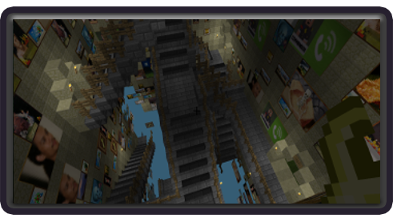
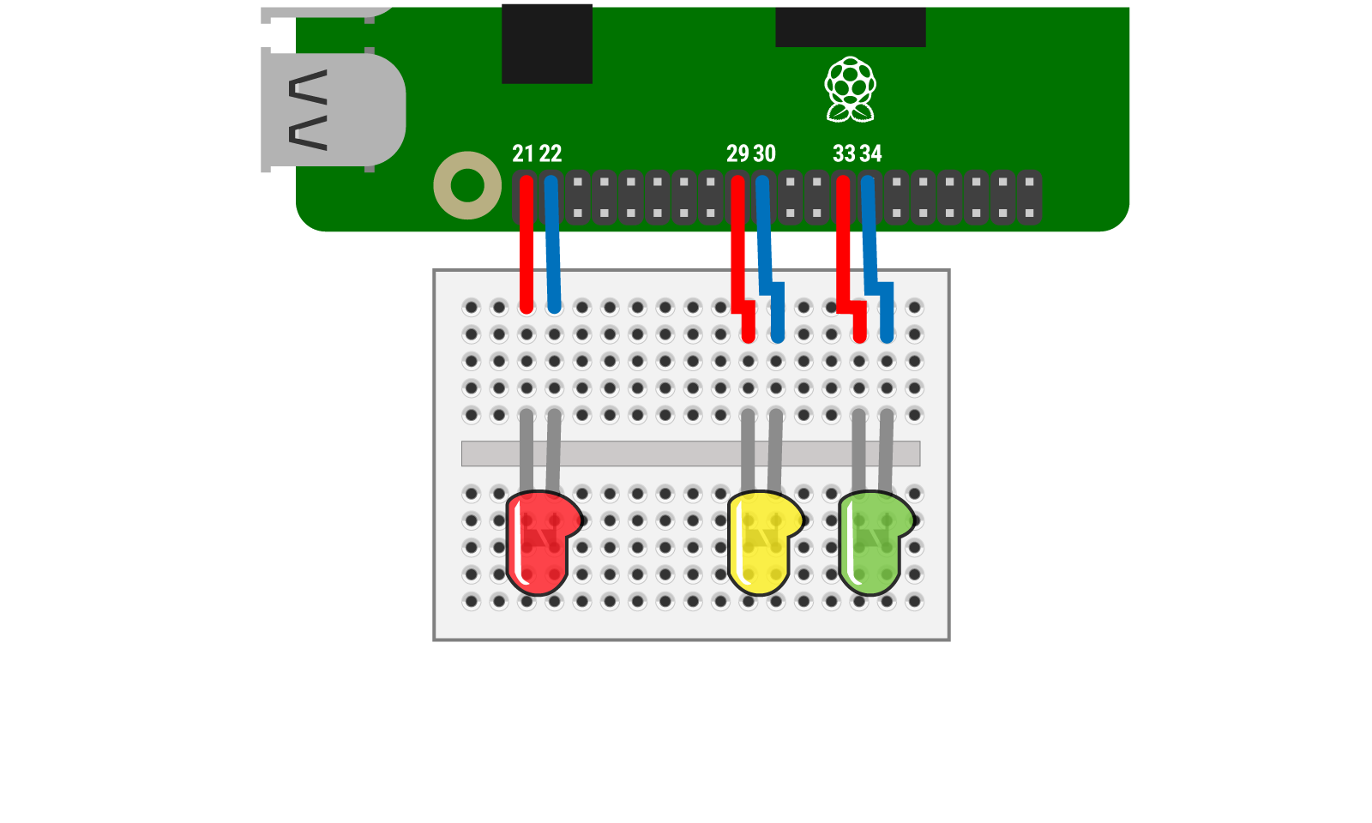
MiniGame:
Chest Quest
What power-up do you get in the game from connecting the circuit above?
Notes:
What was the problem you solved?
How did you solve it? (What process did you use?)

Slide 13
MiniGame:
Chest Quest
How does this circuit work? How does each LED know when to light up? Why don’t they all light up at once?
GPIO Setup
Background Since LEDs are diodes, they must be wired in a particular direction in the loop of a circuit. The longer leg of the LED should be lined up with the + end of the circuit (normally a GPIO pin on the RPi) and the shorter leg of the LED with the - end (normally a "ground pin" on the RPi).
Notes:
What was the problem you solved?
How did you solve it? (What process did you use?)

Slide 14
Review Circuits/Components
Which components did you not use during the MiniGames?
Think, Pair, Shaire: Brainstorm a MiniGame or 2 where you might use these components! How would you use them and connect them?
Notes:
What was the problem you solved?
How did you solve it? (What process did you use?)

Slide 15
Review Circuits/Components
BUZZERS An active buzzer, like an LED, is a diode. It must be connected to the circuit in a particular direction to ensure current can flow through and produce the output of sound. An active buzzer has a built-in oscillating source, so it makes sounds when electrified.
LARGE TACTILE BUTTONS Tactile buttons are types of momentary switches that only remain in their state as long as they're being actuated (pressed or held down). Most often momentary switches are best used for intermittent user-input cases like keypad buttons or controllers, especially because tactile buttons are so easy to press or "click".
Notes:
What was the problem you solved?
How did you solve it? (What process did you use?)

Slide 16
Creative Mode
Take this time to revisit the StoryMode worlds with new PowerUps you just unlocked by replaying these worlds in Creative Mode!
Consider:
What other type of challenge could be made for this world?
What type of “Power-Up” would you want to create to make it through the level more quickly?
Notes:
Creative Mode

Slide 17
Game Design Toolkit
What do you think a Game Designer must consider when creating a game?
1. Who is the player?
2. What do we want the player to experience?
3. How will we engage the player?
4. What circuits will they need to build?
5. What challenge will the player need to solve?
Notes:
Game Design toolkit

Slide 18
Try This!
Design your own MiniGame!
Consider the following:
What are the players needs when playing a MiniGame
What ability (power-up or learning) would the player gain through the minigame?
Plan, design, then create a poster for your minigame.

