Slide 1
Lesson 4.2 Slides Introduction to Design Thinking

Slide 2
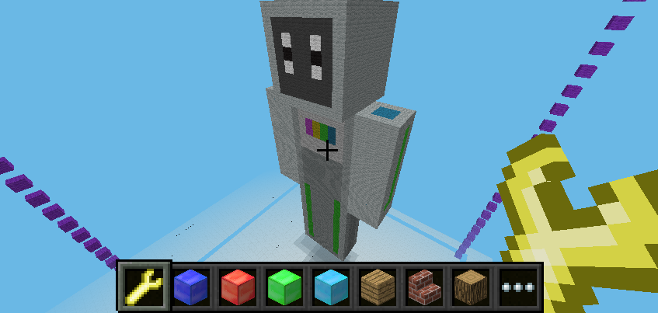
Bot Builder
How did you start designing your Bot?
Did you play around with different designs?
What steps did you follow to create your robot?
What improvements can be made to your Bot?
Notes:
What did you think about when you were designing your bot?

Slide 3
Notes:
Consider: Engineering Design Process

Slide 4
Engineering Design Process:
What is the problem?
The first step is to identify the problem.
What do we know about the problem?
Where else have we seen this problem?
Notes:
First step: Identify the problem

Slide 5
Engineering Design Process:
What are the possible solutions?
The next step is to consider solutions.
What can we do to fix the problem?
How will we go about doing it?
Notes:
Second step: Identify possible solutions

Slide 6
Engineering Design Process:
What will the solution look like?
Once you have considered a solution, you can start planning.
Planning helps organize our implementation.
You should always plan for all possible outcomes (good and bad).
Notes:
Third step: What will your solution look like?

Slide 7
Engineering Design Process:
Build your plan.
Get to work!
Use your plan to build your solution.
There will be obstacles, but you have planned for them!
Notes:
Fourth step: Build your plan.

Slide 8
Engineering Design Process:
Test your solution
Put your solution to the test!
See if your plan worked out.
Again, there might be setbacks, but the next step will help...
Notes:
Fifth step: Test your solution.

Slide 9
Engineering Design Process:
How can you make it better?
There’s always room for improvement.
What worked well?
What can we change to make the solution better?
Notes:
Sixth step: How can you make your solution better?

Slide 10
Engineering Design Process:
Share your results.
Others can benefit from learning of your solution.
Scientists, Mathematicians, and Engineers are always open to sharing.
We all learn and grow together.
Notes:
Final step: Share your results.

Slide 11
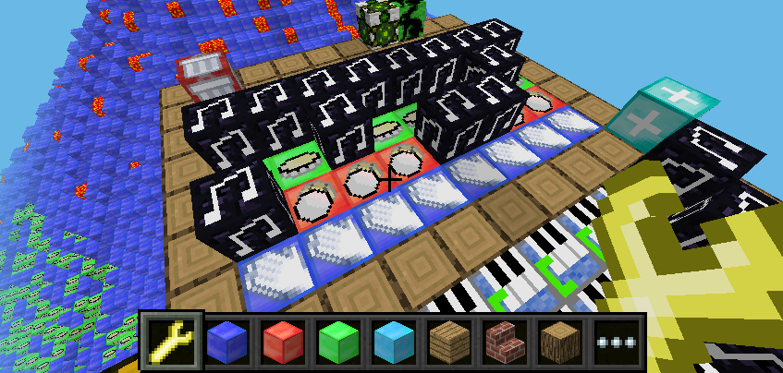
Pip Hop
What was the first thing you did?
How did you explore the minigame?
What did you learn from this minigame?

Slide 12
Notes:
Consider: Engineering Design Process

Slide 13
Reflect!
On your Exit Slip, write down:
2 things you learned today.
1 question you have about today’s lesson.
1 problem you faced and how you were able to solve it.
Notes:
Collect these exit slips as a formative assessment to see what you need to review next class!

