Slide 1
Lesson 4.3 Slides Hackathon 1: Redesign a Traffic Stop

Slide 2
The Setup: Redesigning a Traffic Stop
What are some things we had to consider when completing the PiperCode Project: Stoplight?
How can we apply what we created in that project to a 4-way stop?
Notes:
Intro to puzzles

Slide 3
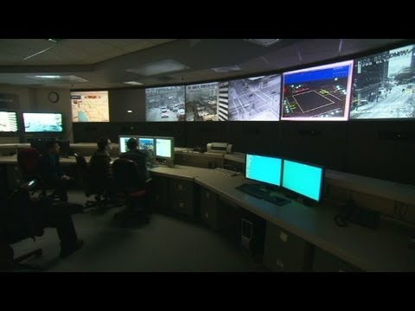
LA Control Center
Notes:
If you have time, students can watch this video on the LA traffic control center.

Slide 4
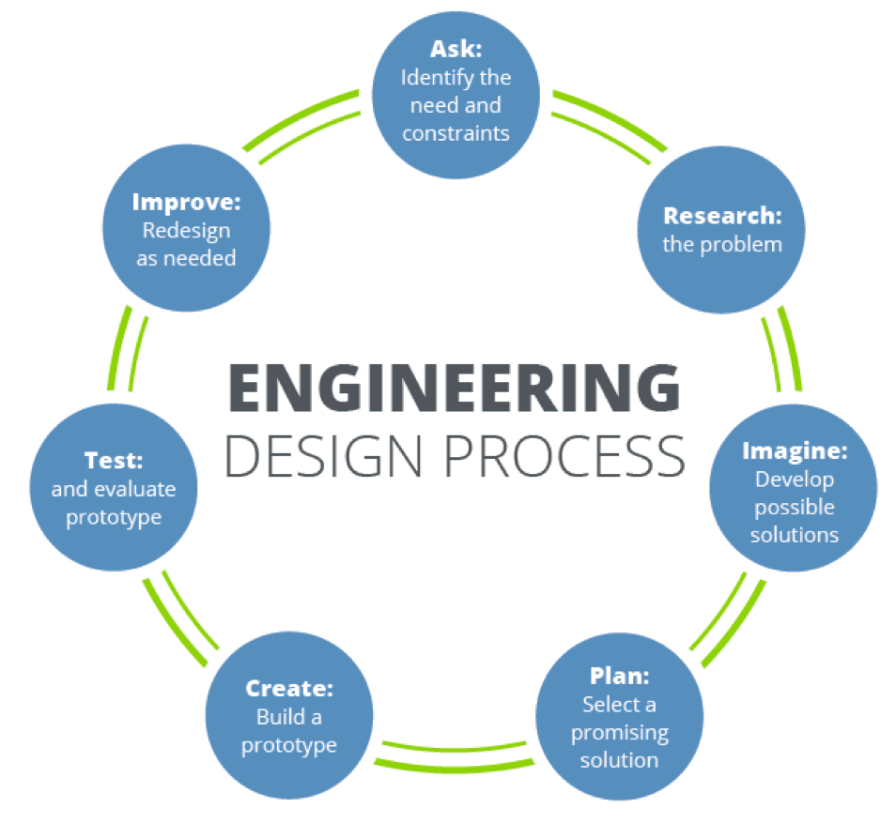
Engineering Design Process
Use the Design Process to create a solution.
Notes:
Review the Design Process to prepare their design for the four-way stopl

Slide 5
Share Your Plan
Before you build, share your plan with the class.
Notes:
Before students get to build their prototypes, they should share their plans with the class.

Slide 6
Build Your Prototype
Use this time to build your prototype.
Once it’s made, we must always test our ideas.
Notes:
Students can begin building their prototypes. Be sure to walk around the classroom and ask guiding questions,

Slide 7
Build Your Prototype
Use this time to build your prototype.
Once it’s made, we must always test our ideas.
Notes:
Guidelines on how to present ideas

Slide 8
Reflect!
On your Exit Slip, write down:
2 things you learned today.
1 question you have about today’s lesson.
1 problem you faced and how you were able to solve it.
Notes:
Collect these exit slips as a formative assessment to see what you need to review next class!

