Slide 1
Lesson 4.4 Slides Engineering Design with Piper

Slide 2
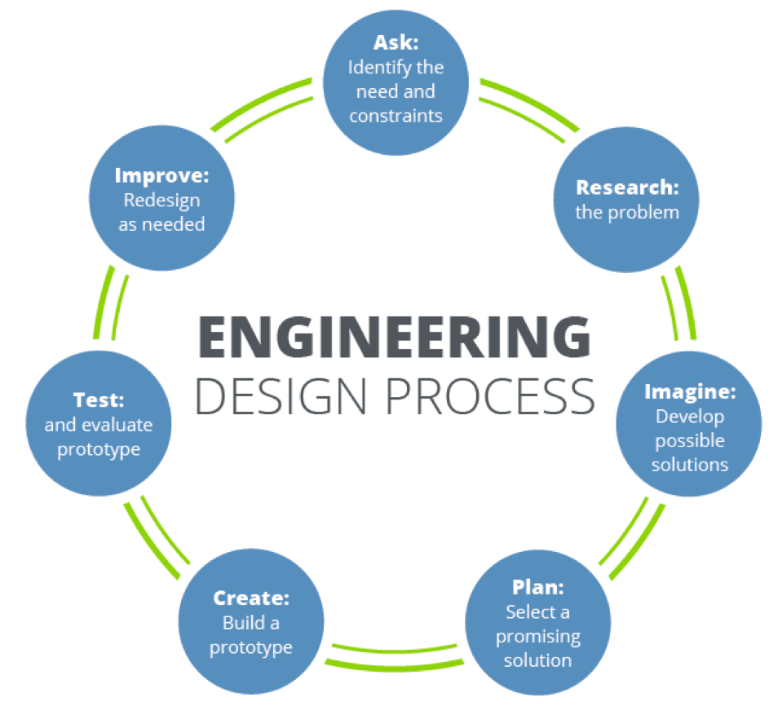
Engineering Design Process
Notes:
Review the Design Process

Slide 3
Solutions at School
Consider the problems of our school. Choose one that you would like to help solve.
What do we know about the problem?
How can we learn more about it?
Notes:
Prepare students for their own Design Project by discussing issues that your school might be facing.
Possible problems:

Slide 4
Solving the Problems of the World
Consider the problems of our world. Choose one that you would like to help solve.
What do we know about the problem?
How can we learn more about it?
Notes:
Prepare students for their own Design Project.

Slide 5
Reflect!
On your Exit Slip, write down:
2 things you learned today.
1 question you have about today’s lesson.
1 problem you faced and how you were able to solve it.
Notes:
Collect these exit slips as a formative assessment to see what you need to review next class!

