Slide 1
Lesson 5.2 Slides Computers in Everyday Life

Slide 2
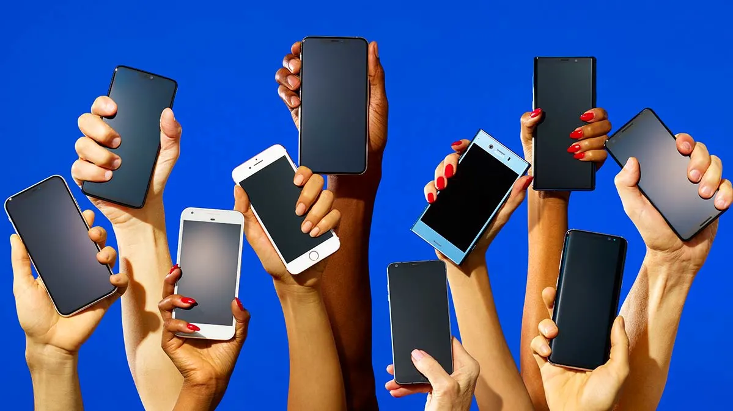
Computers in Our Everyday Lives
How many computers do you think you use in one day?

Slide 3
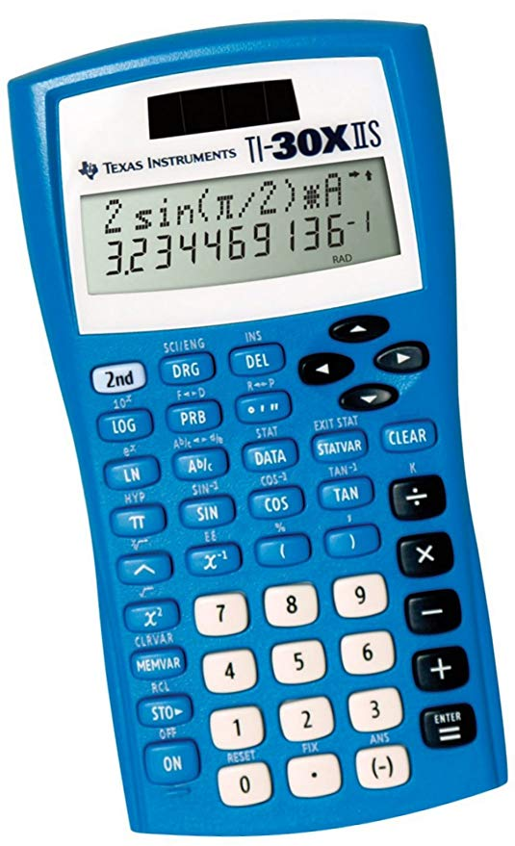
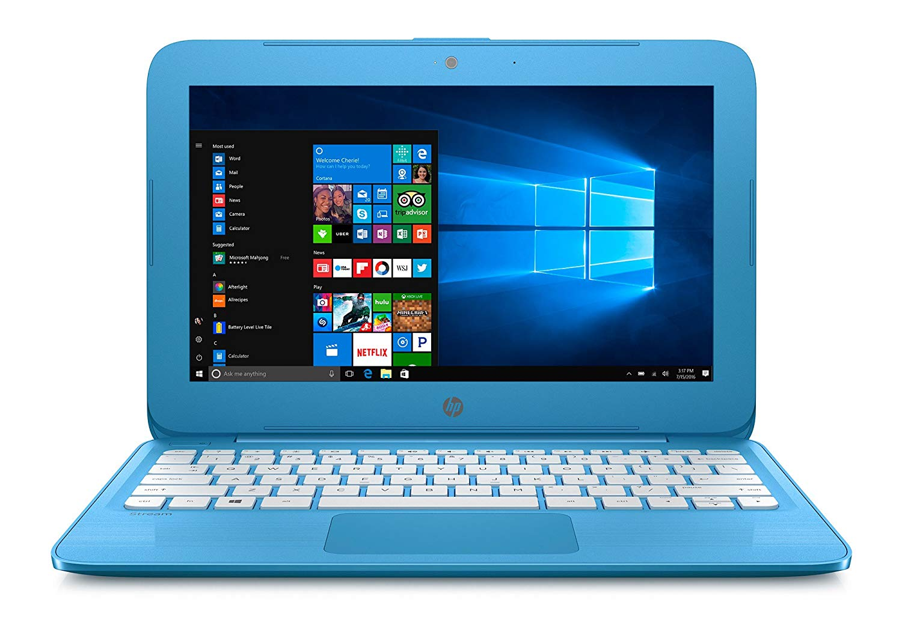
Your Computer Journal
Describe a typical day in your life.
What technology do you use?
How does the technology help you?

Slide 4
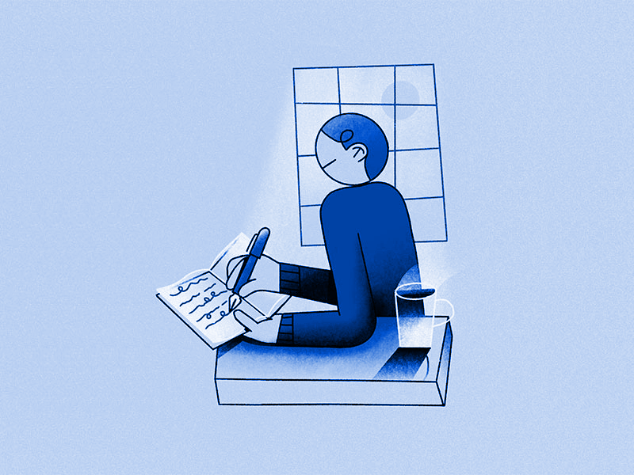
Share Your Journal
Take turns sharing your journals.
Describe a typical day in your life.
Be sure to:
Consider what you have in common
How are your journals different?
What purpose does technology have in each of your daily lives?

Slide 5
Life in Peru
Consider life in a remote village found in the mountains of Peru.
What role would technology play in their daily lives?
What limitations must they consider when choosing the technology the town must purchase?
Would this affect what computers they purchase?
Notes:
More details and a video can be found at: http://www.dailymotion.com/video/xework_peru-green-electricity-in-the-andes_news#.UO2rEGdCPTo

Slide 6
Computers for Professionals
Consider these occupations:
Teacher
Scientist
Accountant
Engineer
Digital designer
What purpose does technology have in their work?

