Slide 1
Lesson 5.3 Slides The Environmental Impacts of Computers

Slide 2
ENGAGE
With your group, discuss the following questions. Write down your own interpretation of the answers as you discuss:
According to the inventory on our blueprint, how many parts make up a computer?
Where do you think these parts come from?
When we tested our computers, the last step was plugging into the power bank. Where does electricity come from?
What do we know about where we get electricity from?
Notes:
Teachers: Have groups share out their responses afterwards

Slide 3
Where do computers come from?
How much do we know about the manufacturing of computers?
How can we learn more about the life cycle of a computer?

Slide 4
Where do computers come from?
Describe the manufacturing process for computers.
How does it impact our environment?

Slide 5
Describe the Life of a Computer
We will research the life of a computer, from the making of a computer, to the recycling of its parts once it’s out of use.
Use the Visual Organizer to guide your research.

Slide 6
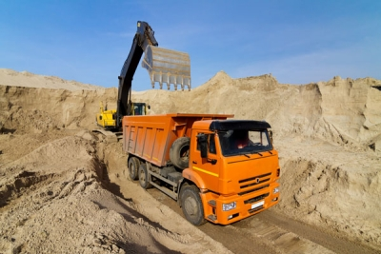
Mining
What are computers made of?
What materials are used during this process?
What kind of impact do you think this has on the environment?

Slide 7
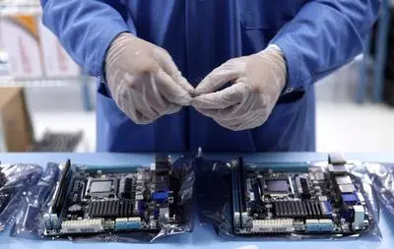
Manufacturing
Consider the blueprint from Lesson 1.1. What parts make up a computer?
How are computers made?
What materials are used during this process?
What kind of impact do you think this has on the environment?

Slide 8
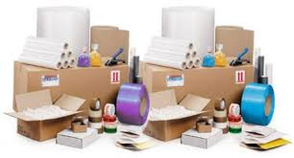
Packaging
How are computers packaged?
What materials are used during this process?
What kind of impact do you think this has on the environment?

Slide 9
Shipping
How are computers shipped?
What systems are used during this process?
What kind of impact do you think this has on the environment?

Slide 10
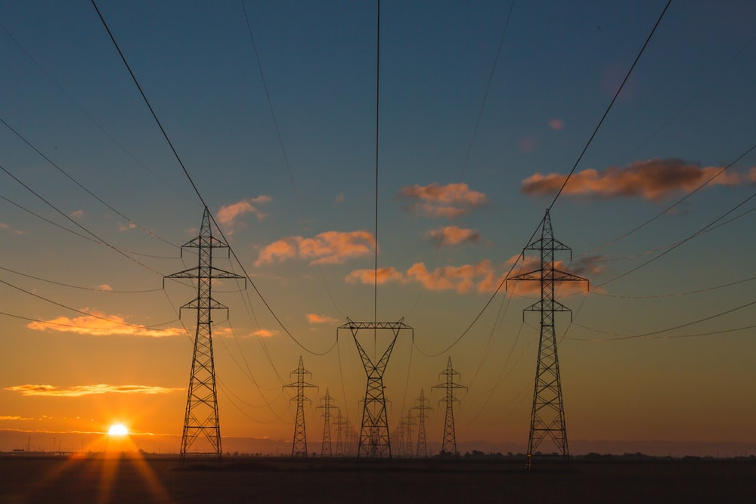
Usage
What makes computers work?
How many different products are used during this process?
What kind of impact do you think this has on the environment?

Slide 11
Recycling
How are computers recycled?
What does this process look like?
What kind of impact do you think this has on the environment?

Slide 12
Reflect!
On your Exit Slip, write down:
How has learning about the environmental impacts of using computers affected the way you look at technology in your everyday life?
Notes:
Collect these exit slips as a formative assessment to see what you need to review next class!

