Slide 1
Lesson 5.4 Slides Final Design Challenge

Slide 2
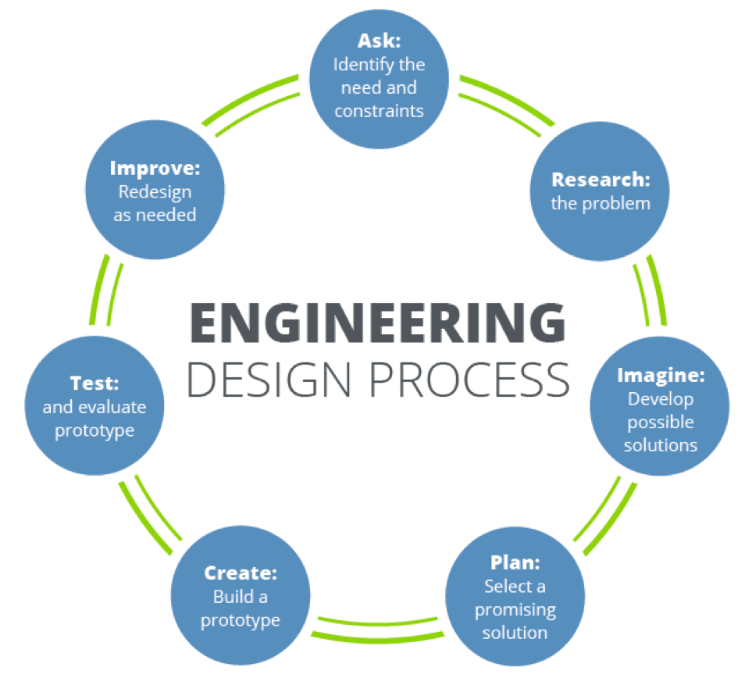
Review: Engineering Design
Follow this process to create your own design for a computer.
Be ready to share how you used this process.
Notes:
Review the Design Process to prepare students through their making of their own computer.

Slide 3
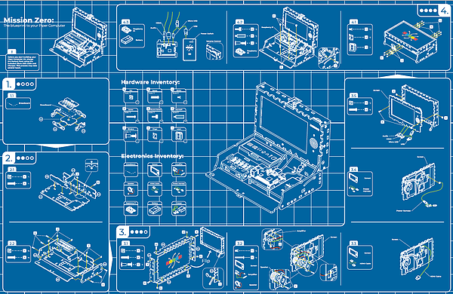
Create Your Own Blueprint
Develop your own version of the Piper Blueprint you used when you built the Piper Computer.
Be sure to include:
A labeling system
Step-by-step instructions for how to build your computer

Slide 4
Creating a Design
Prepare the following for your sales pitch:
Specifications
Estimated costs
Desired User Experience
Estimated environmental impact
Potential business partners

Slide 5
Presenting your Pitch
Prepare a presentation with your team’s work.
Each team member will create slides for their part of the plan.
Decide who will present each slide for the presentation.

Slide 6
Your Turn!
Now that you know the process for making a computer, it’s your turn to design your own!
What must your team consider?
Use the design process to guide your plan.
Prepare to share your designs.

