Slide 1
Temperature Sensor
Lesson 1 - The Water Cycle

Slide 2
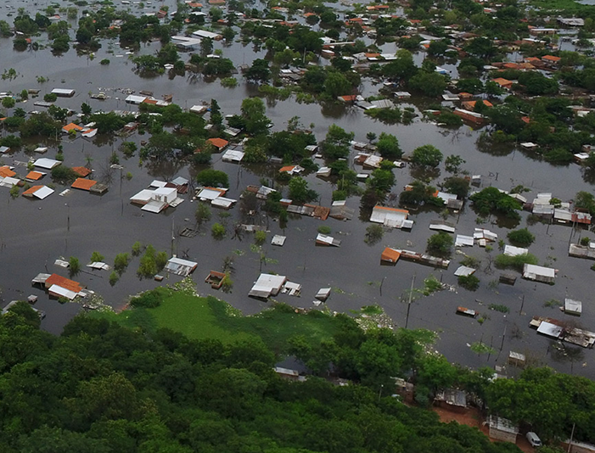
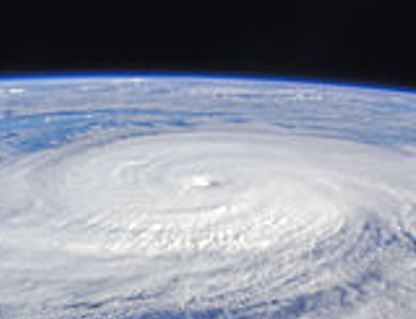
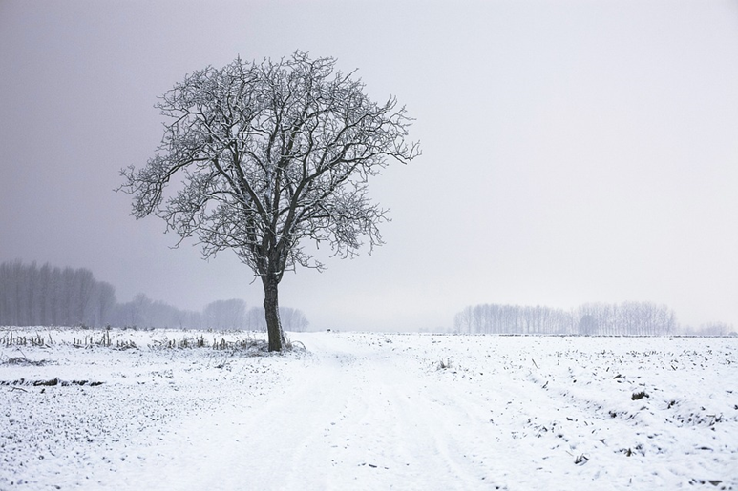
NATURAL DISASTER
How are they all related?
TEMPERATURE
Flooding in Paraguay
Typhoon in Taiwan
Extended winter in the midwest
‹#›
Notes:
Introduce today’s topic with images from natural disasters all created by El Niño.

Slide 3
RESEARCH
Define the question(s):
“How does the water cycle affect weather and climate?”
Research the problem:
Define the water cycle.
Define the phases of the water cycle.
TEMPERATURE
‹#›
Notes:
Weather patterns are what have been in the news most recently. It’s a problem scientists are working to solve. As citizen scientists, we can also help solve this problem using the Engineering Design Process. First step, let’s explore a central part of the problem - the water cycle.

Slide 4
ENGAGE
K | W | L
The Water Cycle is playing a key role in natural disasters.
What do we know about the water cycle and its role in climate change?
Know
Want to Know
Learned
TEMPERATURE
‹#›
Notes:
With your students, complete a KWL chart on poster paper.

Slide 5
RESEARCH
EXPERT GROUPS:
Evaporation
Condensation
Precipitation
Collection
Guiding questions:
What happens to water during your phase of the water cycle?
Why does this phenomenon occur?
How does this phase affect weather and climate?
Criteria:
Name of their part of the water cycle
Drawing of the process
How it occurs, when it occurs
All matter involved
TEMPERATURE
‹#›
Notes:
Introduce today’s group exploration into each phase of the water cycle

Slide 6
Notes:
Use the following slides to review what the students have learned.

Slide 7
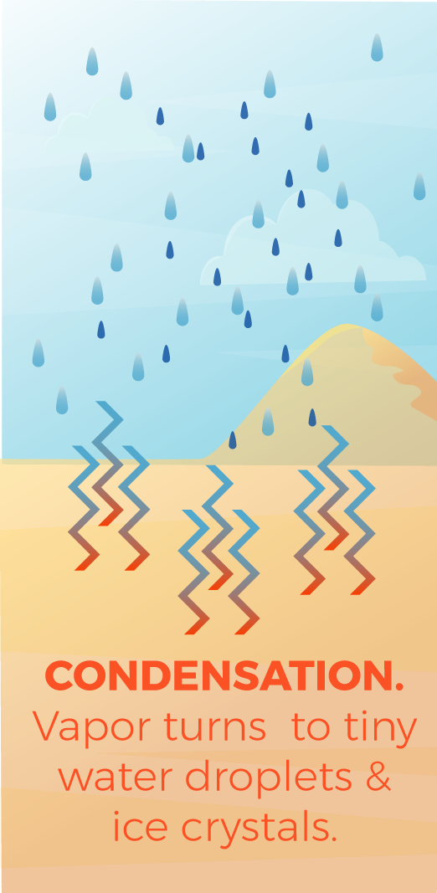
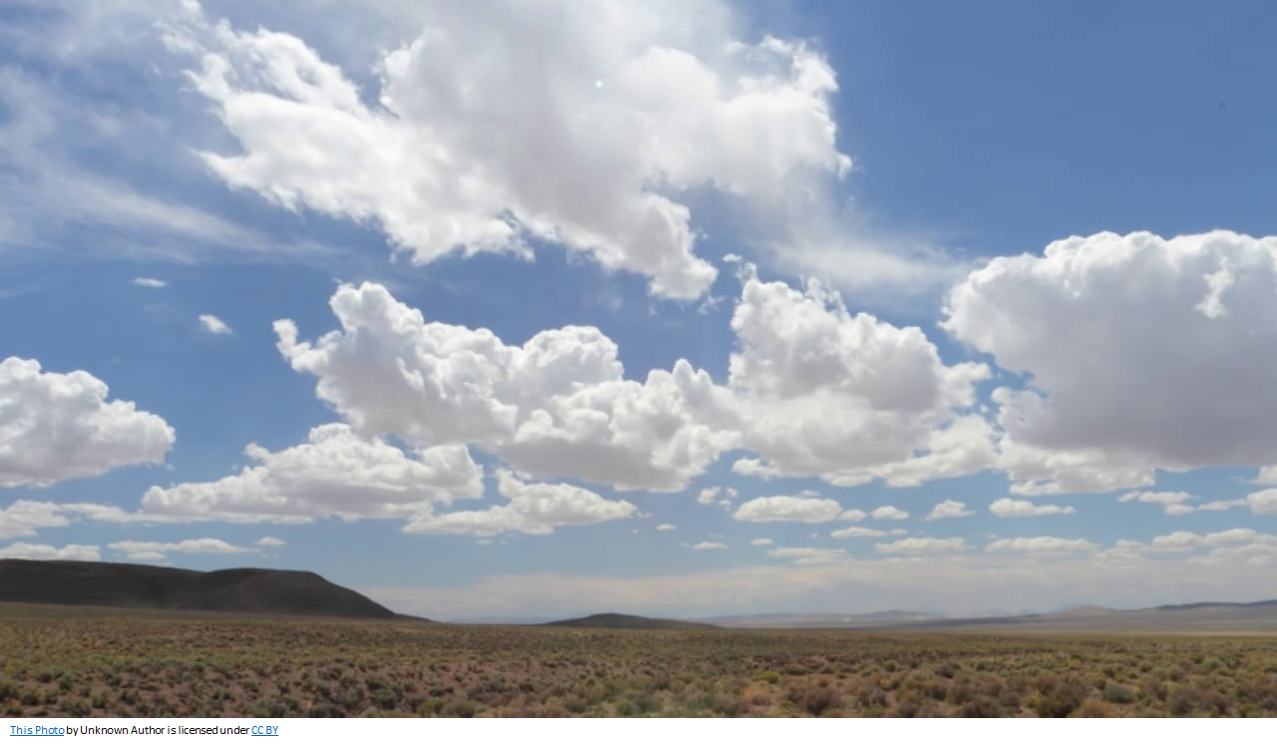
CONDENSATION
TEMPERATURE
The conversion of water vapor to liquid water.
‹#›
Notes:
Water cycle: condensation

Slide 8
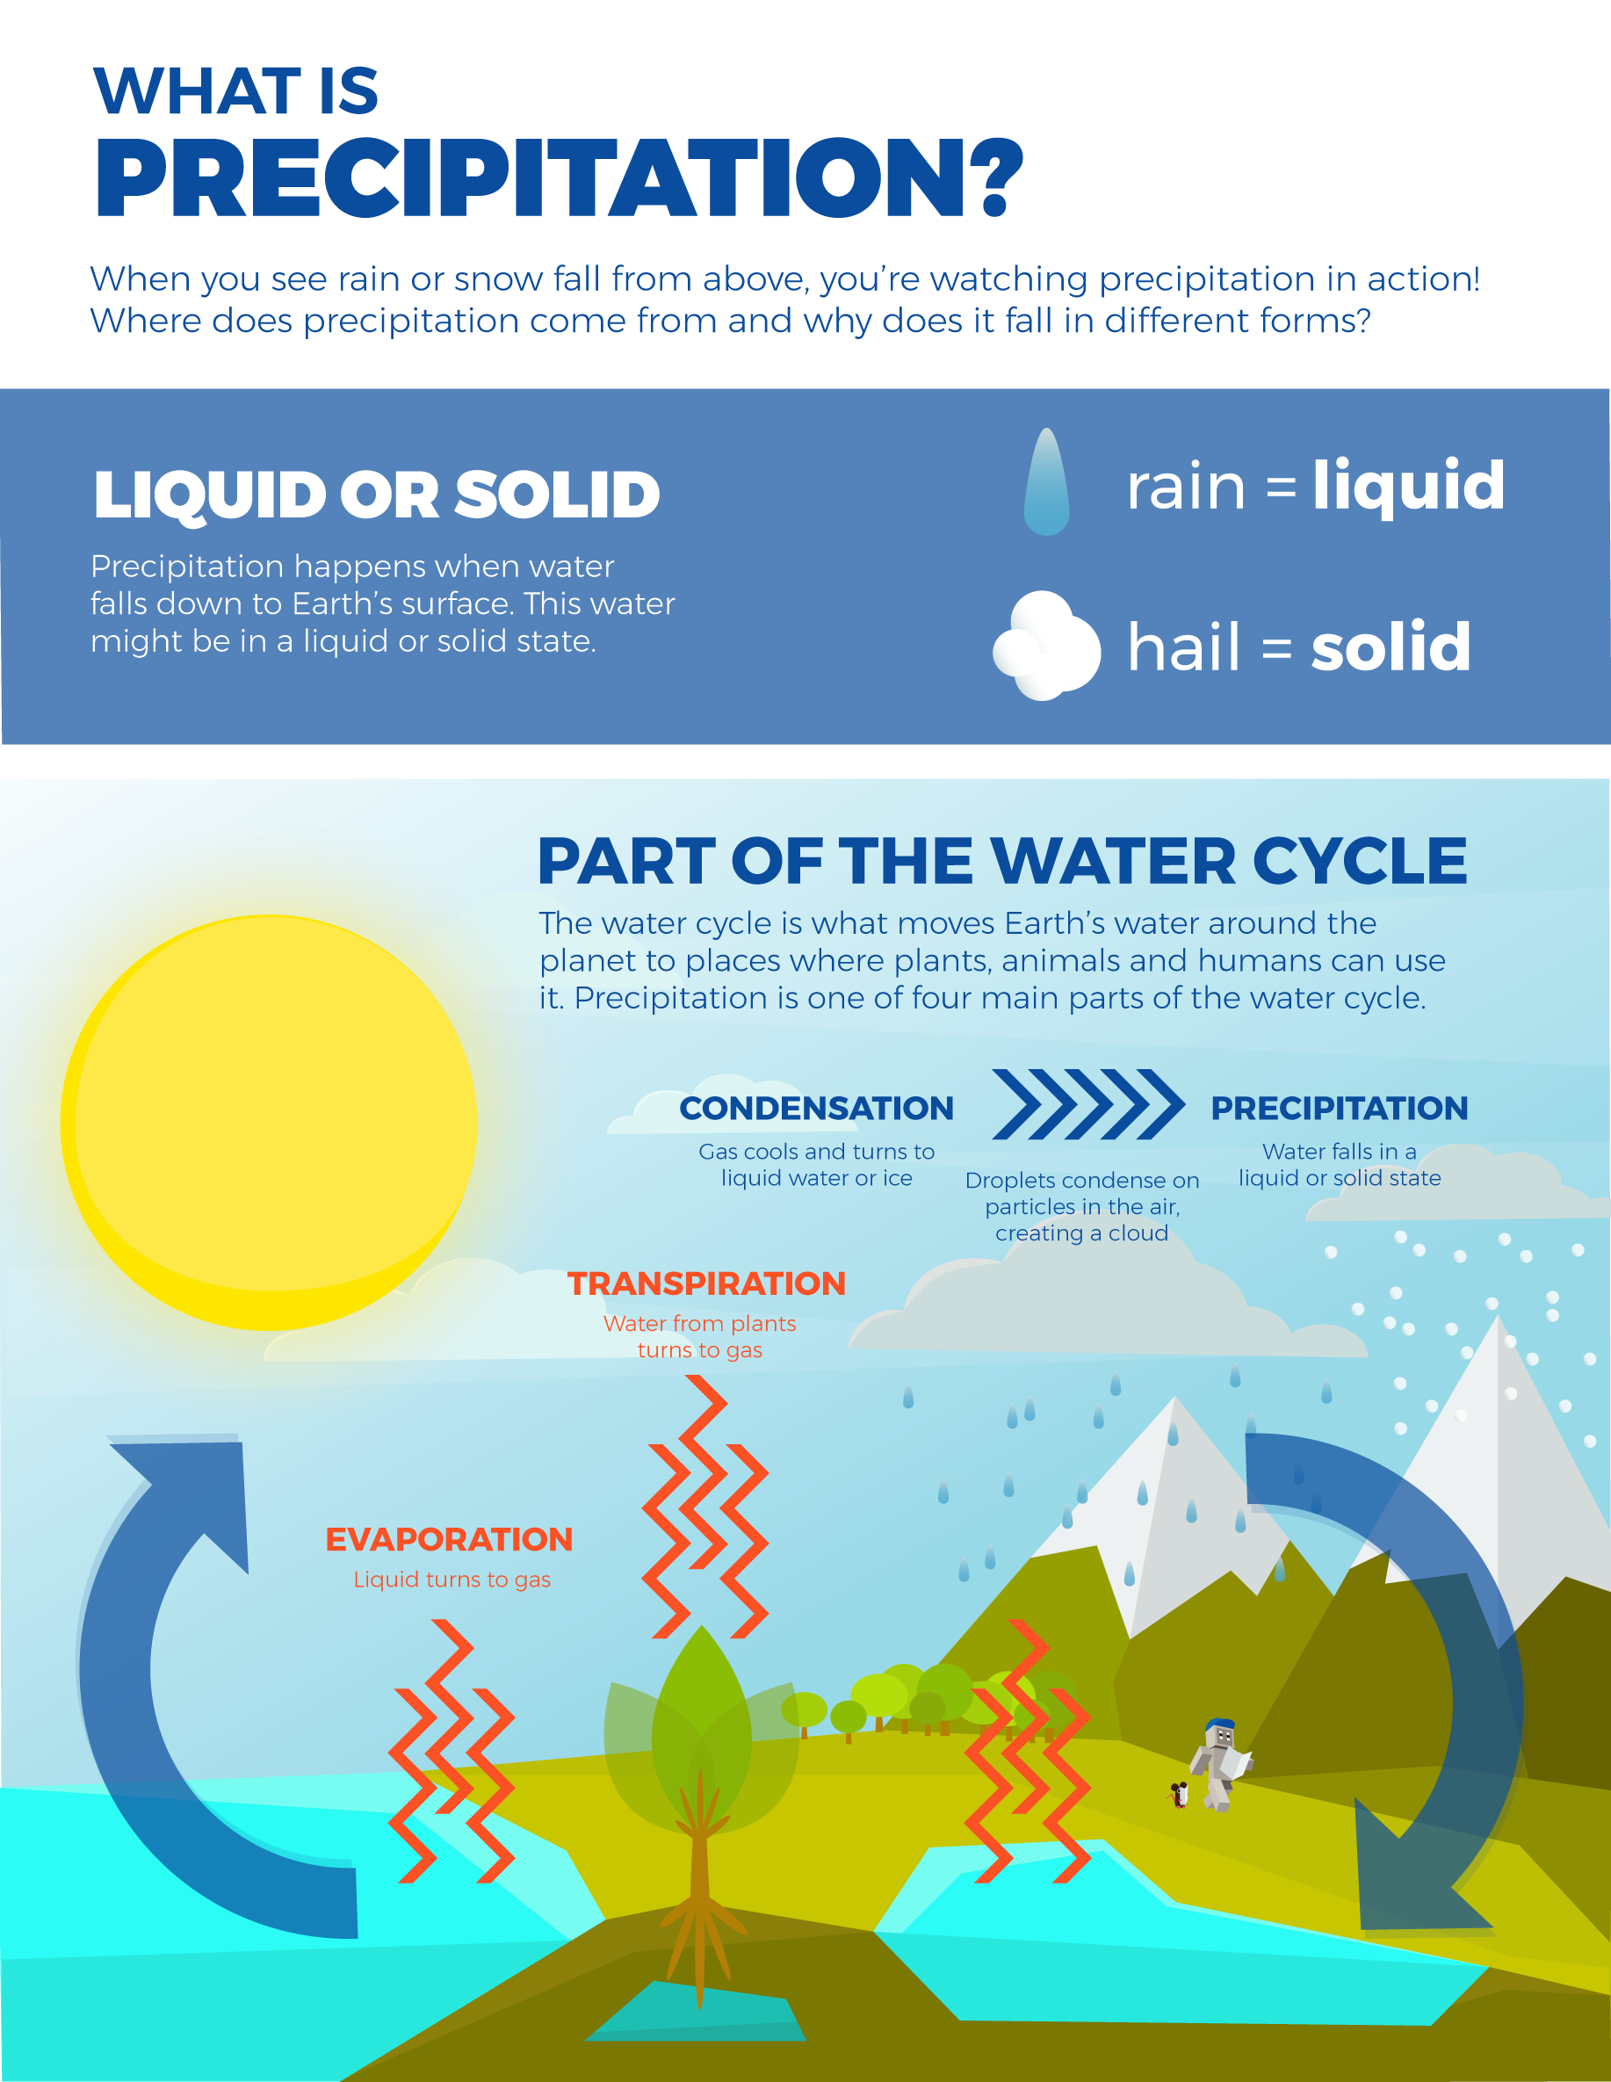
PRECIPITATION
TEMPERATURE
The falling of water in its liquid or solid form.
‹#›
Notes:
Water cycle: precipitation

Slide 9
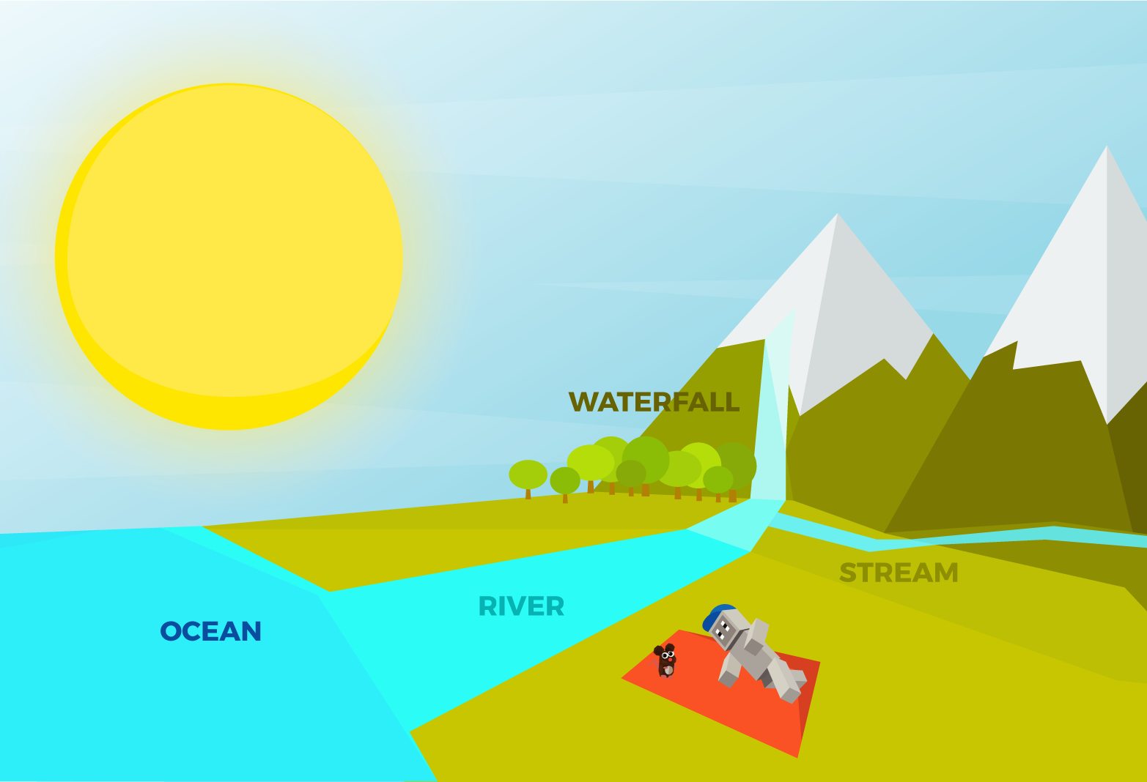
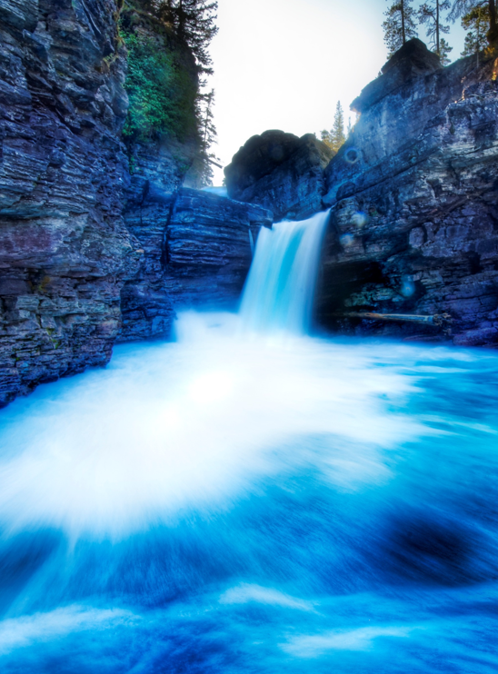
COLLECTION
TEMPERATURE
The collecting of liquid water in oceans, lakes, rivers, streams and land.
‹#›
Notes:
Water cycle: collection

Slide 10
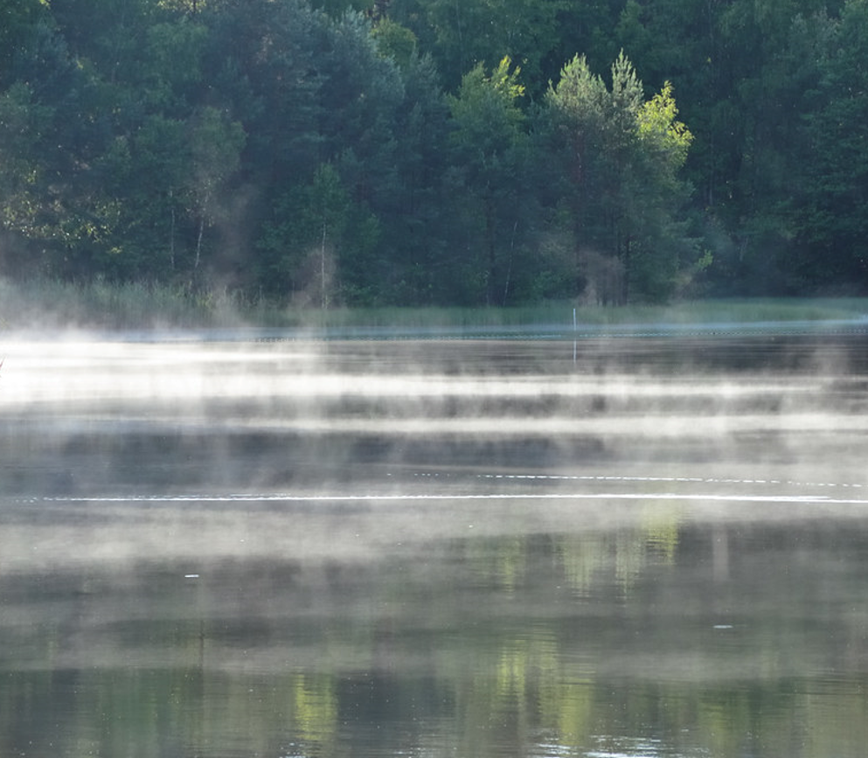
EVAPORATION
TEMPERATURE
When liquid water turns into water vapor.
‹#›
Notes:
Water cycle: evaporation

Slide 11
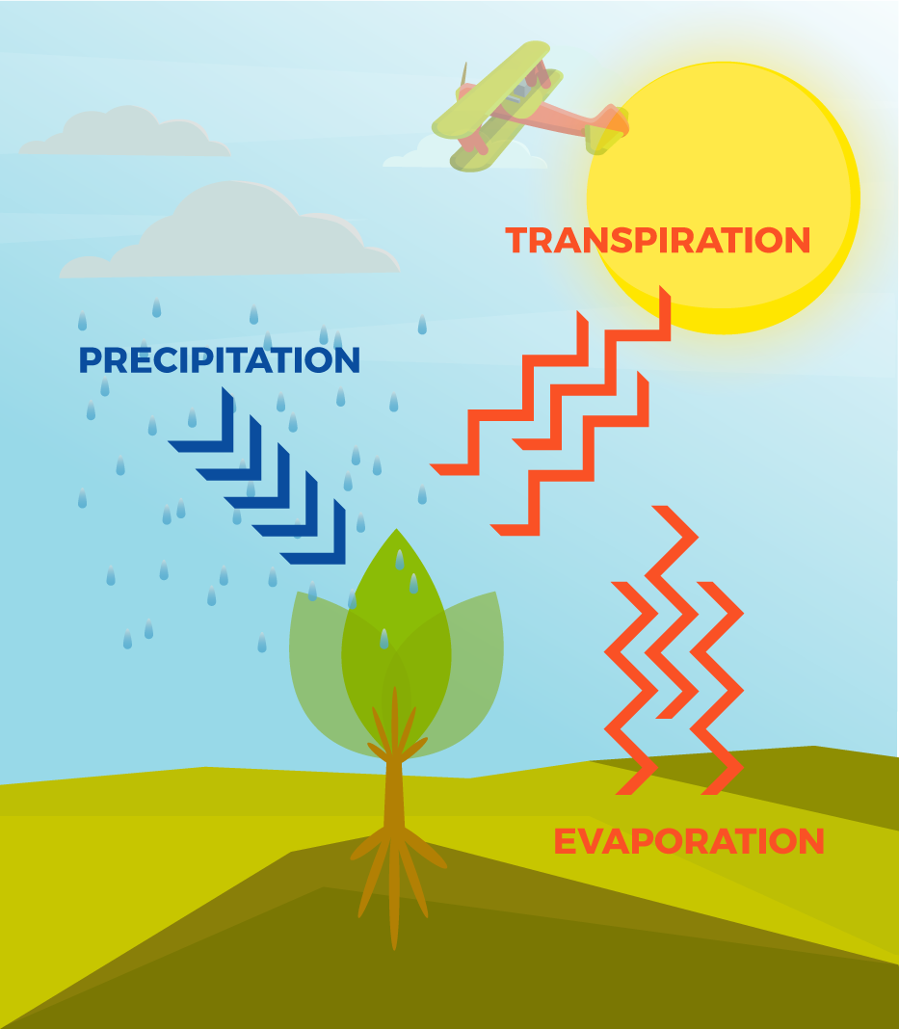
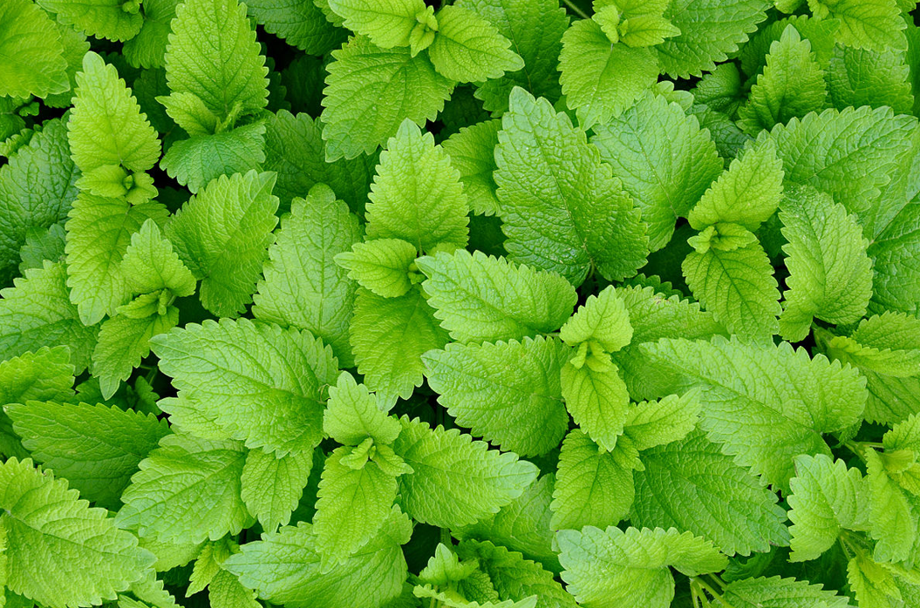
TRANSPIRATION
TEMPERATURE
When liquid water becomes vapor through plant leaves.
‹#›
Notes:
Water cycle: transpiration

Slide 12
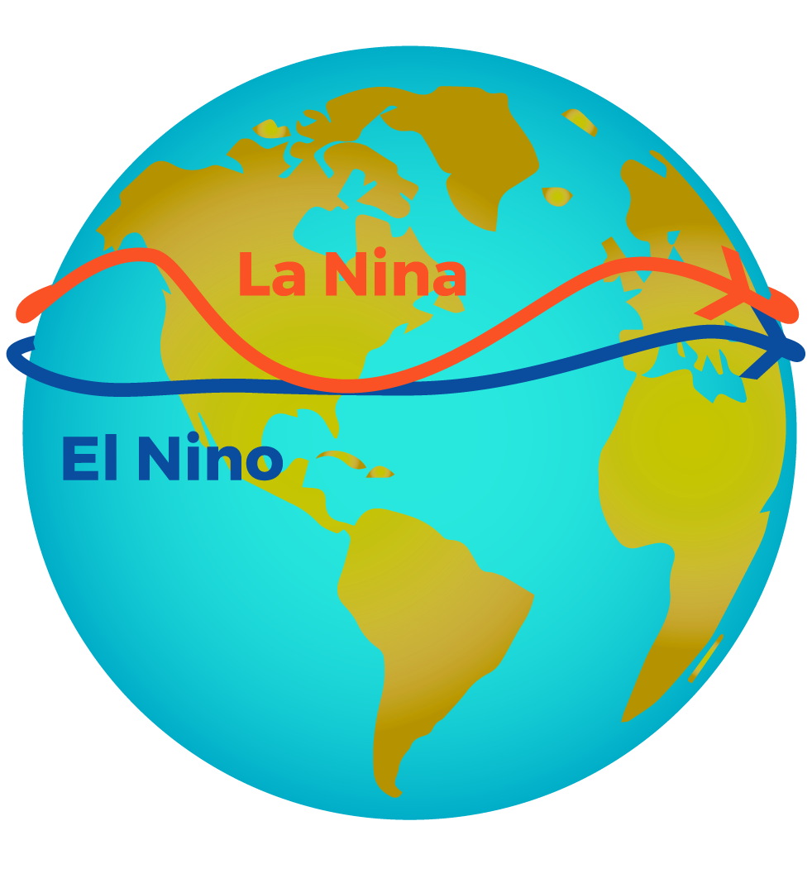
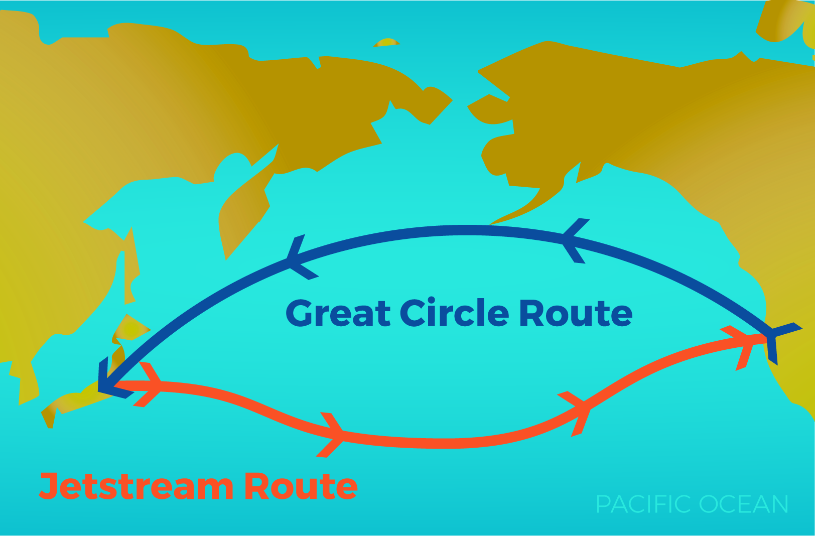
EXTENSION
Why would the air in China affect the air / water in the Bay Area of California?
TEMPERATURE
Hint: The Pacific Jet Stream
‹#›
Notes:
El Nino involves jetstream routes throughout our planet. The Pacific Jet Stream is one way air in one part of the world affects another part across the ocean.
More information can be found at https://www.smithsonianmag.com/science-nature/air-pollution-china-is-spreading-across-pacific-us-180949395/

Slide 13
REFLECT!
Respond to this writing prompt:
Name each part of the water cycle.
How is each part of the water cycle related to natural disasters?
How is the water cycle related to El Niño?
TEMPERATURE
‹#›
Notes:
Collect these exit slips as a formative assessment to see what you need to review next class!

