Slide 1
Temperature Sensor
Lesson 2 - What is Temperature?

Slide 2
SPEED
What is a SLOW speed for a car?
20 miles per hour?
TEMPERATURE
10 miles per hour?
30 miles per hour?
50 miles per hour?
‹#›
Notes:
Have students think of speeds that are considered “slow” for cars.

Slide 3
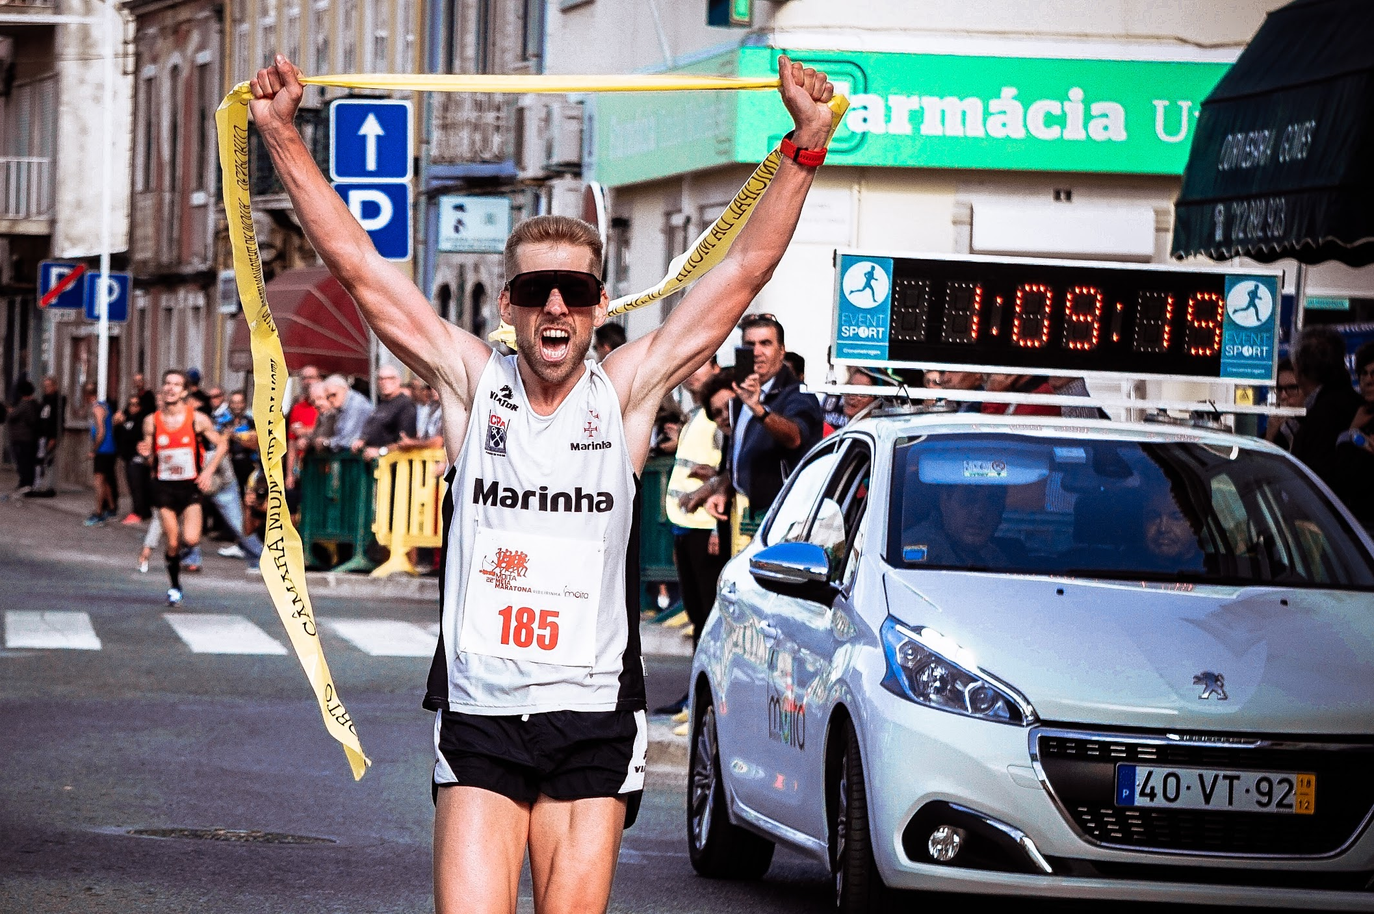
SPEED
TEMPERATURE
Imagine a human is running 10 miles per hour. Would that human still be considered SLOW?
‹#›
Notes:
In this case, 10 miles per hour is a very fast speed for a human to run. Although we are using the same quantitative data, we would describe it differently in this context. This is the key difference between quantitative and qualitative data.

Slide 4
SPEED
Which of these speeds are “fast”?
31 miles per hour
50 kilometers per hour?
How do we compare these speeds to
“miles per hour”?
TEMPERATURE
6 miles per hour
10 kilometers per hour?
12 miles per hour
20 kilometers per hour?
1 mile = 1.61 km
19 miles per hour
30 kilometers per hour?
‹#›
Notes:
Now that the unit of measurement has been changed, are students able to compare the speeds?
Discuss how the relationship between the two units allows people to convert and compare speeds. Here, the relationship is for every 1 mile, we have 1.61 kilometers.

Slide 5
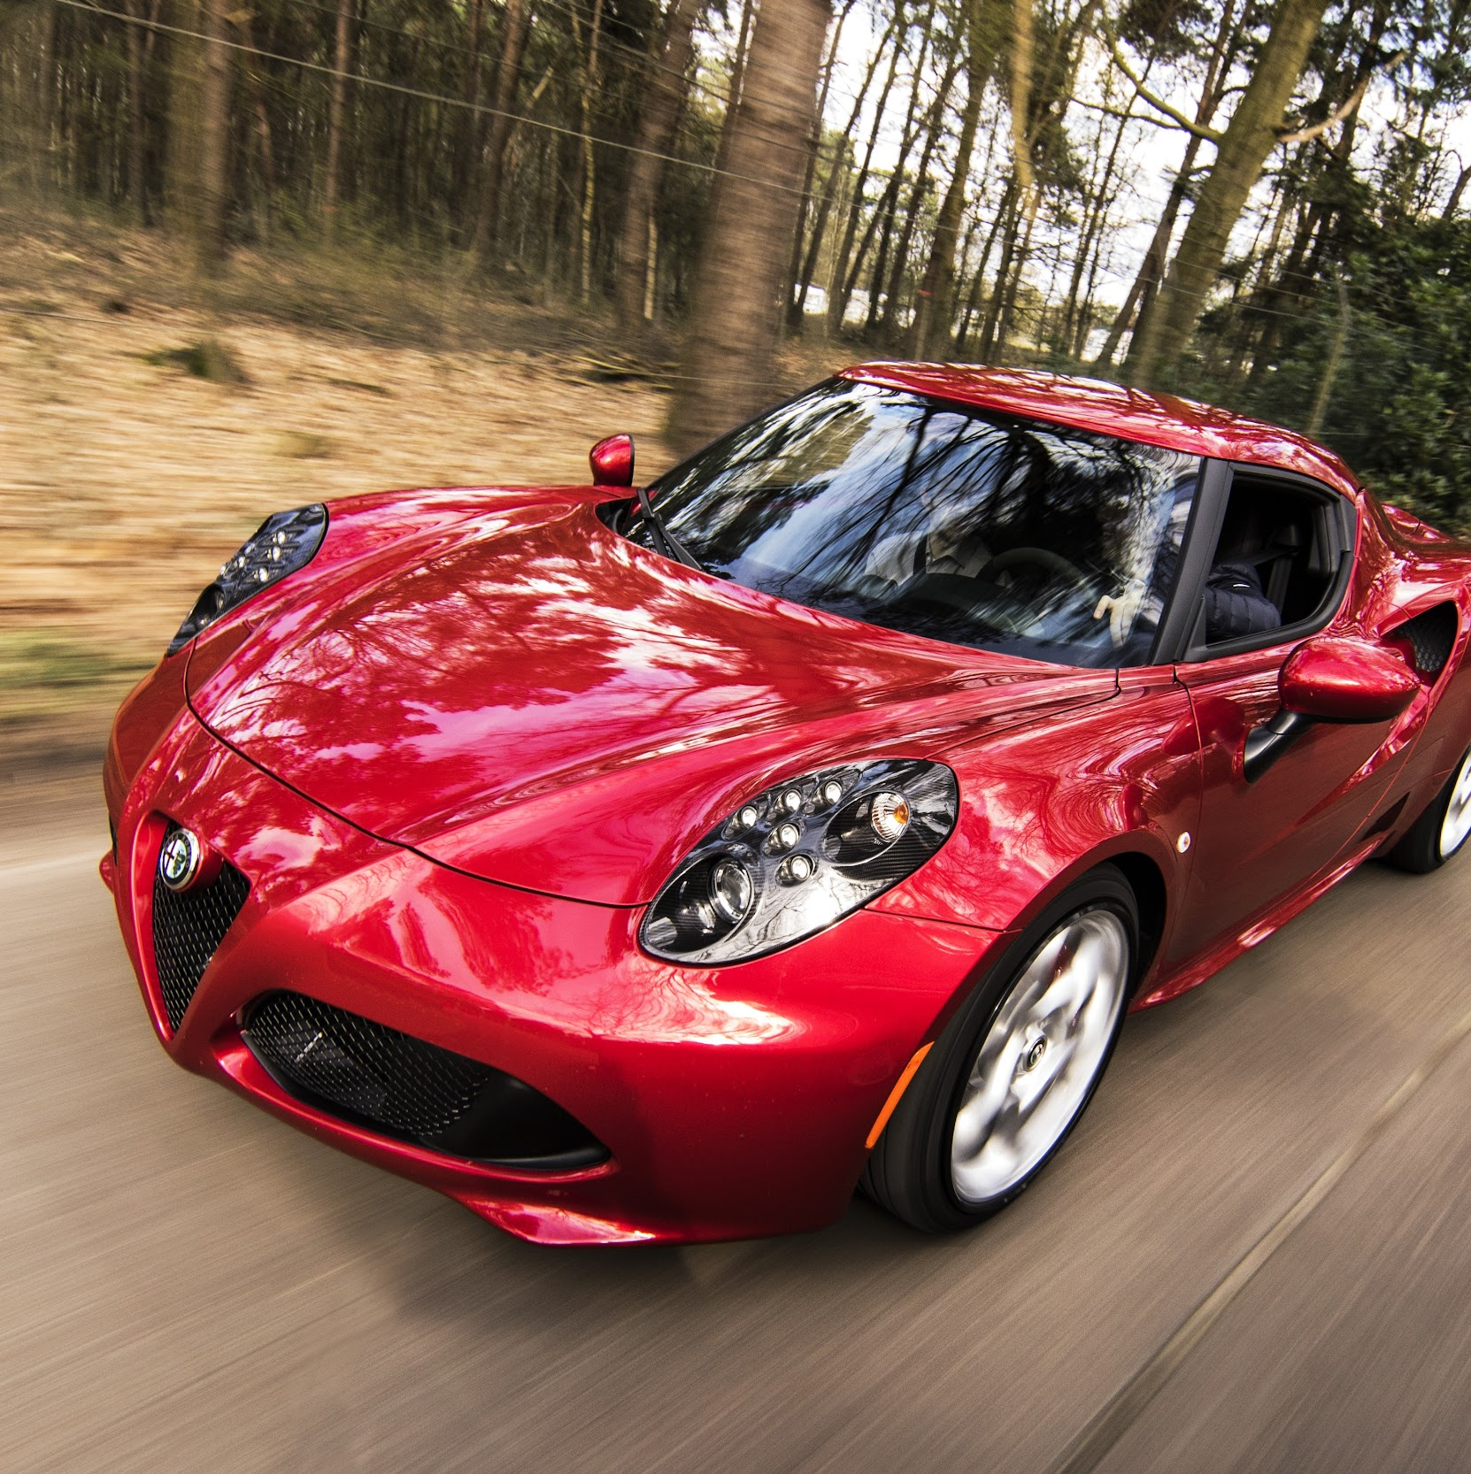
DISCUSS
What is a FAST speed for a car?
12 miles per hour
20 kilometers per hour?
19 miles per hour
30 kilometers per hour?
TEMPERATURE
31 miles per hour
50 kilometers per hour?
6 miles per hour
10 kilometers per hour?
‹#›
Notes:
The goal is to clarify that qualitative data is dependent on the context, whereas quantitative data is not.

Slide 6
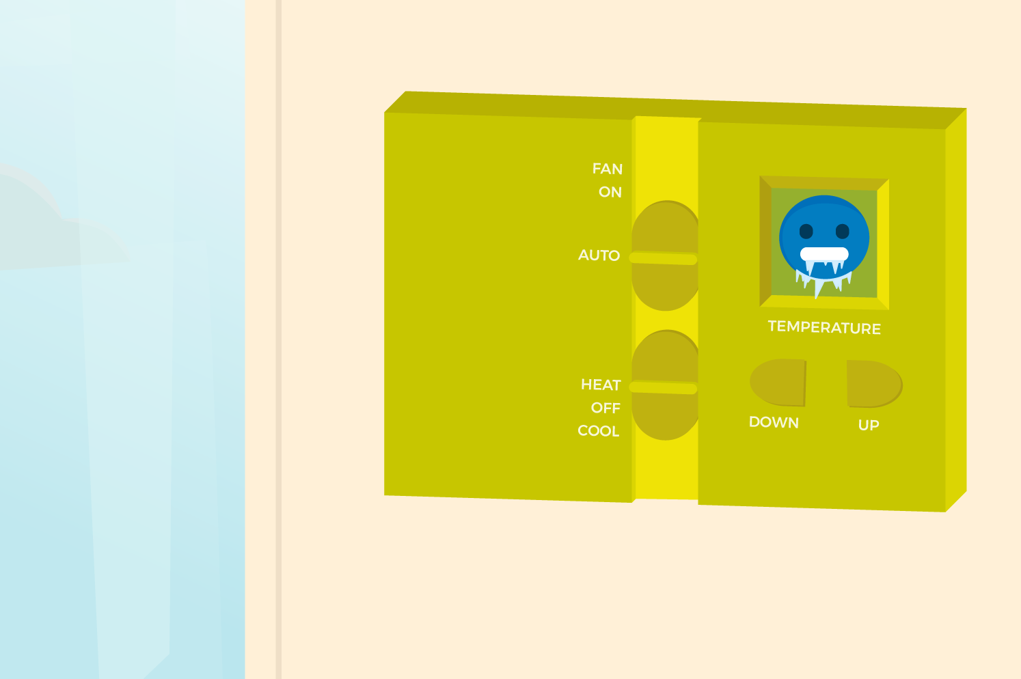
CREATE
PiperCode Project:
Ther-Mood-Stat
Follow the tutorial.
Be sure to pause and DISCUSS with your group.
Record answers in your GRAPHIC ORGANIZER.
TEMPERATURE
‹#›
Notes:
Introduce today’s Piper Project: Ther-Mood-Stat
Students can use the Lesson 2 Graphic Organizer during the exploration.
Troubleshooting: remind students to use the pin map during wiring to verify the pins that have current flowing.

Slide 7
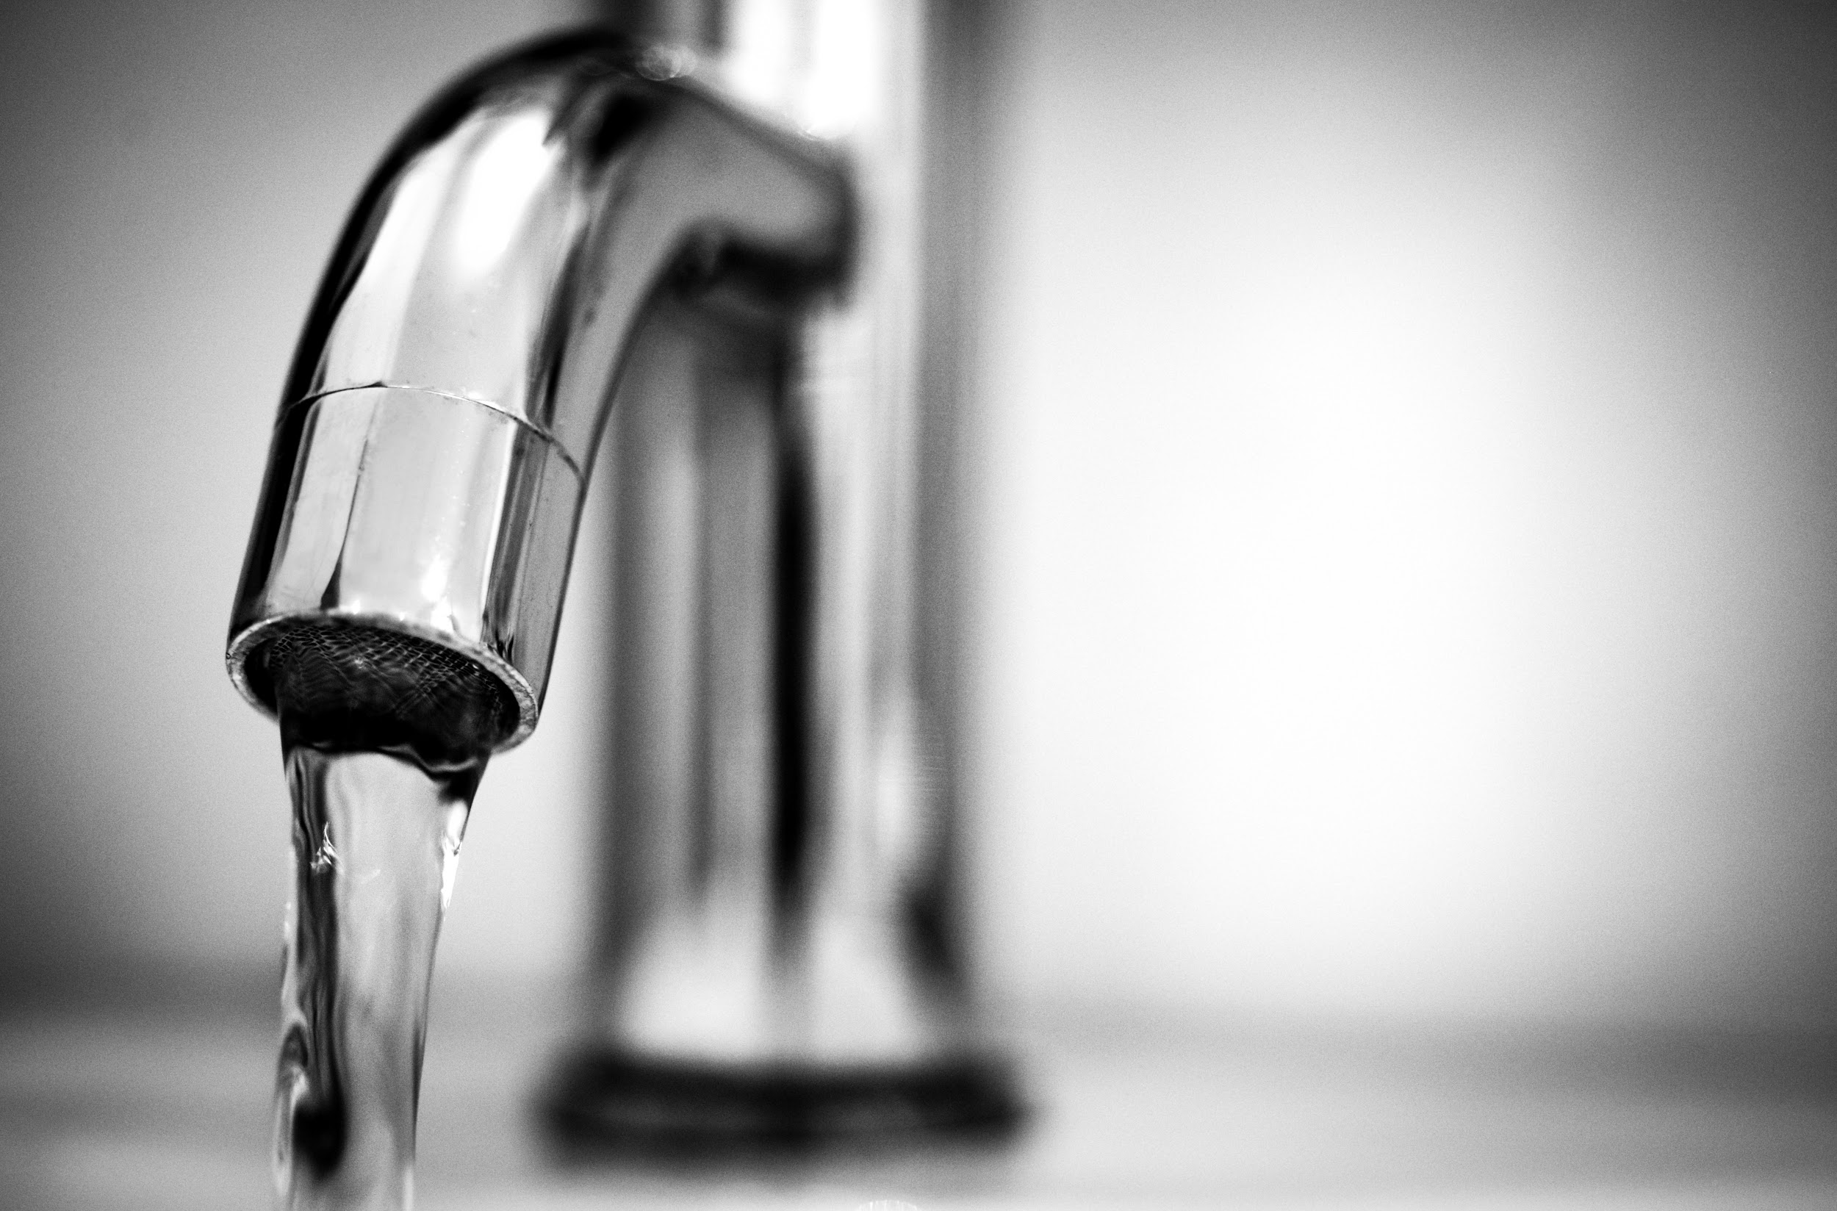
CREATE
The RIGHT way to measure.
TEMPERATURE
The WRONG way.
‹#›
Notes:
Safety concerns: When students need to measure a “cold obeject” students can use cold cans or bottles of water that have been in the fridge. NOTE: The temperature sensor can handle the condensation, but cannot be submerged in any kind of liquid.
Suggestions for warm materials: rubbing hands (creating heat),
You can also try going outdoors on a warm or cold day

Slide 8
DISCUSS
Inequality Symbols
≠ | not equal
< | less than
≤ | less than or equal to
> | greater than
≥ | greater than or equal to
What do these symbols represent?
TEMPERATURE
Why are we using these inequalities in this case?
‹#›
Notes:
Have groups share their responses to the discussion questions.

Slide 9
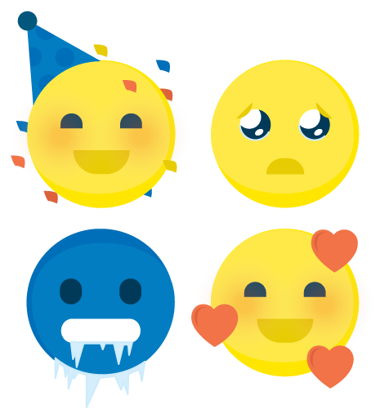
DISCUSS
Which temperature RANGE matches a particular emoji?
TEMPERATURE
‹#›
Notes:
Have groups share their responses to the discussion questions.

Slide 10
RANGE
How would one describe this emoji?
Does everyone agree that this range matches this emoji?
TEMPERATURE
Why would people disagree?
50
60
T ≥ 50
T ≤ 60
‹#›
Notes:
This is an example of a possible range.
Have students discuss in their groups how the emojis they chose might have varied group to group. Why does this happen? Why would the range of temperatures differ between groups? The temperature people are comfortable in can vary; it’s subjective.

Slide 11
DISCUSS
What do you think your sensor was measuring?
(determine certain values)
TEMPERATURE
‹#›
Notes:
The sensor is measuring the motion of the particles it comes into contact.

Slide 12
DISCUSS
How would your temperature ranges change if you use values in Celsius?
TEMPERATURE
‹#›
Notes:
Have groups share their responses to the discussion questions.

Slide 13
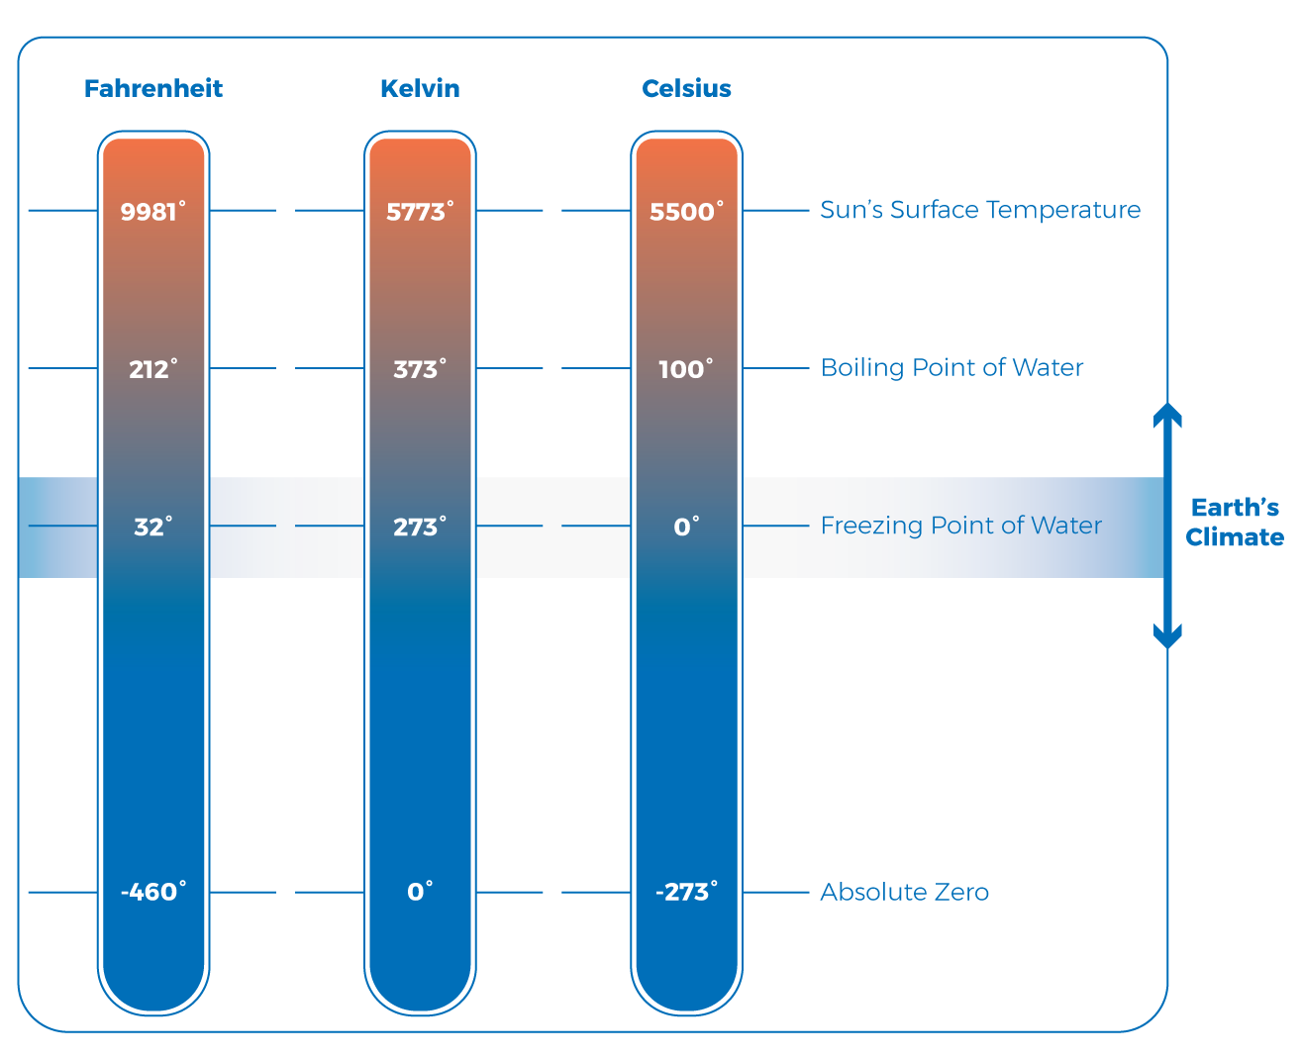
MEASUREMENTS
How would your temperature ranges change if you use values in Celsius?
Try it out!
T(°F) = T(°C) × 9/5 + 32
TEMPERATURE
T(°C) = (T(°F) - 32) × 5/9
To convert your temperature from Fahrenheit to Celsius, use the formulas.
‹#›
Notes:
The measure of that energy has taken on different units. There is Celsius and fahrenheit (the ones typically used today), then there is Kelvin [show 3 different thermometers, then only focus on Celsius and fahrenheit]. As you can imagine, there was interest in creating a standard unit of measure. Can you think of why this would be important? (Scientists sharing their experiments, recreating experiments, a world becoming more and more globally connected; the same reason qualitative isn’t the same thing as quantitative.)

Slide 14
PRACTICE
T(°C) = (T(°F) - 32) × 5/9
T(°F) = T(°C) × 9/5 + 32
T(°F) = 50°F
T(°C) = 30°C
TEMPERATURE
T(°C) = (50 - 32) × 5/9
T(°C) = (22) × 5/9
T(°C) = 10
T(°F) = 30 × 9/5 + 32
T(°F) = 54 + 32
T(°F) = 86
50°F = 10°C
30°C = 86°F
‹#›
Notes:
Have groups practice converting using their Graphic Organizer.

Slide 15
EXTENSION
TEMPERATURE
How can a person create heat?
‹#›
Notes:
What were we measuring with our sensor? (The temperature of an object.) How could we change our “mood”? (By creating heat.) How do you create heat? (I’ve rubbed my hands together.) What did that do? (It created kinetic energy. Temperature is the measure of that energy.)

Slide 16
REFLECT!
On your Exit Slip, write down:
How has your definition for temperature changed?
What quantitative data do you relate to “cold” and “hot”?
TEMPERATURE
‹#›
Notes:
Students can test their understanding of today’s topics with this Summative Assessment.

