Slide 1
Temperature Sensor
Lesson 3 - States of Matter Activity Slides

Slide 2
REFLECT!
LIQUID
GAS
SOLID
TEMPERATURE
‹#›
Notes:
Notice the movement of the particles (shown here as white dots). This will help students prepare for the StoryMode exploration during Lesson 4.

Slide 3
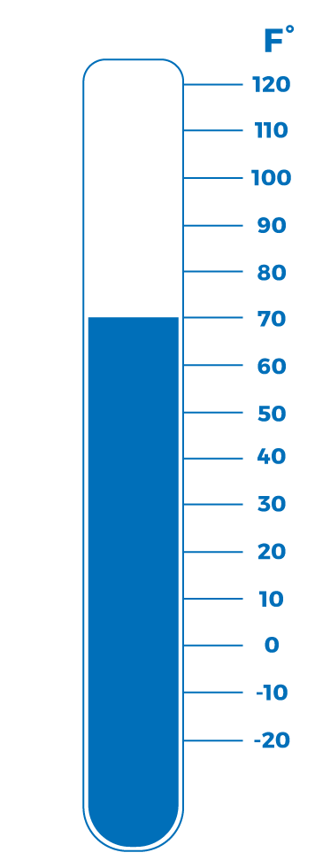
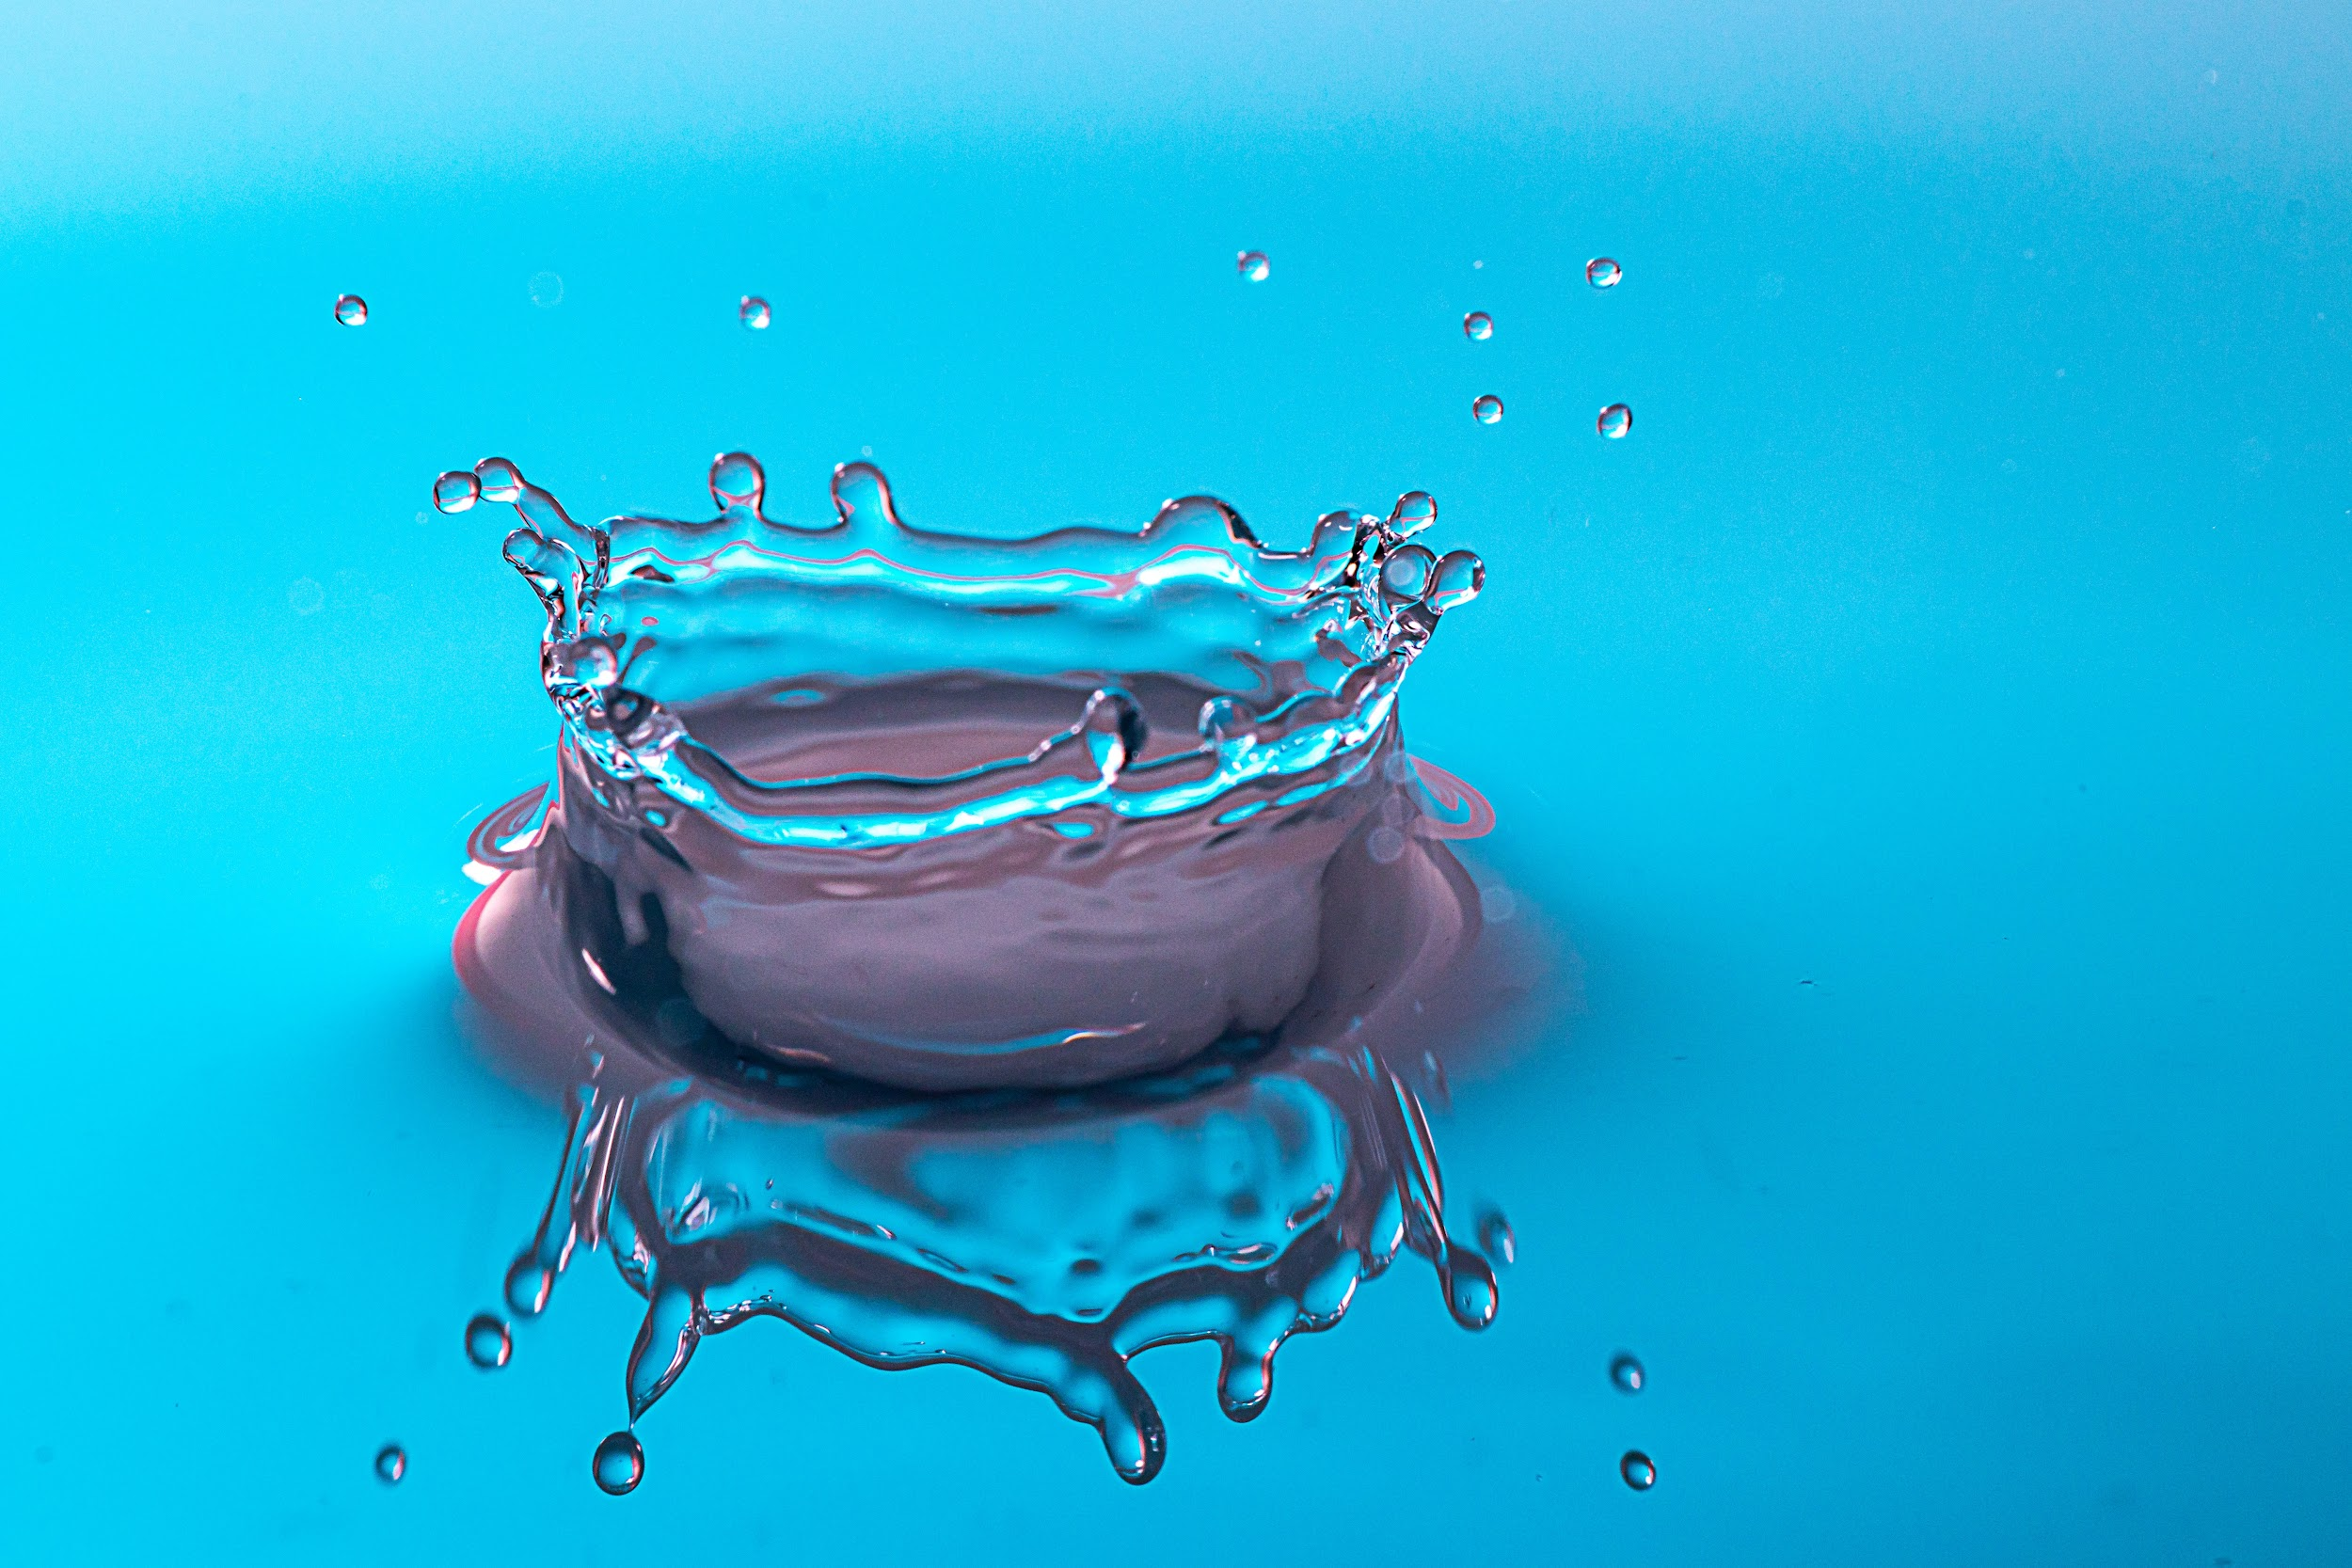
REFLECT!
Between 0ºF and 100ºF
Water is a liquid.
Oxygen is a gas.
TEMPERATURE
Why do you think this happens?
‹#›
Notes:
Water will be liquid between 0ºF and 100ºF but oxygen will be gas. This is based on the composition of matter - objects are found in certain states based on the temperature.

Slide 4
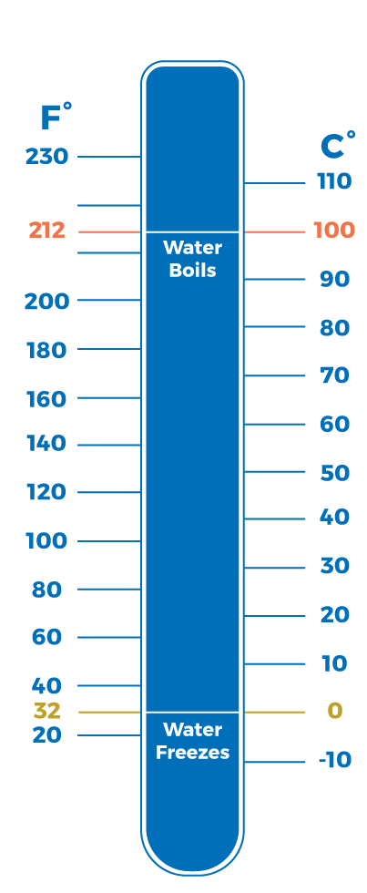
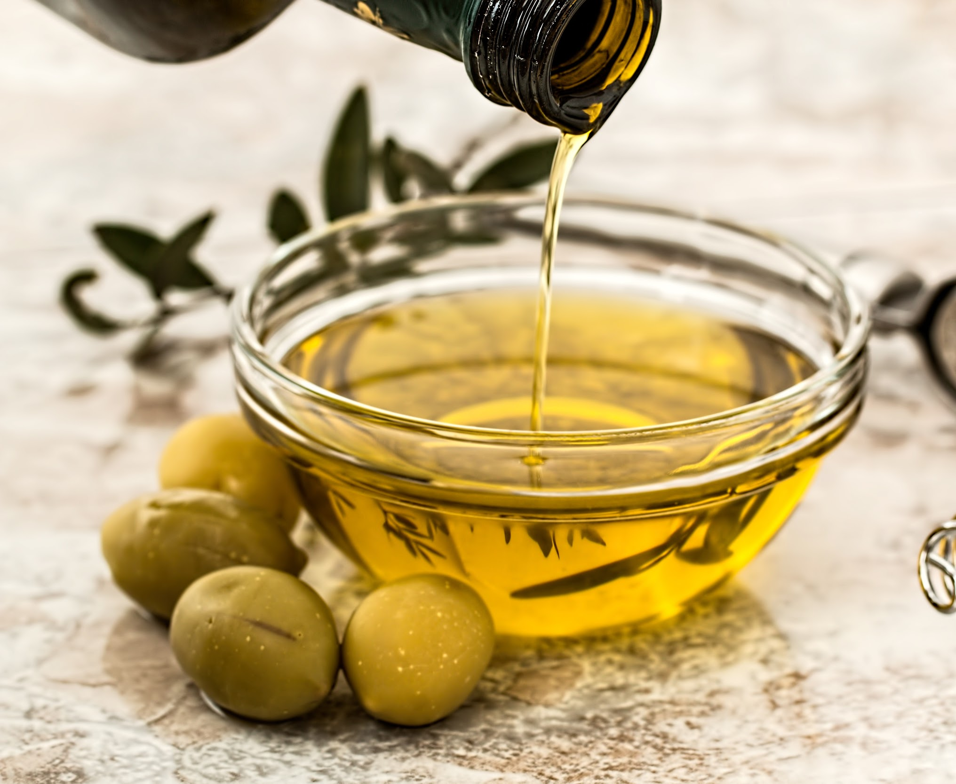
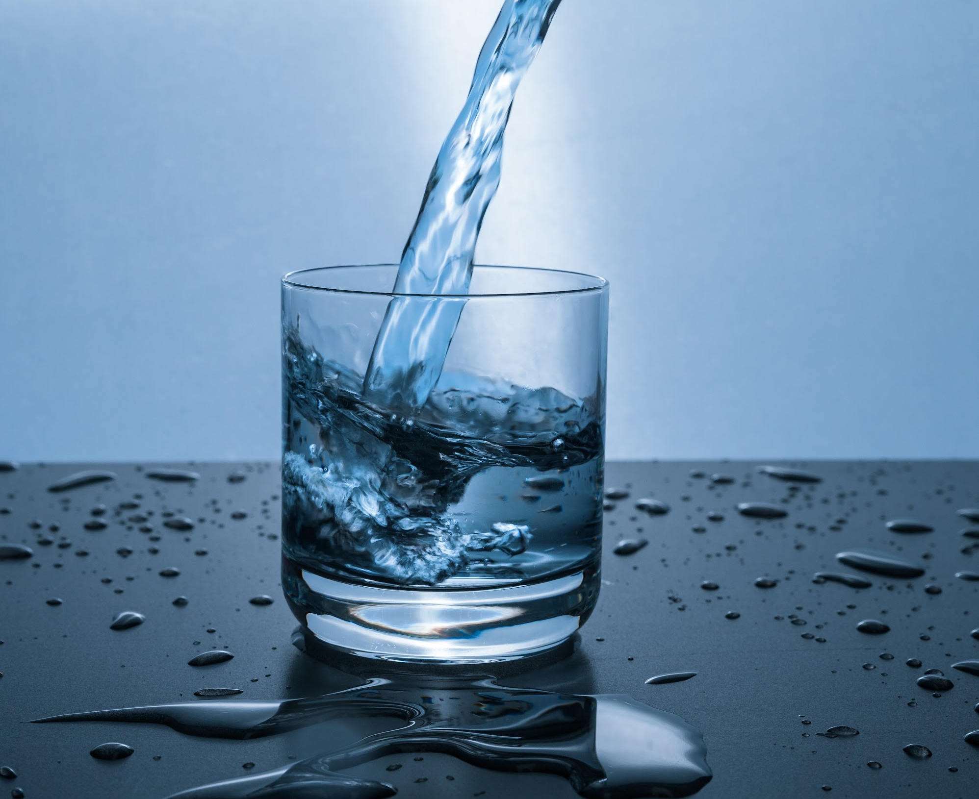
REFLECT!
TEMPERATURE
Would olive oil and water turn from liquid to gas at the same temperature?
‹#›
Notes:
While the two are liquids, olive oil has a higher boiling point than water.
There are certain properties of objects that determine what phase they’re in under certain pressure and temperature. The composition of matter determines when an object becomes liquid, solid, and gas. That’s why our houses don’t melt when it’s hot outside. Temperature plays a part in this, but we will explore that in the next lesson.

Slide 5
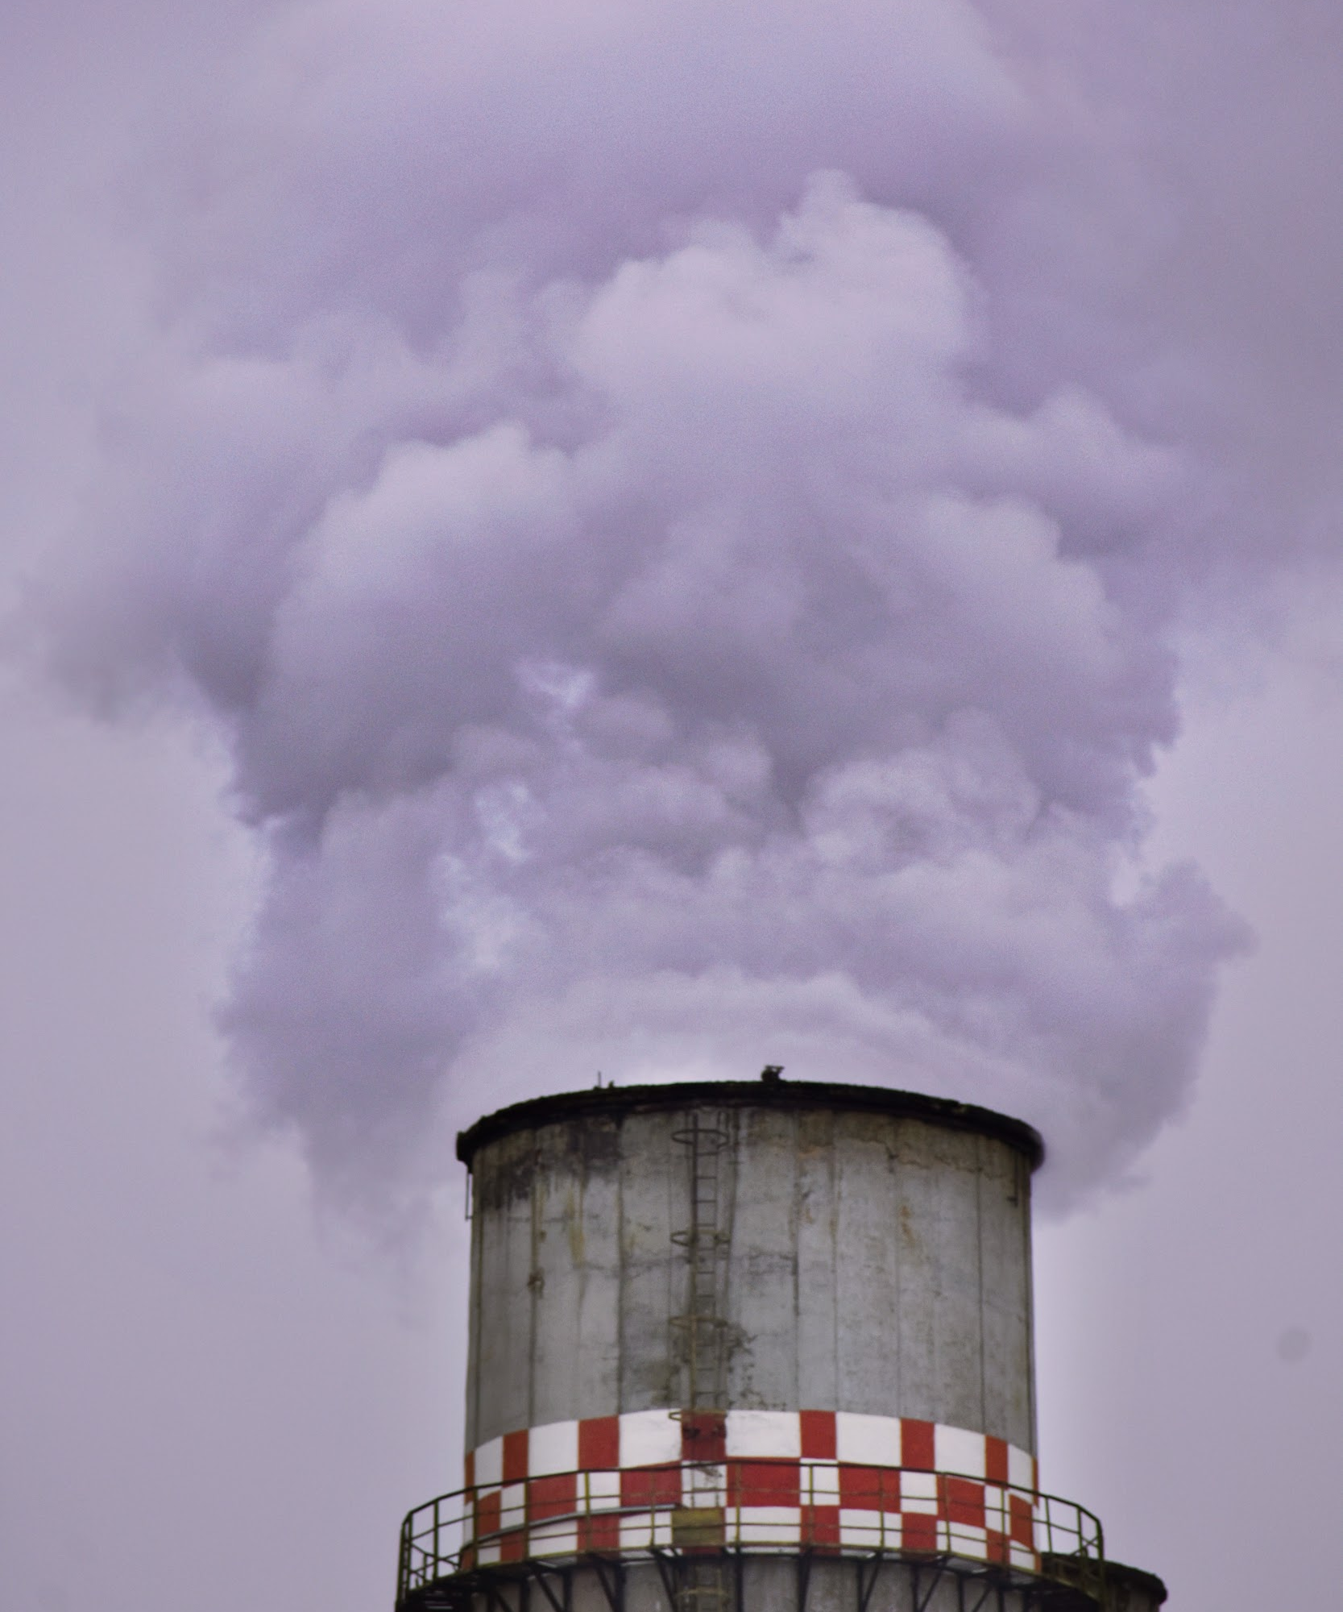
REFLECT!
What’s the difference between
carbon dioxide and water in gas form?
While the two are in the same phase, as gas, they have different properties.
TEMPERATURE
While both are gases, carbon dioxide can have harmful effects on the environment while water in gas form does not.
‹#›
Notes:
We know that carbon dioxide contributes to climate change. While the two are in the same phase, as gas, they have different properties. Carbon dioxide is harmful to the environment but water in gas form is not.

